Slide 1

Working at Heights
Course
Presented by
Conor Kelleher
Notes:
Joining Instructions
Advise people of the duration of the course and the need to wear appropriate clothing.
If necessary you may need to advise them of the need to wear PPE.
Room Set Up
The room should be large enough to seat delegates comfortably and space to carry out the manual handling moves comfortably.
/
00+
+. 0000+.
00000000000000000000+0+
+
U shaped is preferred as it allows you to engage better with the delegates.
Ensure that the room is adequately ventilated, comfortable temperature and there is enough light. Avoid a noisy venue.
It is a good idea to provide water and to put name tags up.
Set up your flipchart, screen and projector in such a way that you can move around safely and comfortably.
Leave yourself enough time to set up before your delegates arrive! As delegates come in ask their name and shake their hand.
Get them to complete the attendance sheet so you have a record of the names.
Ensure that you have your props and sample loads available to you.

Slide 2
Welcome & Introductions
Introductions, me & you!
Housekeeping
Notes
Great expectations!
Assessment: Written test, Skills demonstration
Notes:
Introduce yourself and the topic. You might give a brief background on yourself and your experience in training manual handling and in the specific industry that you are training them in.
As an ice breaker you could ask them to introduce themselves and explain what grindig activities they carry out in their departments.
Cover all housekeeping requirements. They will want to know when the session is finishing. The usual duration for a course would be 3 hours.
Action learning & Assessment: Explain to your class that the assessment is continuous and that if they contribute in the class there will be less emphasis on the final assessment. If anyone has any difficulties with the written or skills assessment they might point this out to you on the break.

Slide 3
Contents
Introduction: What? Why?
Legislation
WAH Hazards & controls
Ladder Safety
Components for a Fall Arrest System
Inspection of a harness & Lanyard

Slide 4
Course Aim
The aim of this course is to provide you with the Knowledge, skills and attitude to Work at Heights
Notes:
Course aim:
It is important that you state clearly the aim of the course.
The aim of your course is to provide the learners with the knowledge, skills and attitude to be able to:
Carry out manual handling tasks safely

Slide 5
Unit 1Introduction
The aim of this module is to provide you with an understanding of what working at heights is and why it is dangerous
At the end of this module you will be able to:
Explain what WAH is
State the approximate number of fatalities from WAH
List factors that increase the risk whilst WAH
Explain why is so dangerous
List the injuries resulting from WAH

Slide 6
Working at Heights
What?
Working in a workplace where a person could be injured by falling from it
Examples?
Working on trestles
Working on a flat roof
Erecting false work or formwork
Working on a ladder
Working at ground level adjacent to an excavation;
Working on formwork within an excavation
Working near or adjacent to fragile materials

Slide 7
Some Exceptions
Walking up and down a staircase in an office
Working in an office on the upper floors of a temporary accommodation building
Sitting in a chair
Work carried out by private individuals at home

Slide 8

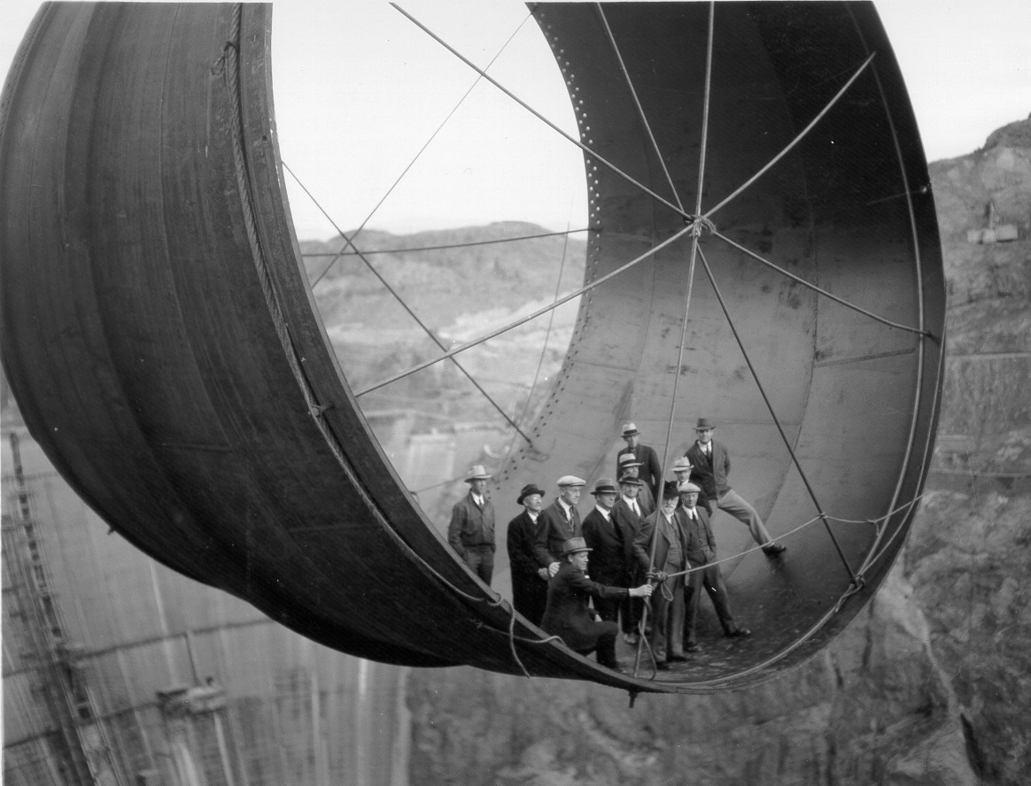
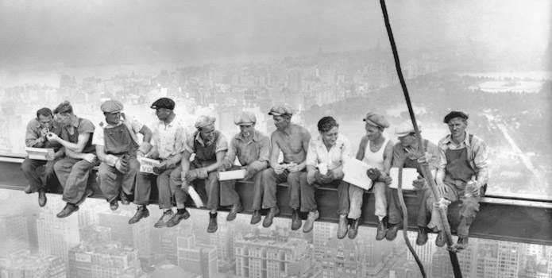
The ‘Good’ Old Days!
Matthew O’Shaughnessy & Sonny Glynn
- Left Galway in the 20’s

Slide 9
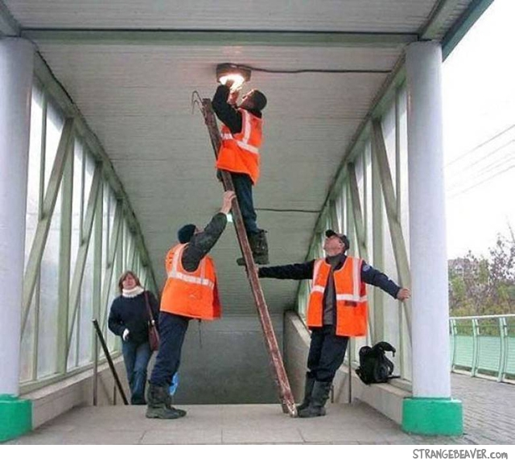
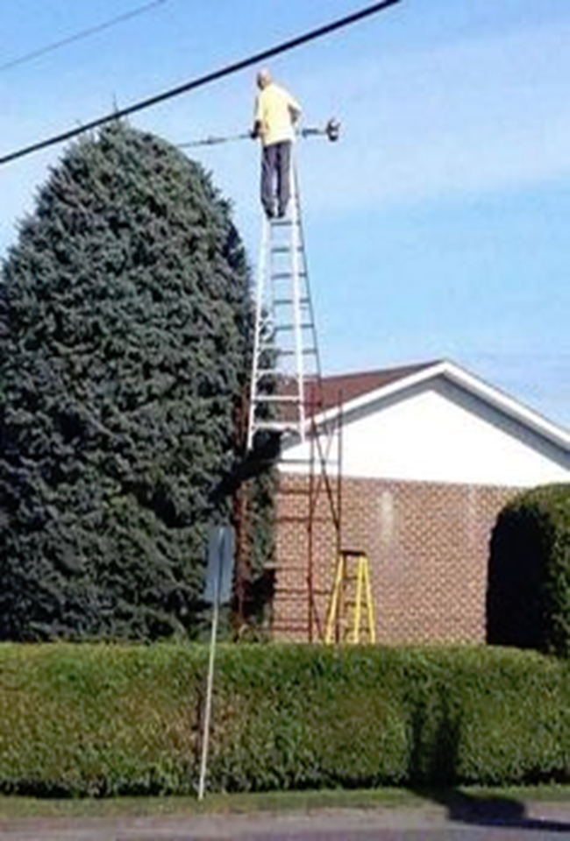
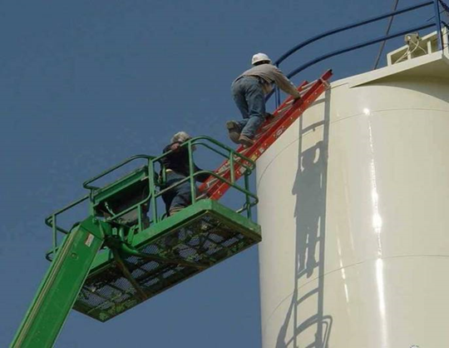
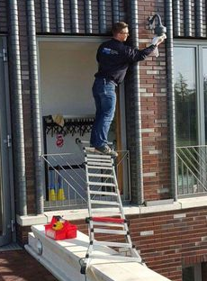
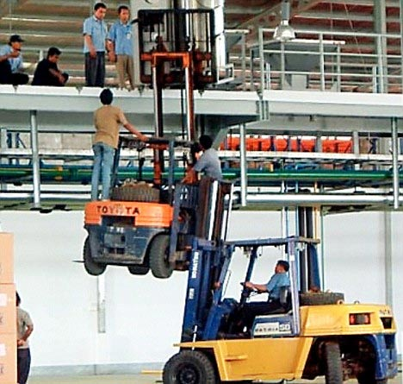

Slide 10
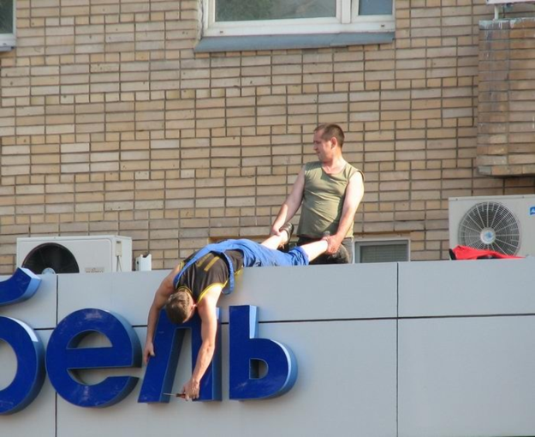
Working at Height
Notes:
Give a brief overview of the presentation. Describe the major focus of the presentation and why it is important.
Introduce each of the major topics.
To provide a road map for the audience, you can repeat this Overview slide throughout the presentation, highlighting the particular topic you will discuss next.

Slide 11
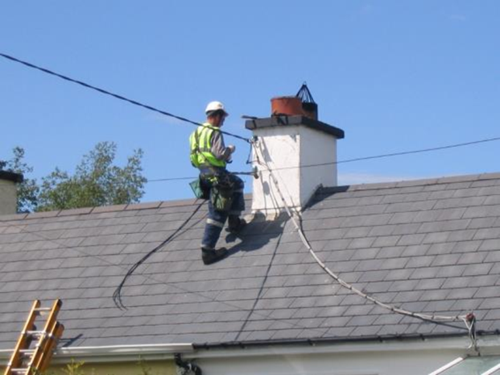
Working at Height
Notes:
Give a brief overview of the presentation. Describe the major focus of the presentation and why it is important.
Introduce each of the major topics.
To provide a road map for the audience, you can repeat this Overview slide throughout the presentation, highlighting the particular topic you will discuss next.

Slide 12
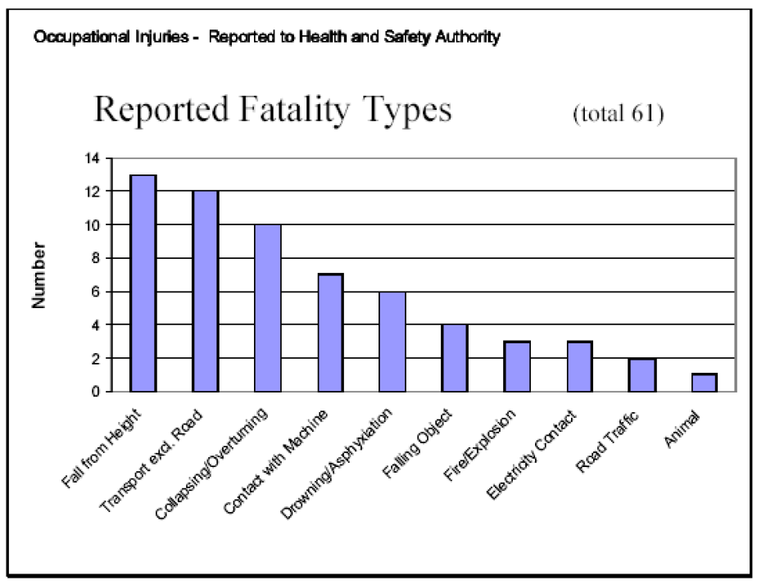
Why? Statistics
Biggest cause of fatalities in construction
11 fatalities in both 2018 & 2019

Slide 13

Case Study
Alan Hind (U.K.) fell 6 metres through a roof he had been working on.
He had 16 skull fractures, broke his jaw in 3 places, fractured his wrist, damaged kidney, deaf in right ear, blind in left eye and suffered brain damage resulting in permanent personality change.

Slide 14
Factors involved in falls from height
Failure to provide safe place of work
Failure to provide safe plant / equipment
Inadequate information, instruction, training or supervision
Failure to use the proper equipment
Unsafe practises
Weather conditions
Inadequate Risk Assessments
Failure to have an emergency plan

Slide 15
Q & A
What?
Why?
What is the approximate number of reportable fatalities are due to falling from a height?
What factors increase the risk of WAH injuries?

Slide 16
Unit 1 Legislation
The aim of this module is to provide you with an understanding of your rights & responsibilities
At the end of this module you will be able to:
List the duties of the employer and employees in relation to Health & Safety
List the Principles of Prevention
State and explain the requirements of the Working at Heights Regulations
Explain the implications of not complying with these requirements.

Slide 17
Safety Health & Welfare at Work
Duty of the employer
Duties of the employee
Safe Place of Work
Safe Access & Egress
Safe Systems of Work
Safe Plant and machinery
Provide PPE
Training
Risk Assessment
Supervision
Keep workplace tidy Follow procedures
Use machinery correctly/ Report defects
Wear PPE
Attend training/ stay awake!
Don’t endanger yourself or others
Notes:
Safety, Health & Welfare at Work 2005
Explain that this is the main piece of legislation governing Health & Safety in the workplace. It sets out in broad terms the responsibilities of different groups towards health & Safety.
Duty of the employer
First go through each duty of the employer and ask/ explain what they mean and their relevance to manual handling
Duties of employees
Ask them to tell which corresponding duties do employees have (you can prompt them.. So the employer must provide you with PPE, what must you do etc?:

Slide 18
Principles of Prevention
Avoidance of risks
Evaluation of unavoidable risks
Combating of risks at source
Adaptation of work to the individual
Adapt to technical progress
Replacement of dangerous articles,systems of work
Develop prevention policy
Training and instruction
PPE
(Fall arrest system)
Notes:
Nine principles of Prevention
This is unnecessary to go through these principles of prevention with your staff

Slide 19

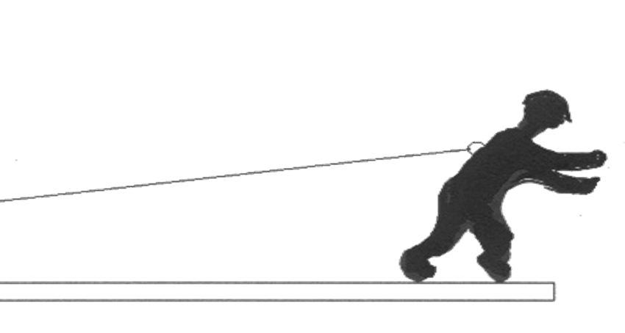
WAH Regulations 2007
Risk assess work at height activities
Avoid, prevent or reduce risks
(such as guard rails/working platforms/ restraint)
Reduce the consequence of falling
(such as nets or airbags, Harness)
All work is properly planned and organised
Appropriate work equipment is selected & used
People working at a height are competent
Equipment is properly inspected and maintained
Risks from fragile surfaces are properly controlled

Slide 20
H S A General guidelines
Ladders are only for work of short duration.
Maintain 3 points of contact
Work platforms must have handrails and toeboards
Protect all edges and openings where a fall could occur
Inspect the equipment used for work at height
Train users of fall arrest equipment
Have rescue and emergency plans in place

Slide 21
Other relevant Legislation/ COPs
Safety, Health & Welfare at Work (Construction) Regulations
Code of Practise for Scaffolding
Code of Practise for Safety in Roof Work 2011

Slide 22
Case Law
Safe Place of Work- Mc Nulty V JA Kilroy 1990
Worker was climbing a ladder to access roof
Ladder did not come over top of roof
He fell and sustained severe head injuries
Judge concluded that place of work was not safe
Awarded £36,445 compensation
Notes:
Safe Place of Work- Mc Nulty V JA Kilroy 1990
Worker was climbing a ladder to access roof
Ladder did not come over top of roof
He fell and sustained severe head injuries
Judge concluded that place of work was not safe
Awarded £36,445 compensation

Slide 23
Case study
Putting up a satellite disk
Overreaching off a ladder
Fell breaking a leg and arm
What questions would you like to ask in deciding on whether he would get compensation?
Was he trained in WAH?
Yes
What was the SSW?
Put in a bolt and anchor harness
Compensation?
No

Slide 24
Recap- Questions & Answers!
Duties of employers?
Duties of employees?
Nine Principles of Prevention?
Working at Heights Regulation requirements?
Other regulations?
What Codes of Practise are relevant to WAH?
Implications for non compliance?
Notes:
Question and Answer session
It is a good idea to go through a Q & A session with your learners to test their understanding of what you have gone through.

Slide 25
Unit 3 Risk Assessment
The aim of this module is to you an understanding of the risks associated with Working at Heights
At the end of this module you will be able to:
Explain what a risk assessment is
Explain what controls are
State the hazards and harm associated with WAH
State the precautions required to control these.
Notes:
The aim of this module is to inspect & select an abrasive wheel

Slide 26
Explanations
What is Risk Assessment?
Identifying hazards/ Risk Factors
Hazard/ Risk Factors
Issues that will cause harm/ increase risk
Controls
Solutions put in place to reduce the risk
Notes:
Ask what is risk assessment?
You can ask them what risk assessments do they carry out on a daily basis. Examples could include crossing the road!
Risk assessment is the identification of hazards (risk factors) and the reduction of risk

Slide 27
Hazards, Risks & precautions?
Hazards?Risk factors
Controls/ precautions
Unsafe practise
Unprotected edges
Fragile roofs/surfaces
Weather: wind/rain
Tools & equipment
Unstable machinery
Uneven ground
Slippy surfaces
Suspension
Faulty/incorrectly fitted/ attached harness
RA/Method statement
Handrails, Harnesses
Keep clear, barrier off
Check weather
Ensure properly secured
Deploy stabilisers
Ensure ground is even
Non slip foot wear
Emergency plan
Inspection of harness
Training

Slide 28
Window Cleaning
Cleaning high windows is always a hazard
Without workplace precautions- High risk
How can you avoid cleaning windows at height?
Telescopic cleaner, self cleaning windows!
How can you reduce the risk?
MEWP, Harness

Slide 29
Recap
What is a hazard?
What is a control?
Hazards/ Risk factors associated with WAH?
Controls/ Precautions?

Slide 30
Unit 4 Ladders
At the end of this module you will be able to:
List the different classifications of ladders
List the different types of ladders
List the different ladder accessories
List the occasions that ladders can be used
List precautions to be taken when using a ladder

Slide 31
European Ladder classifications
European Ladder Certification Standard EN 131
Class 1 - Industrial: 175kg Max.
Class 2 – Trade 150kg Max.
Class 3 – Domestic 125 kg Max.
(based on persons fully clothed weight plus tools)

Slide 32
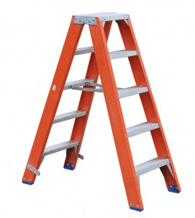
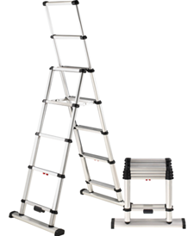
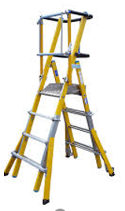
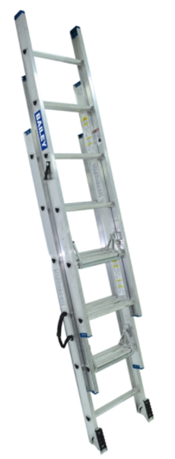
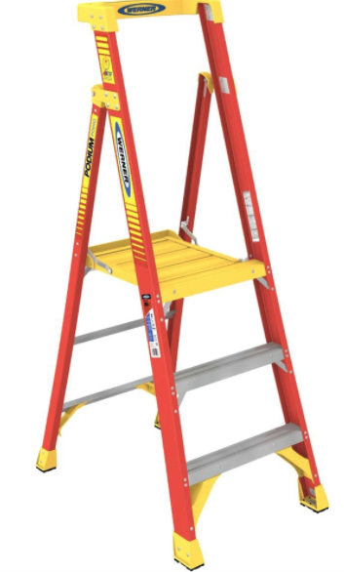
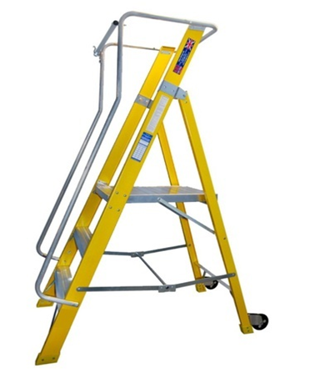
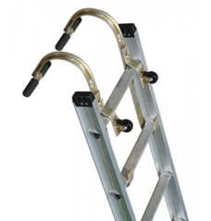
Ladder types?
Extension Ladders
Step Ladders
Podium Steps
Mobile Ladders
Roof Ladders
Loft Ladders
Combination Ladders

Slide 33
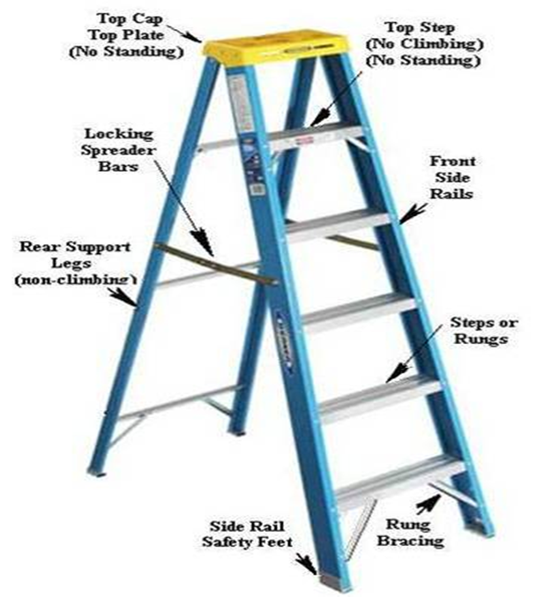

Slide 34
Ladder standards
EN 131 -1 and EN 131-2 Ladders;
Timber BS 1129: 1990 Class 1 Industrial;
Aluminium BS 2037: 1994 Class 1 Industrial
Glass Fibre BS EN 131: 1993 Industrial.
(Kite marked)

Slide 35
Pre use ladder inspection
Suction feet are present and not damaged
Side rails aren’t bent, broken, twisted or split
Rungs, cleats or steps aren’t bent, broken/missing
Steps are free from oil & grease
All bolts/rivets are in place & securely tightened
Joints between the side rails an rungs are tight
All safety features are present and working

Slide 36
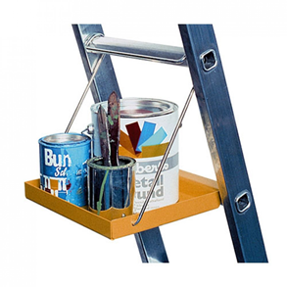
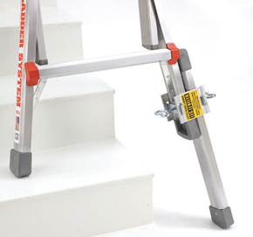
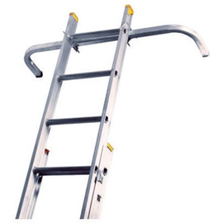
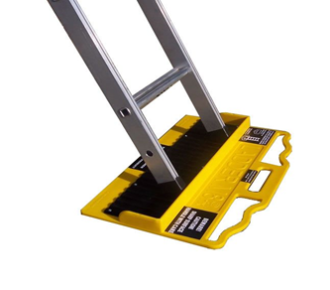
Ladder accessories
Suction Feet
Wheels
Wall Bracket
Stabilisers
Ladder Levels
Anti Slip Attachments

Slide 37
When can you use a ladder?
Where a risk assessment rules out other options
Where the work is of short duration < ½ hr per position
For ‘light work’ – not suitable for strenuous or heavy work
For work that not involving heavy or tools or equipment
Where 3 points of contact can be maintained

Slide 38
Ladder standards
EN 131 -1 and EN 131-2 Ladders;
Timber BS 1129: 1990 Class 1 Industrial;
Aluminium BS 2037: 1994 Class 1 Industrial
Glass Fibre BS EN 131: 1993 Industrial.
(Kite marked)

Slide 39
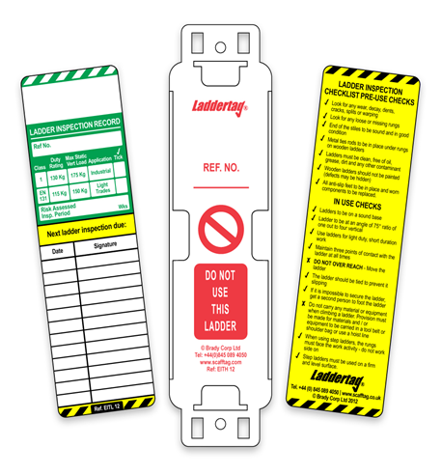
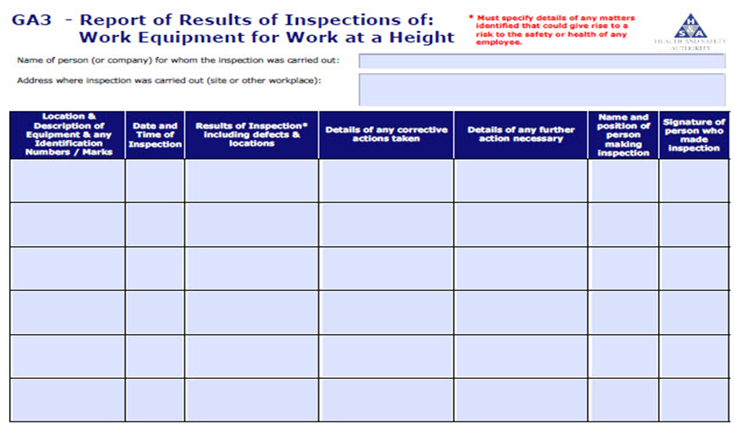
Weekly inspection
Carried out by a competent person
Recorded on GA 3 form
(Inspection of Work Equipment for WAH

Slide 40
Ladder standards
EN 131 -1 and EN 131-2 Ladders;
Timber BS 1129: 1990 Class 1 Industrial;
Aluminium BS 2037: 1994 Class 1 Industrial
Glass Fibre BS EN 131: 1993 Industrial.
(Kite marked)

Slide 41
How? Safe Use of Ladders
Open up step ladder legs completely
Ensure spreader bars are fully deployed if there
Ensure ladder is on a stable and level surface
Not in front of doors that can open out
Not in the paths of pedestrians
Set up an exclusion zone / Use spotter if necessary
Tie or secure a ladder to prevent it from slipping.
Ensure safety rails / bar is closed and secure
Remember 4:1 Ratio for correct set up.
Ladders must be 1m above landing point

Slide 42
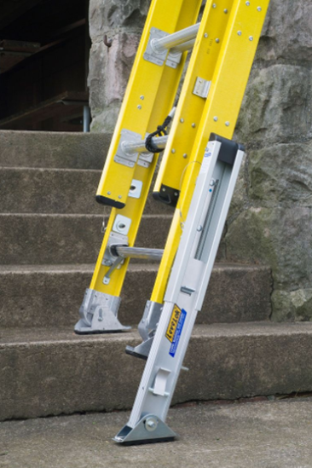
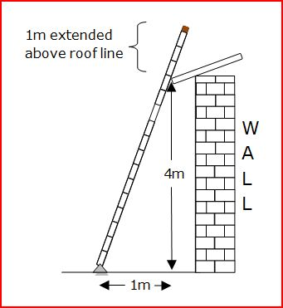
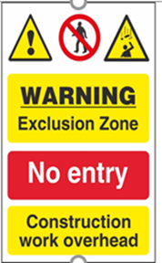
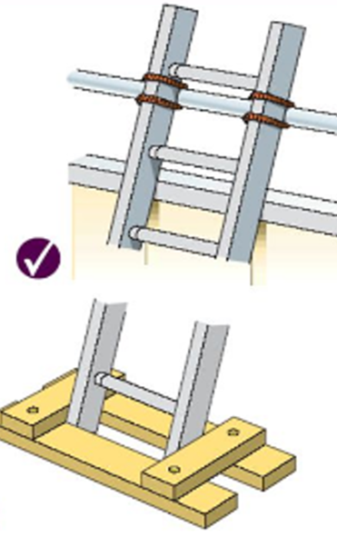
Ladder set up

Slide 43
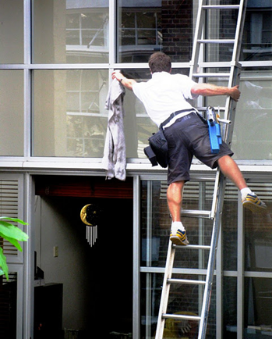
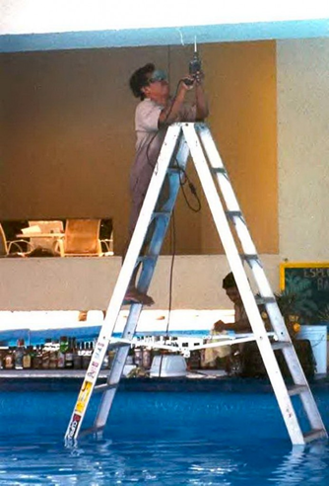
Don’t!
Straddle A frame ladder
Use metal ladders near electrical hazards
Move ladder while on it
Do not overreach - keep belt buckle between rungs
Exceed ladder capacity
Use top step(s) of ladder
Oil, grease or mud on ladder rungs
Using the wrong type ladder for the job
Carry loads up ladders

Slide 44
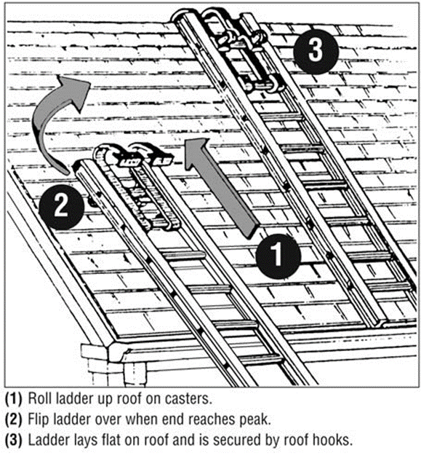
Roof ladders?
Strong and long enough for good support
Fit for purpose
Secured to prevent movement top or bottom
Eaves and gutters are not a footing/support for roof ladder.

Slide 45
Recap
Different Classification of ladders?
Occasions when ladders can be used?
Types of ladders?
Pre inspection checks?
Safe Operations of ladders?
Don’t?!

Slide 46
Unit 5 Fall Arrest Systems
At the end of this module you will be able to:
Explain what a fall arrest system is
List the components of a fall arrest system
Explain the purpose of each component
State the precautions to be taken
Inspect a fall arrest system
Fit a fall arrest system

Slide 47
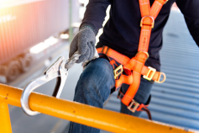
Fall Arrest System
What is it?
A system which a fall is arrested to prevent the collision of the user with the ground or structure.
When?
Last resort!
What does on consist of?
Anchorage Point
  Body Harness
  Connectors: Lanyards, Carabiners, snap hook
  Descent: Rescue plan

Slide 48

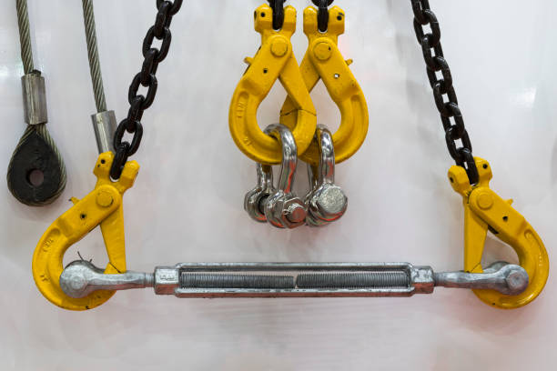
Anchorage Point
What?
The point that the fall arrest is attached to.
Purpose?
To ensure that the suspended person is supported.
Precautions?
Anchor points must be suitable and adequate
Not conduit, piping, plumbing pipe
Look for structural supports such as I beams
Anchor as high as possible
Minimise pendulum effect
Notes:
Depending on the application and type of personal fall arrest system, the strength of the anchorage point can vary. When using fall arrest equipment where the is the potential to fall the anchorage point must withstand 2.2 T of pull per employee. If two people are attached to the same anchorage point the strength must be at least
4.5 T
Anchorage point strengths for fall restraint is .5 T , much less than the five thousand pounds required for fall arrest anchorage points. This is because when using fall restraint there in no danger of a fall.
Remember, you can always contact an ESH representative for assistance in determining anchorage points.

Slide 49
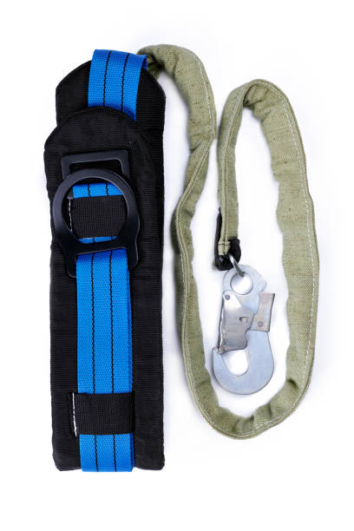
Connectors: Lanyards
What?
A flexible strap that connects harness to anchor point or lifeline
Purpose?
To limit free fall
Precautions:
Check material for cuts, burns, abrasions, kinks, knots, broken stitches and excessive wear
Visually inspect shock absorber for any signs of damage.
Check attachment points to the connectors are defect free
Check label
Must not be tied back to themselves
Suitable clip for the intended anchorage points
Do not knot or wrap around sharp objects
Notes:
Only use the lanyard in accordance with the manufactures recommendations. Do not tie the lanyard back to itself unless it is design to do so. The clips must be designed for the type of anchorage point you are using. And as with any synthetic material equipment, do not use against sharp edges or objects.

Slide 50


Harness Inspection
Heat or friction damage: glazed appearance
Buckles, D rings for cracks, deformations etc.
Ultraviolet degradation: some loss of colour
Contamination (e.g. with dirt, grit, sand etc.)
Damaged stitching & webbing (cuts etc)
Chemical attacks often indicated by flaking
Knots in lanyards
Labels
Notes:
Give a brief overview of the presentation. Describe the major focus of the presentation and why it is important.
Introduce each of the major topics.
To provide a road map for the audience, you can repeat this Overview slide throughout the presentation, highlighting the particular topic you will discuss next.

Slide 51
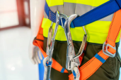

Carabiner/ Snap hooks
What?
Attachment/ connector
Precautions?
Assign to one person
Ensure locking mechanism is working
Check for deformities, distortions
Verify there are no cracks or pitted surfaces

Slide 52
Anchorage Point Risk Factors
Anchorage point location to minimise pendulum effect:
Ideal option: Directly above workers head level
Next best option: at the back of the lanyard anchor point.
Next best option: Below the back anchor point of the harness or near feet.

Slide 53
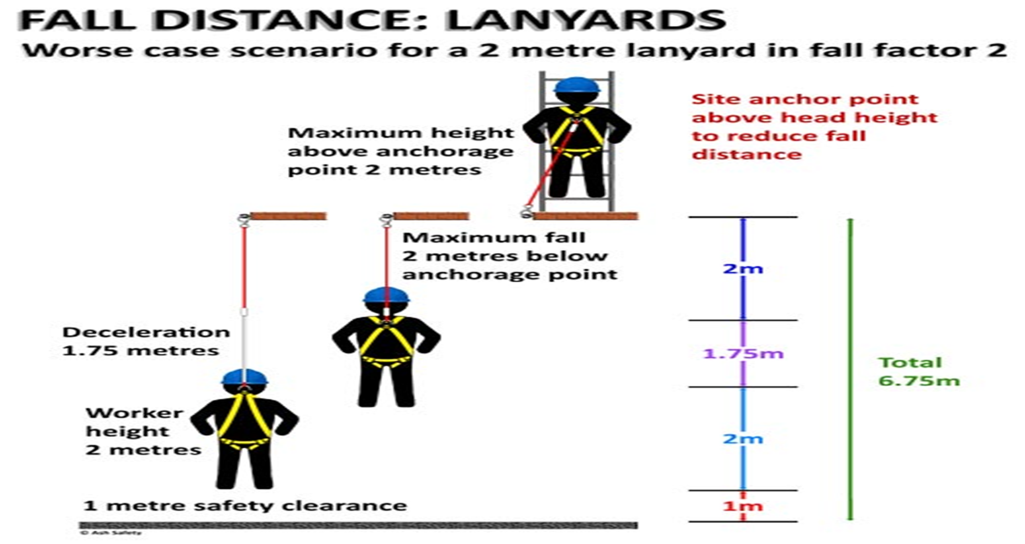
Minimizing Free Fall Distance
How far could you fall with a 2m Fall Arrest Lanyard attached?

Slide 54
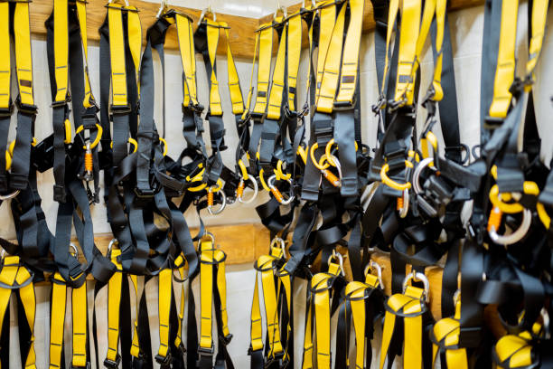
Care for fall arrest systems
Clean equipment with soap & water after use
Air dry equipment, do not hang in direct sunlight
Store a cool, dark, dry well ventilated place
Dispose of after expiry of shelf/ in service life
(5-7 years depending on manufacturer)
Decommission and dispose of after fall

Slide 55
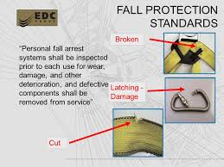
harness defects

Slide 56
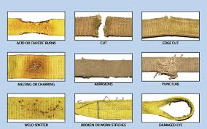
Harness webbing defects

Slide 57
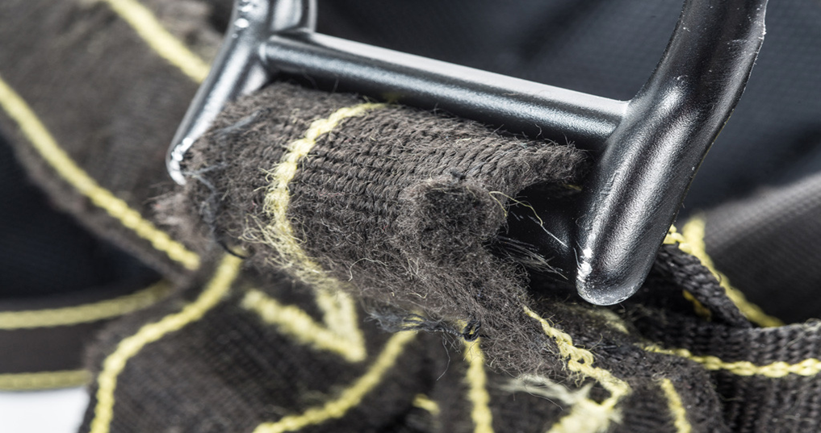
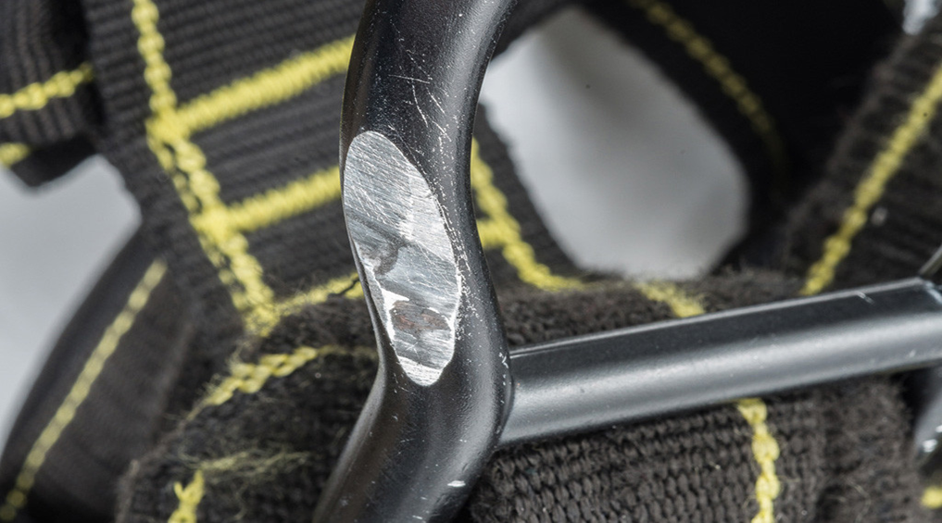
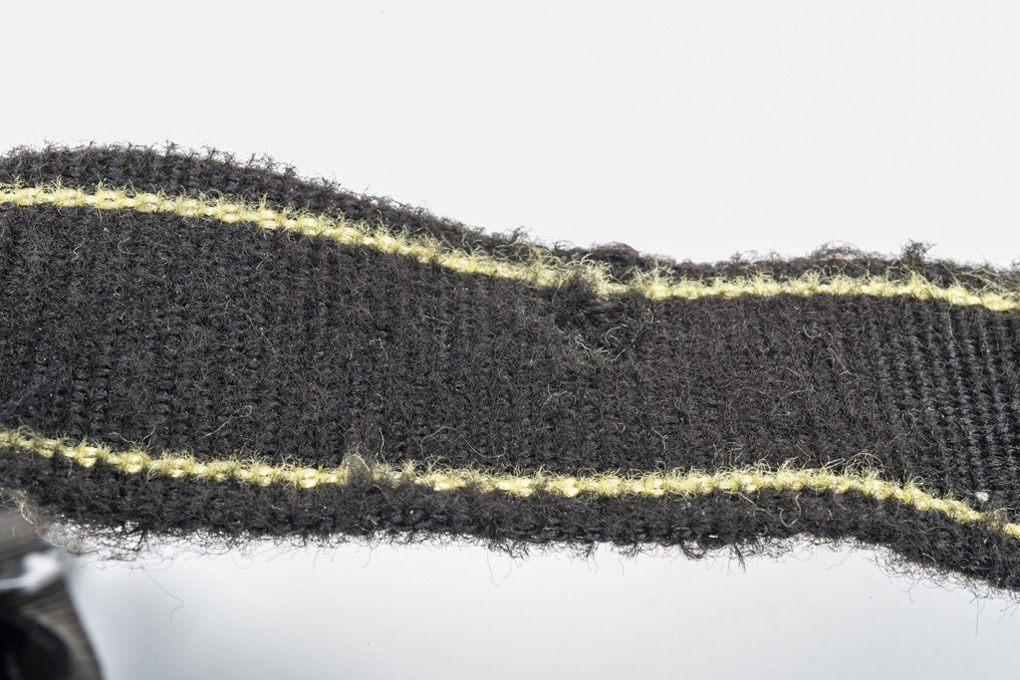
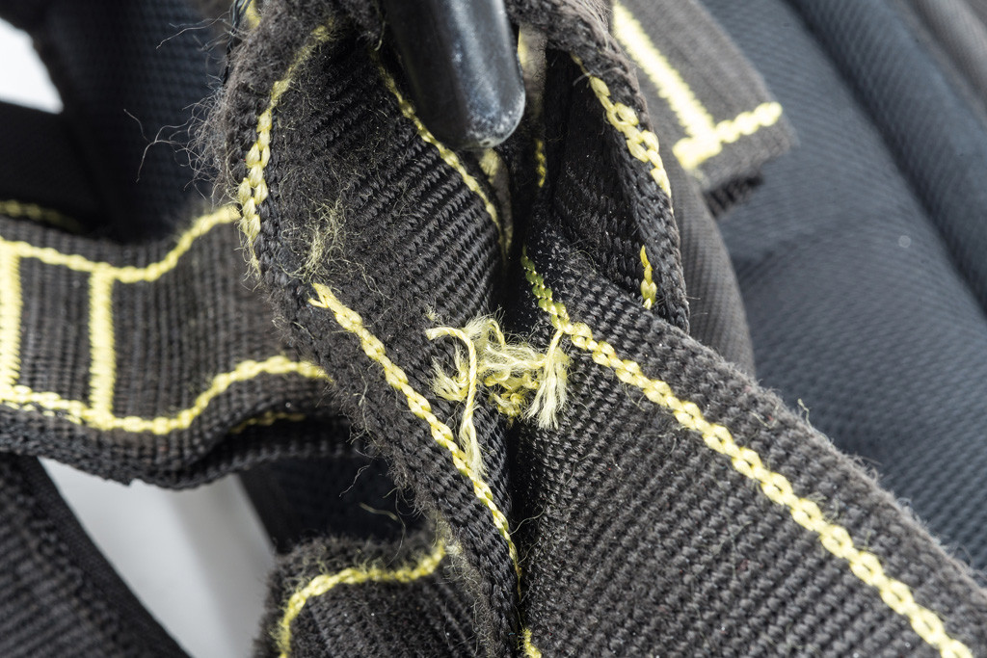

Slide 58
Harness Traceability
You need to know:
Where the equipment came from.
Where it has been
When it has been inspected.
Keep records of:
From whom and when it was purchased.
Date when equipment was first put into service.
Equipment’s identification or serial number.
Log of all inspections carried out.
Equipment’s Certificate of Conformity.
How and when it was disposed of.

Slide 59
Fitting a harness
Hold harness by D-ring & shake out!
Release chest, leg and/or waist straps
Slip straps over shoulders
Locate D-ring in middle of shoulder blades
Pull leg straps between legs and connect
Adjust thigh straps by pulling/ releasing end
If belted connect waist strap after leg straps.
Connect chest strap buckle and centre
Tighten to keep shoulder straps taut.
Tighten straps so the harness fits snugly
Notes:
Hold by D ring
Put on shoulder strap one after the other
Pass thigh straps between legs & lock into buckles on either side of hips (do not cross)
If fitted adjust belt and buckle it
If fitted adjust shoulder strap adjustment
Attach thorax strap if present
Connect using a compliant connector

Slide 60
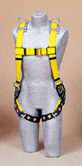
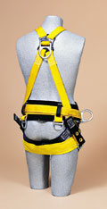
Harness Fitting
Chest strap tightened at mid chest
“D” ring between shoulder blades
Proper snugness shoulder to hips
Butt strap supports the load
Leg straps snug but not binding
Harnesses must be sized for the worker
Notes:
A properly fitted harness is essential to minimize the shock to the body if you were exposed to a fall arrest. Harnesses do have limitations, if you are over three hundred ten pounds and under one hundred thirty pounds you will need specialized equipment. See your supervisor or your ESH representative for assistance if you do not fall within these parameters.

Slide 61
Harness and lanyard inspection
Pre-use checks (visual and tactile) by user
(need to be instructed on how to do this)
Detailed inspections by a competent person
(At interval specified by employer)
Detailed inspection at least every 6 months.
Lanyards inspected at least every 3 months
Maintained and repaired by a competent person
Record inspections on GA3 Form
Keep in a safe/ accessible location

Slide 62
Planning For A Rescue
The rescue plan must be written
Plan for a worker that is unconscious.
Ensure all the rescue equipment in the vicinity
Plan to rescue within 5-15 minutes
Notes:
The goal of any rescue is to limit the hanging/suspension time of the fallen employee. With a harness, the suspension time is a maximum of 15 minutes, less is desirable.
The plan should address the fact the worker may be unconscious.
Ensure all the rescue equipment is in place or ready to be put in place.
Notify the Fermilab Fire Department prior to starting work so they can be prepared to respond. Have them assist you in developing a plan if needed.
Ensure everyone is aware of the plan.

Slide 63
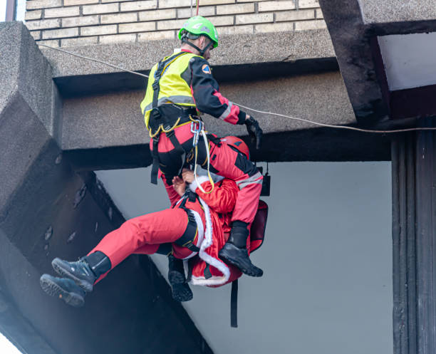
Harness Induced Suspension Trauma
Call 112/999
Advise patient to move legs
Rescue by lowering down or recover with MEWP
Elevate lower limbs if possible during rescue
Place patient in a horizontal position ASAP
Do not remove harness: danger of toxic shock
Monitor vital signs
Extreme care required

Slide 64
Recap
What is a fall arrest system?
What are the components?
What do you inspect a harness for?
How do you fit a harness?
When do you inspect fall arrest systems?

