Slide 1
Unit 8 HACCP- Food Deliveries

Slide 2
Unit 8 HACCP- Food Deliveries
Learners will be able to:
identify the hazards at the delivery step
ldentify the layout of a flow diagram
Identify the hazards at the delivery stage
List controls necessary to control the hazards
Implement corrective actions when necessary
Complete delivery documentation
Notes:
Unit 8 HACCP Food Deliveries.
On completion of this unit, learners will be able to:
identify the hazards ,at the delivery step,
ldentify the layout of a flow diagram,
Identify the hazards at the delivery stage,
List controls necessary to control the hazards,
Implement corrective actions when necessary, and,
Complete delivery documentation.

Slide 3
HACCP
HACCP stands for Hazard Analysis and Critical Control Points
Hazards can be:
Biological
Chemical
Physical
Allergen-related
Notes:
HACCP.
HACCP stands for hazard analysis and critical control points. It’s a food safety system that identifies potential hazards in the food process, assesses the risk of those hazards and puts controls in place to prevent harm to consumers.
Hazards can be:
Biological such as bacteria and viruses,
Chemical such as cleaning residues and allergens,
Physical such as glass, metal and plastic,
Allergen-related such as undeclared ingredients.

Slide 4
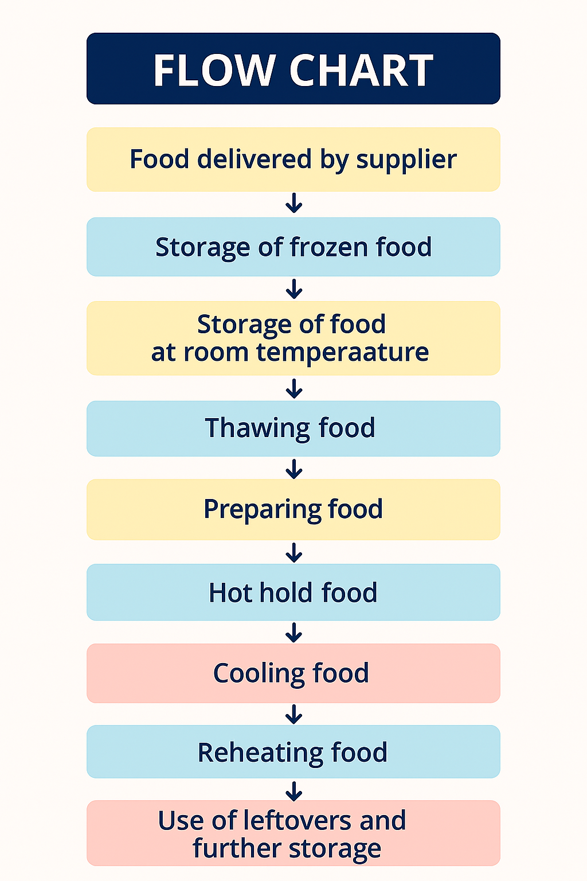
Flow chart
A flow chart maps out every step in the food production process
A flow chart:
must be accurate and complete
must be verified, no steps should be missed
is the foundation for a proper hazard analysis
Notes:
Flow Chart.
A flow chart maps out every step in the food production process, from delivery to service. It shows how food moves through the business and helps identify where hazards might occur. Flow charts help staff understand the process.
A flow chart:
must be accurate and complete
must be verified, no steps should be missed
is the foundation for a proper hazard analysis.
Each step must be analysed for potential hazards and matched with appropriate controls.

Slide 5
Delivery Stage
Bacterial Growth
Cross Contamination
Chemical Contamination
Physical Contamination
Allergen Contamination
Notes:
Delivery stage.
Delivery is the first stage of the food process within a food business. This stage is crucial because it involves identifying and controlling potential hazards that could affect food safety. The business looks for various types of hazards, including physical, chemical, biological, and allergen hazards, and implements controls to reduce the risks.
For example, if the temperature of a chilled delivery is too high, bacteria could grow, or the food could spoil. To control this, the business accepts foods that are delivered at a temperature between 0-5 degrees celsius. Another example is if the packaging is burst or torn, which could allow contaminants to fall into the food (a physical hazard). The control for this is to reject the food.
The following are several hazards and their causes, as well as the controls to manage these hazards:
Bacterial growth caused by temperature abuse such as food transported at incorrect temperatures) or food exceeding its shelf life. Control: check the temperature of the product to ensure it is between 0-5 degrees celsius and check expiry dates.
Cross contamination caused by raw and high-risk or raw ready-to-eat food delivered together, damaged packaging, blood spillage, dirty uniforms on delivery personnel, or fumes from the delivery vehicle. Control: segregate products, ensure packaging is intact, keep raw and cooked food apart, ensure delivery personnel are clean, turn off the delivery vehicle, and visually inspect the product.
Chemical contamination caused by fumes from the delivery vehicle or wood splinters from damaged pallets. Control: turn off the delivery vehicle and visually inspect the product.
Physical contamination caused by damaged packaging or wood splinters from damaged pallets. Control: ensure packaging is intact and visually inspect the product.
Allergen contamination caused by celery delivered in the same box as other vegetables. Control: use approved suppliers and segregate celery in sealed bags.
If a critical limit is breached, a corrective action should be taken. For example, if the temperature of chilled foods is not within the acceptable range, the food should be either restored to the correct temperature.

Slide 6
Delivery Stage Checks
Appearance
Contamination
Packaging
Canned Goods
Temperature
Damaged Cans
Allergens
Labeling
Recording
Notes:
Delivery Stage.
When food is delivered to a food premises, it is crucial to check all deliveries to ensure food safety. If perishable foods are transported or stored at the wrong temperature, bacteria can grow, which is why it is legally required to maintain the cold chain. This means keeping foods at the correct temperatures throughout the delivery process.
Food can be contaminated with chemicals, physical objects, or other contaminants, so delivery checks are an important control measure to ensure food safety. Here are the key points to check during deliveries:
Appearance: The food should look normal.
Contamination: There should be no signs of contamination or pests.
Packaging: Packaging and tamper-proof devices should be intact.
Canned Goods: Cans should not be blown or damaged.
Temperature: Chilled foods should arrive at or below 5 degrees celsius, and frozen foods should be delivered at or below -18 degrees celsius. These temperatures should be checked between packs using a probe thermometer.
Damaged Cans: Blown or damaged cans should be rejected.
Allergens: Allergen ingredients should be kept separate, and allergen information must be provided for all food products.
Labeling: All food should be labeled and within its "best before" or "use by" date.
Recording: All delivery checks must be recorded, and the food should be stored correctly immediately.
The delivery person must be hygienic and clean, wearing a clean uniform.
Delivery personnel should not access storerooms or cold rooms as they may pose a risk to food safety.
Raw and cooked foods, as well as allergenic foods, should be kept separate.
The delivery vehicle should be clean, and chemicals should not be transported with food to avoid contamination.
By following these guidelines, food premises can ensure that the food they receive is safe for consumption.

Slide 7
Food Collections
Use clean transport
Separate raw and cooked food
Separate chilled and frozen foods
Maintain the cold chain
Use insulated cool boxes:

Slide 8
Food Returns
Out of date foods
Mould
Damaged or torn packaging:
Rust or dents on cans:
Incorrect temperature
Notes:
Food Returns.
For food returns, if the food you receive is not up to standard, it should be rejected and returned. Reasons for returning food include:
Out of date foods: If the food is past its expiration date or has insufficient shelf life.
Mould: If there is any mould on the food.
Damaged or torn packaging: If the packaging is damaged or torn.
Rust or dents on cans: If there are rust or dents on canned goods.
Incorrect temperature: If the food has not been kept at the correct temperature.
There should be a separate area or container for foods that are to be returned. This area or container should be clearly marked "returns only" and not for human consumption. Foods that are being returned should be stored according to the manufacturer's instructions until they are picked up.

Slide 9
Unit 8 Recap Questions
1. What does HACCP stand for?
2. Name the four types of food hazards.
3. Why are delivery checks important?
4. What temperature should chilled deliveries arrive at?
5. Give one reason why food should be rejected at delivery.

Slide 10
Unit 8 Scenario Activity
A chilled chicken delivery arrives at 12°C with damaged packaging.
• Identify the hazards present.
• What corrective action should staff take?
• What records should be completed?
• Why is temperature control important at delivery?

Slide 11
Unit 9 HACCP: Food Storage

Slide 12
Unit 9 HACCP: Food Storage
Learners will be able to:
ldentify the four hazards associated with food storage and implement controls
Complete records required for food storage
Implement corrective actions as require
Notes:
Unit 9. HACCP. Food Storage.
On completion of this unit, learners will be able to:
Identify the four hazards associated with food storage and implement controls,
Complete records required for food storage, and,
Implement corrective actions as required.

Slide 13
General Storage Controls
Fridge and Freezer
Fruit and Vegetable Controls
Dry Food Controls
Labelling of Decanted Foods
Freezing Foods
Fridge Storage
Notes:
General storage controls.
Once the delivery process is completed, it is crucial to immediately transfer products to the appropriate storage area. Incorrect storage can lead to several issues, such as physical contamination if the packaging is burst or damaged, food spoilage if foods are stored in the wrong area or at the wrong temperature, and bacterial growth if foods are stored at too high a temperature or for too long. Allergen cross-contamination is also a potential hazard.
When storing foods, always follow good stock rotation practices like fifo (first in, first out). Here are some general controls for food storage:
Fridge and freezer:
Separate raw and cooked foods.
Do not overfill chest freezers beyond the loading line.
Allow air circulation.
Keep doors and seals in good condition and closed.
Ensure all foods are sealed, wrapped, and labeled.
Keep drainage gullies free from debris, clean, and unblocked.
Record temperatures daily.
Fruit and vegetable controls:
Inspect fruits and vegetables to ensure they are mold-free.
Ensure there is no evidence of pests.
Check that they are not damaged or bruised.
Keep them away from ready-to-eat foods.
Allow air circulation.
Dry food controls:
Store in a damp-free area that is well-ventilated and free from pests.
Ensure shelves are adequately shelved (0.2 meters off the floor).
Keep the area clean and well-lit.
Rotate stock.
Do not store foods on the floor.
Store all foods in sealed containers which are labeled.
Labelling of decanted foods:
Include the product name.
Date opened.
New use-by date.
Allergen information.
For meat, fish, eggs, and milk, include an identifying batch or lot number and country of origin where applicable.
Indicate suitability for freezing.
Freezing foods:
Ensure the food is suitable for freezing.
Freeze on the day of purchase, showing the original use-by date on the food as well as the date frozen on the label.
Freeze in small portions, wrap tightly, and freeze as quickly as possible.
Never re-freeze foods unless they are cooked first.
Fridge storage (if foods are not stored in separate fridges):
Top shelves: dairy, desserts, bakery.
Middle shelves: cooked meats, ready-to-eat foods, salads.
Bottom shelves: raw meat/fish.

Slide 14
Food Grade Containers
Cup & fork symbol
Radiation waves symbol
Snowflake symbol
Dishes in water symbol
Notes:
Food grade containers.
When storing food, it's important to use containers that prevent chemicals from transferring from the container to the food. Different symbols on containers indicate how they can be safely used:
Cup & fork symbol: This plastic is safe for contact with food.
Radiation waves symbol: This plastic is safe for use in the microwave.
Snowflake symbol: This plastic is safe for use in the freezer.
Dishes in water symbol: This plastic is safe for the top rack of the dishwasher.

Slide 15
Fridge Controls (0–5 degrees Celsius)
Keep doors closed,
Check seals regularly,
Do not overload.
Keep the fridge clean.
Cover and label all foods.
Avoid prolonged storage
Check temperatures at least twice daily
Report faults immediately
Notes:
Fridge Controls (0–5 degrees Celsius).
Fridges must be kept between 0 degrees celsius and 5 degrees celsius to prevent bacterial growth.
Keep doors closed,
Check seals regularly,
Do not overload.
Keep the fridge clean.
Cover and label all foods.
Avoid prolonged storage.
Check temperatures at least twice daily using a clean, calibrated probe.
Report faults immediately and take corrective action.

Slide 16
Freezer Controls (–18 degrees celsius or lower).
Avoid prolonged storage.
Do not store food longer than 6 months
Wrap, date, and label all foods.
Label with date frozen and use‑by date.
Seal food properly
Divide food into smaller portions
Defrost and clean the freezer regularly.
Check and record temperatures twice daily.
Notes:
Freezer Controls (–18 degrees celsius or lower).
Freezers must be kept at –18 degrees celsius or lower for safe long‑term storage. The workbook lists key rules:
Avoid prolonged storage.
Do not store food longer than 6 months unless the freezer is suitable.
Wrap, date, and label all foods.
Label with date frozen and use‑by date.
Seal food properly to prevent cross‑contamination.
Divide food into smaller portions for faster freezing and defrosting.
Defrost and clean the freezer regularly.
Check and record temperatures twice daily.

Slide 17
What to Do If a Fridge Fails
Check food temperature with a probe.
If above 5 degrees celsius for less than 2 hours, use or restore to safe temperature.
If above 5 degrees celsius for 2–4 hours, use or discard.
If above 5 degrees celsius for more than 4 hours, discard.
If safe to keep, transfer to another working fridge.
Monitor every hour.
Report to supervisor and call repair service.
Notes:
what to do if a fridge fails
check food temperature with a probe.
if above 5 degrees celsius for less than 2 hours, use or restore to safe temperature.
if above 5 degrees celsius for 2–4 hours, use or discard.
if above 5 degrees celsius for more than 4 hours, discard.
if safe to keep, transfer to another working fridge.
monitor every hour.
report to supervisor and call repair service.

Slide 18
What to do if a freezer fails
If food is still frozen, move to another freezer.
If food is partially defrosted, continue defrosting and use.
If food is fully defrosted, cook and use immediately or discard.
Remove, repair, or replace any unit that cannot maintain safe temperatures.
Notes:
What to do if a freezer fails.
If food is still frozen, move to another freezer.
If food is partially defrosted, continue defrosting and use.
If food is fully defrosted, cook and use immediately or discard.
Remove, repair, or replace any unit that cannot maintain safe temperatures.

Slide 19
Unit 9 Recap Questions
1. What temperature should fridges operate at?
2. Why should raw and cooked foods be stored separately?
3. What information should appear on decanted food labels?
4. Why is FIFO important?
5. What should happen if a freezer fails?

Slide 20
Unit 9 Scenario Activity
A fridge is recorded at 10°C and raw chicken is stored above desserts.
• Identify the hazards and risks.
• What immediate corrective actions are required?
• What foods may need to be discarded?
• What monitoring records should be checked?

Slide 21
Unit 10 HACCP: Food Processing

Slide 22
Unit 10 HACCP: Food Processing
Learners will be able to:
Demonstrate operational procedures at processing
Control hazards by visual inspection and temperature control
Implement corrective actions when required
Demonstrate the skill of completing records for these step
Notes:
Unit 10 HACCP. Food Processing.
On completion of this unit, earners will be able to:
Demonstrate operational procedures at processing,
Control hazards by visual inspection and temperature control,
Implement corrective actions when required, and,
Demonstrate the skill of completing records for these step.

Slide 23
Menu Planning and Preparation
Declare Allergens on Menus
Voluntary Statements
Other Ingredients to Watch
Notes:
Menu planning and preparation.
When planning menus, a food business must ensure that all allergens are identified and presented in written form to customers or staff consuming the food. To prevent added risk, standardized recipes can help the business avoid accidental contamination. Staff should be trained in allergen awareness and control. Special attention should be paid to where ingredients may be substituted, especially by suppliers. You must show allergens on your menu.
Declaring allergens on menus.
Allergen declarations must be specific and accurate.
Voluntary statements.
Statements like “prepared in a kitchen that uses nuts”“may contain wheat” are voluntary warnings, not official allergen declarations. They do not meet legal requirements but can help raise awareness.
Other ingredients to watch.
Cooking oil is an ingredient.
If food is cooked in peanut oil, it must be declared as containing peanuts
If vegetable oil was previously used to cook fish, no fish declaration is required
Proper menu planning and allergen control prevents allergic reactions, protect vulnerable customers, ensure legal compliance, builds trust and professionalism and reduces risk of food recalls or legal action.

Slide 24
General Controls During Food Preparation
Fully operational prerequisite programmes
Strict zoning and colour coding
Keep raw and ready‑to‑eat foods separate
Thorough cleaning and disinfection
Excellent staff hygiene
Allergen awareness and control
Avoid over‑handling food
Check dates on all ingredients
Notes:
General controls during food preparation.
To prevent contamination and keep food safe, the following controls must be consistently applied:
Fully operational prerequisite programmes including cleaning, pest control, waste management, staff hygiene and maintenance.
Strict zoning and colour coding prevents raw and ready‑to‑eat foods from coming into contact.
Keep raw and ready‑to‑eat foods separate at all times
Thorough cleaning and disinfection of work surfaces, utensils, chopping boards, and equipment must be cleaned between tasks.
Excellent staff hygiene including frequent handwashing, clean uniforms, no jewellery, correct glove use.
Allergen awareness and control such as check labels, follow customer requests, avoid cross‑contact.
Avoid over‑handling food by using scoops, tongs, utensils.
Check dates on all ingredients. This prevents use of out‑of‑date or spoiled food.

Slide 25
Zoning
Zoning means having different areas for different types of food.
Time Zoning
Notes:
Zoning.
Zoning means having different areas for different types of food. In a large premises, zones may include raw meat area, raw vegetable area, salad area, dessert area and cooked food area.
This physical separation reduces the risk of harmful bacteria spreading.
Time zoning.
This is used when space is limited
Small kitchens may not have separate physical zones. Instead, they use time zoning: prepare one type of food first, clean and disinfect thoroughly, then prepare the next type
This prevents cross‑contamination even in tight spaces.

Slide 26
Additional Food Preparation Controls
Keep food out of the danger zone (5 –63 degrees celsius.
Do not prepare food too far in advance
Never put steaming hot food into a fridge or freezer
Avoid leaving food in direct sunlight
Prepare food fresh where possible
Specialist foods such as sushi and raw shellfish require trained staff.
Notes:
additional food preparation controls.
keep food out of the danger zone (5 –63 degrees celsius.
do not prepare food too far in advance.
never put steaming hot food into a fridge or freezer.
avoid leaving food in direct sunlight.
prepare food fresh where possible.
specialist foods such as sushi and raw shellfish require trained staff.

Slide 27
Thawing & Defrosting Controls
Defrost raw foods thoroughly so they can reach 75 degrees Celsius core temperature during cooking
Once fully defrosted (0–2 degrees Celsius), use within 24 hours.
Never refreeze thawed food unless it has been cooked first.
Prevent cross‑contamination during thawing.
Notes:
Thawing & Defrosting Controls
Foods Must Be Thawed Correctly To Ensure Safe Cooking And Prevent Contamination.
Key Rules Include:
Defrost Raw Foods Thoroughly So They Can Reach 75 Degrees Celsius Core Temperature During Cooking
Once Fully Defrosted (0–2 Degrees Celsius), Use Within 24 Hours.
Never Refreeze Thawed Food Unless It Has Been Cooked First.
Prevent Cross‑contamination During Thawing.

Slide 28
Four safe thawing methods
In the refrigerator – bottom shelf
Under cold running water
In the cooking process
Microwave on defrost cycle
Notes:
four safe thawing methods:
in the refrigerator
safest method but a slow process. dispose of run‑off liquid properly
under cold running water.
use a colander that does not retain water
potable water must be used.
clean and disinfect sink and colander afterwards.
in the cooking process.
this is suitable for small items. follow manufacturer’s instructions
microwave on defrost cycle.
this is also only for small items.
cook immediately afterwards due to hot spots.

Slide 29
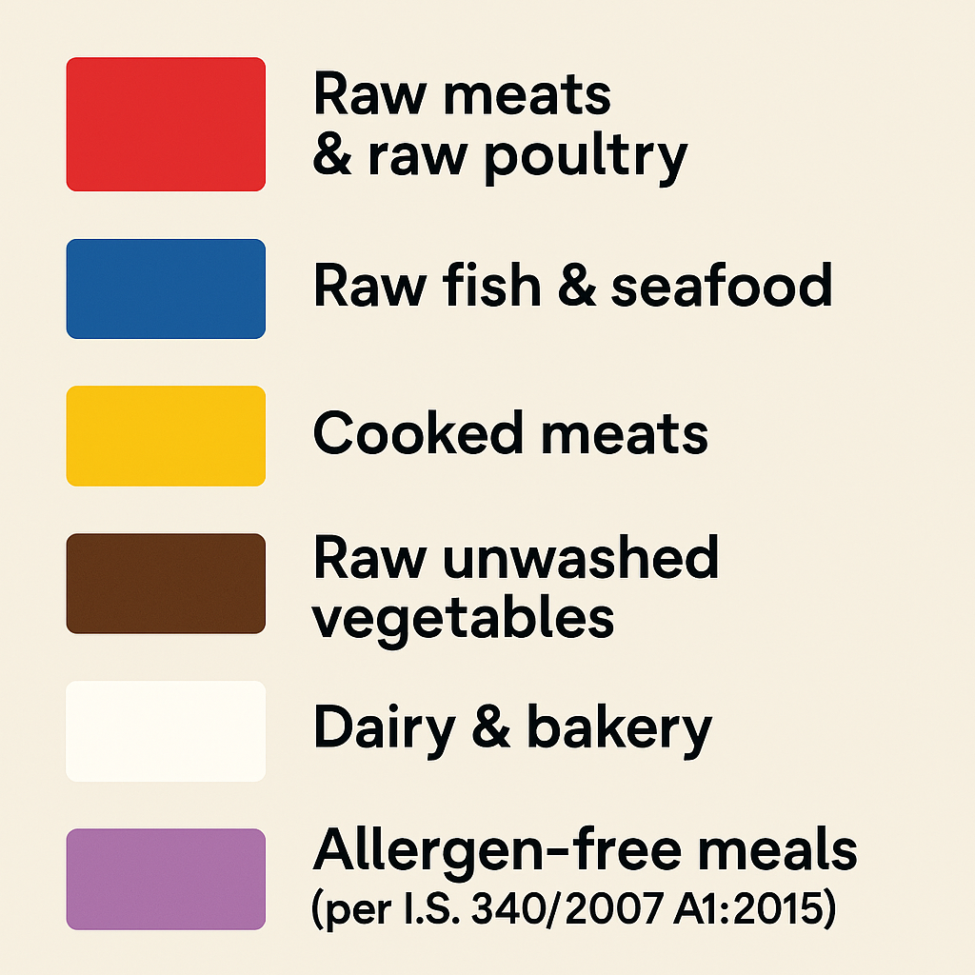
Colour Coding
Notes:
Colour Coding.
Colour coding is a simple but essential food safety control used in kitchens to prevent cross contamination between raw, cooked, and allergen free foods. It applies to chopping boards, knives, utensils, and sometimes cleaning equipment.
By assigning a colour to a specific food category, staff can quickly and consistently choose the right equipment for the task — reducing the risk of spreading harmful bacteria or allergens.
Standard Colour-Coding System.
Red is used for Raw meats & raw poultry.
Blue is used for Raw fish & seafood.
Yellow is used for Cooked meats.
Brown is used for Raw unwashed vegetables.
White is used for Dairy & bakery.
Green is used for Salad & fruit.
Lilac/Purple is used for Allergen free meals.

Slide 30
Controls for Cooking Food
General Cooking Controls
Temperature Requirements
Cook-to-Order Foods
Special Cooking Methods
Notes:
Controls for cooking food.
The main concern when cooking food is that pathogenic bacteria may survive if the food is not cooked properly. The following are key controls to reduce this risk.
General cooking controls.
Preheat ovens and grills before use.
Use clean utensils, no finger tasting.
Use a clean, calibrated insertion probe to check core temperatures.
Disinfect the probe before and after use with disinfectant wipes.
Record temperatures as part of your food safety system.
Temperature requirements.
For pork, poultry, minced meats, pre-formed meat products, and stuffed joints:, cook to a core temperature of 75 degrees Celsius.
If food is not probed, you must use a time/temperature combination to prove it is cooked thoroughly. Record batch numbers and origin of meat for traceability
Cook-to-order foods.
Some foods may be cooked to order based on customer preference. These include fish and shellfish, whole cuts of lamb, beef, venison, game birds and duck.
Cook-to-order foods must be purchased from reputable suppliers, prepared by a fully trained and experienced chef, seared or cooked on the outside and served within 30 minutes
Special cooking methods
Businesses using methods like cook-chill or sous-vide must follow specific guidance and training, ensure food reaches safe temperatures and monitor and record all steps.

Slide 31
Controls to Reduce Acrylamide
• Cook to a light golden colour, not dark brown
• Avoid overcooking, crisping, or burning
• Do not accept burnt or overbaked products from suppliers
• Use alternative cooking methods where possible
• Follow cooking instructions on product labels
• Preheat fryers and ovens before cooking
• Work with suppliers to ensure acrylamide controls are in place

Slide 32
Controls for Cooling Food
The Cooling Rule
Cooling Large Whole Joints
Recommended Cooling Methods
Monitoring Time & Temperature
Notes:
Controls for cooling food
How to cool food safely and prevent bacterial growth
When food is not being eaten immediately after cooking, it must either be kept above 63°c or cooled as quickly as possible. Slow cooling allows surviving bacteria to multiply, increasing the risk of food poisoning.
The cooling rule.
Cool food at room temperature for a maximum of 2 hours, then refrigerate.
The core temperature must be below 10°c within 2.5 hours of the food being cooked. The faster the cooling, the safer the food
Cooling large whole joints.
Large joints cool more slowly.
Cook‑chill foods must follow.
Recommended cooling methods.
Effective cooling techniques blast chilling, storing food in a cool, designated area, slicing or decanting into smaller portions, using cold containers, ice baths, cooling in cold potable water, stirring foods and ice paddles.
Throughout cooling, food must be protected from contamination.
Monitoring time & temperature.
Cooling must be, timed, measured and recorded.
This ensures compliance with haccp and proves the food was cooled safely.

Slide 33
Controls for Leftovers
Labelling.
Shelf Life Guidance for Cooked Foods
Additional Good Practices
Notes:
Controls for leftovers.
Leftovers can be a significant food safety risk if they are not cooled, stored, and labelled correctly. Proper controls ensure traceability, prevent spoilage, and reduce the risk of food poisoning.
Labelling.
When food is prepared but not eaten on the same day, it must be labelled.
This ensures safe storage, prevents confusion, and supports haccp traceability.
A correct leftover label must contain: name of the food, date made, use‑by date and allergen content .
This information helps staff rotate stock correctly and prevents accidental allergen exposure.
Shelf life guidance for cooked foods.
There is a simple rule: preparation day + 2 days = 3‑day shelf life.
For example if food is cooked on monday, the use‑by date is wednesday.
This applies only if the food was cooled safely stored at the correct temperature and protected from contamination.
Additional good practices.
Store leftovers in clean, sealed containers.
Keep them in the correct fridge zone.
Avoid mixing batches.
Use first‑in, first‑out (fifo) rotation.
Discard any unlabelled or out‑of‑date food.
Reheat leftovers once only, to a core temperature of 75 degrees celsius.

Slide 34
Controls for Reheating Foods
Reheat foods once only
Core temperature must reach ≥ 70°C
If food is not probed
Monitor and record temperatures
Using a microwave:
Allow food to stand after reheating
Stir the food to ensure even heating.
Follow manufacturer’s instructions
Notes:
Controls for reheating foods.
Reheating is not the same as cooking. The purpose of reheating is to bring previously cooked food back up to a safe temperature quickly enough to destroy any bacteria that may have grown during cooling or storage.
Key controls include:
Reheat foods once only repeated reheating increases bacterial risk and reduces food quality.
Core temperature must reach ≥ 70°c this ensures harmful bacteria are destroyed.
If food is not probed, you must use a time/temperature combination to prove it was reheated thoroughly.
Monitor and record temperatures this is part of your haccp documentation.
Using a microwave:
Allow food to stand after reheating this helps heat distribute evenly and avoids cold spots.
Stir the food to ensure even heating.
Follow manufacturer’s instructions, especially for ready‑to‑heat products.

Slide 35
Controls for Hot Holding Foods
Keep hot‑held food at ≥ 63°C
If food drops below 63°C for less than 2 hours
If food is below 63°C for more than 2 hours
Monitor temperature every 2 hours And record it as part of your food safety system
Good Practices During Hot Holding.
Sanitise the probe before and after every use
Ensure equipment and water are clean
Keep food covered to prevent contamination and drying out
Use tongs, serving spoons, and clean knives
Notes:
controls for hot holding foods.
hot holding keeps food hot after reheating or cooking, preventing bacterial growth while the food waits to be served.
key controls include:
keep hot‑held food at ≥ 63°c this is the legal minimum safe temperature.
if food drops below 63°c for less than 2 hours, it may be reheated and returned to service.
if food is below 63°c for more than 2 hours, it must be discarded.
monitor temperature every 2 hours and record it as part of your food safety system.
good practices during hot holding.
sanitise the probe before and after every use.
ensure equipment and water are clean.
keep food covered to prevent contamination and drying out.
use tongs, serving spoons, and clean knives.

Slide 36
Controls for Cold Holding
Temperature Control
Equipment Control
Food Handling & Labelling
Food Service Controls
Handling Equipment Correctly
Service Cloth Controls
Notes:
Controls for cold holding.
Cold holding such as deli counters, salad bar and buffet display is a high‑risk stage because food is exposed, handled frequently, and held for long periods. The goal is to keep food cold, clean, and protected.
Key cold holding controls include:
Temperature control.
Keep foods between 0–5 degrees celsius.
Monitor temperatures every hour.
Record all readings as part of haccp.
Sanitise the probe before and after each use.
Equipment control.
Pre‑cool the display unit before loading food.
Ensure the unit is clean and functioning correctly.
Do not overload the display, cold air must circulate.
Food handling & labelling.
If products are removed from original packaging:
Record use‑by dates.
Record batch numbers.
Ensure a new use‑by date is clearly available.
Only display as much food as needed.
Do not mix old and new food. Observe strict fifo.
Food handlers play a major role in keeping food safe during service.
Staff must be clean and tidy at all times, wash hands regularly and whenever necessary and change gloves frequently and never rely on gloves instead of handwashing.
Handling equipment correctly.
Handle cutlery by the handles.
Handle cups and glasses by the base or stem.
Never leave dirty crockery in service or prep areas.
Keep bulk cutlery in covered containers.
Service cloth controls.
Service cloths should not be worn on uniforms or over the shoulder, should be used for one purpose only, must be kept clean and hygienic and dirty, torn, or soiled cloths must be removed from service .immediately.

Slide 37
Corrective Actions, Verification & System Review
Corrective Actions
Verification.
When the HACCP System Should Be Reviewed
Legal Requirement
Notes:
Haccp: corrective actions, verification & system review
1. Corrective actions.
Corrective actions are required whenever monitoring shows loss of control at a ccp. Their purpose is to prevent unsafe food from reaching the consumer, bring the process back under control, prevent the issue from recurring and ensure all actions are documented.
2. Verification.
Verification is the double‑checking step that ensures the haccp system is working as designed.
Verification must be carried out by trained staff who are not responsible for the activity being checked.
Verification methods include supervisors checking cooking and cold‑chain records, sending food or swabs to an accredited laboratory, internal audits by management, external audits (e.g., food safety awards and regulatory audits.
Audits should identify strengths and weaknesses, allowing the business to improve food safety.
3. When the haccp system should be reviewed.
A review is required when the same corrective action keeps recurring, there is a change to the product or process, equipment is added or removed, a food safety incident occurs, the eho instructs an update and annually at a minimum.
4. Legal requirement.
All 7 haccp principles must be followed, and the entire system must be fully documented. Documentation provides traceability, legal protection, and proof of compliance.

Slide 38
Unit 10 Recap Questions
1. What core temperature should high-risk foods reach when cooked?
2. Name two safe thawing methods.
3. Why is zoning important during food preparation?
4. What is the legal minimum temperature for hot holding?
5. Why should leftovers be labelled?

Slide 39
Unit 10 Scenario Activity
Cooked rice is left cooling on a counter for 5 hours before refrigeration.
Identify the food safety hazard.
Why is rice considered high risk?
What corrective action should staff take?
What cooling controls should have been followed?

