Slide 1
Unit 5:
Layout, Design, Services, Water and lce

Slide 2
Unit 5: Layout, Design, Services, Water and lce
Learners will be able to:
Understand the need for proper layout and design of a food premises
State the requirements for equipment used in food operations
Recognise the importance of proper lighting, drainage and ventilation in promoting food safety
Understand the risks of using contaminated water
Define the term potable water
List three controls for handling ice
Notes:
Unit 5. Layout, Design, Services,Water and lce.
On completion of this unit, learners will be able to:
► Understand the need for proper layout and design of a food premises,
State the requirements for equipment used in food operations,
► Recognise the importance of proper lighting, drainage and ventlation
in promoting food safety,
► Understand the risks of using contaminated water,
> Define the term potable water, and,
> List three controls for handling ice.

Slide 3
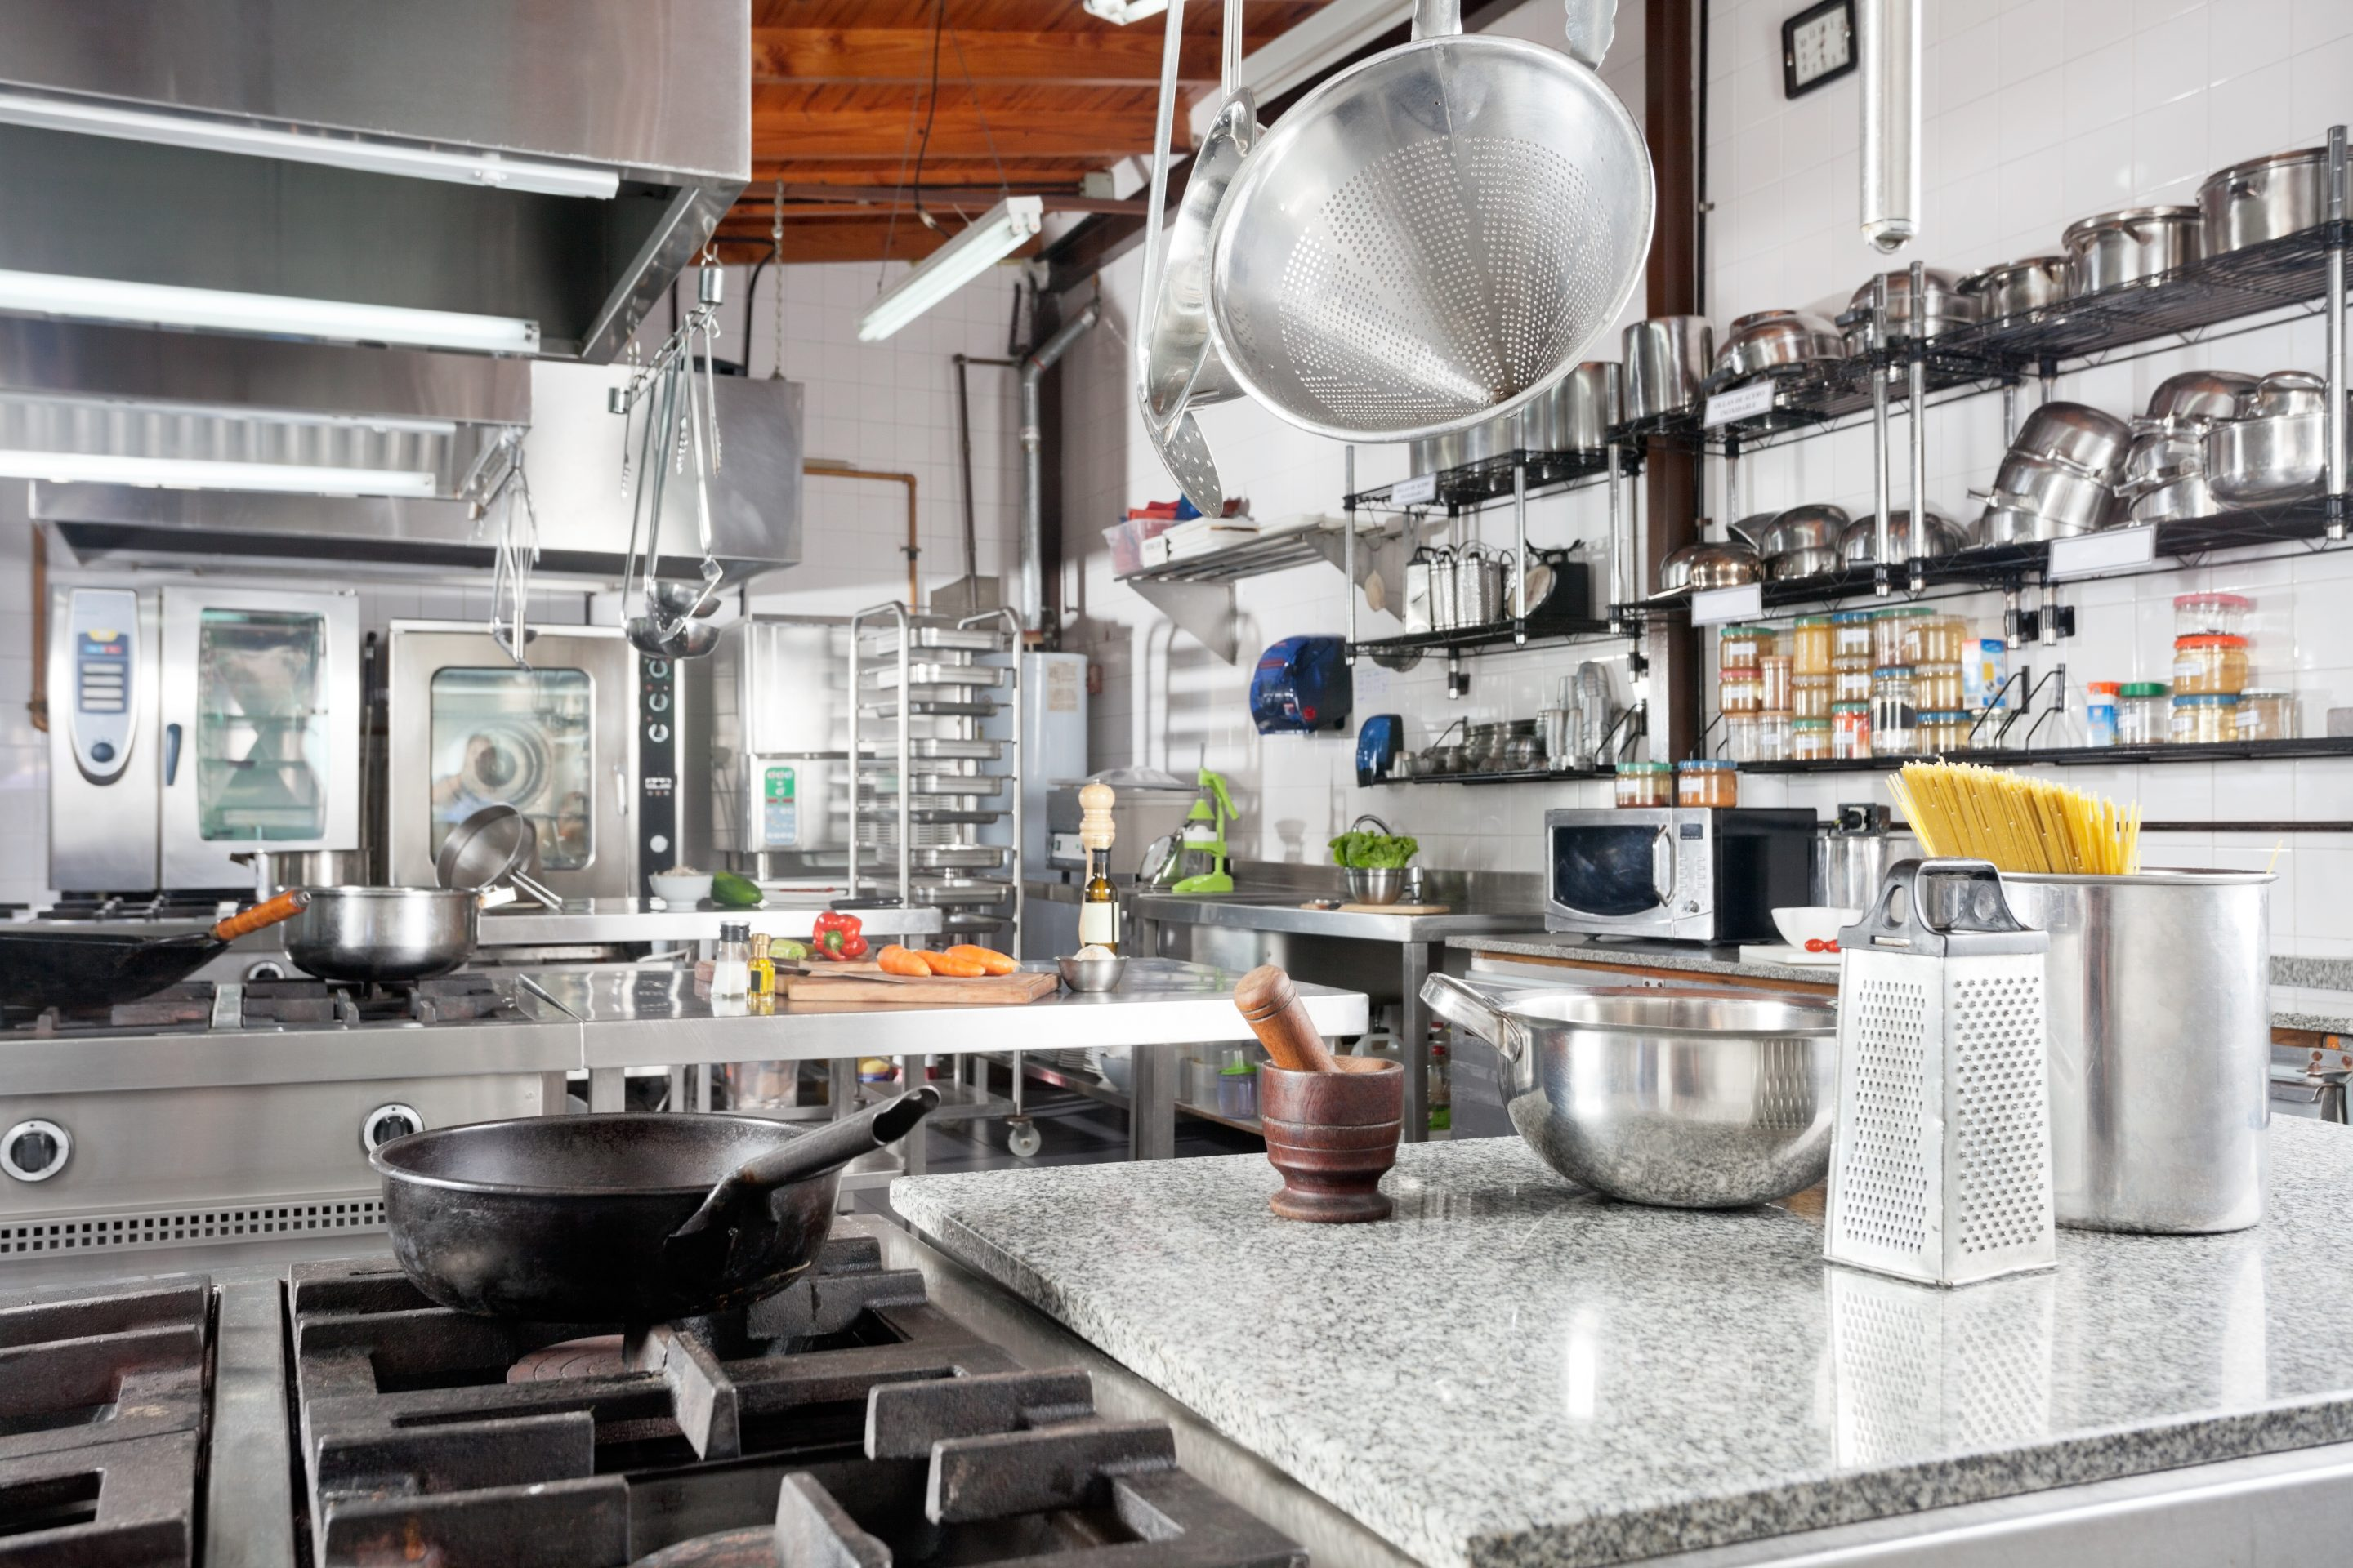
Layout and Design
Building Structure
Drainage and Sewage
Food Process Flow
Storage
Notes:
Layout and design.
Food premises must be designed and maintained to prevent food contamination and the growth of bacteria. Several key factors should be considered when designing a food premises:
Building structure: this includes the floors, walls, and ceilings, which should be designed to be easy to clean and maintain.
Drainage and sewage: adequate drainage and sewage systems are essential to prevent water accumulation and contamination.
Food process flow: the layout should ensure a smooth flow of food processes within the building, with designated zones for different work areas and processes.
Storage: there should be adequate storage, including chilled storage, to keep food at safe temperatures.
In summary, the layout, design, construction, size, and location of a food premises should support good hygiene practices, allow for proper maintenance, and be easy to clean.

Slide 4
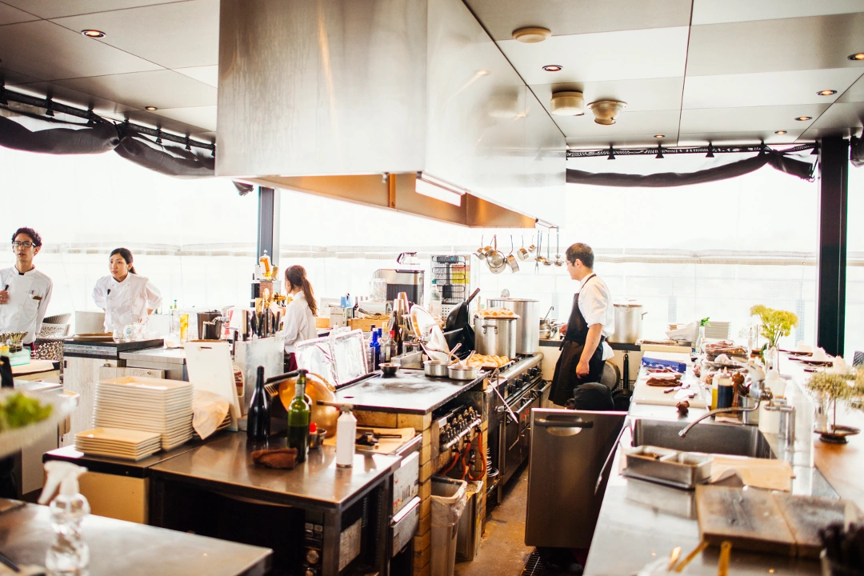
Premises Layout and Design
Floors
Walls
Ceilings
Work Surfaces
Grounds
Notes:
Premises layout and design.
The following are specific requirements for food premises.
Floors: floors in food premises should be smooth, durable, non-absorbent, and easy to clean. Suitable floor coverings include slip-resistant quarry tiles or similar types of flooring.
Walls: walls should also be smooth, durable, non-absorbent, and easy to clean. Suitable wall coverings include ceramic tiles, pvc cladding, and stainless steel sheeting, especially behind cooking equipment.
Ceilings: ceilings should be smooth, durable, non-absorbent, and easy to clean. Canopies, air vents, and screens must be installed in a way that makes them easy to clean.
Work surfaces: work surfaces must be kept in good condition, be smooth, durable, and water-resistant. These surfaces should be easy to clean and sanitize.
Grounds: the grounds around the food premises must be kept clean, free from litter, uncut weeds, waste materials, or any other materials where pests could hide. An external tap and a straining basket on gullies will help with cleaning.

Slide 5
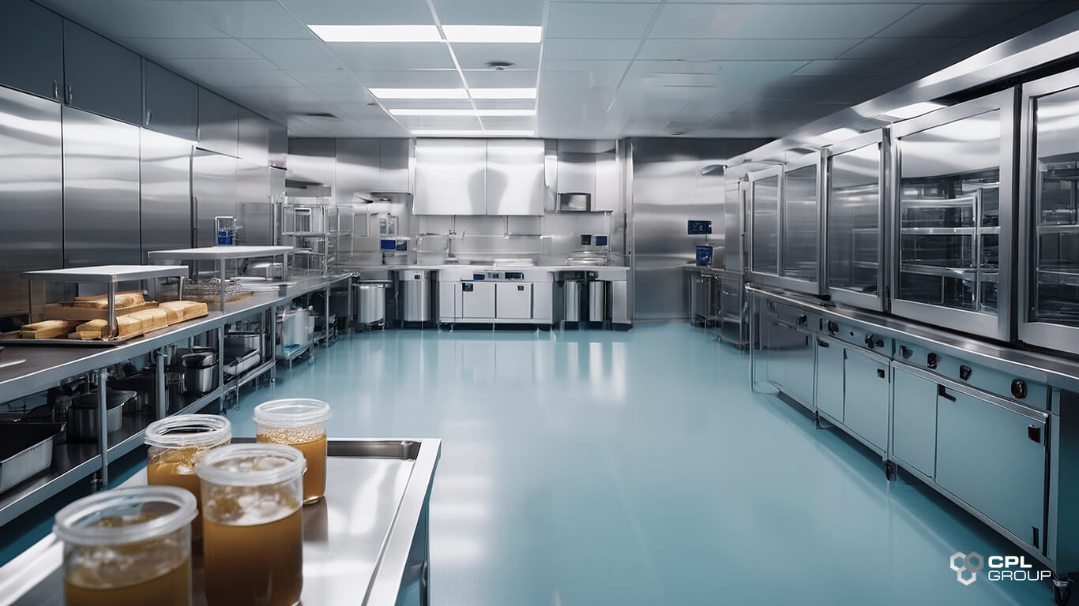
Equipment
Food Grade Surfaces
Regular Maintenance and Servicing
• Calibration
• Correct Installation
• Suitability for Purpose
• Smooth, Impervious, and Resistant to Heat and Impact Damage
Notes:
Equipment.
All fixtures, fittings, and equipment in food premises must be designed and installed in a way that allows for easy cleaning, sanitization, and maintenance. This ensures that the equipment remains hygienic and safe to use. Additionally, all equipment, fixtures, and fittings must be kept in good repair to prevent any potential hazards.
The materials used for equipment and surfaces that come into contact with food must be non-toxic and safe for food use. Key points for equipment include:
Food grade surfaces: equipment should have surfaces made from materials like stainless steel, which are safe for food contact.
Regular maintenance and servicing: equipment should be maintained and serviced regularly to ensure it remains in good working condition.
Calibration: if required, equipment should be calibrated to ensure it functions correctly.
Correct installation: equipment should be installed properly to ensure it operates safely and effectively.
Suitability for purpose: equipment should be suitable for its intended use.
Smooth, impervious, and resistant to heat and impact damage: equipment surfaces should be smooth, non-absorbent, and resistant to heat and impact damage to ensure they are easy to clean and durable.

Slide 6
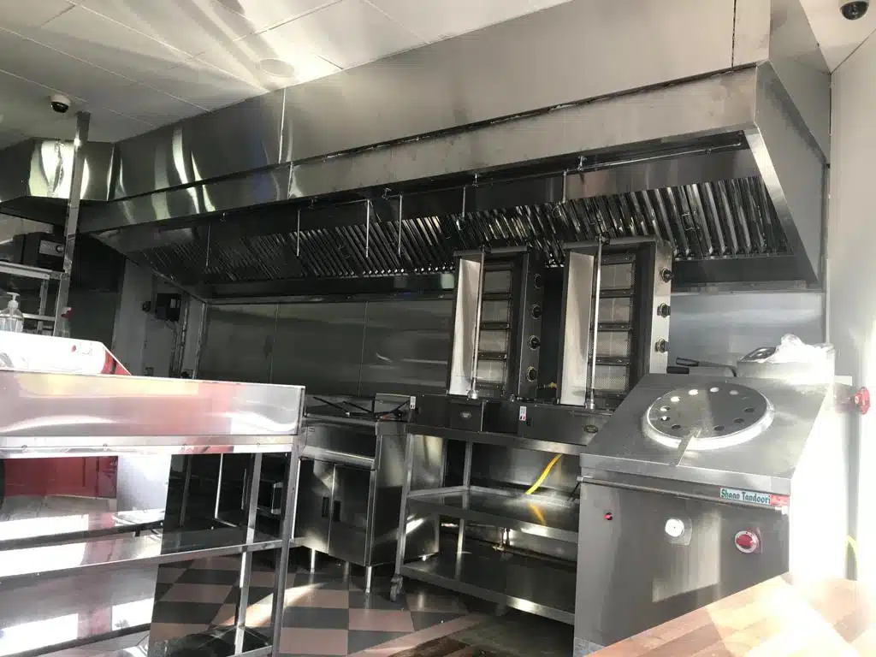
Services
Ventilation
Lighting
Drainage
Notes:
Services.
All food premises are required to have an adequate supply of services to help maintain the premises in a clean and safe condition.
explains the importance of ventilation, lighting, and drainage in food premises.
Ventilation: Ventilation is necessary for several reasons:
It ensures the comfort of staff by providing fresh air.
It helps remove odors that might attract pests like vermin or insects.
It reduces moisture and condensation in the food area, which can prevent mould and other issues.
Lighting: Proper lighting is essential for:
Allowing staff to see visible dirt and clean it effectively.
Inspecting for signs of pest activity.
Reading labels on food and other items.
Inspecting foods for any physical contamination.
Drainage: Good drainage is important to:
Prevent the buildup of grease and unpleasant smells.
Remove foul water from the premises, and,
Ensure that sewage is properly removed from the premises.

Slide 7
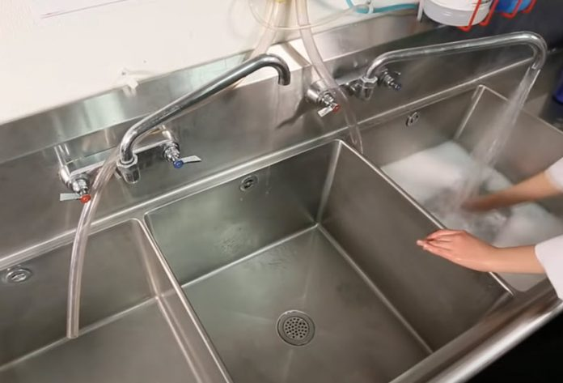
Potable Water and Ice
Potable Water is water that is safe for drinking, cooking, food preparation, and food production.
Basic Standards:
Drinking Water Taps
Clean Taps
Clean Sinks
Wash Hand Basins
Notes:
Potable Water and Ice:
Potable Water is water that is safe for drinking, cooking, food preparation, and food production. It must comply with relevant legislation to ensure its quality.
Food Business Operators are responsible for ensuring the quality of water used in their operations. This includes water used directly in food production and indirectly for cleaning or processing.
The water used in food production must meet the following basic standards for drinking water, meaning it must be potable.
Drinking Water Taps: These should be clearly designated as drinking water taps and must be kept clean and hygienic.
Clean Taps: Taps should always be clean and free from any contamination.
Clean Sinks: Sinks should be cleaned and disinfected before use to ensure they are hygienic.
Wash Hand Basins: These should not be used for washing any food items to prevent contamination.
If the water becomes contaminated or is considered unsafe to use, the business may receive a boil water notice. This means you must use a separate source of safe drinking water for all food or ice preparations. Alternatively, you can boil all water before using it for making ice or preparing food.

Slide 8
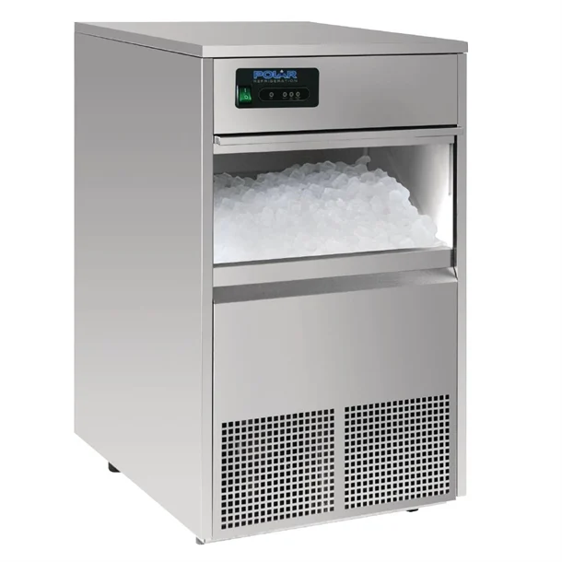
Ice
Use Only Potable Water
Keep the Machine Clean & Closed
Clean Scoops & Containers
Never Touch Ice With Bare Hands
Don’t Chill Bottles in the Ice Machine
Notes:
Ice.
The following points are essentially guidelines for keeping ice safe, clean, and free from contamination, especially in food‑service settings like restaurants, bars, or cafés.
Use potable water.
Ice is considered a food. If the water isn’t safe to drink, the ice won’t be safe either. Using potable water ensures the ice won’t make people sick.
Keep the ice machine clean and closed.
Ice machines can easily collect dirt, mould, or bacteria if not maintained.
Keeping the machine clean and the door closed protects the ice from dust, pests, and other contaminants.
Clean and sanitize scoops and containers.
Anything that touches the ice must be hygienic.
Regular cleaning prevents bacteria from building up on scoops, bins, or buckets.
Don’t touch ice with bare hands.
Hands carry germs, even clean hands.
Using a scoop instead of hands prevents contamination.
Glassware should never be used as a scoop because it can break, leaving dangerous shards in the ice.
Don’t chill bottles or drinks inside the ice machine
Bottles can be dirty on the outside, and placing them in the ice can transfer bacteria or chemicals.
If a bottle breaks, it can contaminate the entire ice supply.
Ice machines are for making ice only, not for cooling products.

Slide 9
Unit 5 Recap Questions
1. What does potable water mean?
2. Why is ventilation important in food premises?
3. Give one requirement for food equipment.
4. Why should ice never be touched with bare hands?
5. What flooring properties are suitable for food areas?

Slide 10
Unit 5 Scenario Activity
An ice scoop is stored directly inside the ice machine with the handle touching the ice.
• Identify the food safety risk.
• What contamination could occur?
• What corrective action should staff take?
• What other controls should be in place?

Slide 11
Unit 6. Pest, Waste and Maintenance Control.

Slide 12
Unit 6. Pest, Waste and Maintenance Control.
Learners will be able to:
Distinguish between the different types of pests and signs of their activity
Explain how pests pose a risk to food safety
Manage internal and external waste in a food environment
Maintain equipment and premises
Implement corrective actions when require
Notes:
Unit 6. Pest, Waste and Maintenance Control.
On completion of this unit, learners will be able to:
Distinguish between the different types of pests and signs of their activity,
Explain how pests pose a risk to food safety,
Manage internal and external waste in a food environment,
Maintain equipment and premises, and,
Implement corrective actions when require.

Slide 13


Main Types of Food Pests
Rodents
Insects
Controls:
• Good Housekeeping
• Inspect All Food Deliveries
• Rodent and Insect Proof the Premises
• Bait and Trap
Notes:
Main types of food pests.
Rats, mice, flies, and insects can carry diseases, making them a risk to food safety. These pests can contaminate food with their feces, urine, hair, fur, eggs, and dead bodies. They can transmit various diseases and pathogens to food and food workers, so it's crucial to keep them out of any food business. The following are the most common types of pests and signs of infestation:
Rodents (rats and mice):
Signs of infestation include droppings, gnawed packaging, chewed food or packaging, live or dead bodies, greasy smears along walls and bait boxes that are gone, empty, or nibbled.
Insects (houseflies, bluebottles, cockroaches, mites, and beetles):
o Signs of infestation include live or dead insects or flies, eggs and egg casings, cockroaches leave a smell and insects in fly catcher trays.
The following are controls for pests and insects:
• Good housekeeping:
o Eliminate all food and shelter for pests,
o Remove bins and clean as you go, and,
o Ensure good ventilation.
• Inspect all food deliveries:
o Keep foods off the floor and covered.
o Remove excess packaging.
• Rodent and insect proof the premises:
o Install fly screens on windows and doors, which should be removable for cleaning.
o Seal all holes and gaps larger than 6mm to prevent entry.
o Keep external yards and access areas clean and free from weeds.
• Bait and trap:
o Hire a pest control contractor to regularly visit and inspect the premises and take necessary actions.

Slide 14
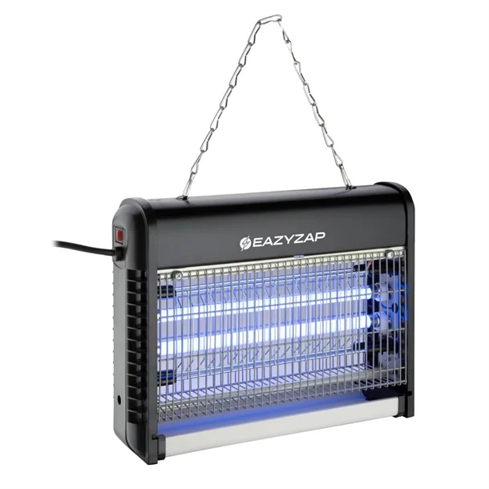
Bird & Insect Control
Using Electronic Fly Killers:
• Operation
• Placement
• Maintenance
Notes:
Bird & insect control.
In outdoor areas, birds can be problematic because their droppings are hazardous and must be kept away from food areas. To prevent birds from gathering, many places use bristles on surfaces where birds might perch. Birds should not be allowed to nest in food storage areas.
The following are guidelines for using electronic fly killers.
Operation: these devices must be kept on 24 hours a day.
Placement: they should be placed away from natural light and drafts, and not directly above food areas.
Maintenance: the ultraviolet (uv) bulbs in these units need to be replaced annually, and records of these changes should be kept. The units should be regularly serviced and cleaned. The catch trays, which collect dead insects, should be emptied as needed, especially more frequently during the summer months.

Slide 15
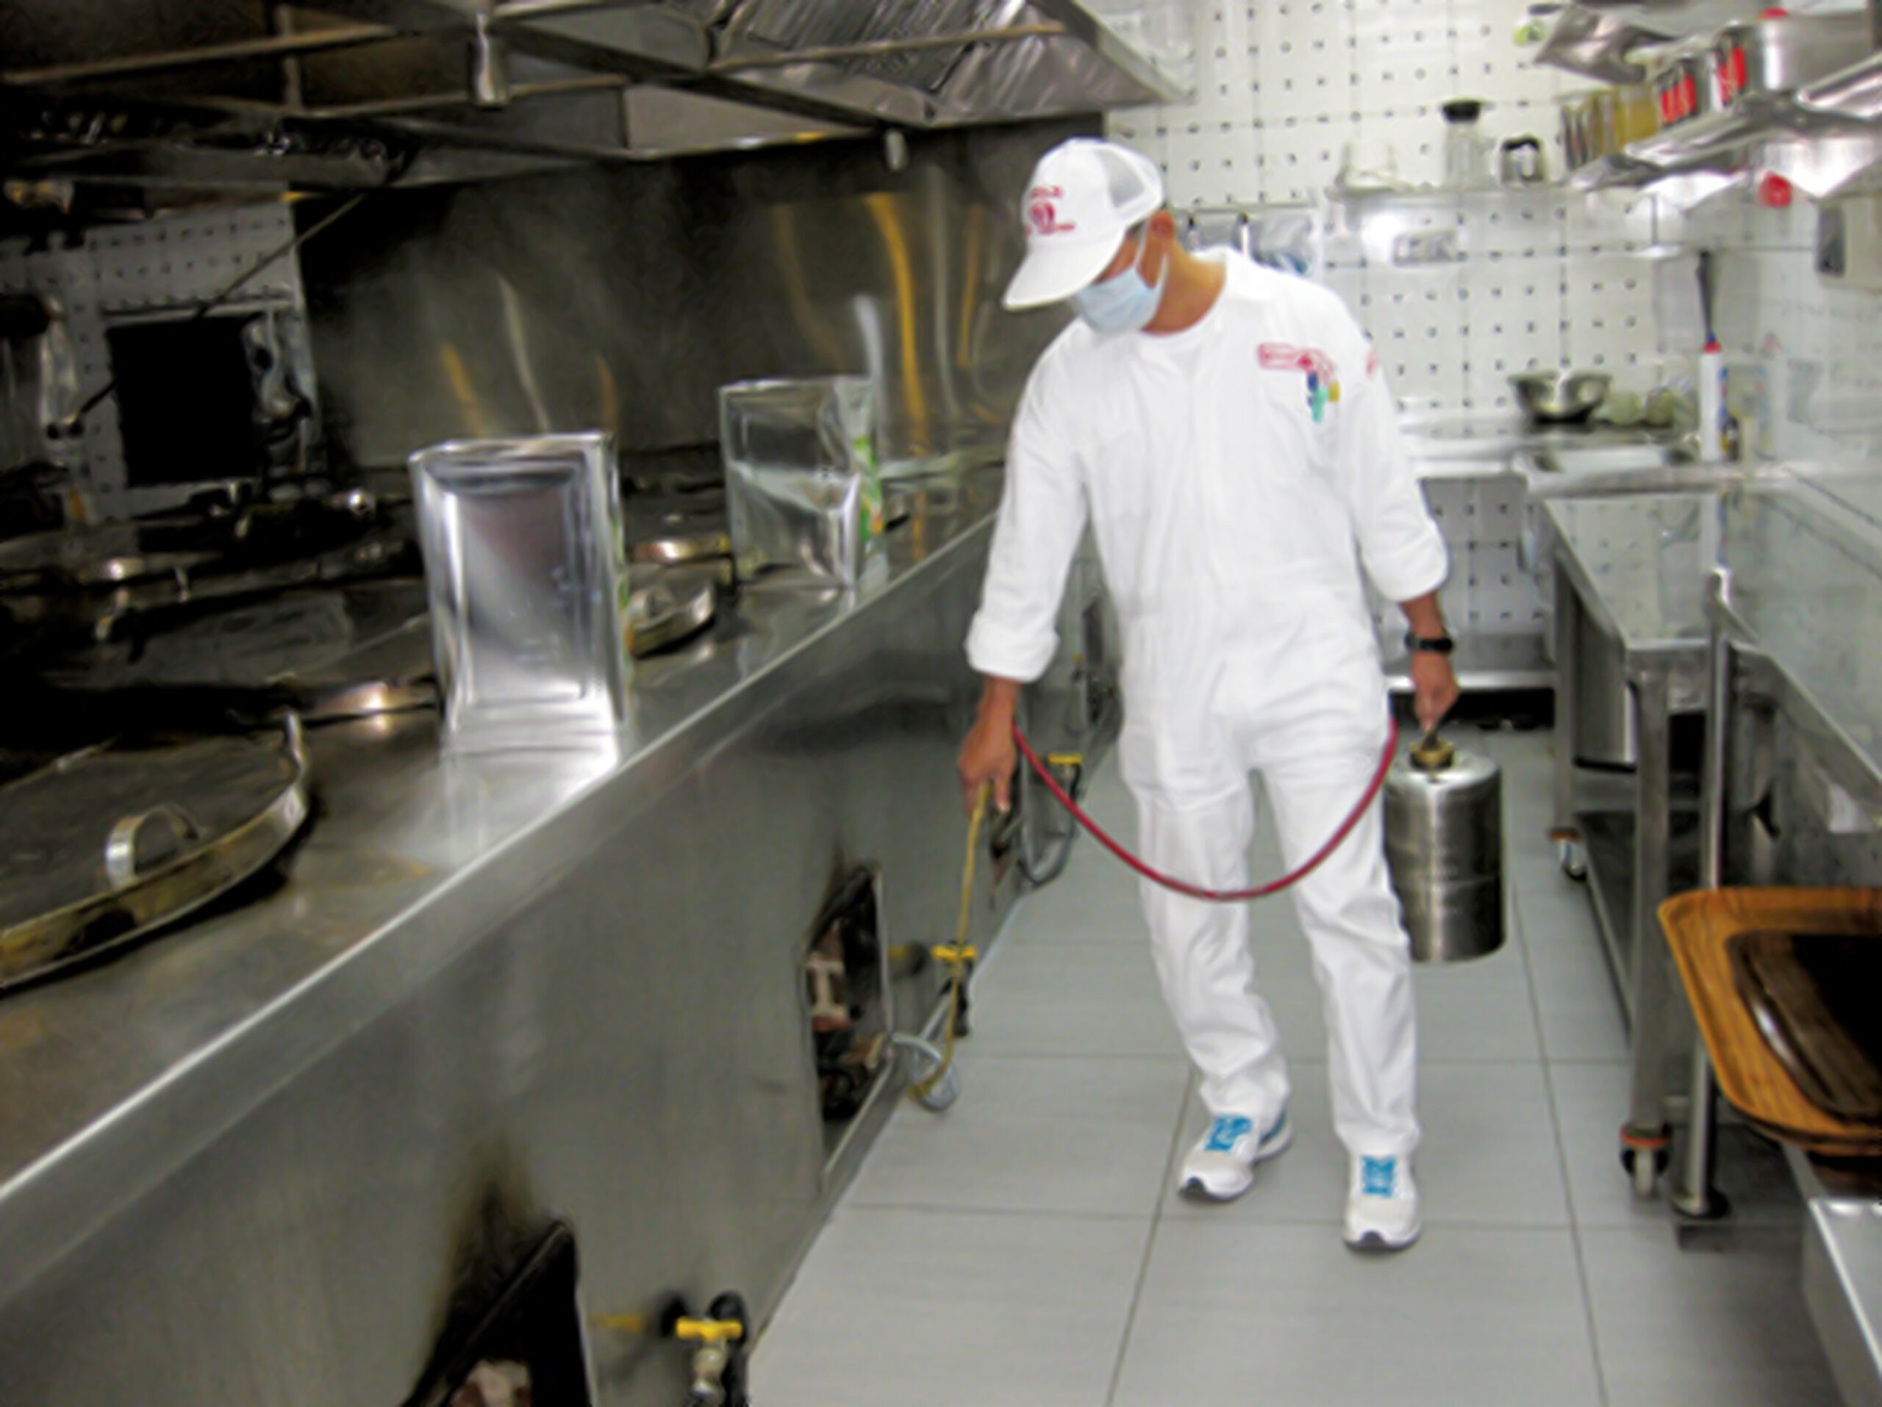
Pest Control & the Contractor
• Reputation and Licensing
• Staff Competence
• Site Mapping
• Frequency of Visits
• Documentation
Notes:
Pest control & the contractor.
Pest control contractors provide various services to help food businesses minimize the risk of pest infestations. Here are some important points to consider when hiring a contractor:
• Reputation and licensing: ensure the contractor is reputable and licensed.
• Staff competence: their staff should be trained and competent in using baits, and safety data sheets for all chemicals used should be available.
• Site mapping: contractors should provide a location map of all bait and insect units on site, which should be verified annually.
• Labeling: all bait boxes and electronic fly killers should be labeled.
• Frequency of visits: contractors should visit at least every three months or more frequently if needed for emergency call-outs. Most premises will have 6-8 visits annually.
• Documentation: written reports of all inspections and corrective actions taken should be kept on file.

Slide 16

Infestation Management
Contact a professional pest control company
Inform the Environmental Health Officer (EHO)
Identify the cause and fix it
Increase inspection frequency
Notes:
Infestation management.
When pests are found in a food business, management has a legal and safety duty to act quickly. Each step below helps protect customers, staff, and the business.
Contact a professional pest control company.
• pest infestations must be handled by trained specialists.
• professionals can identify the type of pest, treat the problem safely, and prevent it from spreading.
Inform the environmental health officer (eho) if required.
• some infestations are serious enough that the eho must be notified.
• the eho may give guidance, require corrective actions, or inspect the premises to ensure food safety is maintained.
Identify the cause and fix it.
• management must find out why the infestation happened. For example, poor waste storage, gaps in walls, or food left uncovered.
• fixing the root cause prevents the problem from returning.
4. Increase inspection frequency.
• after an infestation, the premises should be checked more often.
• this includes monitoring traps, checking storage areas, and ensuring cleaning routines are followed.
• frequent inspections help catch any new pest activity early.

Slide 17
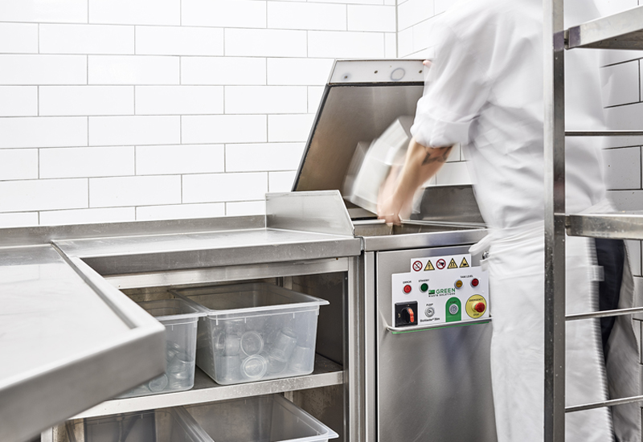
Internal Waste Management
Separate different types of waste
Remove waste at least daily or as required
Clean and disinfect bins regularly
Use pedal‑operated bins or suitable alternatives
Notes:
Internal waste management.
Good waste management is essential in any food business. Poorly handled waste is one of the biggest attractors of pests such as flies, rodents, and cockroaches. These guidelines help keep the premises clean, safe, and compliant.
Separate different types of waste.
• food waste, recyclables, and general waste should be kept in separate containers.
• this reduces smells, makes disposal easier, and prevents pests from being drawn to mixed, uncontained rubbish.
Remove waste daily.
• waste should never be allowed to build up.
• full or overflowing bins create strong odours and provide easy access for pests.
• busy kitchens may need waste removed several times a day.
Clean and disinfect bins regularly.
• even when emptied, bins can hold residue that attracts insects and rodents.
• washing and sanitizing bins prevents bacteria growth and removes smells that pests seek out.
Use pedal‑operated bins or suitable alternatives.
• pedal bins allow staff to open the lid without touching it, reducing contamination.
• a closed‑lid system also keeps pests out and prevents odours from escaping.
• if pedal bins aren’t available, any hands‑free or tightly sealed option is acceptable.

Slide 18
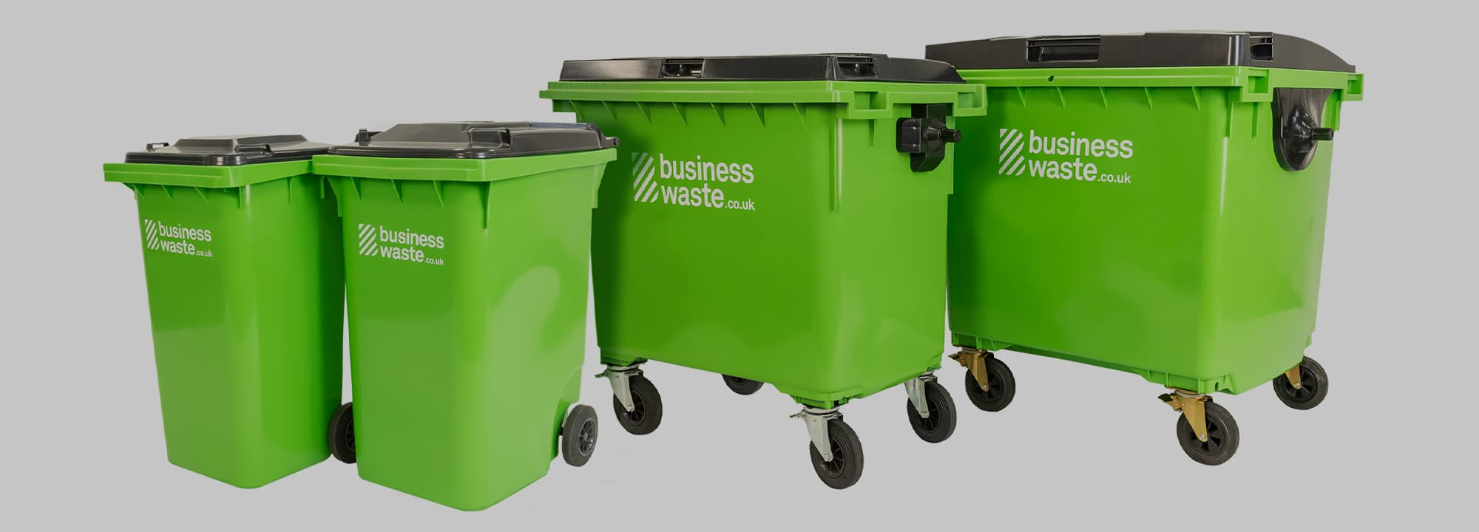
External Waste Management
Waste should be separated
Waste should be placed in bins with lids or skips on a hard surface
The waste area should be kept clean and protected from pests
Waste should be removed regularly and should not overflow
Waste should only be removed by a licensed waste contractor
Notes:
External waste management.
Managing waste outside the building is just as important as managing it inside. Poorly controlled external waste can attract pests, create bad odours, and lead to contamination risks that affect the entire premises.
Waste should be separated.
Different types of waste must be kept in separate bins.
This prevents cross‑contamination and makes disposal safer and more efficient.
Waste should be placed in bins with lids or skips on a hard surface.
Bins must have tight‑fitting lids to stop pests, birds, and animals from accessing waste.
A hard surface, like concrete, prevents leaks from soaking into the ground and makes cleaning easier.
The waste area should be kept clean and protected from pests
Regular cleaning prevents smells and residue that attract rodents and insects.
Good housekeeping, such as closing lids, keeping the area tidy, and removing spills, helps keep pests away.
Waste should be removed regularly and should not overflow.
Overflowing bins are a major pest attractant and create hygiene hazards.
Regular collection ensures waste doesn’t build up and the area stays manageable and safe.
Waste should only be removed by a licensed waste contractor.
Only approved contractors are legally allowed to collect and dispose of commercial waste.
This ensures waste is handled safely, responsibly, and in compliance with environmental regulations.

Slide 19
Unit 6 Recap Questions
1. Name two signs of pest activity.
2. Why should waste be removed regularly?
3. What is the purpose of fly screens?
4. Why are pedal bins recommended?
5. What should happen if an infestation is discovered?

Slide 20
Unit 6 Scenario Activity
Staff notice rodent droppings near the dry goods store.
• Identify the food safety hazards.
• What immediate actions should be taken?
• Who should be informed?
• What preventative controls should be reviewed?

Slide 21
Unit 7 Suppliers, Traceability and Calibration

Slide 22
Unit 7 Suppliers, Traceability and Calibration
Learners will be able to:
Define traceability
Understand the importance of supplier control
Deal with recalled food products
Dealing with a food safety complaint
Provide correct food information
Take samples for testing
Recognise the different types of probe thermometers
Carry out internal calibration of the probe thermometer
Notes:
Unit 7. Suppliers, traceability and calibration.
Learners will be able to:
Define traceability,
Understand the importance of supplier control,
Deal with recalled food products,
Dealing with a food safety complaint,
Provide correct food information,
Take samples for testing,
Recognise the different types of probe thermometers, and,
Carry out internal calibration of the probe thermometer.

Slide 23
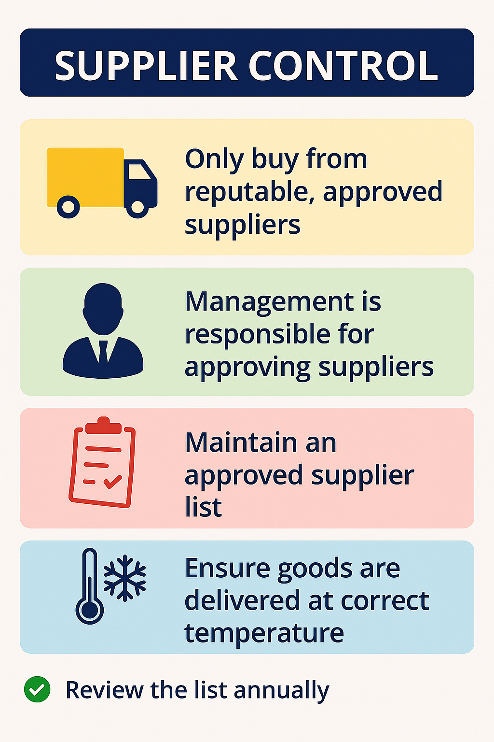
Supplier Control
Only buy from reputable, approved suppliers
Management is responsible for approving suppliers
Maintain an approved supplier list
Review the list annually
Notes:
Supplier control.
Supplier control is all about making sure that every ingredient, product, and piece of packaging brought into the premises is safe, high‑quality, and free from contamination. Good supplier control protects customers, prevents foodborne illness, and supports legal compliance.
Only buy from reputable, approved suppliers.
Raw materials, packaging, and ready‑to‑eat foods must come from suppliers who can guarantee safety and quality.
Approved suppliers follow proper hygiene, storage, and transport standards, reducing the risk of contamination before the food even arrives.
Management is responsible for approving suppliers.
To ensure suppliers meet required standards, management may use several checks, such as:
Approved supplier questionnaires where suppliers provide details about their food safety systems.
On‑site audits or visits where management can inspect the supplier’s premises and practices.
Reputation and reliability. Consider the supplier’s history, reviews, and performance.
Regulatory registration. All suppliers must be registered with the appropriate authority to operate legally.
These steps help confirm that the supplier can consistently provide safe, compliant products.
Maintain an approved supplier list.
Once suppliers are checked and approved, they are added to an official list.
Staff must only order products from suppliers on this list.
This prevents accidental purchases from unknown or unsafe sources.
Review the list annually.
Suppliers can change ownership, processes, or standards over time.
An annual review ensures the list stays accurate and that all suppliers continue to meet food‑safety requirements.

Slide 24
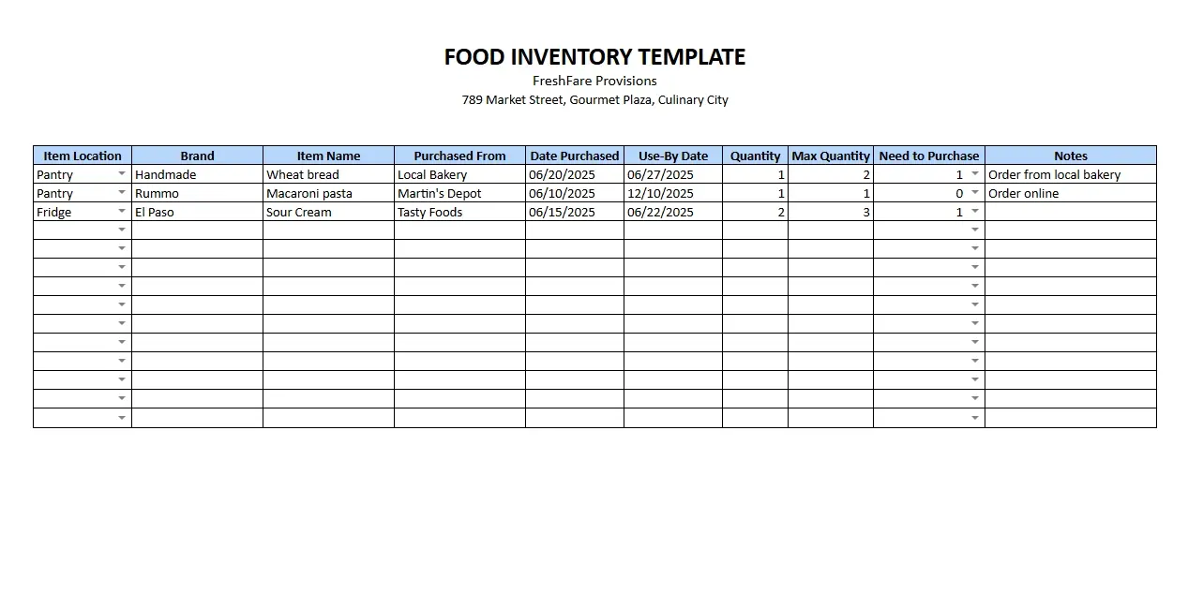
Traceability
Traceability means being able to track food, ingredients, and packaging one step back and one step forward.
Basic Traceability Information:
Supplier’s name and address
Delivery dates
Type of food
Product name
Date of minimum durability
Net quantity
Health mark
Approved voluntary claims
Storage instructions
Notes:
Traceability.
Traceability means being able to track food, ingredients, and packaging one step back, where they came from, and one step forward, where they were sent. This system allows a food business to quickly identify and isolate any product that may pose a risk to consumers.
Good traceability protects customers, supports legal compliance, and helps businesses respond effectively during recalls or complaints.
Food businesses must maintain detailed records for every food and packaging item received. These records should include basic traceability information such as:
• supplier’s name and address.
This identifies exactly who provided the product.
• delivery dates.
This shows when the product entered the business.
• type of food.
This helps classify and identify the product.
• product name.
This ensures the item can be matched to labels and menus.
• date of minimum durability.
This indicates shelf life and helps manage stock rotation.
• net quantity.
This shows how much product was received.
• health mark for fresh meat.
This confirms the meat came from an approved establishment.
• approved voluntary claims.
For example, special beef labelling or quality marks.
• list of ingredients.
This is essential for allergen control and accurate labelling.
• storage instructions.
This ensures the product is kept safely.
For items like meat, fish, milk, and eggs the volume or quantity, batch or lot number and country of origin must be recorded:
Traceability is essential because it allows a business to quickly remove unsafe food from sale, investigate complaints effectively, protect public health and comply with legal requirements.

Slide 25
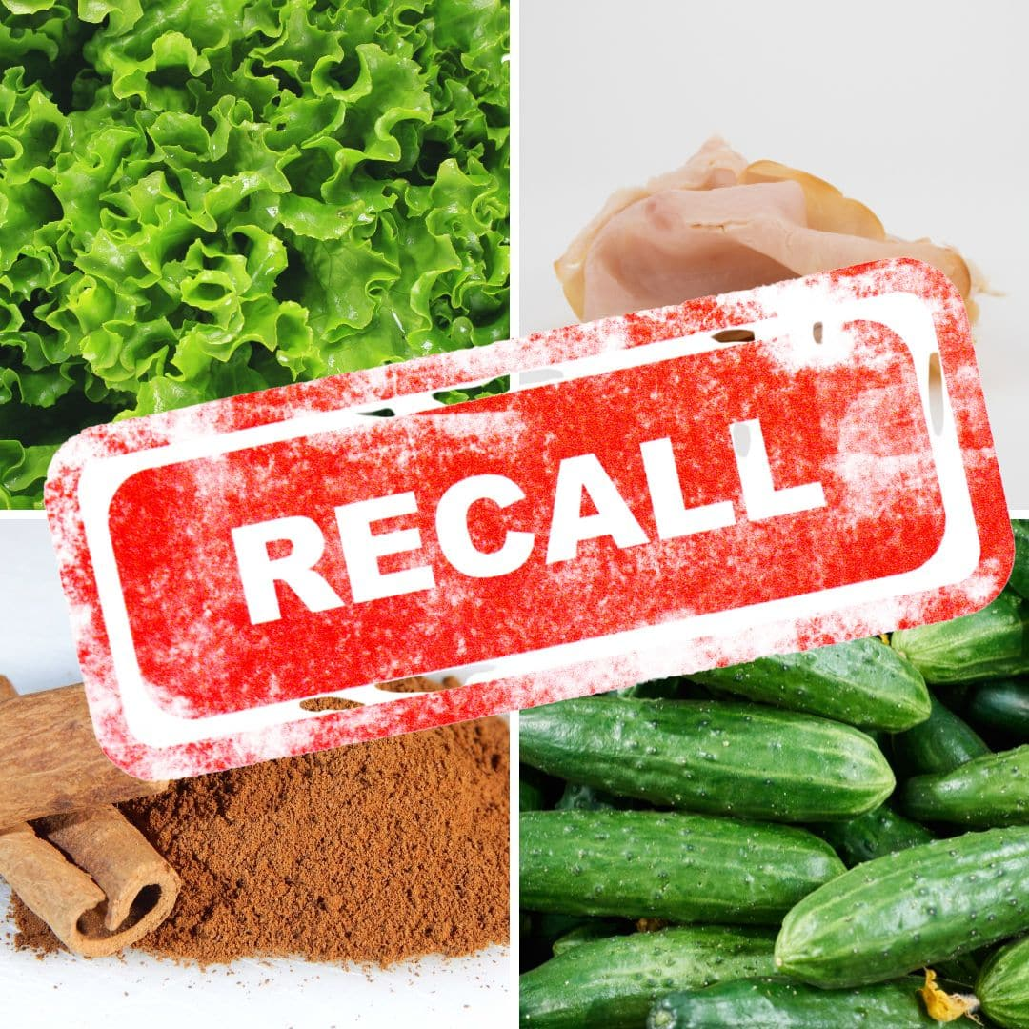
Dealing with Recalled Food Products
Follow the established recall or withdrawal procedure
Store unsafe or non‑compliant products separately
Notes:
Dealing with recalled food products.
When a food product is found to be unsafe, contaminated, or not up to required standards, the business must act quickly and correctly. Proper handling of recalled or withdrawn products protects customers and ensures legal compliance.
Follow the established recall or withdrawal procedure.
Every food business should have a written procedure that explains what to do when a product is unsafe.
This procedure usually includes steps such as identifying the affected product, stopping its use or sale, informing staff, and documenting actions taken.
Following the procedure ensures the response is fast, consistent, and effective.
Store unsafe or non‑compliant products separately.
Any product that is recalled, expired, contaminated, or otherwise unsafe must be kept away from all other food.
These items should be clearly labelled such as “do not use” or “recalled product”.
Storing them separately prevents accidental use and avoids cross‑contamination.

Slide 26

Dealing with a Food Safety Complaint
Dealing with the customer
Reporting the incident to a supervisor or manager
Identifying and storing the food in a designated area
Recording the complaint and corrective actions
Cooperating with Environmental Health Officers.
Notes:
Dealing with a food safety complaint.
Food safety complaints must be taken seriously. A structured response helps protect public health, maintain customer trust, and ensure the business meets legal requirements.
Follow the procedures in place for handling food safety complaints, which include the following:
Dealing with the customer.
• listen politely and take the complaint seriously.
• avoid arguing or dismissing their concerns.
• thank them for bringing the issue to your attention and reassure them that it will be investigated.
Reporting the incident to a supervisor or manager.
• all food safety complaints must be escalated immediately.
• management is responsible for deciding what actions to take and ensuring procedures are followed.
Identifying and storing the food in a designated area
• if the complaint involves a specific food item, it should be removed from use straight away.
• store it in a clearly marked area such as “do not use”so it can be examined later.
• this prevents accidental use and helps with investigation.
Recording the complaint and corrective actions.
• document everything: what the customer reported, when it happened, who was involved, and what actions were taken.
• good records help identify patterns, prevent future issues, and demonstrate due diligence.
Cooperating with environmental health officers.
• if an eho becomes involved, staff and management must provide accurate information and full cooperation.
• ehos may inspect the premises, review records, or take samples.
• cooperation ensures the investigation is completed quickly and fairly.

Slide 27
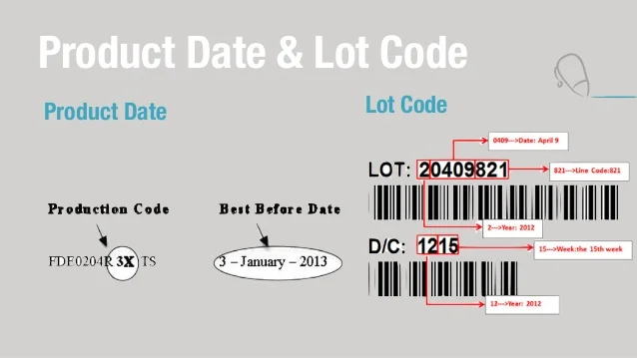
Food Labelling
Labelling Food to Show Shelf Life
Use‑by date
Allergens
Batch code
Labelling After Cooking, Cooling, and Storing Food
Made on
Use‑by date
Batch code
Notes:
Food labelling.
Proper labelling is essential in any food business. It helps staff handle food safely, prevents the use of out‑of‑date products, supports allergen control, and ensures full traceability.
Labelling food to show shelf life.
Food must be labelled correctly whenever it is opened or moved. This ensures everyone knows how long the food is safe to use.
Label food when a pack is opened and a new use‑by date is needed and
Each label must include:
• use‑by date.
The final day the food is safe to eat.
• allergens.
These can be listed directly on the label or displayed in a central allergen folder or chart. This protects customers with allergies.
• batch code (for meat products).
This helps trace the exact source of the meat if there is a recall or investigation.
2. Labelling after cooking, cooling, and storing food.
Once food has been prepared, cooked, or cooled, it must be labelled again to ensure safe storage and correct stock rotation.
Labels must include:
• made on (production date).
The date the food was cooked or prepared.
• use‑by date.
• allergens, and,
• batch code (for meat products).

Slide 28
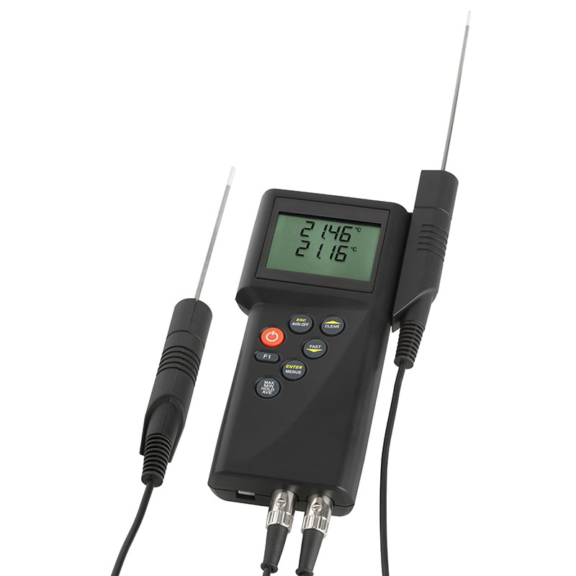
Handheld Digital Thermometers
What They Are Used For
• Checking the temperature of hot food to ensure it is cooked thoroughly.
• Checking cold food, including chilled and frozen items.
• Monitoring the temperature inside fridges and freezers.
• Measuring air temperature in storage or preparation areas.
How to Use the Probe Safely
Clean and disinfect the probe before and after every use
Insert the probe into the thickest part of the food
Leave the probe in place for up to two minutes
Notes:
Handheld digital thermometers.
Handheld digital thermometers are widely used in food businesses because they give fast, accurate temperature readings. They help ensure food is cooked properly, stored safely, and kept out of the danger zone where harmful bacteria multiply.
They are used for:
• checking the temperature of hot food to ensure it is cooked thoroughly.
• checking cold food, including chilled and frozen items.
• monitoring the temperature inside fridges and freezers, and,
• measuring air temperature in storage or preparation areas.
To prevent cross‑contamination and ensure accurate readings:
• clean and disinfect the probe before and after every use.
This stops bacteria from spreading between foods.
• insert the probe into the thickest part of the food.
This is where the temperature will be lowest and gives the most accurate indication of whether the food is safe.
• leave the probe in place for up to two minutes or until the reading stabilizes.
This ensures the thermometer has enough time to measure the true internal temperature.

Slide 29
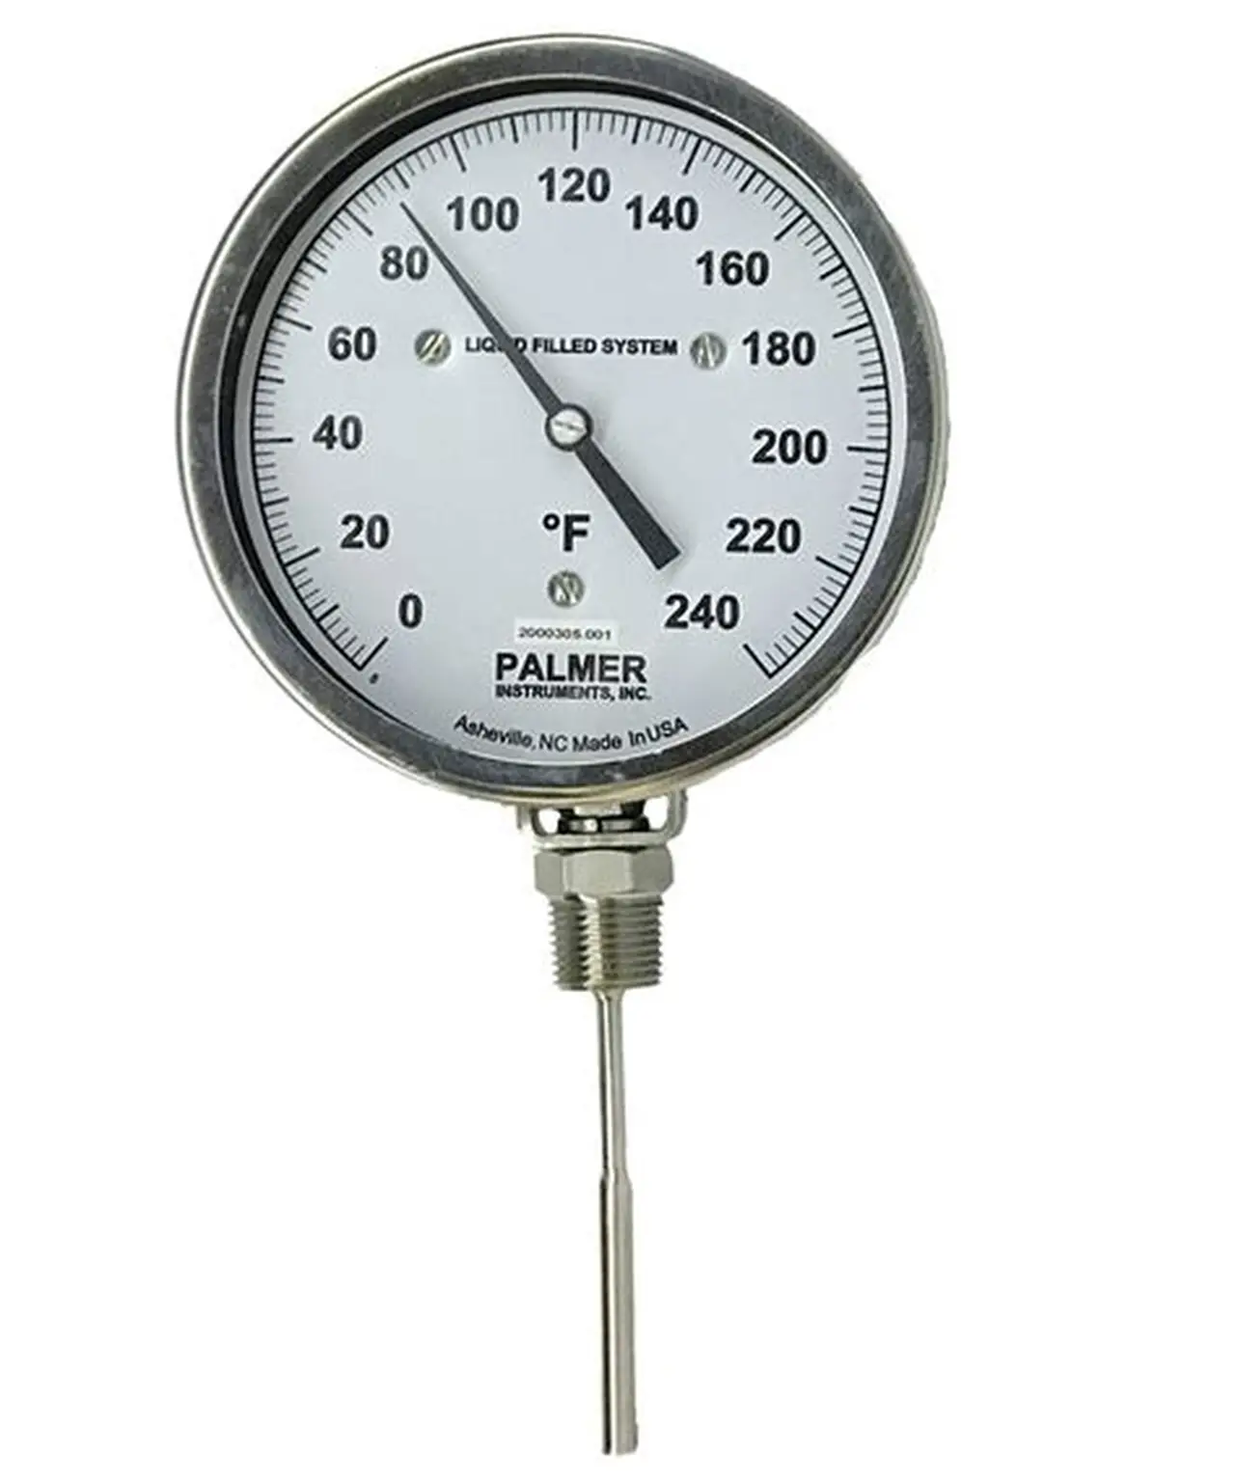
Dial Thermometers
Clean and disinfect the probe before and after every use
Wait until the display stops changing
Take the reading once the temperature stabilizes

Slide 30
Monthly Probe Thermometer Checks
Calibration
In‑House Accuracy Checks
Iced Water Test
Boiling Water Test
Notes:
Monthly probe thermometer checks.
Thermometers are only useful if they give correct readings. Monthly checks help ensure the thermometer is working properly so food is always cooked, cooled, and stored safely.
Calibration.
This is the most accurate way to verify a thermometer’s performance.
A specialist laboratory tests the thermometer using precise equipment.
After testing, the lab provides a calibration certificate confirming the thermometer’s accuracy.
This certificate is important for audits and food‑safety compliance.
External calibration is usually done once a year, but monthly in‑house checks help maintain confidence between lab visits.
In‑house accuracy checks
These simple tests can be done on‑site to make sure the thermometer is still reading correctly.
Iced water test
Place the probe into a container of iced water (a mix of ice and a little water).
The thermometer should read between −0.5 degrees celsius and +0.5 degrees celsius.
If the reading is outside this range, the thermometer may be inaccurate and should be recalibrated or replaced.
Boiling water test.
Place the probe into boiling water.
The reading should be between 99.5 degrees celsius and 100.5 degrees celsius.
If it falls outside this range, the thermometer is not reliable and needs recalibration or replacement.

Slide 31
Unit 7 Recap Questions
1. What is traceability?
2. Why must probe thermometers be calibrated?
3. Name two details required on food labels.
4. What should happen to recalled food products?
5. Why is supplier approval important?

Slide 32
Unit 7 Scenario Activity
A customer reports illness after eating a chicken dish and management cannot identify the supplier batch.
• Why is traceability important in this situation?
• What records should be checked?
• What corrective actions should management take?
• How could this issue have been prevented?

