Slide 1
Unit 4: Cleaning
On completion of this unit, learners will be able to:
Distinguish between the different types of cleaning chemical and how they should be used,
List the 5 steps in the deep cleaning process,
Ensure the safe storage of cleaning chemicals,
Implement corrective actions when required,
Complete documentation in relation to cleaning.
Notes:
Unit 4. Cleaning.
On completion of this unit, learners will be able to:
Distinguish between the different types of cleaning chemical and how they should be used,
List the 5 steps in the deep cleaning process,
Ensure the safe storage of cleaning chemicals,
Implement corrective actions when required, and,
Complete documentation in relation to cleaning.

Slide 2
Cleaning
Removing visible dirt, including Food residues, Grease, Spills and General dirt.
Benefits:
Prevents food poisoning
Keeps the workplace safe
Keeps food safe
Notes:
Cleaning.
Cleaning means removing visible dirt, including food residues, grease, spills and general dirt.
It is a physical process. If a surface looks dirty, it cannot be disinfected properly because dirt blocks the disinfectant from reaching bacteria.
Cleaning is essential because:
It prevents food poisoning.
Proper cleaning and disinfection reduce harmful bacteria to safe levels.
It keeps the workplace safe.
Cleaning must happen throughout the day, not just at closing time. This prevents build ups of dirt, spills, and bacteria.
It keeps food safe.
Clean surfaces prevent cross contamination between raw and ready to eat foods.
Cleaning isn’t just about hygiene, it protects the business, the staff, and the customer.

Slide 3
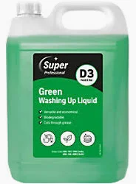
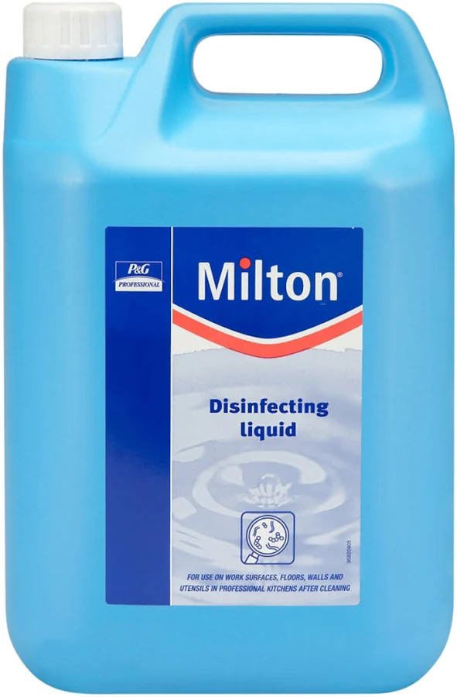
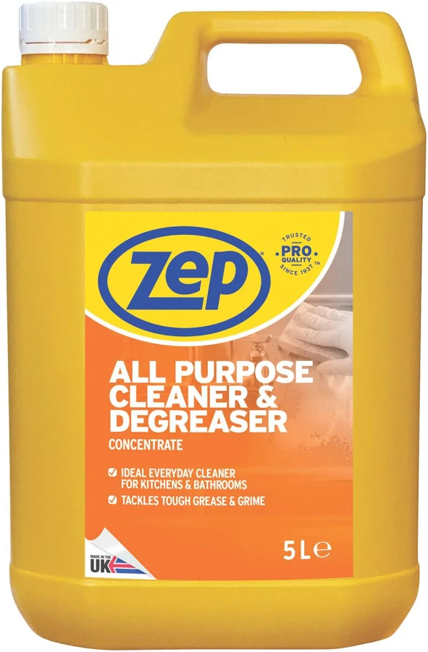
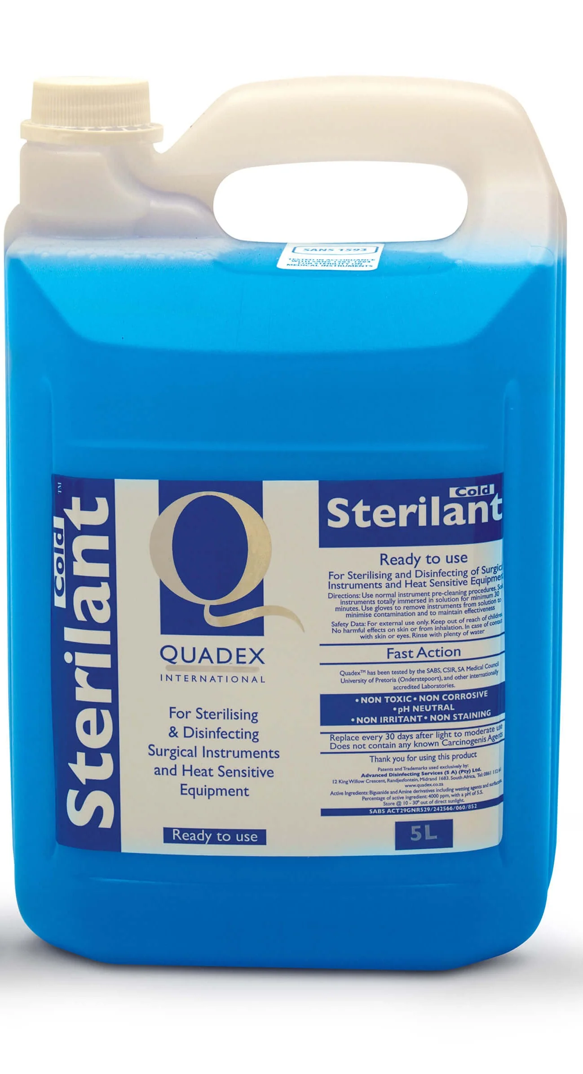
Types of Chemicals in a Food Business
Detergent
Disinfectant
Sanitiser
Notes:
Types of chemicals in a food business.
There are four categories of chemicals in a food business. Each one has a different purpose, and using the wrong one can lead to poor cleaning, unsafe food, or legal non compliance.
Detergent.
• This removes dirt, grease, and food residues
• It does not kill bacteria.
It is used for everyday cleaning (mild detergents) and heavy-duty jobs like ovens, grills, and fryers (strong degreasers).
Cleaning must happen before disinfection because disinfectants don’t work on dirty surfaces.
Disinfectant.
This reduces bacteria to a safe level. It does not kill all bacteria.
• Disinfectants do not work properly on dirty surfaces.
• Heat over 82 degrees Celsius or steam can also act as a disinfectant.
• Follow instructions for correct dilution and contact time.
An example is milton works as a disinfectant when mixed correctly and left for 5 minutes.
Sanitiser.
• This is a detergent + disinfectant combined
• It removes dirt and reduces bacteria
• Follow manufacturer instructions.
• It needs contact time to work
• It should be used twice, first to remove dirt, second to kill bacteria.
An example is a multi purpose cleaner which removes grease and kills germs.
Sterilant.
•
• This kills or permanently inactivates all bacteria, fungi, viruses, and spores.
• It is the strongest type of chemical control,
• Milton becomes a sterilant if left on a surface for 15 minutes.
Using the right chemical for the right job is essential for:
• Preventing food poisoning,
• Meeting legal requirements,
• Keeping equipment safe and hygienic, and,
• Ensuring disinfectants and sanitisers actually work.

Slide 4
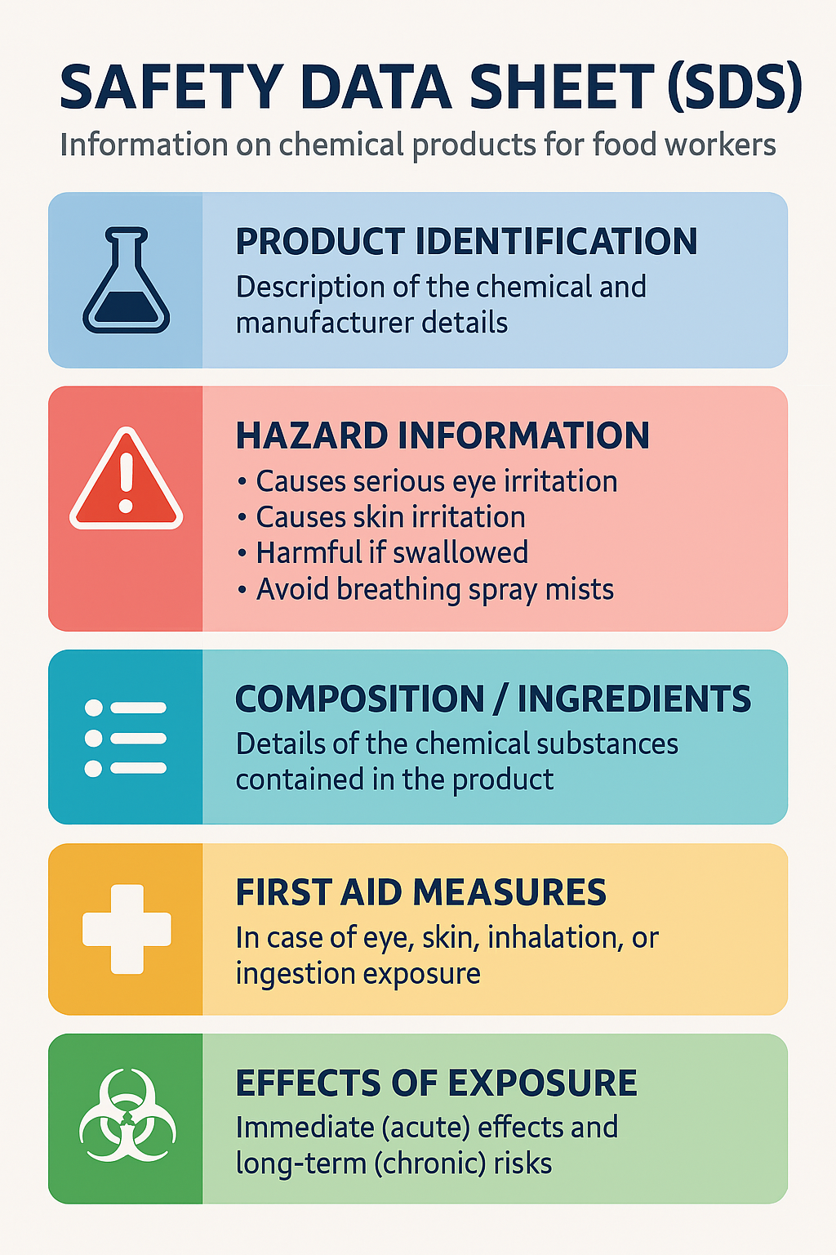
Using Chemicals
Dilution Rate
Contact Time
Industrial Cleaning Chemicals
Chemical Training essential
Appropriate PPE
Notes:
Using chemicals.
All chemicals used in food areas must be food grade, non perfumed, nontoxic, and always used according to the manufacturer’s instructions. Incorrect use leads to unsafe food, ineffective cleaning, and legal risks. chemicals must be food grade, they must be stored away from food and staff must know how to mix them and how long to leave them on surfaces.some chemicals also require rinsing after use, depending on the product.
Dilution rate.
Many cleaning chemicals come in concentrated form. They must be diluted with water before use.
If too much water is used, the chemical becomes too weak and won’t clean or disinfect properly
If too oo little water, the chemical becomes too strong and may damage surfaces or leave unsafe residues
This is why following the manufacturer’s instructions is essential.
Contact time.
Contact time is the period the chemical must remain on the surface to remove dirt and grease and kill or reduce bacteria.
If the chemical is wiped off too soon, it cannot work effectively. This applies to disinfectants and sanitisers in particular.
Industrial cleaning chemicals.
Staff must be trained in how to use each chemical, how to store chemicals safely and what safety precautions to take such as gloves and ventilation.
When industrial chemicals are used, a safety data sheet (sds) must be available. The sds explains what to do in case of spills, skin contact, eye exposure, inhalation and accidental ingestion.
This ensures staff can respond safely to any chemical incident.
Using chemicals incorrectly can lead to ineffective cleaning, surfaces that still contain .

Slide 5
Deep Cleaning
Deep Cleaning
1-Step Cleaning Process
Step 1: Pre-Clean by rinsing with water
Step 2: Main Clean using detergent
Step 3: Rinse
Step 4: Disinfect
Step 5: Air Dry
Wipe with sanitiser and clean cloth
Contact time
Airdry
Notes:
Deep cleaning.
Deep cleaning is a systematic process used to remove hidden dirt, grease, and bacteria from food preparation areas and equipment. It goes beyond routine cleaning and is essential for maintaining hygiene and preventing food poisoning. The following is a 5-step process to deep cleaning.
Step 1: pre-clean.
Remove loose debris, dirt, and grime.
Unplug and dismantle equipment safely.
This prepares the surface and exposes hidden areas for thorough cleaning.
Step 2: main clean.
Wash with hot water and detergent.
Clean all corners, crevices, and hard-to-reach areas
This removes grease and visible contamination.
Step 3: rinse.
Rinse with clean water to remove detergent and loosened dirt
This step is essential before disinfection. Disinfectants don’t work on dirty surfaces.
Step 4: disinfect.
Use steam or chemical disinfectant.
Apply for the correct contact time.
Rinse if required by the product instructions
This reduces bacteria to a safe level
Step 5: air dry.
Air dry where possible.
If not, use a paper towel and dispose of it in a bin.
Drying prevents bacteria from spreading on wet surfaces.

Slide 6
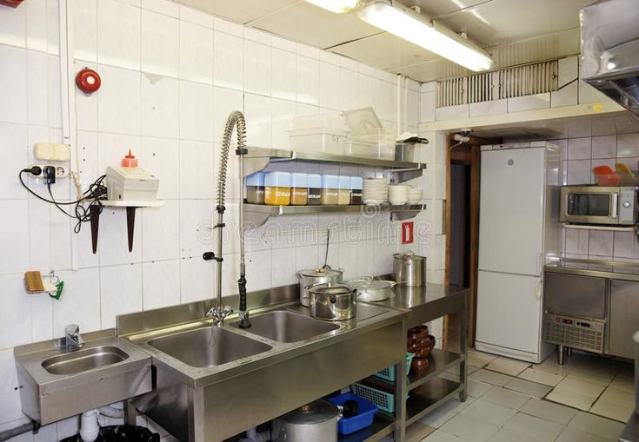
Wash-Up Area
Required Facilities
Double sink with drainer or sanitising washer
Drop-off area
Draining area
Hygiene Rules
• No crossover between clean and dirty items
• High-pressure hoses must not cause contamination
• Food waste must be removed regularly
Notes:
Wash-up area.
Wash-up areas must be well organised to prevent cross-contamination between dirty and clean items. This is especially important in busy kitchens where dishes, utensils, and equipment are constantly in use.
Required facilities.
The wash-up area must include:
• A double sink with drainer for washing and rinsing separately (or a dishwasher plus a deep single sink with drainer)
• A drop-off area for scraping, stacking, and storing dirty items before washing
• A draining area for air drying clean items after washing — this prevents bacteria from spreading on wet surfaces
Hygiene rules.
• No crossover between clean and dirty items dirty dishes must never touch clean ones — this is a key food safety principle
• High-pressure hoses must not cause contamination spray from hoses can spread bacteria if used carelessly
• Food waste must be removed regularly, at least daily waste attracts pests and increases the risk of cross-contamination

Slide 7
Storage of Cleaning Materials
Store chemicals safely
Colour coded cleaning equipment
Care of mops, buckets, and tools
Mops must be clean after use and hung to air dry
Cleaning cloths and scrubbing tools
Notes:
Storage of cleaning materials.
The following are the essential rules for storing chemicals and cleaning tools in a food business. The goal is to keep food safe, prevent accidents, and ensure cleaning equipment does not become a source of contamination.
Store chemicals safely.
Chemicals must be stored away from food kept in a locker area or ventilated sluice room and clearly labelled.
Colour‑coded cleaning equipment.
Colour coding helps prevent cross‑contamination. For example:
Red for toilets,
Blue for general areas,
Green for food preparation areas, and,
Yellow for washrooms.
Separate equipment must be provided for toilets, public areas, and external areas.
Care of mops, buckets, and tools.
To prevent bacteria growth, mops and buckets must be cleaned after use, buckets must be emptied out and equipment must be stored dry to prevent mould and smells.
Cleaning cloths and scrubbing tools.
Cloths, pot scrubs, and similar items must be clean and sanitised after use, disposed of if single‑use and washed in a hot washing machine cycle. A hot cycle kills bacteria and disinfects cloths
Cloths should not be worn on the person such as tucked into aprons or pockets. This spreads bacteria and looks unprofessional.

Slide 8
Cleaning After a Vomiting or Diarrhoea Incident
Cover the Area
Clear All Personnel
Cordon Off the Area
Call the Trained Staff Member
Clean and Decontaminate the Area
Notes:
Cleaning after a vomiting or diarrhoea incident,
Vomiting and diarrhoea can spread millions of infectious particles. Cleaning must be immediate, controlled, and thorough to prevent contamination of food, staff, and customers.
1. cover the area.
• Place paper towels or absorbent material over the spill. This prevents splashing and limits the spread of infectious particles.
2. clear all personnel.
• Remove staff, customers, and anyone nearby. This reduces the risk of airborne or surface contamination.
3. Cordon off the area.
• Block access using signs or barriers. This ensures no one walks through the contaminated zone.
4. Call the trained staff member.
• Only trained staff should carry out this type of cleaning. They must know the correct ppe, chemicals, and procedure.
5. Clean and decontaminate the area.
Clean a 3 metre radius. Norovirus can spread several metres from the original incident.
Use separate equipment, a dedicated mop, bucket and dustpan these must not be used for normal cleaning afterwards.
Disinfect heavily soiled area. Use appropriate disinfectant. Follow correct contact time
Wear disposable ppe such as gloves and apron. Dispose of ppe immediately after use.
Use heat where possible. Steam clean or wash surfaces at over 60 degrees celsius. Soft furnishings such as cushions and fabric must also be cleaned.

Slide 9
Cleaning Documentation
Follow the cleaning schedule
Document the area you cleaned on the daily cleaning record
Supervisor must monitor the quality of cleaning
Swab samples may be taken to verify the quality of cleaning.
Cleaning effectiveness is included in the hygiene inspection checklist

Slide 10
Unit 4 Cleaning – Recap Questions
1. What is the difference between cleaning and disinfecting?
2. Why is contact time important when using chemicals?
3. List the 5 steps of deep cleaning.
4. Why should chemicals be stored away from food?
5. What should happen after a vomiting incident?

Slide 11
Cleaning Scenario Activity
A food preparation area still smells strongly of chemicals after cleaning.
• Identify the food safety hazard.
• What may have gone wrong during cleaning?
• What corrective actions should be taken?
• What documentation should be completed?

