Slide 1
Unit 2
Introduction to HACCP

Slide 2
Introduction to HACCP
Learning Outcomes
On completion of this unit, you will be able to:
Explain the structure of a Food Safety Management System
List the prerequisites of a food business
Identify the key elements of HACCP
List the seven principles of HACCP

Slide 3
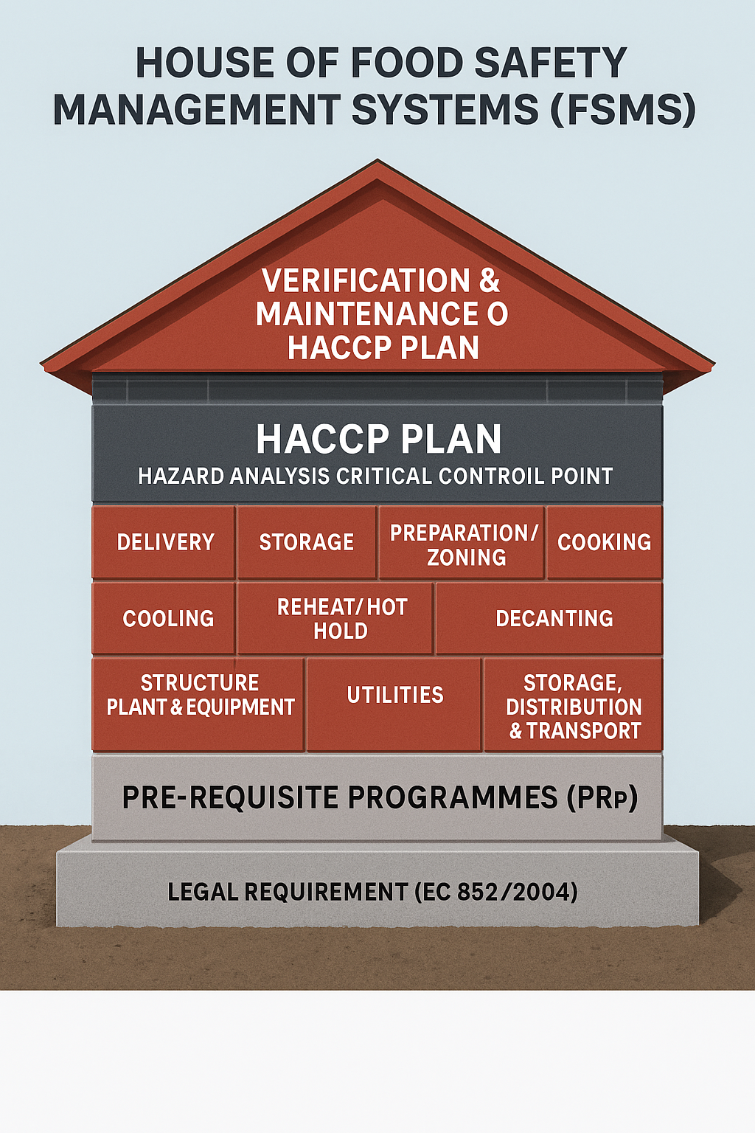
The House of Food Safety Management Systems
The Foundations. Pre Requisite Programmes (PRPs).
The Walls: HACCP Controls at Each Process Step
The Roof: Verification & Maintenance of the HACCP Plan
Notes:
The house of food safety management systems (fsms).
The “house” shows that food safety is a structure. It only stands strong when every part is in place.
The foundations: pre requisite programmes (prps).
These are the basic hygiene and operational conditions that must exist before haccp can work. They support the whole system.
Prps include: personal hygiene & training, cleaning & sanitation, layout & design of premises, water & ice, pest control, waste management, supplier control & traceability and equipment, maintenance & utilities.
If these foundations are weak, haccp will fail, just like a house built on sand.
The walls: haccp controls at each process step.
These are the specific controls applied to each stage of food production. They form the “walls” that protect the consumer.
The key operational steps: delivery, storage, preparation, cooking, cooling, reheating, service, decanting, thawing, cold chain maintenance, production planning, traceability, waste management, pest control, cleaning, personnel, structure, plant & equipment and storage, distribution & transport.
Each step must be assessed for hazards and controlled using the 7 principles of haccp.
The roof: verification & maintenance of the haccp plan.
The roof protects the whole system. This includes verification through audits, thermometer accuracy checks, hygiene inspections, review of haccp plans, updating documentation, maintaining records and ensuring the system continues to work as intended.
Without the roof, the house is exposed, meaning food safety risks can enter the system.
Legal requirement.
Every food business must have a food safety management system based on haccp principles. This is a legal obligation, not optional.

Slide 4
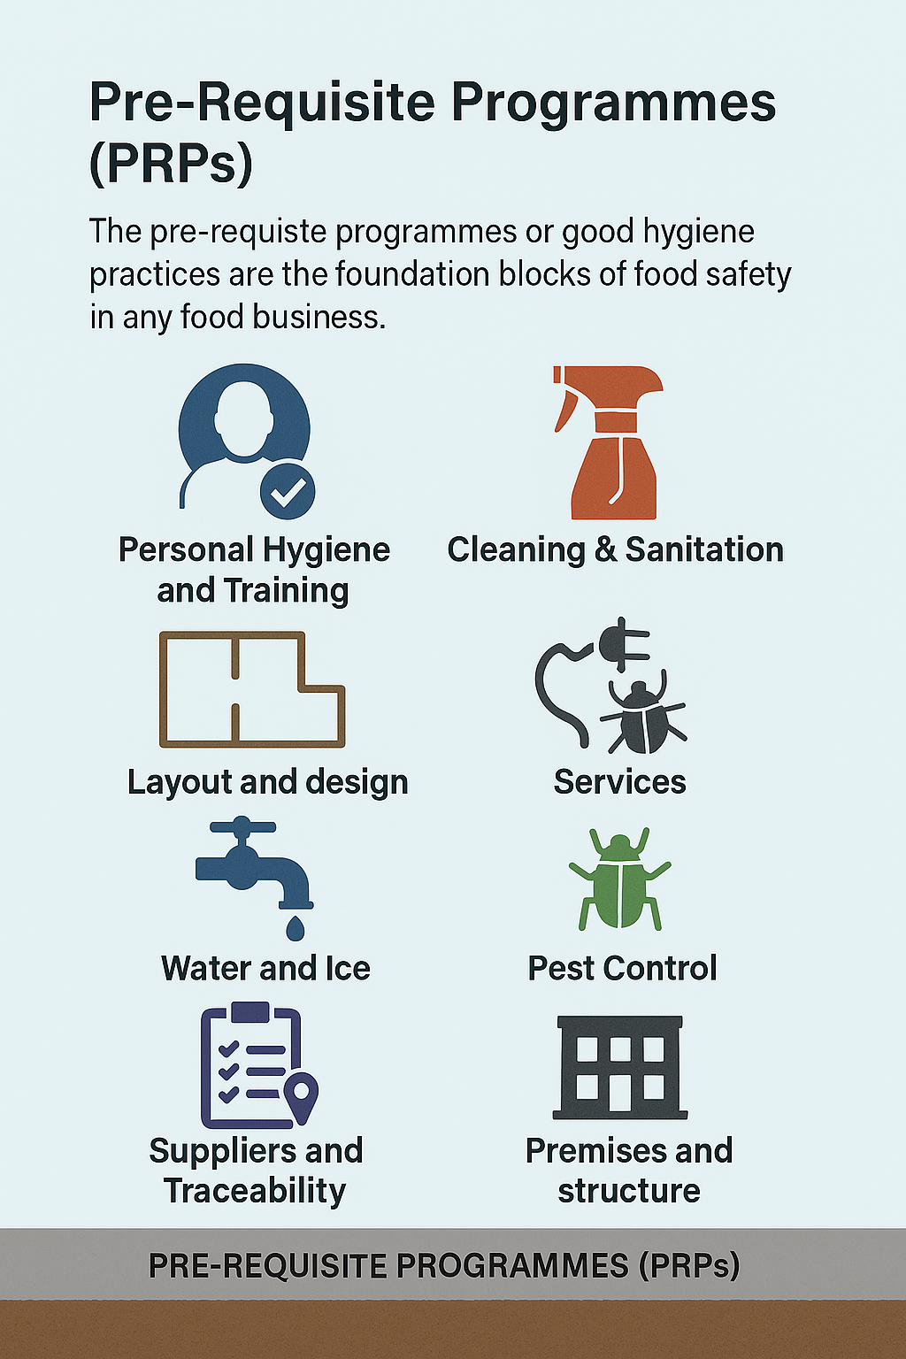
Pre Requisite Programmes (PRPs)
Personal Hygiene & Training
Cleaning & Sanitation
Layout and Design
Services
Water and Ice
Pest Control
Waste Management
Suppliers & Traceability
Premises and Structure
Notes:
Pre requisite programmes (prps).
Prps are the basic hygiene and operational conditions that must be in place before a food business can implement a haccp plan. They’re not optional extras. They’re the minimum standards required to run a safe food business. In the house analogy, prps are the concrete foundation. If they’re weak or missing, the haccp “walls” above will collapse.
The following are key prps that every food business must manage:
Personal hygiene & training. This ensures staff understand and follow hygiene rules to prevent contamination.
Cleaning & sanitation. This prevents cross-contamination and microbial growth on surfaces and equipment.
Layout and design. This supports safe workflow and zoning to separate raw and cooked areas.
Services. This includes ventilation, lighting, and drainage. All must support hygiene.
Water and ice. This must be potable and safe for food contact.
Pest control. This prevents contamination from rodents, insects, and birds.
Waste management. This ensures safe disposal of food waste and prevents attraction of pests.
Suppliers & traceability. This ensures ingredients are safe and traceable in case of recall.
Premises and structure. This the building itself must be cleanable, well-maintained, and suitable for food operations.

Slide 5
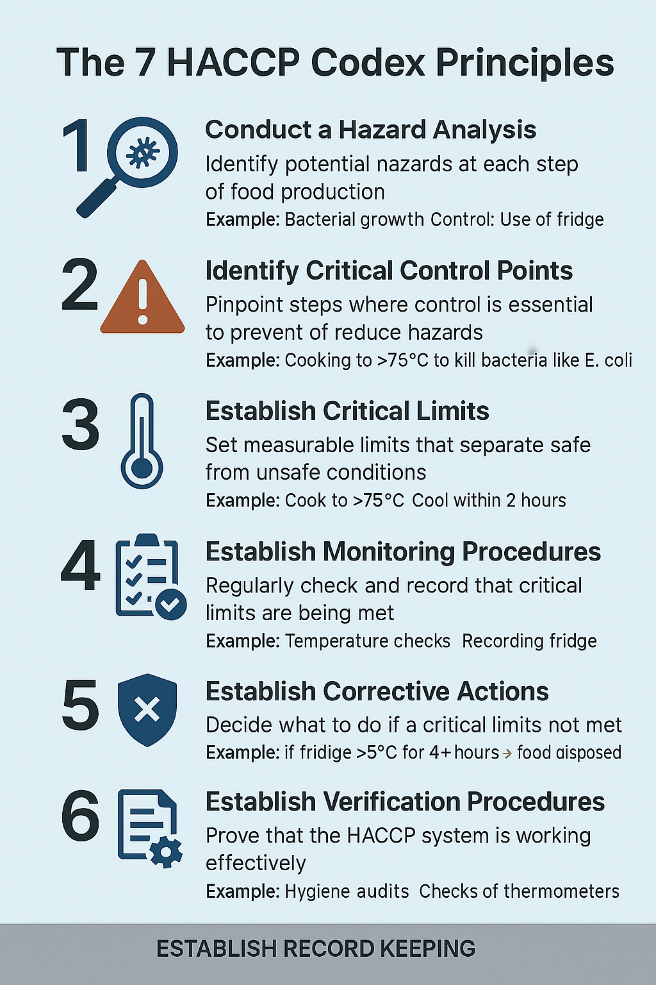
The 7 HACCP Codex Principles
1. Conduct a Hazard Analysis
2. Identify Critical Control Points (CCPs)
3. Establish Critical Limits
4. Establish Monitoring Procedures
5. Establish Corrective Actions
6. Establish Verification Procedures
7. Establish Record Keeping
Notes:
The 7 haccp codex principles.
The 7 haccp codex principles helps food businesses produce safe, wholesome food and comply with ec 852/2004.
1. Conduct a hazard analysis.
Identify potential hazards at each step of food production. For example:
Hazard: bacterial growth.
• Control: use of fridge to keep food cold.
2. Identify critical control points (ccps).
Pinpoint steps where control is essential to prevent or reduce hazards. For example:
• Cooking to >75 degrees Celsius to kill bacteria like e. Coli.
3. Establish critical limits
What to do: set measurable limits that separate safe from unsafe. Example:
• Cook to >75 degrees Celsius.
• Cool within 2 hours.
• Refrigerate below 5 degrees Celsius.
4. Establish monitoring procedures.
Regularly check and record that critical limits are being met. Examples include:
• Temperature checks and, recording fridge and cooking temperatures.
5. Establish corrective actions.
Decide what to do if a critical limit is not met. For example:
• If fridge temperature >5 degrees Celsius for 4 or more hours, food must be disposed of.
6. Establish verification procedures.
Prove the haccp system is working effectively. Examples include hygiene audits and accuracy checks of thermometers.
7. Establish record keeping.
Keep documentation to show food safety is being managed. Examples include safe catering haccp system, temperature logs and corrective action records.

Slide 6
Documents Versus Records in Food Safety
Documents
Documents are plans, procedures, and instructions
Records
Records are proof that something was done
Notes:
Documents versus records in food safety.
Though they sound similar, documents and records serve very different purposes in a food safety management system.
Documents.
Documents are plans, procedures, and instructions created before something is done.
Examples include haccp plan, cleaning schedule, temperature monitoring procedure and supplier approval checklist.
Documents are created in advance, can be revised and updated and tell staff what to do.
Records.
Records are proof that something was done. They are created after the activity takes place.
Examples include:
Temperature logs, cleaning records, delivery checks and corrective action forms.
Records must not be changed, must be signed and dated, must be legible and traceable, can be handwritten (in biro) or electronic (non-editable) and must be retained for a specific time.
The success of the HACCP/food safety management systems depends on the facilities and the teamwork of management and staff to ensure that the system is implemented, monitored and
adhered to.

Slide 7
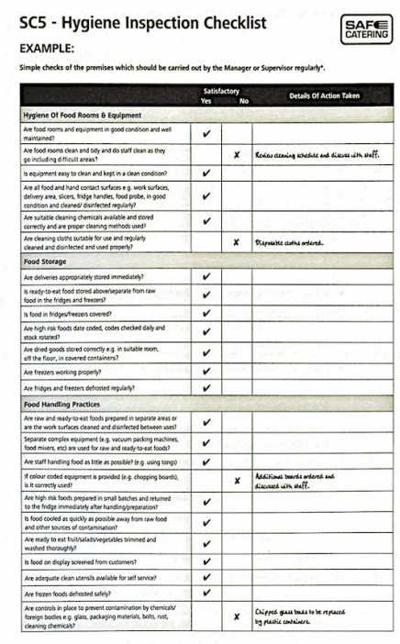
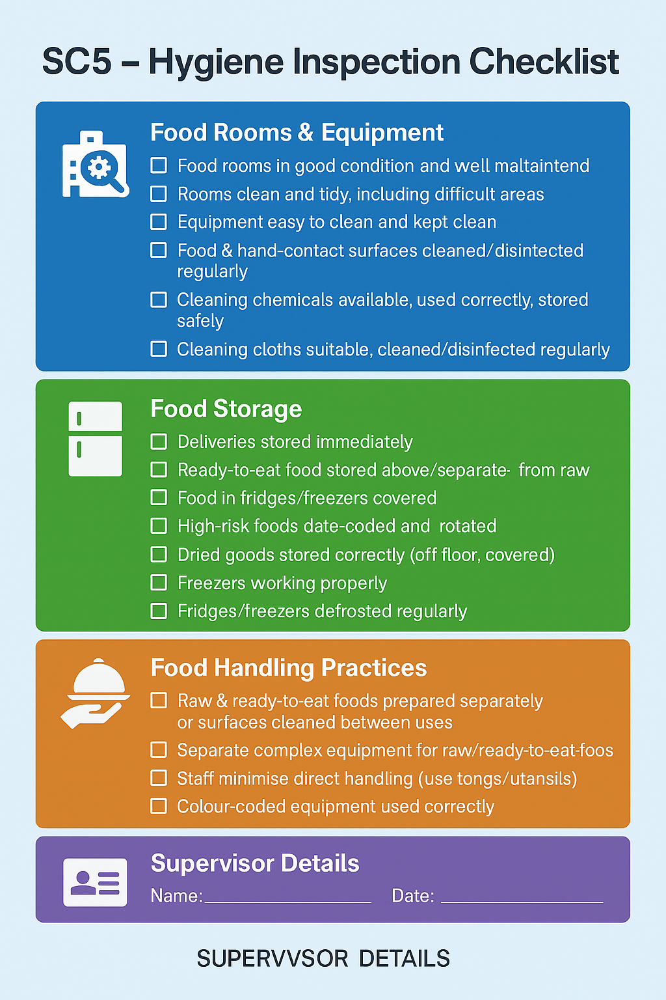
Notes:
This is an example of a Hygiene Inspection Checklist.

Slide 8
Unit 2 Recap Questions
1. What does HACCP stand for?
2. Name two Pre-Requisite Programmes (PRPs).
3. What is a Critical Control Point (CCP)?
4. Why are records important in food safety?
5. Give one example of a corrective action.

Slide 9
Unit 2 HACCP Scenario
A fridge temperature is recorded at 10°C during service.
• Identify the hazard.
• Is this a CCP issue?
• What corrective action should staff take?
• What record should be completed?

Slide 10
Unit 3 Personal Hygiene
On completion of this unit, learners will be able to:
Identify the importance of personal hygiene for food safety,
Identify poor personal hygiene practices,
List the food handlers’ legal and personal responsibilities,
Implement corrective actions when required,
Recognise the benefits of training for both the food worker and the business.
Notes:
Personal Hygiene.
On completion of this unit, learners will be able to:
Identify the importance of personal hygiene for food safety,
ldentify poor personal hygiene practices,
List the food handlers legal and personal responsibilities,
Implement corrective actions when required, and,
Recognise the benefits of training for both the food worker and the business.

Slide 11
Conditions That Must Be Reported
Vomiting or diarrhoea
Gastrointestinal illness while abroad
Boils or infected wounds
Skin infections on hands, face, forearms
Flu, coughing, mouth/throat/ear/eye infections
Pus from eyes, ears, nose, mouth, gums
Hepatitis A
VTEC, Typhoid, Paratyphoid, Shigella dysenteriae
Travel to Hepatitis outbreak area
Notes:
Conditions that must be reported to a supervisor.
Food workers can carry harmful bacteria and viruses without knowing it. These can easily transfer to food, equipment, or surfaces, leading to food poisoning outbreaks.
Common pathogens carried by food workers include staphylococcus aureus,. E. Coli and viruses like norovirus.
Anyone suffering from or carrying a disease that could be transmitted through food must not handle food or enter food areas.
The following are conditions that must be reported and the actions required.
Vomiting or diarrhoea. Stay off work until symptom-free for 48 hours or cleared by gp.
Gastrointestinal illness while abroad. Report this on return to work.
Boils or infected wounds. This must be covered or excluded.
Skin infections on hands, face, forearms. This may require exclusion.
Flu, coughing, mouth/throat/ear/eye infections. Assess the risk of transmission.
Pus from eyes, ears, nose, mouth, gums. Exclude until resolved.
Hepatitis a. Exclude for 7 days after jaundice/symptoms begin.
Vtec, typhoid, paratyphoid, shigella dysenteriae. This must be cleared by doctor before returning.
Travel to hepatitis outbreak area. This may require medical clearance.

Slide 12
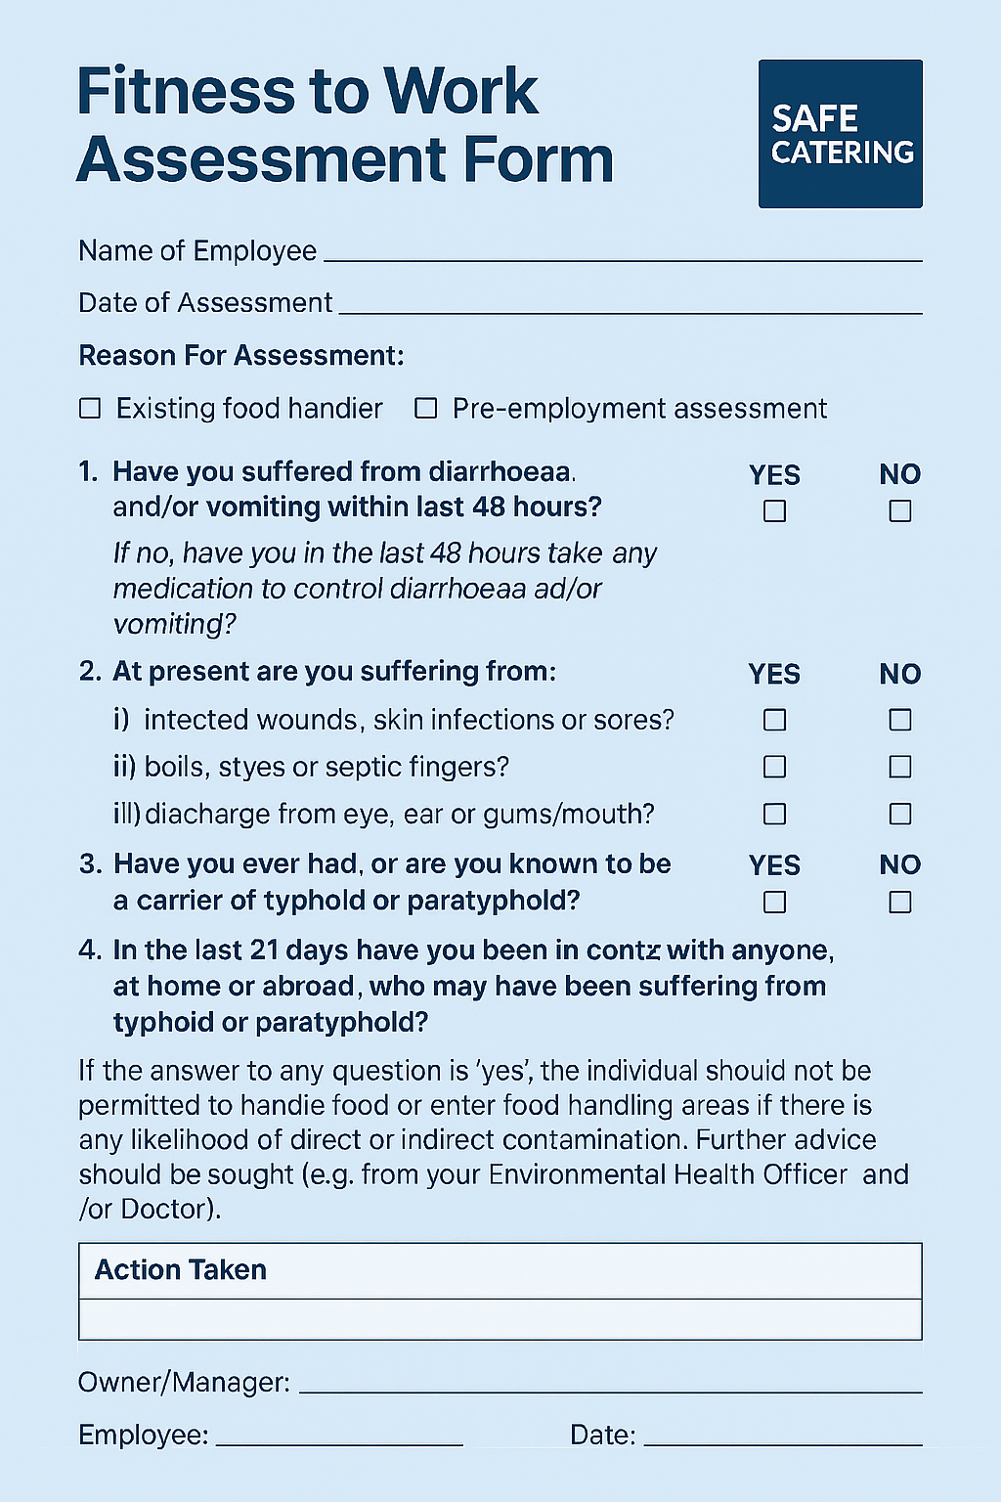
Personal Hygiene & Fitness to Work
Medical Questionnaire / Fitness to Work
Cuts, Sores & Burns
Legal Responsibilities of Food Workers.
Notes:
Personal hygiene & fitness to work.
Medical questionnaire & fitness to work.
Before starting work in a food business, even if it’s temporary, staff must complete a medical questionnaire. This helps protect customers and colleagues.
All new staff, including temporary, must complete a medical questionnaire or screening.
The form asks about, allergies, personal medication and medical conditions that may affect food safety.
Cuts, sores & burns.
Any cuts, sores, or burns must be covered with a bright blue waterproof plaster. First aid boxes must be checked and refilled regularly. Staff must notify management if items need replacing
Legal responsibilities of food workers.
Food workers have both a legal and moral duty to protect food from contamination. This isn’t just about doing the right thing, it’s the law.
They must not contaminate food. This is a legal and moral duty and follow food safety instructions from supervisors & managers. They can face fines up to €5000 or 3 months in jail for breaches.
Regulation ec 852/2004 requires food handlers to be supervised, instructed, and/or trained in hygiene.

Slide 13
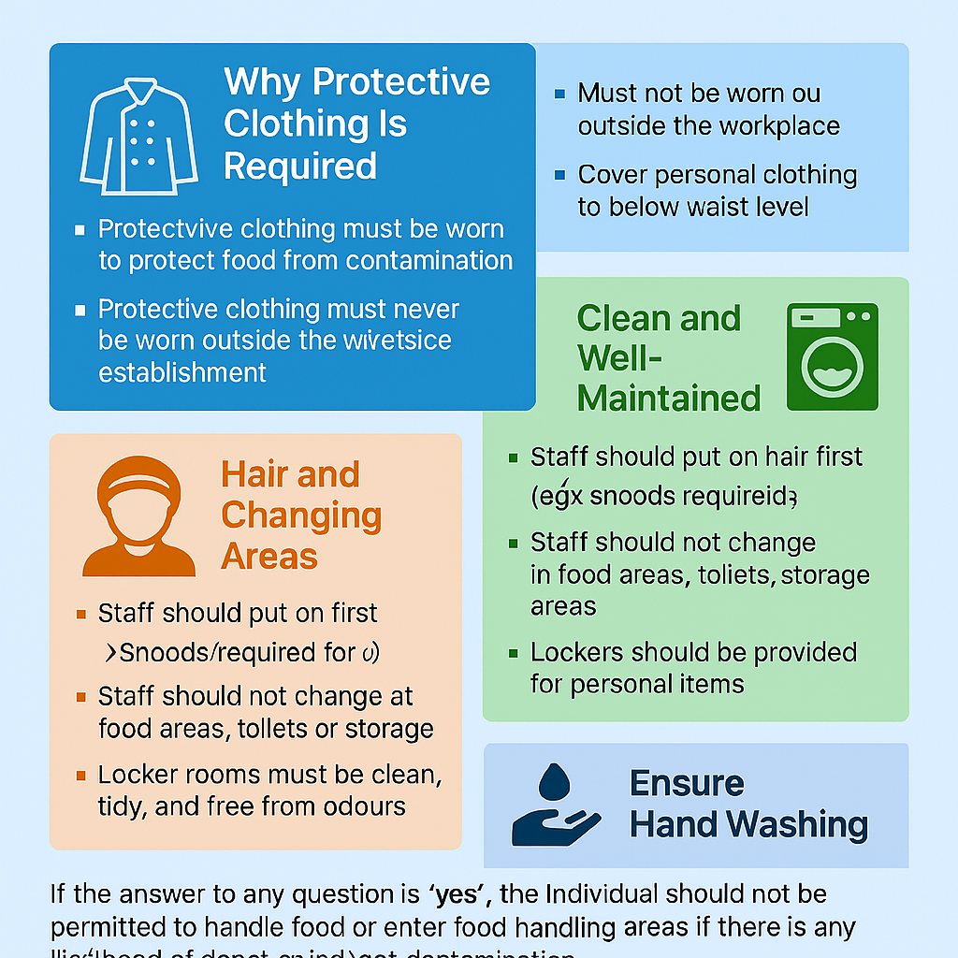
Protective Clothing & Uniforms
Design & Maintenance
Hair & Changing Areas
Handwashing Reminder
Jewellery & Grooming Rules
Notes:
Protective clothing & uniforms.
Protective clothing isn’t just about looking professional, it’s about protecting food from contamination. It creates a barrier between personal clothing and food.
• Protective clothing must be worn in food areas, must not be worn outside the workplace or to/from work and must cover personal clothing to below waist level.
Design & maintenance.
Protective clothing must be designed to prevent contamination and show when it’s dirty.”
• It should be light in colour to show up dirt. No external pockets or buttons as they can fall into food and must be clean, in good condition, and changed daily or as needed.
Hair & changing areas.
Hair and personal items can also contaminate food. Hair shall be maintained in a clean and tidy condition. Hair covering shall be worn where there is a risk of contamination of food. Hair nets should cover all the hair.
• Hair protection must be put on first.
• Snoods may be needed for facial hair.
• Staff must not change in food prep areas, toilets, or storage areas.
• Lockers must be provided for outdoor clothing and personal items.
• Locker rooms must be clean, tidy, and free from odours.
Handwashing reminder.
Protective clothing is only effective if paired with proper hand hygiene.
• Staff must wash hands before putting on protective clothing.
• Handwashing must be done frequently and correctly.
Jewellery & grooming rules.
To prevent contamination, food workers must follow strict grooming standards:
• No jewellery except a plain wedding band and sleeper earrings is allowed.
• Nails must be clean, short and free from nail varnish or gel.
• False eyelashes should be avoided.
• Piercings must be removed or securely covered.
Hair.
These rules help prevent physical contamination and support good hygiene.
Opportunity here to identify how their
partner is noncompliant to work in
food preparation area.

Slide 14
Correct Sequence When Putting on a Uniform
Hand Hygiene
Hair protection first
Clean protective clothing
Apron or outer layer
4. Wash hands thoroughly
Notes:
Correct sequence when putting on a uniform.
Learners should follow this order to reduce contamination risk:
1. Hair protection first with Hairnet and snood for facial hair.
2. Clean protective clothing must cover personal clothes to below waist.
3. Apron or outer layer if used.
4. Wash hands thoroughly before entering food areas.
This sequence ensures that hair and personal clothing are fully covered before food handling begins.

Slide 15
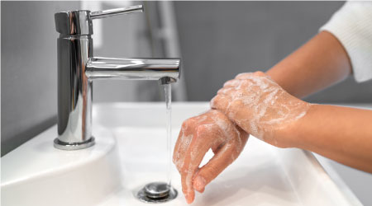
Hand Washing Facilities
A clean, hand wash only sink
Hot and cold running water
Hands free taps
Liquid soap in dispensers
Safe drying options
A pedal operated, lidded bin
Nail brushes
Notes:
Hand washing facilities.
Handwashing is one of the most important actions a food worker can take to protect both themselves and customers. The surrounding page emphasises that even perfect technique won’t work unless the right facilities are available.
The following are the essential features of a proper handwashing station:
A clean, hand wash only sink.
This sink must be used only for washing hands, not for food, equipment, or cleaning cloths. This prevents cross contamination.
Hot and cold running water.
A constant supply is required so staff can wash hands effectively at any time.
Hands free taps.
Foot, knee, electronic, or pedal operated taps reduce the risk of re contaminating clean hands.
Liquid soap in dispensers.
These must be non perfumed.
Bars of soap are not allowed because they harbour bacteria.
Safe drying options.
Paper towels or cabinet roller towels.
Never use tea towels or kitchen cloths. They spread bacteria.
A pedal operated, lidded bin.
This allows safe disposal of paper towels without touching the bin lid.
Nail brushes
These should be avoided unless they are kept clean and disinfected.
If hot water, liquid soap or paper towels are not available, this must be reported to management. Do not start work until hands are clean

Slide 16
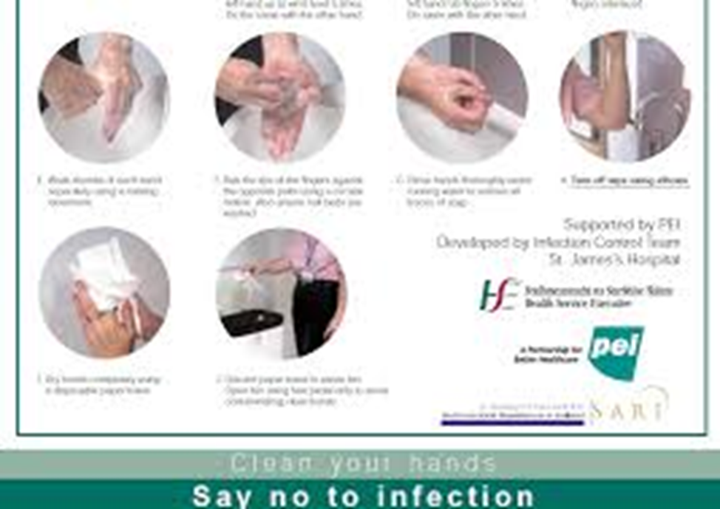
Hand Washing Technique
1. Remove all jewellery
2. Wet hands thoroughly
3. Apply liquid soap
4. Lather vigorously for 20 secs
5. Rinse hands thoroughly
6. Dry hands thoroughly
7. Bin the towel
Practice Correct Hand Hygiene
Notes:
Hand washing technique.
Handwashing is one of the most important food safety controls. Poor technique leads to cross contamination, food poisoning, and breaches of hygiene law.
The following is the correct sequence for effective handwashing, which is essential for preventing cross contamination in food businesses. The workbook emphasises that even with good facilities, technique is what actually removes bacteria, viruses, dirt, and grease from hands.
1. Remove all jewellery.
Jewellery traps dirt and bacteria and prevents proper cleaning of the skin underneath. Removing it ensures every part of the hand can be washed effectively.
2. Wet hands thoroughly.
Water helps spread the soap evenly and prepares the skin so the soap can lift dirt and microbes.
3. Apply liquid soap.
Liquid soap is required because bar soap can harbour bacteria. Soap helps break down oils and contamination on the skin.
4. Lather vigorously for 20 seconds.
This is the most important step. The workbook includes a chart showing how to rub palms, backs of hands, between fingers, thumbs, fingertips, and wrists. The 20 second lathering time ensures all surfaces are cleaned properly.
5. Rinse hands thoroughly.
Rinsing removes the loosened dirt, grease, and microorganisms. Poor rinsing leaves residue that can still contaminate food.
6. Dry hands thoroughly.
Wet hands transfer bacteria more easily than dry hands. Paper towels or roller towels must be used — never tea towels or cloths, which spread contamination.
7. Bin the towel.
If taps are not hands free, the towel is used to turn them off so clean hands don’t touch a contaminated surface. Afterwards, the towel is disposed of in a pedal operated lidded bin.

Slide 17
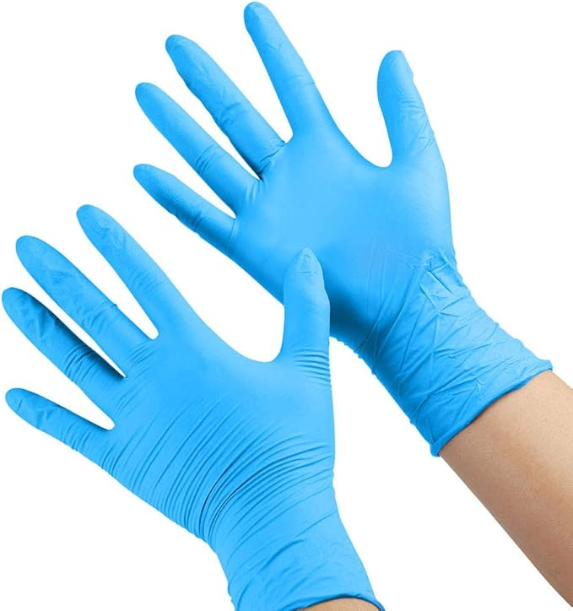
Disposable Gloves
Wash hands before putting on gloves
Only wear gloves for short periods
Change gloves after each task
Gloves cannot be reused
Use vinyl gloves, not latex
Notes:
Disposable Gloves.
Gloves can protect food from contamination, but only when used correctly. Gloves can give a false sense of security. If used incorrectly, they can spread contamination faster than bare hands. Gloves are not a replacement for good hand hygiene; they are an additional control.
The following are precautions to take with gloves.
Wash hands before putting on gloves.
Even clean gloves can become contaminated if hands are dirty.
Handwashing removes bacteria, viruses, and dirt before the glove goes on.
Only wear gloves for short periods.
Gloves make hands sweat, which encourages bacterial growth.
Wearing them too long creates a warm, moist environment where microbes multiply.
Change gloves after each task.
This prevents cross‑contamination.
Examples include changing gloves after Handling raw meat, Touching bins, Cleaning tasks and Moving from raw to ready‑to‑eat foods.
Gloves must be treated like hands, if the task changes, so must the gloves.
Gloves cannot be reused.
Once removed, gloves are contaminated on the outside and inside.
They must be thrown away immediately.
Hands must be washed again before putting on a new pair.
Use vinyl gloves, not latex.
latex can cause allergic reactions in some people.
Vinyl gloves are safer and more widely accepted in food businesses.

Slide 18
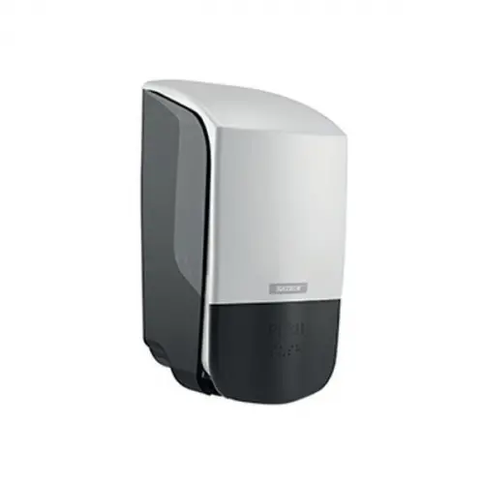
Hand Sanitisers
Never use in food production area
Only work on physically clean hands
Must NOT replace handwashing
Notes:
Hand sanitisers.
Handwashing is the primary defence against contamination. Sanitisers are only a supporting measure, not a substitute.
Hand sanitisers only work on physically clean hands.
Sanitisers cannot remove grease, dirt, food residues or organic matter.
If hands are visibly dirty, the sanitiser cannot reach the skin properly, meaning bacteria and viruses remain.
Sanitisers must not replace handwashing.
They shall not be used as a method of hand disinfection unless hands have been thoroughly washed.
This means you must wash hands first and only then can sanitiser be used as an additional step.
• Sanitiser alone is not acceptable in food handling environments.
Handwashing removes, physical dirt, oils, microorganisms and contamination picked up during work.
Sanitiser can only kill some microbes, it cannot clean the hands. If hands are dirty, sanitiser simply spreads the contamination around.

Slide 19
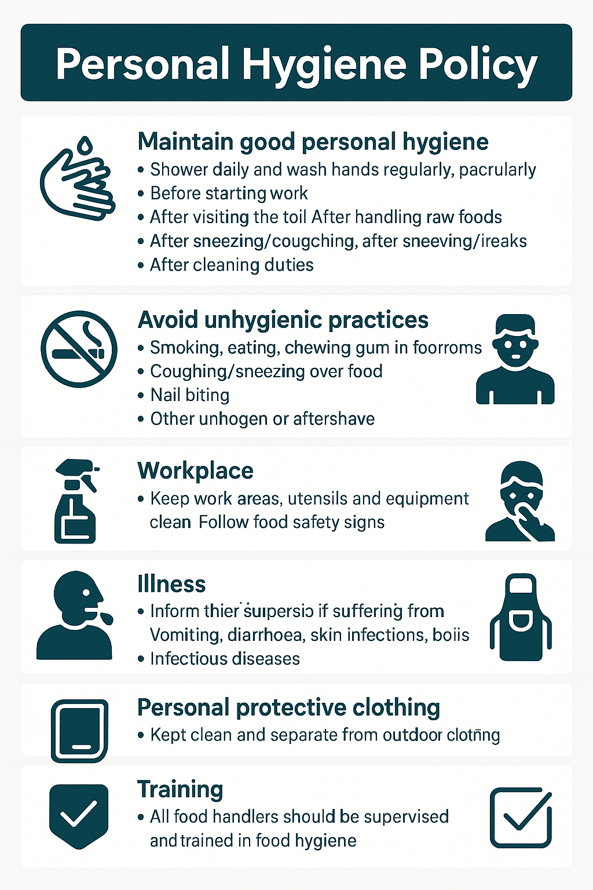
Personal Hygiene Policy
Maintain Good Personal Hygiene
Avoid Unhygienic Practices
Appearance & Grooming Standards
. Workplace Hygiene Responsibilities
Illness Reporting
Personal Protective Clothing
Training Requirements
Notes:
Personal hygiene policy.
This policy summarises the key expectations for personal hygiene in a food business. It acts as a contract between the employee and employer to ensure safe food handling.
Maintain good personal hygiene
The policy highlights moments when handwashing is essential. Hands must be washed before starting work, after using the toilet, before handling food, after handling raw food, after coughing, sneezing, touching the face, hair, cuts, after smoking or taking breaks, after cleaning and after handling money or waste.
This reinforces the earlier workbook content: handwashing is the most important control against contamination.
Avoid unhygienic practices.
The following behaviours that can contaminate food and must be avoided:
Smoking, eating, chewing gum in food rooms.
Coughing or sneezing over food.
Nail biting.
Nose picking.
Finger tasting, and,
Wetting fingers to open bags.
These actions spread bacteria and violate food safety rules.
Appearance & grooming standards.
Food workers must not have long nails, nail varnish, or false nails, watches or jewellery or strong perfume or aftershave.
Workplace hygiene responsibilities.
Food workers agree to keep work areas, utensils, and equipment clean and follow all food safety signs.
Illness reporting.
Workers must inform their supervisor if they have vomiting or diarrhoea, skin infections, boils, septic cuts, styes or infectious diseases.
Personal protective clothing.
Protective clothing must be clean, separate from outdoor clothing and not covered by personal items.
Training requirements.
All food handlers agree to be supervised, instructed and trained in food hygiene.

Slide 20
Unit 3 Recap Questions
1. When should food handlers wash their hands?
2. Why are blue plasters used in food businesses?
3. Name two illnesses that must be reported.
4. Why should jewellery be removed?
5. What type of gloves are recommended in food handling?

Slide 21
Unit 3 Personal Hygiene Scenario
A food worker arrives with a cough, jewellery on, and long painted nails.
• Identify the hygiene risks.
• What food safety hazards could occur?
• What actions should the supervisor take?
• What policies apply in this situation?

