Slide 1
Food Safety Level 1

Slide 2
Programme Objectives
To inform the learner about the legal responsibilities of a food handler in a food enterprise
To facilitate a comprehensive understanding of food handlers personal responsibilities
To explain key food safety hazards
To facilitate a comprehensive understanding of food hazards and food borne illness and how they may occur
To enable the learner to demonstrate operational procedures in a food safety system based on the principles of HACCP
To provide the learner with the knowledge and skills of pre-requisite controls and monitoring in a food enterprise in the following areas pest prevention
and control, internal and external waste disposal, safe use and storage of cleaning chemicals and good housekeeping procedures
Notes:
Programme Objectives.
To inform the learner about the legal responsibilities of a food handler in a food enterprise
Including the legal enforcement actions open to regulatory authorities.
To facilitate a comprehensive understanding of food handlers personal responsibilities
To explain key food safety hazards.
To facilitate a comprehensive understanding of food hazards and food borne illness and
how they may occur.
To enable the learner to demonstrate operational procedures in a food safety system based
on the principles of HACCP (Hazard Analysis Critical Control Point).
To provide the learner with the knowledge and skills of pre-requisite controls and
monitoring in a food enterprise in the following areas pest prevention and control, internal
and external waste disposal, safe use and storage of cleaning chemicals and good
housekeeping procedures

Slide 3
Unit 1 Food Hygiene
Up on completion of this unit learners will be able to:
Define the term food hygiene
Understand the benefits of good food hygiene and outline the costs of poor food hygiene practices
List the four types of food safety hazard and give examples
of each
Explain how to control the various food safety hazards in
the workplace
Notes:
Unit 1 Food Hygiene.
Up on completion of this unit learners will be able to:
Define the term food hygiene,
Understand the benefits of good food hygiene and outline the costs of poor food hygiene practices,
List the four types of food safety hazard and give examples of each, and,
Explain how to control the various food safety hazards in the workplace.

Slide 4
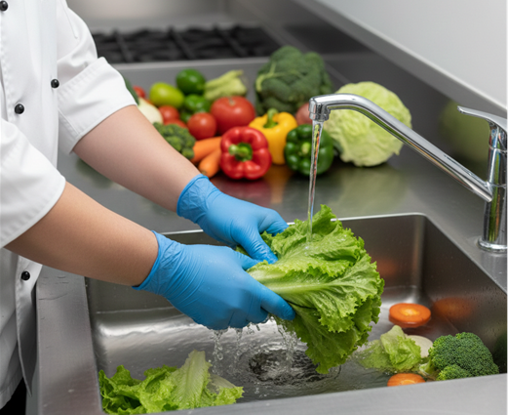
Food Hygiene
Food hygiene refers to all the measures, practices, and conditions that ensure food is safe, wholesome, and fit for human consumption.
Why Food Hygiene Matters
Safe
Sound
Wholesome
Notes:
Food Hygiene.
Food hygiene refers to all the measures, practices, and conditions that ensure food is safe, wholesome, and fit for human consumption. The workbook draws directly from European Regulation EC 852/2004, which defines food hygiene as:
“The measures and conditions necessary to control hazards and to ensure fitness for human consumption of a foodstuff, taking into account its intended use.”
In simple terms, food hygiene is everything we do to keep food safe from the moment it is received, stored, prepared, cooked, and served.
Why Food Hygiene Matters.
The purpose of food hygiene is to make sure that when food reaches the consumer, it is:
Safe. Free from hazards.
Sound. – not spoiled or contaminated
Wholesome. Nutritious and suitable to eat.
Good hygiene protects public health, prevents food poisoning, and ensures compliance with EU and Irish food safety law.

Slide 5
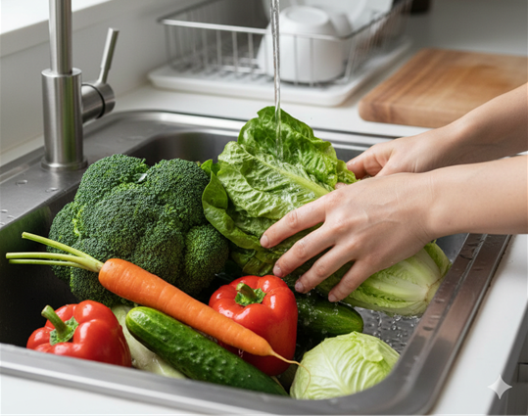
How Food Hygiene is Achieved
Protecting Food From Contamination.
Preventing Bacteria From Multiplying.
Destroying Harmful Bacteria in Food
Notes:
How Food Hygiene Achieves This.
The Following Are Ways That Food Hygiene Is Achieved:
1. Protecting Food From Contamination.
This Includes Preventing Physical, Chemical, Biological, And Allergen Hazards From Entering Food By Keeping Raw And Cooked Foods Separate, Using Colour‑coded Equipment, Maintaining Clean Work Areas And, Practising Good Personal Hygiene.
2. Preventing Bacteria From Multiplying.
Bacteria Grow Quickly In The “Danger Zone”. Food Hygiene Controls Include Correct Refrigeration, Safe Cooking And Reheating, Proper Hot‑holding And Avoiding Long Periods At Room Temperature
These Steps Stop Harmful Bacteria From Reaching Dangerous Levels.
3. Destroying Harmful Bacteria In Food.
This Is Achieved Through Thorough Cooking, Correct Reheating. Using Safe Cooking Temperatures And Following Time/Temperature Controls.
Heat Treatment Is One Of The Most Effective Ways To Kill Pathogens.

Slide 6
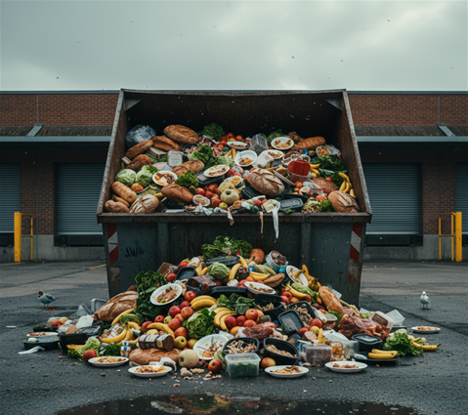
Costs of Poor Food Hygiene
Food Contamination
Food Poisoning
Customer Complaints
Loss of Reputation
Loss of Business & Jobs
Food Waste & Pest Infestations
Legal Consequences
Notes:
Costs of poor food hygiene.
Poor food hygiene has serious consequences for both the business and the public. The workbook highlights the following risks:
Food contamination.
Unsafe handling, poor cleaning, or cross‑contamination can introduce hazards into food.
Food poisoning.
Customers may become ill due to harmful bacteria, viruses, chemicals, or allergens.
Customer complaints & loss of reputation.
Complaints damage trust.
Negative reviews and social media posts spread quickly.
Reputation loss often leads to reduced sales.
Loss of business & jobs.
When customers stop coming, income drops.
Staff hours may be cut or jobs lost.
Food waste & pest infestations.
Poor hygiene attracts pests.
Contaminated food must be thrown away, increasing costs.
Legal consequences.
Enforcement action from regulatory authorities.
Fines, prosecution, or being placed under enhanced

Slide 7
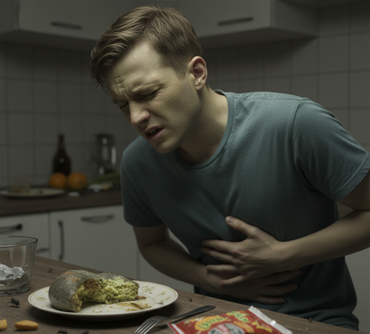
Food Poisoning & Symptoms
Food poisoning is an illness caused by eating contaminated food.
Symptoms of Food Poisoning
Vomiting
Diarrhoea
Nausea
Abdominal pain or stomach cramps
Notes:
Food poisoning is described as an illness caused by eating contaminated food.
Symptoms usually appear between 1 and 72 hours after eating the contaminated food.
The time it takes for symptoms to appear is known as the incubation period, and it varies depending on the type of bacteria or contaminant.
This reinforces the workbook’s message that unsafe food handling can have rapid and serious health effects.
Symptoms of food poisoning
The workbook lists several common symptoms. These can vary from mild to severe:
Vomiting,
Diarrhoea,
Nausea, and,
Abdominal pain or stomach cramps
In severe cases, especially in vulnerable groups, food poisoning can lead to life‑threatening complications and death.

Slide 8

Vulnerable groups
The Very Young
Elderly People
People Who Are Ill or Recovering
Pregnant Women and Unborn Babies
Notes:
Vulnerable groups.
Anyone can get food poisoning, but some people are more likely to become seriously ill if they eat contaminated food. These individuals are described as vulnerable groups because their immune systems are weaker or still developing.
The four groups are:
The very young.
Babies and young children have immature immune systems.
They cannot fight off harmful bacteria as effectively as adults.
Elderly people.
Ageing weakens the immune system.
Older adults may also have underlying health conditions that increase risk.
People who are ill or recovering.
Illness, medical treatments, or weakened immunity make it harder to fight infection.
This includes people with chronic conditions or those recovering from surgery.
Pregnant women and unborn babies.
Pregnancy naturally lowers the immune system.
Some bacteria such as listeria can harm both the mother and the developing baby.
These groups are highlighted because food poisoning can lead to more severe complications, hospitalisation, or even death.

Slide 9

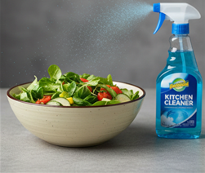
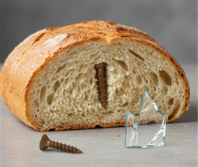
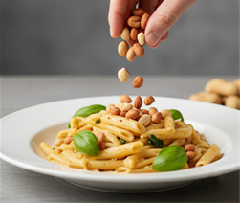
Food Safety Hazards
Biological Hazards
Chemical Hazards
Physical Hazards
Allergen Hazards
Notes:
Food safety hazards.
There are four groups of hazards that can cause food to become unsafe. These hazards are also called food contaminants because they contaminate food and make it harmful to eat.
These four hazard groups form the foundation of all food safety training.
The four categories of food hazards.
Biological hazards
These are living organisms or toxins produced by them. They include bacteria, viruses, parasites, moulds and toxins. Biological hazards are the most common cause of food poisoning.
Chemical hazards.
These are harmful chemicals that can contaminate food.
Examples include incorrect use of cleaning chemicals, pesticides, food additives used incorrectly, industrial chemicals and chemicals from packaging.
Physical hazards.
These are foreign objects that should not be in food.
Examples include, hair, glass, plastic, metal fragments, stones, jewellery and wood splinters.
Physical hazards can cause injury, choking, or contamination.
Allergen hazards.
These occur when a food contains an allergen that a consumer is allergic to, or when allergens are accidentally transferred into a dish.
Examples include nuts, milk, eggs, gluten, sesame, soy and shellfish.
Allergen hazards can cause severe reactions, including anaphylaxis.

Slide 10
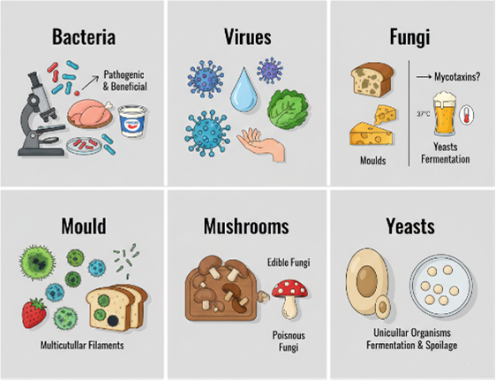
Classes of Micro-organisms
Bacteria
Viruses
Fungi
Mould
Mushrooms
Yeasts
Notes:
Classes of micro‑organisms.
Microbiological hazards are one of the four major food hazard groups. This section explains the different types of micro‑organisms that can affect food safety.
Micro‑organisms are tiny living organisms, often invisible to the naked eye, so small that millions could fit on a single full stop
Some micro‑organisms are harmless or even useful, while others can cause serious illness.
Bacteria.
Bacteria are the most common micro‑organisms in food safety.
Most bacteria are harmless.
Some are beneficial such as used to make cheese and yogurt.
Pathogenic bacteria are the dangerous ones. They cause food poisoning.
Pathogenic bacteria do not change the colour, taste, smell, or texture of food. This makes contaminated food look normal, which is why strict hygiene controls are essential.
Viruses.
Viruses are even smaller than bacteria and can cause illness when they contaminate food.
Viruses enter food through infected food workers handling food, contact with human or animal waste and contaminated foodstuffs such as shellfish from polluted waters.
Viruses do not grow in food, but food can carry them into the body.
Fungi.
Fungi include moulds, yeasts, and mushrooms. They can be helpful or harmful.
Moulds.
Some moulds produce mycotoxins, which can cause illness or, in rare cases, death.
Common cause of food spoilage, especially bread and bakery items and fruit stored too long.
Mushrooms.
Some mushrooms are edible and nutritious. However, Others are poisonous.
Yeasts.
Yeasts can spoil fatty foods and May cause rancidity or off‑flavours.

Slide 11
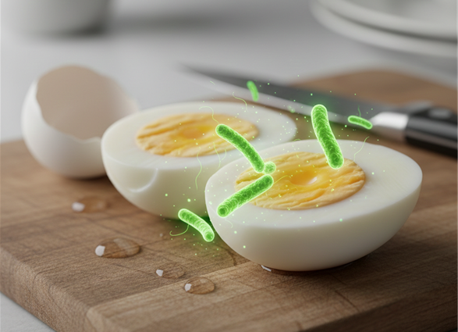
Food Poisoning Bacteria & their Sources
Salmonella
E. coli
Staphylococcus Aureus
Bacillus Cereus
Clostridium perfringens
Clostridium Botulinium
Campylobacter
Listeria
Notes:
Food poisoning bacteria & their sources.
Most pathogenic (disease‑causing) bacteria originate in the intestines of animals and humans. These bacteria can then transfer onto food through poor handwashing, cross‑contamination, dirty equipment, contaminated water and raw or undercooked foods.
Once these bacteria enter food, they can multiply and cause food poisoning.
The following is a list of the bacteria most frequently linked to food poisoning cases along with their typical sources.
Salmonella.
Common sources include chicken, turkey, duck and eggs.
It is often linked to undercooking or cross‑contamination from raw poultry.
E. Coli.
Common sources include undercooked minced meat, especially beef burgers and contaminated water
E. Coli can cause severe illness, especially in vulnerable groups.
Staphylococcus aureus.
Common sources include people’s eyes, nose, mouth, skin, cuts and boils.
This bacteria is spread by poor personal hygiene or handling food with infected wounds.
Bacillus cereus.
Common sources include rice and pasta, especially when reheated or left cooling too long.
This is why cooked rice must be cooled quickly and stored safely.
Clostridium perfringens.
Common sources include soil, vegetables, joints of meat, meat pies and stocks.
It is often linked to large batches of food cooled too slowly.
Clostridium botulinum.
Common sources include blown or damaged cans, vacuum‑packed foods and soil on mushrooms.
This bacteria produces a dangerous toxin, making damaged cans a serious hazard.
Campylobacter.
Common sources include chicken and dirty or untreated water.
One of the most common causes of food poisoning.
Listeria.
Common sources include unpasteurised soft cheeses, pâté and coleslaw.
Listeria can grow at fridge temperatures, making it especially dangerous for pregnant women and vulnerable groups.

Slide 12
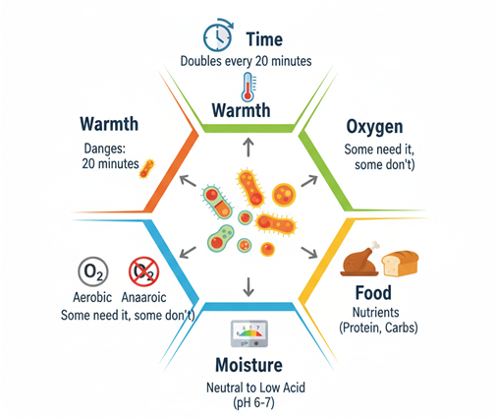
Conditions for bacterial growth
Time
Warmth
Oxygen
Food
Moisture
PH
Notes:
Conditions for bacterial growth.
The workbook explains that bacteria need several conditions working together in order to grow, multiply, and become dangerous. When these conditions are present, bacteria can increase rapidly and cause food poisoning.
These conditions are often remembered using the idea that bacteria need the right time, temperature, food, moisture, oxygen, and ph.
Time.
Bacteria multiply by a process called binary fission, where one bacterium splits into two.
This happens every 10–20 minutes under ideal conditions.
After a few hours, millions of bacteria can be present.
This is why time control is essential in food safety.
Warmth.
The workbook highlights the danger zone: 5 degrees celsius to 63 degrees celsius.
Bacteria grow slowly at 5 degrees celsius..
Growth increases as temperature rises.
Growth continues until around 63 degrees celsius, where heat begins to destroy bacteria.
The 2‑hour rule.
Food should not be left out of the fridge for more than 2 hours, because bacteria multiply quickly at room temperature.
Oxygen.
Some bacteria need oxygen to grow (aerobic bacteria). Others grow without oxygen (anaerobic bacteria), such as clostridium botulinum.
The workbook focuses on the idea that oxygen availability affects bacterial growth, especially in vacuum‑packed or canned foods.
Food.
Bacteria grow best on foods that are high in protein, moist and nutrient‑rich.
Examples include meat, poultry, fish, and dairy and cooked rice and pasta.
These are known as high‑risk foods.
Moisture.
Bacteria need water to grow. Foods with high moisture content support rapid bacterial growth.
Examples include cooked foods, fresh meat, dairy, prepared salads
Dry foods such as flour, rice and pasta become risky once cooked because moisture is added.
Ph (acidity).
Bacteria prefer neutral or slightly acidic environments.
High‑acid foods such as vinegar, citrus fruits slow or stop bacterial growth.
Low‑acid foods such as meat, dairy support rapid growth.

Slide 13
The pH Scale
Examples from the page:
This chart
pH Level | Example | Meaning
0 | Battery acid | Extremely acidic
2 | Lemon juice | Strong acid
3 | Tomato | Acidic food
4–5 | Vinegar, milk | Mild acids
7 | Water | Neutral
8–10 | Baking soda, ammonia solution | Mild alkalis
11–14 | Soap, bleach, drain cleaner | Strong alkalis

Slide 14
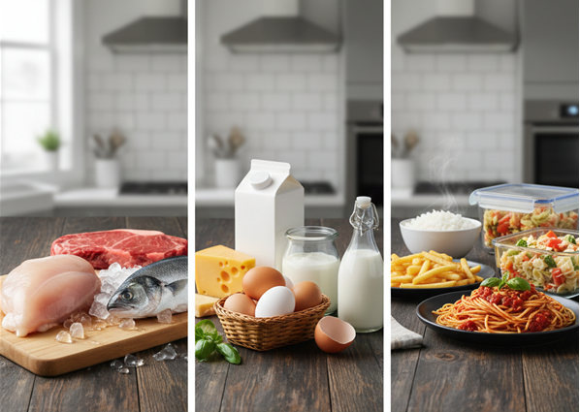
High Risk Foods
High‑risk foods are those that support the growth of harmful micro‑organisms,
Examples:
Meat & Poultry.
Fish & Shellfish
Dairy
Eggs
Cooked carbohydrates
Prepared meals
Notes:
High risk foods.
Different foods carry different levels of risk when it comes to food poisoning. Understanding these categories helps food workers apply the correct controls for storage, preparation, and service.
High‑risk foods are those that support the growth of harmful micro‑organisms, and will not receive any further cooking or heat treatment before being eaten.
This makes them especially dangerous if contaminated, because bacteria will not be destroyed before consumption.
These foods are usually high in protein, moist, ready‑to‑eat and stored in the fridge.
Examples include:
Meat & poultry.
Cooked meats, raw meat served as ready‑to‑eat such as beef tartare, cooked poultry and meat products such as gravies, stocks, sauces and soups.
Fish & shellfish.
Cooked and raw shellfish such as chowders and cooked and raw fish such as fish pie.
Dairy.
Milk and milk products such as butter, cream, yogurt, soft cheeses, unpasteurised and cheeses and milks.
Eggs.
Egg and egg products such as quiches, egg mayonnaise and hollandaise or béarnaise sauces.
Cooked carbohydrates.
Cooked rice and cooked pasta.
Prepared meals.
Cook‑chill meals, cook‑freeze meals and any food containing the above ingredients.
These foods must be handled with strict hygiene and temperature control because bacteria can multiply rapidly in them.

Slide 15
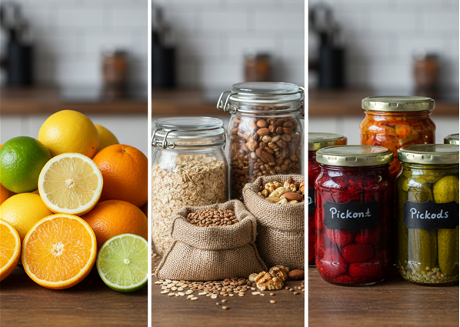
Low risk foods
Low risk foods are foods where bacteria does not grow easily.
Examples would include:
Citrus fruits
Dry foods
Pickles or preserves
Notes:
Low risk foods.
Low risk foods are foods where bacteria do not grow easily. They are usually high in sugar, high in salt, acidic, dry or preserved.
These conditions make it difficult for bacteria to multiply.
Examples include:
• Citrus fruits,
• Dry foods such as bread, biscuits, flour
• Pickles, preserves, jam
These foods can still become contaminated physically or chemically, but they are less likely to cause bacterial food poisoning.

Slide 16
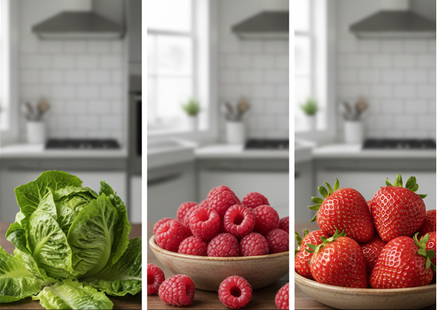
Raw Ready to Eat Food
These foods are eaten without cooking, so any contamination remains on the food.
Examples:
Lettuce
Raspberries
Strawberries
Notes:
Raw ready‑to‑eat foods.
These foods are eaten without cooking, so any contamination remains on the food. They may carry small numbers of bacteria, viruses and chemical residues.
Because they are not heated, washing is the only control step.
Examples:
Lettuce,
Raspberries, and,
Strawberries.
They must be washed in running potable (safe‑to‑drink) water before consumption.

Slide 17
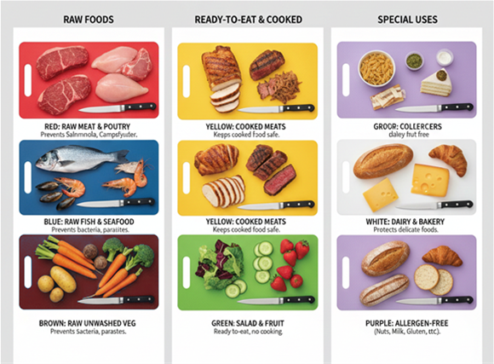
Colour Coding
Red: Raw Meats and Poultry
Blue: Raw Fish and Seafood
Yellow: Cooked Meats
Brown: Raw Unwashed Vegetables
White: Dairy and Bakery Products
Green: Salad and Fruit
Lilac/Purple: Allergen Free Preparation
Notes:
Colour coding.
The workbook explains that colour coded chopping boards are an important food safety control used in professional kitchens. Their purpose is to prevent cross contamination between raw foods, cooked foods, allergens, and ready to eat items.
Cross contamination happens when harmful bacteria or allergens transfer from one food to another through equipment, hands, or surfaces. Using different colours for different food types helps staff avoid this.
The following is a list of the colours and their uses:
Red: raw meats and poultry.
Used for raw beef, pork, lamb, and raw chicken/turkey. Prevents raw meat bacteria such as salmonella, campylobacter from contaminating other foods.
Blue: raw fish and seafood.
Used for raw fish and shellfish. Prevents fish related bacteria and parasites from spreading.
Yellow: cooked meats.
Used for cooked beef, pork, lamb, chicken, etc. Keeps cooked foods safe from raw food contamination.
Brown: raw unwashed vegetables.
Used for muddy or unwashed vegetables. Prevents soil bacteria from contaminating ready to eat foods.
White: dairy and bakery products.
Used for bread, pastries, cheese, and other dairy items. Helps protect delicate foods from contamination.
Green: salad and fruit.
Used for ready to eat fruit and salad items. These foods will not be cooked, so they must be kept very safe.
Lilac/purple: allergen free preparation.
Although not part of the original list, many modern food businesses now use a lilac/purple board for preparing allergen free meals.
This helps prevent accidental allergen cross contact, especially with gluten, nuts, milk, eggs, sesame, soy and shellfish.
This addition reflects the growing importance of allergen control in food safety.

Slide 18
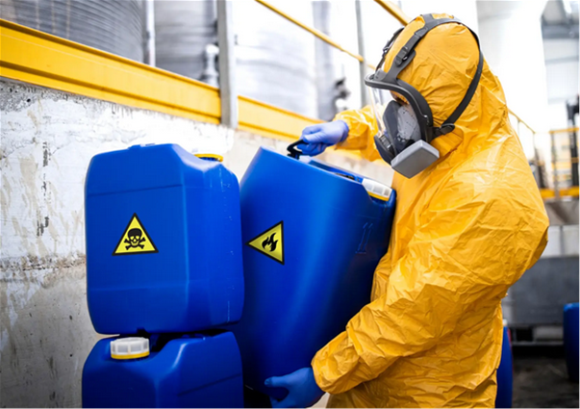
Chemical Hazards
The presence in food of unacceptable levels of chemical substances e.g.
Herbicides, Pesticides, Fungicides
Cleaning agents
Industrial chemicals
Preservatives or additives
Veterinary drugs
Staff- medicines, perfumes,aftershaves
Migration of chemicals from food packaging
Plastic containers
Acrylamide in the cooking process
Notes:
Examples of Chemical Hazards (Based on the Workbook)
The list in the text highlights common sources of chemical contamination:
Agricultural Chemicals
Herbicides, pesticides, fungicides Used in farming to protect crops but can remain as residues on food if not properly controlled.
Cleaning Agents
Detergents, disinfectants, sanitisers Can contaminate food if surfaces are not rinsed properly or chemicals are stored incorrectly.
Industrial Chemicals
Substances used in manufacturing or maintenance (e.g., oils, lubricants) Can enter food through equipment faults or poor storage.
Preservatives or Additives
Normally safe when used correctly, but excessive or incorrect use can make food unsafe.
Veterinary Drugs
Antibiotics or treatments used in animals Residues may remain in meat, milk, or eggs if withdrawal periods are not followed.
Staff‑Related Chemicals
Medicines, perfumes, aftershaves, lotions These can transfer to food through poor personal hygiene or inappropriate use in food areas.
Migration from Food Packaging
Chemicals can leach from packaging into food, especially when heated or stored incorrectly.
Plastic Containers
Low‑quality or unsuitable plastics may release chemicals into food.
Acrylamide in the Cooking Process
A chemical formed when starchy foods (chips, toast, biscuits) are cooked at high temperatures.
The workbook highlights this as a process‑generated contaminant that must be controlled.
🛡️ Why This Matters in the Workbook
The surrounding content emphasises that food handlers must:
Understand where chemical hazards come from
Prevent contamination through correct storage, cleaning, and handling
Follow manufacturer instructions for chemicals
Use approved food‑grade materials
Control cooking processes to reduce acrylamide formation
Maintain good personal hygiene to avoid transferring chemicals to food
This section supports the broader message that chemical hazards are preventable when proper food safety practices are followed.

Slide 19
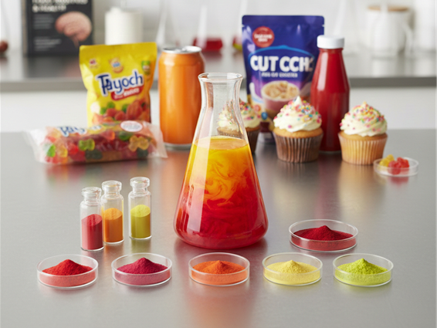
Food Additives
The colours are
Sunset yellow(E110)
Quinoline yellow(E104)
Carmoisine(E122)
Allura red(E129)
Tartrazine (E102)
Ponceau (E124)
Notes:
Food Additives.
The following is lists a group of artificial food colourings identified by their E numbers that are commonly used in processed foods. There is a requirement for warning labels under EU food law. These colours are often referred to as the “Southampton Six”, a group of additives linked to behavioural effects in sensitive individuals.
Sunset Yellow.
Quinoline Yellow.
Carmoisine.
Allura Red .
Tartrazine .
Ponceau .
These are synthetic dyes used to enhance the appearance of foods such as sweets, soft drinks, desserts, sauces, and baked goods.

Slide 20
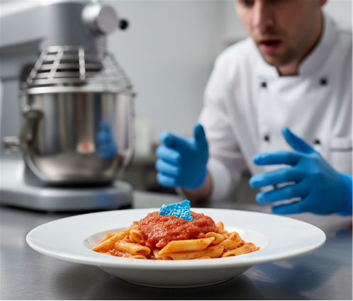
Physical Contamination
Glass.
Wood splinters
Plastic
Plasters
Jewellery
Hair
Insects or rodent droppings
Bolts or screws
Notes:
Physical contamination.
Physical contamination happens when foreign objects or unwanted physical materials accidentally enter food. These items are not meant to be in food and can make it unsafe to eat, causing injury, choking, or illness.
In the context of food hygiene, physical contamination is one of the four major food hazards it sits alongside other hazards because it directly threatens consumer safety and can seriously damage a business’s reputation.
Examples of physical contaminants.
Glass such as broken jars, light bulbs.
Wood splinters from damaged utensils or pallets.
Plastic packaging fragments and broken utensils.
Plasters from uncovered wounds or poor personal hygiene.
Jewellery such as rings, earrings or false nails.
Hair from uncovered heads or poor hygiene
Insects or rodent droppings linked to poor pest control.
Bolts or screws (from damaged equipment or fixtures)
These examples match the workbook’s emphasis on preventing contamination through good hygiene, proper maintenance, pest control, and safe food handling practices.
Physical contamination is dangerous because it can cause injury, lead to choking hazards, introduce harmful microorganisms carried on foreign objects, trigger complaints, legal action, or business closure and damage customer trust and reputation.
Preventing contamination of any type is a core responsibility of every food worker.
This can be achieved through pest control, safe storage and handling (keeping packaging intact, avoiding broken containers and regular inspections on equipment, utensils, and food rooms.

Slide 21

Allergen Hazards
Many people have food sensitivities, and some of these can be serious or even life threatening.
Types of Food Senstivities
Food allergies
Food intolerances
Coeliac disease
Notes:
Allergen hazards.
Many people have food sensitivities, and some of these can be serious or even life threatening. In food safety, allergens are treated as a major hazard because even tiny amounts can trigger reactions.
The three types of food sensitivities described are:
Food allergies: this is an immune system response. The body mistakenly identifies a food protein as harmful and produces antibodies to fight it. When the person eats that food again, the immune system reacts, causing symptoms that can range from mild to severe.
The workbook highlights common allergens such as shellfish, nuts, fish, eggs, peanuts and milk. These are also part of the eu’s list of major allergens that must be declared on labels and menus.
Food intolerances: a food intolerance is different because it involves the digestive system, not the immune system. It happens when: the digestive system is irritated, or the person cannot properly break down a food component. The most common example given is lactose intolerance, where the body lacks the enzyme needed to digest lactose in milk and dairy products.
Symptoms are usually uncomfortable but not life threatening, unlike allergies.
Coeliac disease.
Coeliac disease is a genetically determined hypersensitivity to gluten. Gluten is a protein fraction found in wheat, rye, barley, oats, and related grains.
In people with coeliac disease, gluten damages the lining of the small intestine.
The only treatment is strict lifelong avoidance of gluten.
This condition is included in allergen training because gluten is one of the 14 eu regulated allergens.

Slide 22
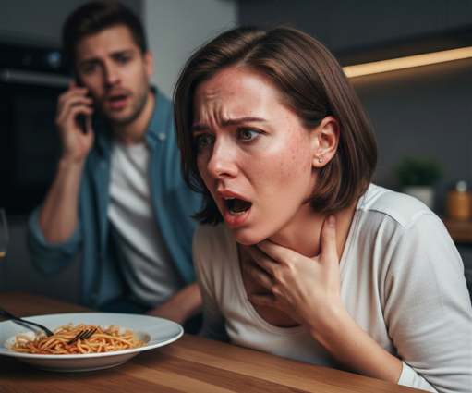
Common Symptoms of an Allergic Reaction
• Rash or flushing of the skin
• Severe asthma or difficulty breathing
• Difficulty swallowing or speaking
• Itchy eyes and throat
• Swelling of the throat and tongue
• Vomiting, abdominal pain, nausea
• Drop in blood pressure
• Collapse or unconsciousness
Notes:
Common Symptoms of an Allergic Reaction
The following are symptoms that may appear after someone eats a food they are allergic to:
• Rash or flushing of the skin,
• Severe asthma or difficulty breathing,
• Difficulty swallowing or speaking,
• Itchy eyes and throat,
• Swelling of the throat and tongue,
• Vomiting, abdominal pain, nausea,
• Drop in blood pressure, and,
• Collapse or unconsciousness.
These symptoms can develop very quickly, which is why allergen control is so important in food businesses.

Slide 23

Anaphylaxis (Severe Allergic Reaction)
Anaphylaxis is a medical emergency.
Symptoms include:
•Loss of consciousness
• Hives
• Rapid swelling of the tongue
• Inability to swallow
• Swelling of throat that can block the airway
Notes:
Anaphylaxis (severe allergic reaction).
Anaphylaxis is a medical emergency. Symptoms include:
• Loss of consciousness,
• Hives,
• Rapid swelling of the tongue,
• Inability to swallow, and,
• Swelling of throat tissues that can block the airway
Because anaphylaxis can be fatal, staff must know the emergency procedures on site. This usually includes recognising symptoms, calling emergency services and following the business’s allergen emergency plan

Slide 24
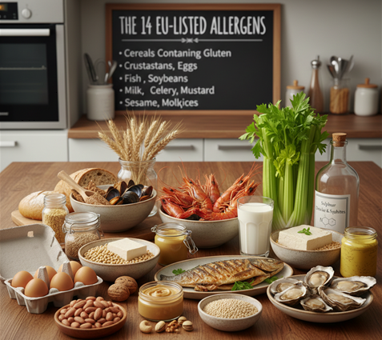
The 14 EU‑Listed Allergens
Cereals Containing Gluten
Crustaceans
Eggs
Fish
Peanuts
Soybeans
Milk
Nuts
Celery
Mustard
Sesame Seeds
Sulphur Dioxide & Sulphites
Molluscs
Notes:
The 14 eu‑listed allergens.
The european union requires that 14 specific allergens must be clearly identified on all pre packaged foods, all non pre packaged foods and any food sold or served to consumers these allergens must be declared whenever they are present as ingredients, even in small amounts.
The 14 eu‑listed allergens.
The european union requires that 14 specific allergens must be clearly identified on all pre packaged foods, all non pre packaged foods and any food sold or served to consumers these allergens must be declared whenever they are present as ingredients, even in small amounts.
The european union requires that food businesses clearly state if any of the 14 major allergens are present in food. These allergens must be highlighted because they can cause serious or life threatening reactions.
The following is a list of each allergen along with common food examples:
Cereals containing gluten.
This includes wheat, rye, barley, oats. This is found in bread, pasta, cakes, meat products, sauces, soups, batter, stock cubes the specific grain must be listed.
Crustaceans
This includes prawns, lobster, crab, scampi and shrimp paste.
Eggs.
These are found in desserts, sauces, pasta, quiche, mayonnaise and foods brushed with egg (e.g., pastries.
Fish
This is found in salad dressings, pizzas, sauces, some soy and worcestershire sauces
Peanuts.
These are found in sauces, desserts, oils and peanut flour.
Soybeans.
These are found in tofu, bean curd, ice cream desserts and sliced bread.
Lupin.
This is similar to peanuts. This is found in pastry, pasta and batter coatings.
Milk
This is found in dairy products, whey powder and foods glazed with milk.
Nuts.
This includes walnut, almond, hazelnut, brazil nut, pistachio, cashew, pecan, macadamia and queensland nut. These are found in desserts, sauces and oils.
Celery.
This includes root, stalk, and seeds. This is found in salads, sauces, soups and meat products.
Mustard.
This includes plant, liquid, powder, leaves, seeds, flowers. This is found in sauces, dressings, soups, curries, meat products and marinades.
Sesame seeds.
These are found in bread, pastes, greek and turkish foods such as tahini and houmous and oils.
Sulphur dioxide & sulphites.
These are used as preservatives. They are found in meat products, soft drinks, dried fruit and vegetables and wine and beer
Molluscs
These includes mussels, whelks, squid, snails and oyster sauce.
Other common allergens not on the eu list that some people may be allergic to foods not included in the official 14 include kiwi, strawberry, mango, papaya, legumes and latex.
These are not legally required to be highlighted, but staff must still be aware of them because they can cause reactions in sensitive individuals.

Slide 25
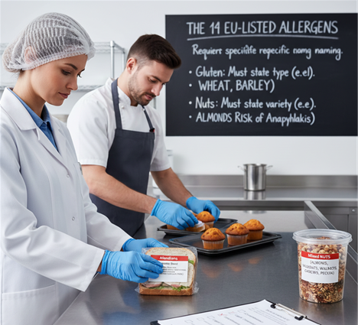
Labelling & Relabelling
Gluten Must Be Listed by Type
Nuts Must Be Listed by Variety
Why This Matters
Protects consumers with allergies,
Prevents accidental exposure,
Ensures legal compliance,
Helps staff communicate confidently, and
Reduces the risk of severe allergic reactions
Notes:
Labelling & relabelling.
When food is prepared, packaged, or relabelled in a food business, allergen information must be clearly provided to consumers. This is a legal requirement under eu regulations.
The following are important rules when labelling allergens.
Gluten must be listed by type.
If a food contains cereals with gluten, you must state the specific grain, such as wheat, rye, barley or oats.
For example: “cereals containing gluten (wheat, barley)”
This prevents confusion and helps consumers with specific sensitivities.
Nuts must be listed by variety.
“nuts” alone is not acceptable. Such as almonds, hazelnuts, walnuts, brazil nuts, pistachios, cashews, pecans, macadamia or queensland nuts.
This is essential because different nuts cause different allergic reactions.
Why this matters.
Proper labelling and relabelling:
Protects consumers with allergies,
Prevents accidental exposure,
Ensures legal compliance,
Helps staff communicate confidently, and
Reduces the risk of severe allergic reactions, including anaphylaxis.
Accurate allergen labelling is a core part of food safety and consumer protection.

