Slide 1
Abrasive Wheels Course
Presented by
Conor Kelleher
Notes:
Joining Instructions
Advise people of the duration of the course and the need to wear appropriate clothing.
If necessary you may need to advise them of the need to wear PPE.
Room Set Up
The room should be large enough to seat delegates comfortably and space to carry out the manual handling moves comfortably.
U shaped is preferred as it allows you to engage better with the delegates.
Ensure that the room is adequately ventilated, comfortable temperature and there is enough light. Avoid a noisy venue.
It is a good idea to provide water and to put name tags up.
Set up your flipchart, screen and projector in such a way that you can move around safely and comfortably.
Leave yourself enough time to set up before your delegates arrive! As delegates come in ask their name and shake their hand.
Get them to complete the attendance sheet so you have a record of the names.
Ensure that you have your props and sample loads available to you.

Slide 2
Contents
What? Why?
Legislation
Methods of marking
Inspection, Handling, storage & transporting
Hazards, risks & controls
Components
Mounting, dressing & trueing
Operating

Slide 3
Course Aim
The aim of this course is to provide you with the Knowledge, skills and attitude to be able to train others how to inspect, select and mount abrasive wheels
Notes:
Course aim:
It is important that you state clearly the aim of the course.
The aim of your course is to provide the learners with the knowledge, skills and attitude to be able to:
Carry out manual handling tasks safely

Slide 4
Unit 1 What & Why?
The aim of this module is to provide you with an understanding of what abrasive wheels are.
At the end of this module you will be able to:
Explain what abrasive wheels are.
List the different types of abrasive wheels.
State the characteristics of these
Explain why training is required

Slide 5
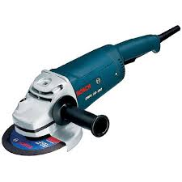
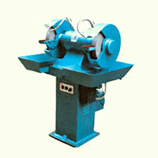

Abrasive Wheels
What abrasive wheels are:
A wheel consisting of abrasive particles held together used for cutting or grinding
Examples of Abrasive Wheels Equipment?
Consaws, Bench grinders, angle ginders

Slide 6

Organic bonds
How?
Cured at low temperatures.
Bonded by resin, rubber.
Characteristics?
Tough, shock resistant, self dressing
Uses?
Non precision grinding and cutting off

Slide 7
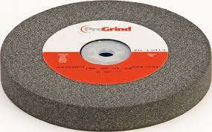
Inorganic bonds
How?
Vitrified: Fired in a furnace at high temperature
Characteristics?
Strong, Hard, brittle, require dressing
Uses?
Precision grinding on pedestal grinder

Slide 8
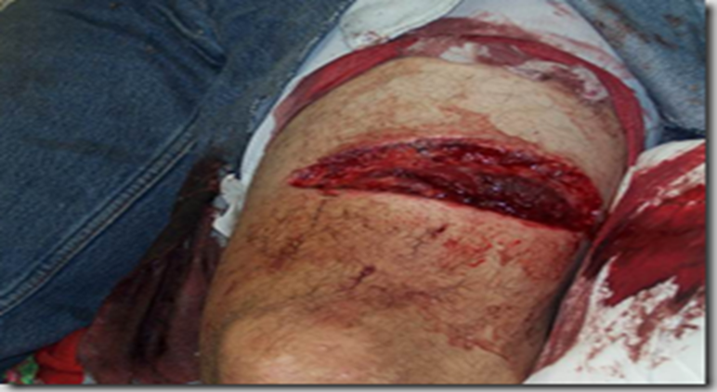
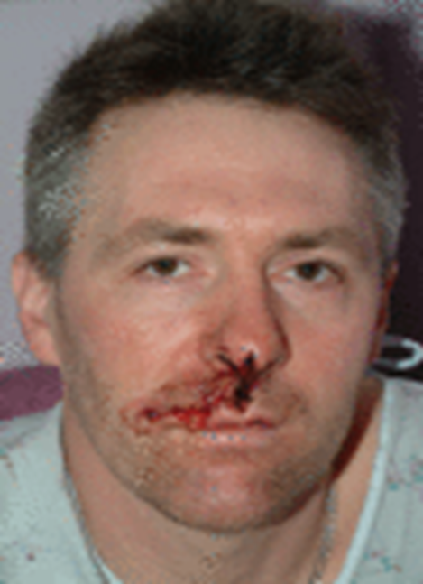
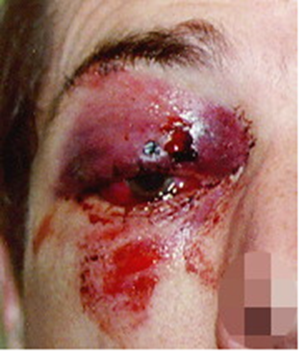
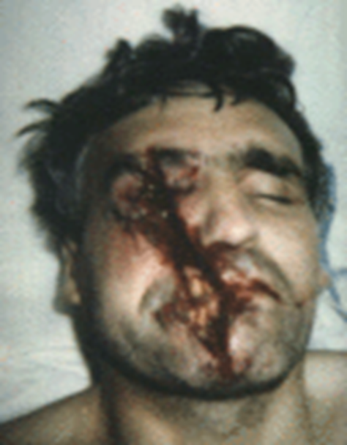
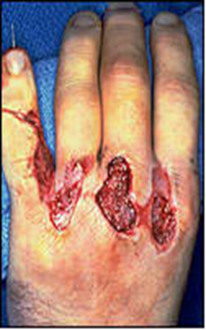
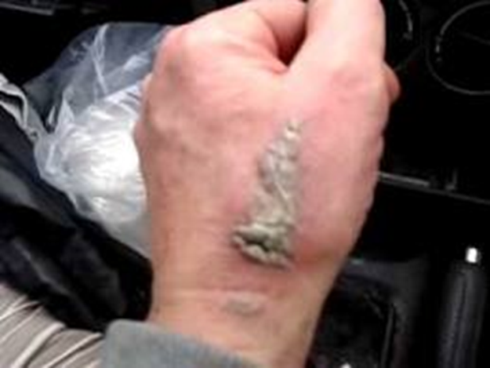
Abrasive Wheels Injuries
What parts of the body? Caution graphic images!!

Slide 9
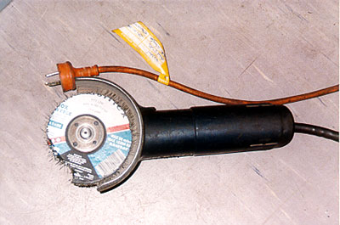
Sheet metal worker lost part of nose when disc shattered – disc subjected to excessive bending and pressure, overheated and shattered.

Slide 10
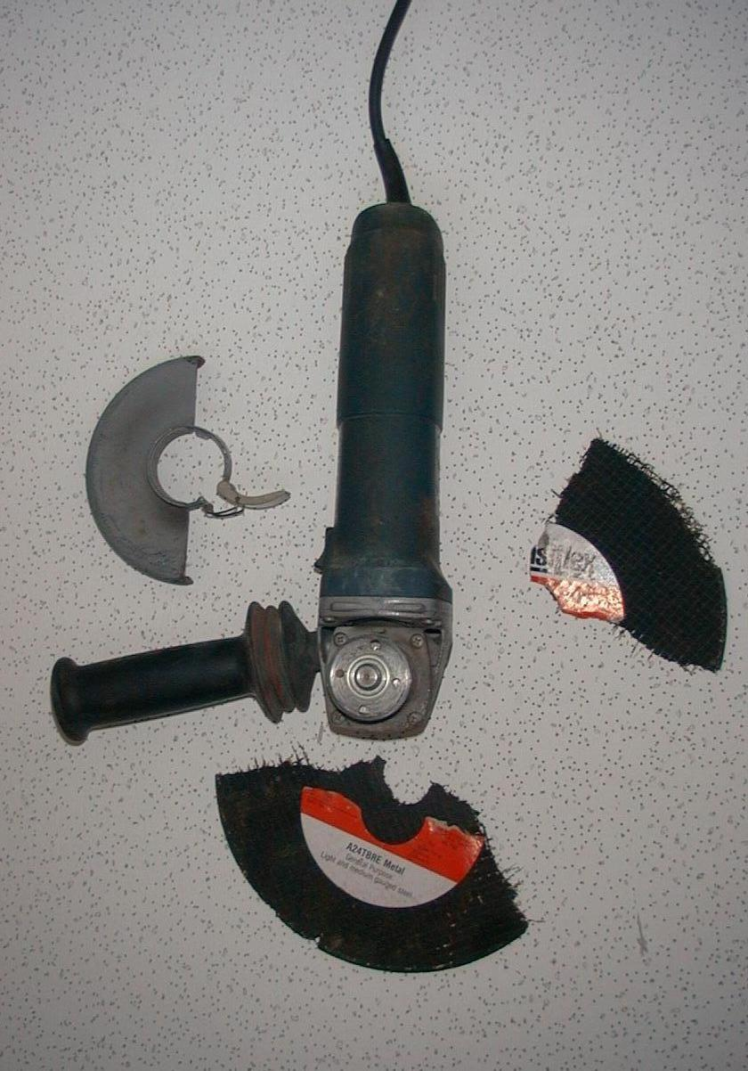
Using grinder without guard, wrong disc – fragments of shattered disc penetrated chest & stomach resulting in fatality of operator.

Slide 11
Q & A
Abrasive Wheels?
Examples?
Injuries?
Organic: How? Bonds? Characteristics? Uses?
Inorganic: How? Bonds? Characteristics? Uses?
Why?

Slide 12

Unit 2 Legislation
The aim of this module is to provide you with an understanding of your rights & responsibilities
At the end of this module you will be able to:
List the duties of the employer and employees,
State and explain the requirements of the Abrasive Wheels Legislation 2016,
Explain the implications of not complying with these requirements.

Slide 13
Safety Health & Welfare at Work
Duty of the employer
Duties of the employee
Safe Place of Work
Safe Access & Egress
Safe Systems of Work
Safe Plant and machinery
Provide PPE
Training
Risk Assessment
Supervision
Keep workplace tidy Follow procedures
Use machinery correctly/ Report defects
Wear PPE
Attend training/ stay awake!
Don’t endanger yourself or others
Notes:
Safety, Health & Welfare at Work 2005
Explain that this is the main piece of legislation governing Health & Safety in the workplace. It sets out in broad terms the responsibilities of different groups towards health & Safety.
Duty of the employer
First go through each duty of the employer and ask/ explain what they mean and their relevance to manual handling
Duties of employees
Ask them to tell which corresponding duties do employees have (you can prompt them.. So the employer must provide you with PPE, what must you do etc?:

Slide 14
Abrasive Wheels Regulation 2016
Must be suitable to the work
Must have expiry date, speed, restrictions of use
Must have any other information for safe use
Every machine must be marked with speed
Properly mounted by authorised personnel
Guards must be provided, secured, maintained
Rests must be provided, adjusted & secured

Slide 15
Case Study
Using 5-inch angle grinder on wrought iron gate
Abrasive wheel broke and pieces flew off
One piece flew off severing a large artery of leg
Wheel rated for 6,000 rpm, grinder 10,000
9 inch Wheel on 5 inch grinder
Guard not in place
What would you like to know in deciding on whether he got compensation?
Speed? Wheel rated for 6,000 rpm, grinder 10,000
Wheel size? 9 inch grinder on 5 inch grinder
Guard? Not in place.
Who told him? No one
Compensation?

Slide 16
Recap- Questions & Answers!
Duties of employers?
Duties of employees?
Abrasive Wheels Regulation requirements?
Implications for non compliance?
Notes:
Question and Answer session
It is a good idea to go through a Q & A session with your learners to test their understanding of what you have gone through.

Slide 17
Unit 3 Method of Marking
The aim of this module is to provide you with an understanding of the marking on a wheel
At the end of this module learners should be able to:
State the information on an abrasive wheel
Explain what this information stands for

Slide 18
What information?
Maximum permissible speed
Restrictions of use
Cutting V grinding?
Expiry date/ date of manufacture
PPE
Mounting direction
ISO type
Wheel identification

Slide 19

Wheel selection: Marking
Peripheral speed: m/s
Rotational speed: rpm

Slide 20
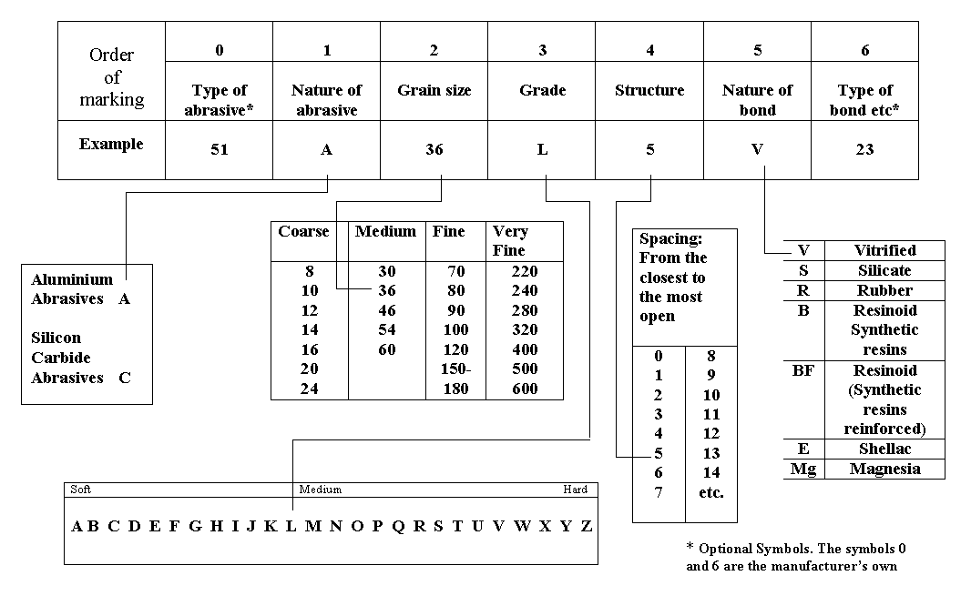
EUROPEAN SYSTEM FOR MARKING ABRASIVE WHEELS

Slide 21
Restrictions on use of Abrasive Wheels
RE1: Not permitted for hand-held and manually guided grinding;
RE2: Not permitted for hand-held cutting-off machines
RE3: Not suitable for wet grinding;
RE4: Only permitted for totally enclosed working area;
RE6: Not permitted for face grinding.

Slide 22


Disc information

Slide 23
Recap- Questions & answers
Wheel information?

Slide 24
Unit 4 Handling, Storage, transportation and inspection
The aim of this module is to provide learners with an understanding of how abrasive wheels should be inspected, handled & stored
.
At the end of this module learners will be able to:
List what an abrasive wheel should be tested for;
Inspect an abrasive wheel;
Carry out a ring test;
Explain how abrasive wheels should be handled;
Explain how abrasive wheels should be stored.

Slide 25
Handling, Storage & transportation
Store in a clean, dry and at room temperature
Keep out of direct sunlight and heat sources
Store away liquids, fluids and damp locations
Store to allow older wheels used first
Rotate stock and use within 2 years
Suitable racks, bins, drawers
Fragile: Handle with care
Do not drop, knock, strike

Slide 26
Visual inspection
Check for:
Cracks
Corrosion
Contamination
Warping
Expiry date

Slide 27
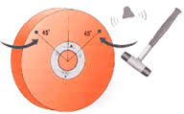
Ring test
Use non metallic implement
Tap wheels about 2 inches from edge
Rotate the wheel 45 degrees and repeat the test.
Thud = Dud

Slide 28
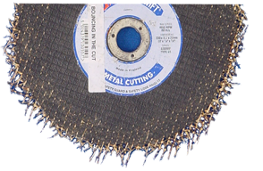
Notes:
BOUNCING IN THE CUT:
This condition is identified by a ragged and exposed fibreglass surrounding the wheel circumference.
Possible cause of failure:
A) Insufficient clamping of application
B) Incorrect product grade application
C) Anti-vibration pads or bearing worn on machine
D) Oversize wheel bore

Slide 29
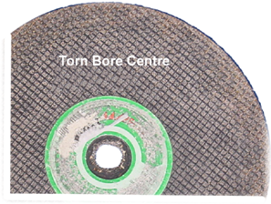
Notes:
TORN CENTRE BORE:
A ragged or torn bore hole identifies this condition. In some cases this is accompanied by a circular score pattern to the wheel face caused by the free spinning of the machine wheel clamping flange
Possible causes of the failure:
A) Clamping flange not reversed for use with thick or thin wheels 9”/230mmm or below
B) Insufficient tightening of the wheel clamping flange
C) Incorrect clamping flange arrangement
D) Incorrect wheel bore size

Slide 30
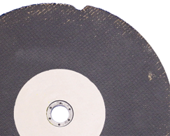
Notes:
SNAGGING IN THE CUT
This condition is identified by a ‘V’ or ‘L’ shaped fragment loss from the wheel circumference.
The cutting material must be supported or positioned so that the section being removed falls away and does not collapse on the wheel.
Apply a steady cutting momentum keeping the wheel straight
Possible causes of failure:
A) Insufficient clamping of application
B) Loss of cutting momentum
C) Excessive pressure applied
D) Lateral movement within the cut

Slide 31
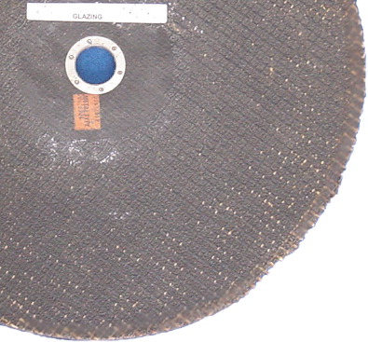
Notes:
GLAZING
This condition is identified by a band of glazing around the wheel edge; this is normally caused by an excessive build up of heat. Fragment loss may also occur due to a thermal breakdown of the resin bond.
Possible causes of failure:
A) Incorrect product grade selection
B) Excessive or insufficient pressure applied
C) Machine RPM too slow

Slide 32
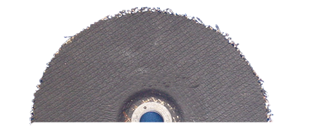
Notes:
BACK CHIPPING Also known as ‘Straw Hatting’ and ‘Spalling’.
This condition is identified by a continuous fragment loss around the wheel circumference, exposing the back fibreglass reinforcement.
Possible causes of failure:
A) grinding below the recommended angle
B) Excessive vibration i.e. application insecure or worn machine bearings.

Slide 33
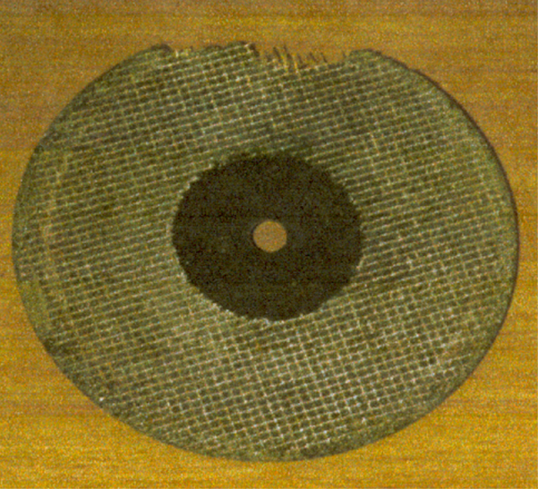
Notes:
EXCESSIVE FACIAL WEAR TO REINFORCEMENT
This condition is identified by excessive wear to the side wall fibreglass reinforcements, either across the entire face or in patches. In most cases this is caused by cutting soft abrasive materials e.g. sandstone, Thermalite building blocks.
(A diamond blade is better suited for cutting these soft abrasive materials)
Possible causes of failure:
A) Cutting soft materials
B) Using the face of the wheel to clean or smooth the material
C) Excessive side or lateral pressure within the cut

Slide 34
Recap
What do you inspect them for?
How do you carry out a ring test?
How should they be handled?
How should they be stored & transported?

Slide 35
Unit 5 Risk Assessment
The aim of this module is to you an understanding of the risks associated with abrasive wheels
At the end of this module you will be able to:
State the hazards and harm associated with abrasive wheels;
State the precautions required to control these.
Notes:
The aim of this module is to inspect & select an abrasive wheel

Slide 36
Explanations
What is Risk Assessment?
Identifying hazards
What is hazard?
Something that can cause harm?
What is harm?
Injury suffered
Controls?
Arrangements in place to reduce risk
Notes:
Ask what is risk assessment?
You can ask them what risk assessments do they carry out on a daily basis. Examples could include crossing the road!
Risk assessment is the identification of hazards (risk factors) and the reduction of risk
Ergonomics is organising workplaces and work to reduce the strain on people.

Slide 37
Hazards, Risks & precautions?
Hazards
Harm
Controls
Rotating wheel
Ejected materials
Sparks/ Fuel
Noise
Damaged leads
Contact
Faulty wheels
Vibration
Rubble
Dust
Entanglement
Eye/ face injury
Burns/ Fire
Hearing loss
Electrocution
Lacerations
Puncture wounds
White finger
Trips
Lung damage
No loose clothing, Guards, face shield
Overalls, check cap
Ear defenders
Inspect prior to use
Guards, secure Correct inspection, selection, handling, speed, use etc.
Rotation, gloves
Housekeeping
Mask

Slide 38
Recap
Hazards/ harm?
Precautions?

Slide 39
Unit 6 Components
The aim of this module is to give you an understanding of the different components of equipment
At the end of this module you will be able to:
List the components of AW equipment
State their function
List the precautions to be taken with these
Notes:
The aim of this module is to give you an understanding of the different components of equipment
At the end of this module you will be able to:
List the components of abrasive wheels equipment,
State their function, and,
List the precautions to be taken with these.

Slide 40
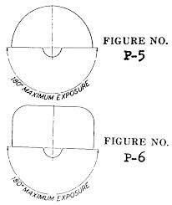
Guards
Function:
To protect against contact and ejected materials
Precautions. Make sure safety guards:
Are properly secured
Are positioned correctly
Are free from debris
Notes:
Guards
The function of guards is to protect operators and others against contact with the blade or wheel and from ejected materials.
Operators must ensure that Guards are,
properly secured,
positioned correctly and free from debris.

Slide 41
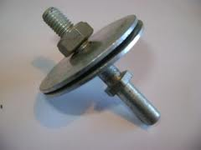
Flanges
Function:
To secure the wheel
Precautions. Make sure flanges are:
Free of exposed rough edges or surfaces.
not warped, worn or burred
Free of particles
Notes:
Flanges
The function of flanges is to secure the wheel to the spindle.
Operators must ensure that flanges are,
Free of exposed rough edges or surfaces.
not warped, worn or burred, and,
Free of particles.

Slide 42

Blotters
Function:
Prevent slipping at lower clamping force
Precautions: Make sure blotters are:
covering the entire flange contact area.
not scuffed or damaged
free from wrinkles
Notes:
Blotters.
Blo

Slide 43
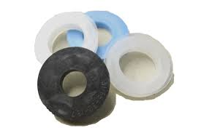
Bushes
Material:
Plastic or metal
Function:
Used to reduce the hole size on abrasive wheel
Precautions: Make sure bushes are:
measured correctly
not in contact with the flange
cannot come loose inside recess of flange
Fits freely on the spindle
Notes:
Bushes are inserts made of plastics or metal and used to reduce the
hole size in an abrasive wheel so that it can be mounted correctly on a small
diameter spindle. Bushes are hand-pressed into the hole of the wheel and are
not recommended for use with wheels fitted to portable grinding machines. They
should be slightly less than the width of the wheel and blotters. As the power
required to drive a grinding wheel is transmitted to it through the flanges, care
should be taken to ensure that the bearing area of the flange is in contact with the
wheel and not the bush.
58
Before using wheel bushes, the depth of the recess in the securing flanges
should be measured to see if it is possible for the bush to slide out of the wheel
and become loose in the recess of the flange. This is most likely to occur when
two narrow bushes are used one at each end of the hole as an alternative to one
bush extending the full width of the wheel. If the depth of the recess will allow this
to happen, the bushes should not be used and a wheel with a hole to suit the
machine spindle should be used.

Slide 44
Spindle
Function:
Rotates the wheel
Precautions: Ensure spindle is:
In good condition,
Rotates freely
Is secure
Threads are in good condition
Is straight
Bearings in good condition
Notes:
Spindles
The spindle rotates the wheel.
Operators must ensure that the spindle is,
Secure,
In good condition,
Rotates freely,
Is straight, and,
That threads and bearings in good condition

Slide 45
Recap Q & A
Guards, Function? Precautions?
Spindles, Function? Precautions?
Flanges, Function? Precautions?

Slide 46
Unit 7 Mounting, dressing, trueing and using an abrasive Wheel
The aim of this module is to provide you with an understanding of how to mount, dress and true an abrasive wheel.
At the end of this module you will be able to:
State the steps and precautions for mounting
State the steps and precautions for using
State the steps and precautions for dressing
State the steps and precautions for trueing

Slide 47
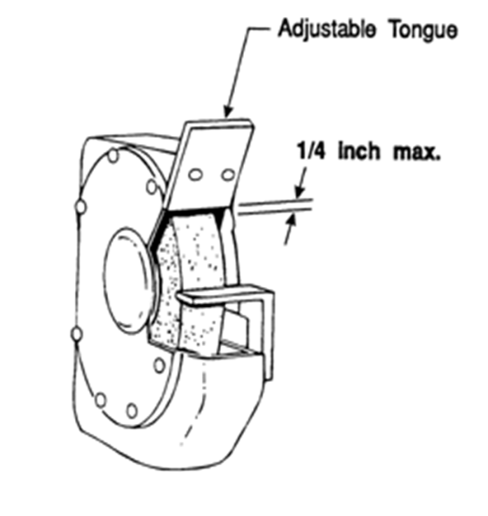
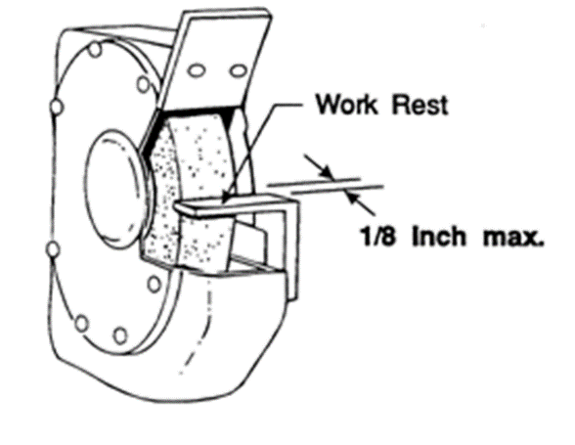
Mounting (Bench Grinder)
Disconnect from power source
Use correct tool to loosen outer nut
Remove inner nut/ flange/wheel
Check guard, flange, spindle
Check wheel and information
Hand tighten outer nut
Adjust tongue guard and work rest
Ensure guard is secure
Rotate wheel to check rotation
Notes:
Tightening order
Place the threads of the central spindle in the direction that allows the nut to tighten because of the force of the work being done.
Ensure all safety guards are in place.
Wear appropriate personal protective equipment (e.g. safety eye glasses with side shields/full face shield, dust mask, cotton gloves and hearing protectors).
Do not wear loose clothing, dangling jewellery and make sure that loose hair is tied properly.
Ensure work area and floor are clean.
Before turning on the power, the operator should turn the wheel by hand to check for appropriate wheel clearance.
Warn all persons to stay clear of the area where the wheel is used.
Stand to one side and test the wheel. Start and run the wheel for at least 1 minute. If any undue vibration occurs, switch off immediately and make adjustments. Never adjust moving machinery.

Slide 48
Wheel operation
Wear appropriate PPE
Stand to one side and test for 1 min
Avoid bumping
Do not jam work between wheel and tool rest
Gradually apply pressure
Don’t use side of wheel to grind
Move material back and forth across face of wheel
Use right wheel for the job

Slide 49
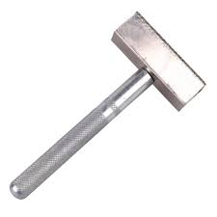
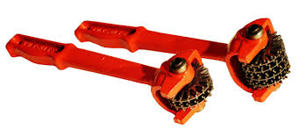
Dressing & Trueing (bench)
Use star or diamond dresser
Trueing- restoring even and circular shape
Vibrates excessively
Apply pressure evenly
Never use work piece to dress or true a wheel

Slide 50
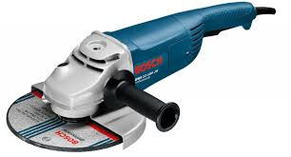
Mounting a handheld grinder
Disconnect from power source
Use key to loosen outer nut/ flange
Take care not to catch fingers
Remove old disc
Remove inner nut/ flange
Check for particles between contact surfaces
Check guard, flange, spindle
Ensure disc is orientated correctly
Tighten outer nut/flange (Do not over tighten)
Ensure guard is oriented correctly
Rotate disc to ensure it is rotating correctly

Slide 51
Handheld grinder operation
Check environment for fuel
Allow to reach its operational speed
Ensure correct disc for the job
Ensure correct stance
Ensure work-piece is secured correctly
Avoid bumping or twisting blade
Apply pressure gradually
Allow to stop before placing down

Slide 52

Fitting an abrasive wheel on a Con Saw
The engine must be switched off
Use pin & wrench to loosen the screw.
Remove the flange & wheel
Check, guard, flange, spindle
Check condition and information on new disc
Note the direction of rotation when replacing
Tighten the screw with wrench.
Draw the locking pin out of the guard.
Rotate wheel to check it is mounted correctly

Slide 53
Recap Q & A
Safe operation?
Demonstration

