Slide 1

PMAV Course
Presented by

Slide 2

Basic Housekeeping Rules
Phones: Please keeping on silent and leaving meeting if necessary
Health & Safety: Leave immediately using fire exits and go to assembly point
Schedule and breaks: Course times are 9.30 to 3.30. Breaks at 11am and 1pm
Participation: Participation is expected, and questions used to check progress
Assessment: Presentations, Test, Skills assessment
Resources: Resource folder containing videos and guides

Slide 3
Contents
Introduction to PMAV
PMAV & the Law
PMAV Risk Assessment
Assault Cycle
PMAV Skills
Physical Intervention

Slide 4

Course Aim
The aim of this course is to provide you with the
Knowledge, skills and attitude to be able to manage of aggression and violence in the workplace
Notes:
Course aim:
It is important that you state clearly the aim of the course.
The aim of this course is to provide you with the Knowledge, skills and attitude to be able to train others how to perform manual handling tasks safely & efficiently.

Slide 5
Introduction to PMAV
On completion of this module, you will be able to:
Explain the terms Anger, Aggression & Violence
List who is at greatest risk
Explain why Aggression & Violence needs to be managed
State the % of reportable injuries attributable to Violence & Aggression

Slide 6
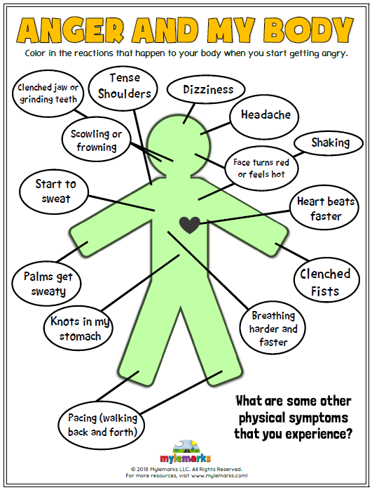
Anger
What anger is
Anger is an emotional state that sometimes leads to aggression.
Symptoms
Heart thumping, tense muscles, fast breathing, raised blood pressure.
Signs
Fast and loud speech, drumming fingers on a table, rocking etc.

Slide 7
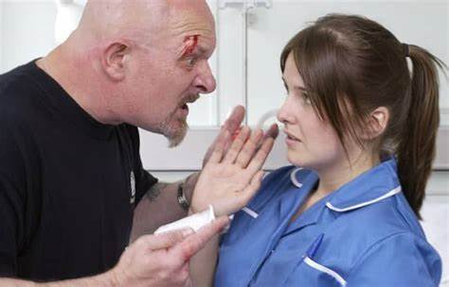

Definition of Aggression and Violence
“any incident where staff are abused, threatened or assaulted in circumstances related to their work, involving an explicit or implicit challenge to their safety, wellbeing or health.” HSE/EU

Slide 8


Who is at greater risk?
Lone Workers
Night shift Workers
Community Workers
Enforcement workers
Healthcare Staff
New, inexperienced workers

Slide 9




Why Prevent and Manage Aggression & Violence?
Legal duty under Safety, Health & Welfare at Work 2005
Required by HSE, HIQA & MHC
Staff morale
Client & Staff safety

Slide 10
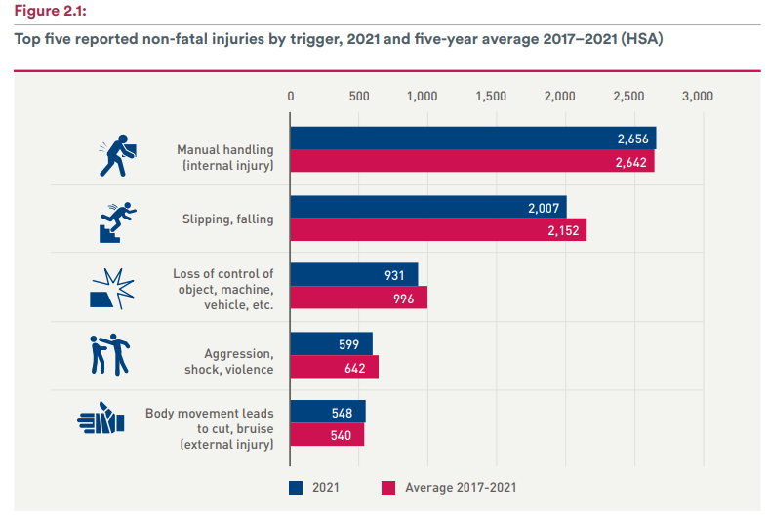
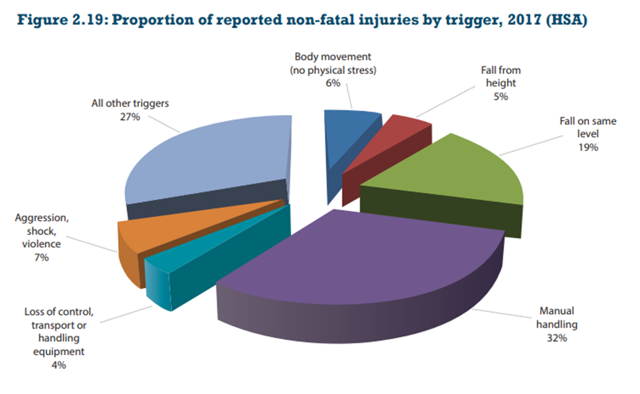
Statistics

Slide 11
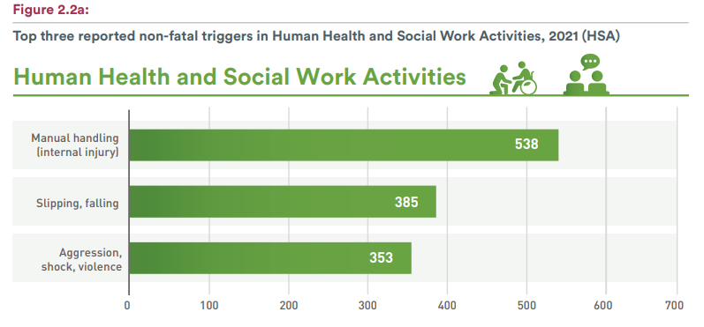
Statistics
Healthcare accounts for
59%
of all Aggression, shock & violence cases

Slide 12
Recap
What is Violence & Aggression?
What is Anger?
Why does it need to be managed?
Who is at greater risk?
What % of reportable incidents and due to Violence & Aggression?

Slide 13
PMAV & the Law

Slide 14
On completion of this module learners will be able to:
List applicable legislation
List the duties of employers & employees under the S, H,WWA 2005
List the rights outlined in the Human Rights Act 2003

Slide 15

Legal framework
Constitutional & Common Law
Safety, Health & Welfare at Work Act 2005
Human Rights Act 2003
Mental Health Act 2001-2018
MHC Code of Practice on the Use of Physical Restraint (Revised 2022)

Slide 16
Safety Health & Welfare at Work 2005
Duty of the employer
Duties of the employee
Safe Place of Work
Safe Access & Egress
Safe Systems of Work
Safe Plant and machinery
Provide PPE
Training
Risk Assessment
Supervision
Keep workplace tidy and exits clear
Follow procedures
Report incidents/ issues
Wear PPE
Attend training & participate
Don’t endanger yourself or others
Co-operate
Notes:
Safety, Health & Welfare at Work 2005
Explain that this is the main piece of legislation governing Health & Safety in the workplace. It sets out in broad terms the responsibilities of different groups towards health & Safety.
Duty of the employer
First go through each duty of the employer and ask/ explain what they mean and their relevance to manual handling
Duties of employees
Ask them to tell which corresponding duties do employees have (you can prompt them.. So the employer must provide you with PPE, what must you do etc?:
16

Slide 17

Human Rights Act 2003
  Right to life
  Not to be subjected to torture or to inhuman or degrading treatment or punishment
  Personal liberty (Exceptions include the “lawful detention of Persons of Unsound Mind)”
  Freedom of expression
  The right to fair procedures
  Bodily integrity
  Religious liberty
  Privacy

Slide 18
O’Connor V Nice Residential Home Ltd
O’Connor has a healthcare worker working in a Residential House
Heard a cry for assistance from a resident
Went into the house as was assaulted
What questions would you like to ask?
Trained?
Yes
Controls in place?
Yes. Care plan outlining history of violence must only provide care in pairs. Carry Alarm
Went in on his own and did not carry alarm
Compensation?
No. Deemed to be negligent as did not follow Care Plan

Slide 19
Recap
What legislation applies to PMAV?
What are the Duties of the Employer?
What are the Duties of Employee?
What are our human rights?

Slide 20

PMAV Risk Assessment

Slide 21
At the end of this module, learners will be able to:
Explain the terms risk assessment, risk factors & controls
List and explain the different types of risk assessments
List and explain the different risk factors
Suggest solutions to reduce the risk
Suggest controls to ensure the safety of lone workers
Notes:
The aim of this module is to provide the learners with the skills to be able to identify risks associated with manual handling tasks
21

Slide 22
Explanations
What is Risk Assessment?
Identifying hazards
Hazard
Things that can cause harm
Risk Factors
Factors that increase risk
Controls
Solutions put in place to reduce the risk
Notes:
22
Ask what is risk assessment?
You can ask them what risk assessments do they carry out on a daily basis. Examples could include crossing the road!
Risk assessment is the identification of hazards (risk factors) and the reduction of risk
Ergonomics is organising workplaces and work to reduce the strain on people.

Slide 23
Types of Risk Assessments
Ward/department risk assessment
Task specific risk assessment;
Individual clinical risk assessment
Completed on each service user on admission/ referral
Reviewed every four months or
When initial assessment is no longer valid
Dynamic Risk Assessment
Carried out on the spot by employees prior to task
Notes:
23

Slide 24
Risk Factors
Service user:
Mental state, Physical factors (pain, hunger, fatigue) Unmet needs
Service provider:
Attitude, experience, confidence, training, communication skills
Interaction:
Denial of requests, enforcing rules, removal of personal object
Environment:
Decor, heat, cold noise, overcrowding

Slide 25
Clinical Risk Factors
History:
History of violent or aggressive behaviour, nonadherence to rules
Clinical:
Bi-polar disorder, impulse control disorder, Drug or alcohol abuse
Context:
Unstable or unsupportive family environments, fractured relationships
Gender:
Males generally can be more aggressive
Age:
Juveniles are more associated with violent crime

Slide 26
Control measures?
Working environment : Layout, space, fixtures & fittings
Information & signage for service users
Access & Egress (Safe areas and/or Access control)
Security systems/CCTV, monitors/alarms/ mobile phones/ radios
Guidance & Training on dealing with difficult people
Lone Working policies & procedures
Emergency Plans/Procedures
Incident Management

Slide 27


Lone Worker Risk Factors
Risk of violence
High Risk Confined space
Age of the workers (young, old, disabled, untrained)
English is not their first Language

Slide 28

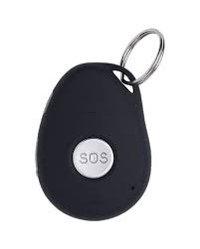
Lone Worker Safety
Provide lone workers with a client history prior to the visit
Provide lone workers with emergency alarm
Inform people where you are going and what time to be expected back
Match lone worker skills to client support needs;
Withdraw from a situation if they feel at risk;
Review the building security arrangements where there is a lone worker
Notes:
Guidance on Lone Working in the Healthcare Sector
28

Slide 29
Dynamic Risk Assessment
Risk Assess: Aggressor, scene & situation
Respond: Retreat! Help. Defend, Breakaway as appropriate
Position: Location of a person or object, exit
Proximity: Nearness in space or time
Posture: A position of a person’s body

Slide 30
Recap
What is a Risk assessment?
What is a Dynamic Risk Assessment?
What is a hazard?
What are Risk factors?
What are Controls?
What are the Clinical Risk Factors categories?
Notes:
30

Slide 31
Assault Cycle

Slide 32
On completion of this module, you will be able to:
Explain the Assault Cycle
List the signs and symptoms of each phase of the assault cycle
Explain the interventions for each phase

Slide 33
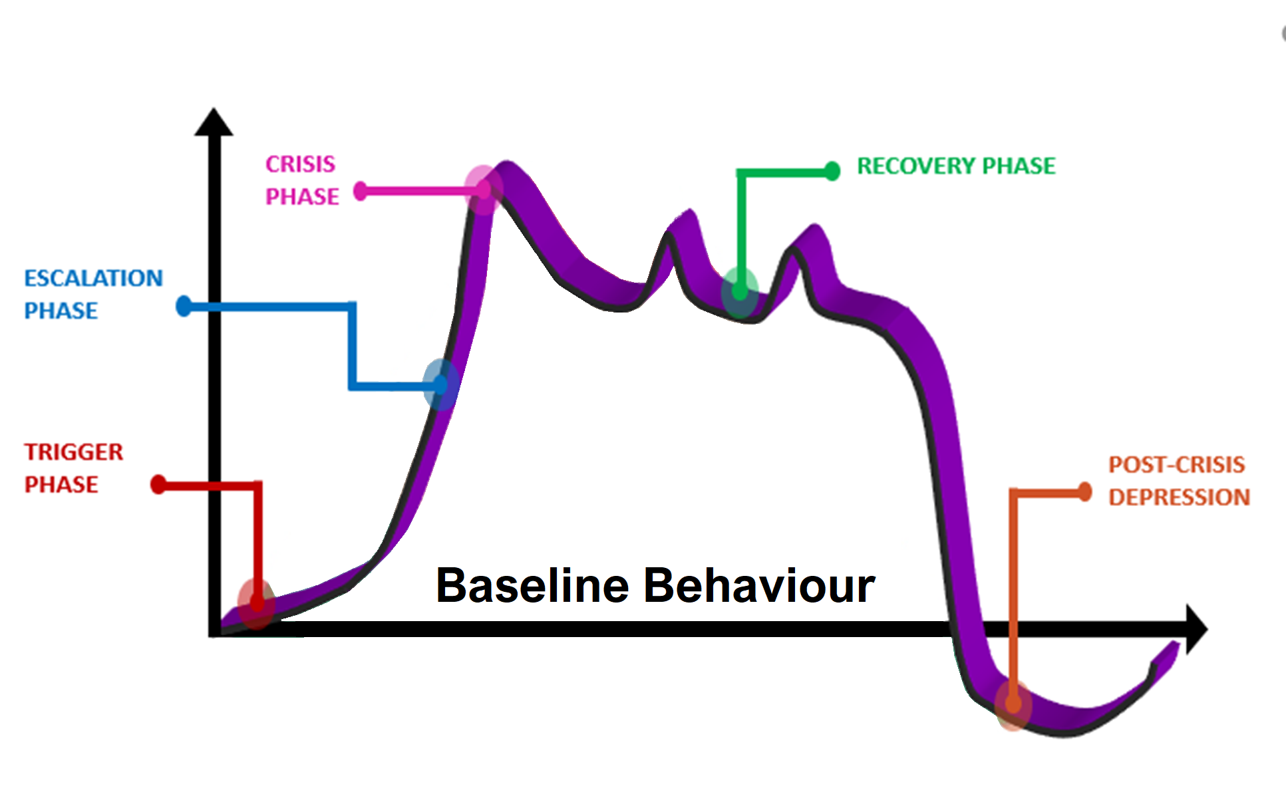
Assault Cycle
What?
A model used to explain the typical progression of an assault
Why?
To assist in identifying the triggers, signs and symptoms and appropriate intervention at each phase

Slide 34
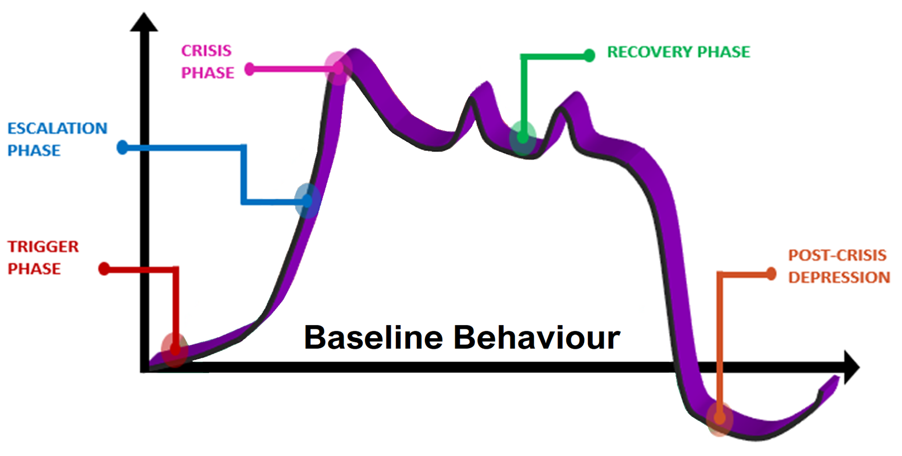
Phase 1: Trigger Phase
External: Environment, People telling them what to do
Internal: Fear, dementia etc.
Symptoms:
Fear, Confusion, frustration
Annoyance, Anxiety
Signs:
Restlessness, pacing, fidgeting
Interventions:
Verbal communication.
Distract, Reassure, Reduce stress.

Slide 35
Phase 2: Escalation Phase
Unresolved issues remain
Symptoms (fight or flight)
Blood pressure raised,
Anxious and angry
Signs (physical aggression unlikely)
Staring, aggressive tone,
Volume increases, pacing,
Mumbling, clenched fists
Interventions
Nonverbal communication: Agitated person responds better
Dynamic Risk Assessment (your safety & others)
Control your emotions, remain calm
Notes:
Remember, if you feel or get a sense of risk to your safety, you should attempt to create distance or leave/escape from the person. This should be your preferred option.
During an escalating crisis, the use of non-verbal communication is crucial to de-escalating a situation. An agitated person will focus on non-verbal communication (proxemics, kinesics and paraverbals) more than verbal communication due to the ‘fight or flight’ response to threat (that both person and staff are experiencing).
Staff might subconsciously adopt a stance/posture which could be mistaken for an aggressive stance. How you present when standing in front of an angry person will play a large part in your own personal safety and how effectively you manage the situation.

Slide 36
Phase 3: Crisis Phase
Behavioural pattern explodes into physical assaults on perceived source of threat.
Symptoms:
Impaired hearing and Inability to reason
May not feel pain
Signs:
Total loss of control,
Violent and reckless behaviour
Risk of harm to self or others
Interventions
Dynamic Risk Assessment (Consider your own and other’s safety)
Retreat. Alert others, call for help/backup, raise alarm
Defend/Breakaway/ Physical intervention if required

Slide 37
Phase 4: Plateau/Recovery Phase
Heightened perception of threat still present
Symptoms:
Tired. Guilt, remorse.
Signs:
Arousal level may visibly reduce
Possible further violent behaviour
Intervention:
Use silence & closed questions
Would you like a glass of water?
Engage constructively with the patient
Problem solve & re-build trust

Slide 38
Phase V Post-Crisis
Symptoms:
Fatigue, depression, guilt
Signs:
Reduced exertion, (fetal position)
Crying, hiding, sleeping,
Interventions
Monitor & Facilitate return to normal
Debrief Service user and staff (Facts, Patterns, Triggers)
Communicate with user to re establish trust and prevent another crisis
Seek alternative ways for them maintain self-control

Slide 39

Case study

Slide 40
Recap
Explain the Assault Cycle
List the different phases of the assault cycle
List the signs at the different phases
Outline the interventions at the different phases

Slide 41

Communication
At the end of this module, you will be able to:
Explain what communication is
List the barriers to communication
Outline the do’s and don’t of verbal and non-verbal communication
Outline the do’s and don’t of active listening
Demonstrate good verbal communication skills
Demonstrate good non-verbal communication skills

Slide 42
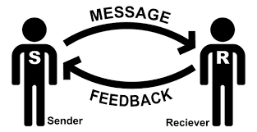
Communication
What ?
Sharing, Imparting or exchanging of information
Key terms:
Sender: Person sending the message
Receiver: Person receiving message
Channel: Medium for imparting the message
Feedback: Response to the message
Noise: Interference in the with the channel capacity
Notes:
The word 'communicate' derives from the Latin word communica re, which means to share, impart or make common (Oxford Dictionaries 2014).
The definition of communication is the activity of conveying meaningful information through the process of sending and receiving messages between two or more individuals , ((Stephenson
2008).
Key Terms Used in Communication Theory
Receiver: A receiver is the person the message is sent to and who interprets the message. Some messages are literal and others have an implied meaning. For instance, is there ever an implied meaning to the question, 'Would you like to come in for a cup of coffee'?Message: This term has two aspects - the message the sender wants to communicate and the message the receiver interprets.
People often think or say, 'Did I get that message across?’
Code: Code is the way in which the sender (or source) wraps the message: the choice of language; the tone and body language that accompany a spoken message.
Channel: This is the way the message is transmitted, for example orally (face to face, by telephone), in actions or in writing (e.g. email).Noise: Noise means any kind of interference which interrupts or prevents the successful transmission of the message. It can be physical - pain can inhibit effective communication or the receiver may have a hearing, sight, speech or cognitive impairment; emotional - mistrust between the sender and receiver interfering with the message; psychological - a receiver who is tired and finding it difficult to take in a lengthy, complicated message; or technological - a fear of computers may prevent a person from using one to communicate.
Feedback: If the process of communication is two-way and participative, the receiver will issue a response to the message. This response is called feedback. In doing this, the receiver then becomes the sender of a new message, creating a reciprocal process as the cycle begins again.
Context: This means the situation in which the communication takes place. It usually refers to time and place but may also include the people involved, for example at work in a hospital, or in a social venue like a pub.

Slide 43
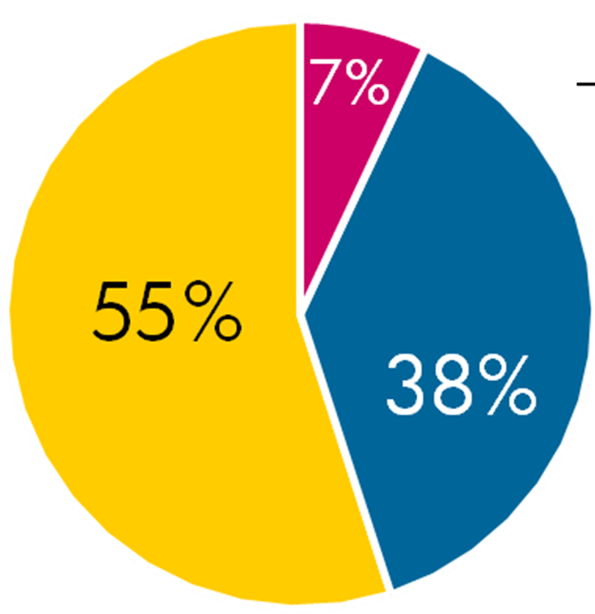
Verbal and Non-Verbal Communication
What?
38% Verbal: Tone of voice, pitch, etc.
55% Nonverbal: Body language, facial expressions, etc.
7%: Words: The actual words spoken
Words
Verbal
Non-verbal
Notes:
It's commonly believed that nonverbal communication makes up the vast majority of how we communicate. This idea likely stems from research by Albert Mehrabian in the 1960s. His studies focused on the impact of vocal delivery and facial expressions on understanding emotions. Mehrabian concluded that communication effectiveness is influenced by:
38% Verbal: Tone of voice, pitch, etc.
55% Nonverbal: Body language, facial expressions, etc.
7% Words: The actual words spoken
From this, came the idea that 93% of communication is nonverbal. However, it's important to consider some caveats:
Context Matters: Mehrabian's research focused on isolated words expressing emotions, not everyday conversations. In situations where the content of the message is crucial, the verbal aspect likely carries more weight.
Oversimplification: The 7-38-55 rule doesn't account for cultural differences or the fact that nonverbal cues can be ambiguous and open to interpretation.
So, while nonverbal communication is undeniably important, the exact percentages are debatable. It's more accurate to say that both verbal and nonverbal elements work together to convey meaning effectively.

Slide 44
Good use of your Voice
Pitch and tone: Vary your tone and pitch.
Power: Not too loud or low.
Pace: Not too fast or slow.
Pronunciation: Ensure to articulate clearly.
Emphasis: Ensure to emphasise important words
Notes:
Pitch and tone: Younger people have a naturally higher tone which deepens with age. The pitch and tone of a person's voice can communicate emotions such as whether they are sad, anxious, scared, happy or excited. Emotions can be communicated by a meek, low, slow voice or an accelerated, louder, gasping voice, which can run off into a pitch that is different from normal (a way of controlling this is to relax the muscles in the stomach, chest, shoulders and neck, and take controlled deep breaths with natural pauses in rhythm).
A monotonous tone is when the person does not change their tone or allow any emotion into their voice and delivery, which can be boring and unexciting to listen to. Inflection is the change of voice pitch depending on the message the person wants to convey. It can also add to the words being spoken by stressing particular words to communicate extra or implied meaning.
A monotonous tone is when the person does not change their tone or allow any emotion into their voice and delivery, which can be boring and unexciting to listen to. This can enhance delivery and keep people interested; however, or 'how-ev-vaaaah' (Lauren from The Catherine Tate Show, see the link www.youtube.
Power: It is important to judge how loudly to speak. Over-loud voices can be off-putting and communicate the idea that the person is brash, boisterous and unable to listen; very quiet voices can suggest that a person is easily manipulated, meek or unassertive, or that they do not know what they are doing. If you are presenting to a group and people have to strain to hear you, they are likely to become irritated or lose interest. Hence, volume and control are extremely important when communicating with someone with any form of sensory disability.
something the listeners want to communicate to them. Self-awareness is key, as fast and slow speakers often do not recognise these tendencies. During a presentation it is important for the speaker to check how they are speaking, take pauses and reiterate as well as checking that the audience has heard and understood them.
Pace/speed: Again, emotion can interfere with the ability to exert control in this area. If a person speaks too quickly or too slowly, they can easily lose their listeners and possibly miss out on
Articulation: This relates to, for example, contracting words and sentences, such as 'dontcha' and 'howya'. While this is fine in everyday use, it is not acceptable in more formal speech
Emphasis: We stress certain words to encourage the listener to receive a specific part of the information, for example 'Don'tyou ever do that again' or 'The train leaves from platform
number.
Inflection is com/watch?v=ZjD_7bRYOral Communication Skills

Slide 45
Voice
Do’s
Don’ts
Have a calm, friendly tone
Project your voice
Ensure a good pace
Pronounce your words
Use simple terms
Whisper, Shout, Monotone
Speak too fast or slow,
Mumble
Use jargon or complex terms
Notes:
Pitch and tone: Younger people have a naturally higher tone which deepens with age. The pitch and tone of a person's voice can communicate emotions such as whether they are sad, anxious, scared, happy or excited. Emotions can be communicated by a meek, low, slow voice or an accelerated, louder, gasping voice, which can run off into a pitch that is different from normal (a way of controlling this is to relax the muscles in the stomach, chest, shoulders and neck, and take controlled deep breaths with natural pauses in rhythm).
A monotonous tone is when the person does not change their tone or allow any emotion into their voice and delivery, which can be boring and unexciting to listen to. Inflection is the change of voice pitch depending on the message the person wants to convey. It can also add to the words being spoken by stressing particular words to communicate extra or implied meaning. This can enhance delivery and keep people interested; however, or 'how-ev-vaaaah' (Lauren from The Catherine Tate Show, see the link www.youtube.
Volume: It is important to judge how loudly to speak. Over-loud voices can be off-putting and communicate the idea that the person is brash, boisterous and unable to listen; very quiet voices can suggest that a person is easily manipulated, meek or unassertive, or that they do not know what they are doing. If you are presenting to a group and people have to strain to hear you, they are likely to become irritated or lose interest. Hence, volume and control are extremely important when communicating with someone with any form of sensory disability.
Emphasis: We stress certain words to encourage the listener to receive a specific part of the information, for example 'Don'tyou ever do that again' or 'The train leaves from platform
number
Pace/speed: Again, emotion can interfere with the ability to exert control in this area. If a person speaks too quickly or too slowly, they can easily lose their listeners and possibly miss out on something the listeners want to communicate to them. Self-awareness is key, as fast and slow speakers often do not recognise these tendencies. During a presentation it is important for the speaker to check how they are speaking, take pauses and reiterate as well as checking that the audience has heard and understood them.
Articulation: This relates to, for example, contracting words and sentences, such as 'dontcha' and 'howya'. While this is fine in everyday use, it is not acceptable in more formal speech
A monotonous tone is when the person does not change their tone or allow any emotion into their voice and delivery, which can be boring and unexciting to listen to. Inflection is com/watch?v=ZjD_7bRYOral Communication Skills

Slide 46
Non-Verbal Communication
The following are some of the ways we can communicate non-verbally:
Eye Contact:
Maintain appropriate eye contact. Not too much or too little.
Facial Expressions:
Smile, raise eyebrows, or nod in acknowledgement
Posture:
Open posture
Gestures:
Use appropriate hand gestures
Notes:
Non-verbal and visual communication play a crucial role in both personal and work-related settings. Let’s explore how to use them effectively:
Eye Contact: Maintain appropriate eye contact to convey interest and attentiveness. Too much or too little eye contact can send unintended messages.
Facial Expressions: Use smiles, raised eyebrows, or nods to show engagement and understanding. A warm smile can create a positive atmosphere.
Posture: Sit or stand with an open posture to signal openness and willingness to communicate. Avoid crossing arms, which may appear defensive.
Gestures: Use hand gestures to emphasize points or express agreement. Be mindful of cultural differences in gesture meanings.

Slide 47
Eye Contact/Facial expressions
Do’s
Don’ts
Maintain when talking
Look at everyone
Smile & nod
Don’t turn your back
Stare, Look at one person
Roll your eyes,
Frown,
Shake your head

Slide 48
Hand gestures/ Movement Exercise
Do’s
Don’ts
Animated & open
Steady stance
Move with purpose
Point & cross arms
Don’t slouch
Don't put hands in pockets

Slide 49
Non-Verbal Communication
Do’s
Dont’s
Good eye contact
Open posture with hands ready
Nod in acknowledgement
Point or cross arms
Frown/ stare
Stand in their personal space

Slide 50
Barriers to Effective Communication
Physical (External)?
Emotional (Internal)?
Language & Culture
Noise & Distractions
Temperature
Pain
Alcohol or Drugs
Mental Health
Intellectual Disabilities
Physical Disabilities: Hearing, Speech
Anxiety
Confusion
Frustration
Anger
Stress
Fear/worry
Bad news
Lack of trust

Slide 51
Listening
What?
Listening is to the process of hearing what the person is saying, encompassing not only the words that are being used, but also the nonverbal aspects of the encounter.
Why?
It is essential to good communication
Notes:
Types of Listening Required in Different Contexts
Listening is as important if not more important than speaking, because without effective listening skills it is difficult to communicate with others.
Listening is a key element essential for effective helping. Often people are concentrating on their own problems, thoughts and feelings rather than listening to others,
As the Chinese proverb says, 'Listen with your eyes, listen with your ears, listen with your heart and give undivided attention.
U6b8Le3-yEc&feature=related
• Everybody Loves Raymond uses active listening: www.
youtube.com/watch?v=4VOubVB4CTU
Demonstrate a range of listening behaviours appropriate to the context, such as eye contact, facial expression, encouragement and control of one's own responses.
Discuss a variety of examples of times at work when you find it difficult to listen effectively.
Watch the Managing Disclosure section of the Open Your Eyes to Elder Abuse in the Community video below as an example of good listening behaviours. Pay attention to how the community nurse communicates with Margaret and demonstrates effective and empathetic listening skills.
• www.youtube.com/watch?v=PkdoeSXj5fo&index=8&list=

Slide 52
Good Listening Skills
Effective Listening Skills is demonstrated by:
Making Eye Contact: Maintain appropriate eye contact with the person speaking.
Receiving Information: Be open and receptive to the information being shared.
Interpreting Information: Try to understand the underlying message or intent
Control of Personal Response: Keep your emotions in check
Active Listening: Nod and use affirmative words, and paraphrasing
Asking Clarifying Questions: If something is unclear, seek clarification.
Providing Feedback: Provide constructive feedback when appropriate.
Respect Different Perspectives: Understand that people may have different views
Notes:
Demonstrating effective listening skills, especially in a work environment where you’re working under general direction, is crucial. Here are some tips on how to do this:
Making Eye Contact: Maintain appropriate eye contact with the person speaking. This shows that you’re focused and paying attention to what they’re saying.
Receiving Information: Be open and receptive to the information being shared. Avoid interrupting the speaker and let them finish their thoughts before you respond.
Interpreting Information: Try to understand the underlying message or intent behind the words. Pay attention to the speaker’s tone, body language, and other non-verbal cues.
Control of Personal Response: Keep your emotions in check and avoid reacting impulsively to what’s being said. Take a moment to process the information before responding.
Active Listening: Show that you’re engaged in the conversation by nodding, using affirmative words, and paraphrasing or summarizing what the speaker said to confirm your understanding.
Asking Clarifying Questions: If something is unclear, don’t hesitate to ask for clarification. This shows that you’re actively trying to understand the information.
Providing Feedback: Provide constructive feedback when appropriate. This can help the speaker know that you’ve understood their point and are considering it.
Respecting Different Perspectives: Understand that people may have different perspectives. Respect these differences and try to understand their point of view.
Remember, effective listening is about more than just hearing the words that are being said. It’s about understanding the complete message being communicated and responding in a thoughtful and respectful manner. Good luck!

Slide 53

Active listening
Maintain appropriate eye contact
Consider appropriate body language, leaning in generally shows more interest
Listen to the individual
Use appropriate facial expressions, e.g. nodding; show you are listening
Use appropriate confirmation words without interruption; e.g. ok, ah huh
Recap to confirm listening and understanding
Notes:
Outline what is meant by active listening

Slide 54
Active Listening Exercise
Do’s
Don’ts
Respond honestly
Paraphrase
Show clear interest
Give undivided attention
Listen to understand
Nod in acknowledgement
Argue
Interrupt
Give advice
Discount people’s feelings

Slide 55

Listening skills Exercise
Notes:
Watch the Managing Disclosure section of the Open Your Eyes to Elder Abuse in the Community video below as an example of good listening behaviours. Pay attention to how the community nurse communicates with Margaret and demonstrates effective and empathetic listening skills.

Slide 56
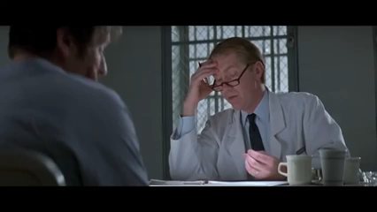
Poor Listening Skills Exercise

Slide 57
Verbal Deescalating situations?
Here are some steps you can take:
Stay Calm:
Active Listening:
Empathize:
Avoid Argument:
Offer Solutions:
Use a Soft Tone:
Take a Break:
Notes:
Deescalating aggressive situations, whether on the phone or face-to-face, requires a calm demeanor, active listening, and effective communication. Here are some steps you can take:
Stay Calm: Maintain your composure and try to stay as calm as possible. Your calmness can help to defuse the situation.
Active Listening: Show that you are listening and understanding their concerns. Use phrases like “I understand that you’re upset because…”.
Empathize: Try to understand the other person’s point of view and validate their feelings. You might say, “I can see why you would be upset about that.”
Avoid Argument: Do not argue or try to prove the other person wrong. This can escalate the situation further.
Offer Solutions: If possible, offer solutions to their problem or concern. This shows that you are willing to help and resolve the issue.
Use a Soft Tone: Speak in a soft, low tone. This can have a calming effect and can prevent the situation from escalating.
Take a Break: If the situation continues to escalate, suggest taking a break and returning to the conversation when everyone has had a chance to calm down.

Slide 58
Non-Verbal Descalation
Position: Avoid blocking their exit or causing them to feel trapped or threatened
Attitude. Positive and Supportive
Look & Listen: Appropriate eye contact and active/empathic listening
Make Space: Maintain a safe distance
Stance: Relaxed and non-threatening posture, Side-on, Hands above naval, Natural movements
If the situation becomes threatening or violent, seek help immediately.
Notes:
Position: Avoid blocking their exit or causing them to feel trapped or threatened
Attitude. Positive and Supportive
Look & Listen: Appropriate eye contact and active/empathic listening
Make Space: Maintain a safe distance
Stance: Relaxed and non-threatening posture, Side-on, Hands above naval, Natural movements
Remember, it’s important to ensure your own safety. If the situation becomes threatening or violent, seek help immediately. It’s always okay to remove yourself from a situation if you feel unsafe.

Slide 59
Recap
Explain what communication is
List the barriers to communication
Outline the do’s and don’t of verbal and non-verbal communication
Outline the do’s and don’t of active listening
Demonstrate good verbal communication skills
Demonstrate good non-verbal communication skills

Slide 60
PMAV Skills

Slide 61
Basic Housekeeping Rules
Phones: Please keeping on silent and leaving meeting if necessary
Health & Safety: Leave immediately using fire exits and go to assembly point
Schedule and breaks: Course times are 9.30 to 3.30. Breaks at 11am and 1pm
Participation: Participation is expected, and questions used to check progress
Assessment: Presentations, Test, Skills assessment
Resources: Resource folder containing videos and guides

Slide 62
On completion of this module learners will be able to:
List the Safety Principles
Explain the 3 P’s
Explain ARC
List the vulnerable areas
Defend against kicks, slaps or punches
Breakaway from holds to clothing, wrists, hair or body
Restraint a service user safely

Slide 63
Safety Checks
Let the instructor know of any limitations
Remove jewellery, bracelets & watches
No force to be used
Respect each other

Slide 64
Safety Principles
Risk Assess: Person. Assess immediate risk to you and others
Respond: Retreat and Raise alarm. Always consider your own safety first
3 P’s
Position: Exits, obstacles & others
Posture: Broad stable base, side on, Hands open, looking forward
Proximity: Outside personal space/Arc (accounts for 70% of injuries).

Slide 65
Vulnerable Areas
Vulnerable areas include:
A: Neck & Head (High risk area)
B: Torso (Medium Risk Area)
C: Groin (High Risk Area)
D: Legs (Low Risk Area)

Slide 66
Defence against Kicks, Slaps & Punches
Risk Assess: Assess immediate risk to you and others
Respond: Retreat. Seek assistance. Always consider your own safety first
3’Ps:
Position: Exits, obstacles & others
Posture: Broad stable base, side on, Hands in defensive position, looking forward
Proximity: Outside personal space/ARC
Defend. Move and back into defence

Slide 67
Breakaways
Risk Assess: Assess immediate risk to you and others
Respond: Retreat to secure safety. Always consider your own safety first
3 P’s:
Position: Exits, obstacles & others
Posture: Broad stable base, side on, Hands open & looking forward
Proximity: Outside personal space/Arc (accounts for 70% or injuries).
Release:
Prompt/ cue, Firm Palm grip, Push/Pull, Rotate, levers, emergency response
Move and defend

Slide 68
Recap
What are the 2 R’s & 3 P’s?
What is the ARC?
What are the vulnerable areas that should be protected?

Slide 69
Physical Intervention

Slide 70
Learning Outcomes
By the end of this module, you will be able to:
Explain what restraint is
List the principles of restraint
List the MHC rules on restraint
List the risks associated with restraint
List the controls and precautions associated with restraint

Slide 71
Physical Restraint
“the use of physical force (by one or more persons) for the purpose of preventing the free movement of a resident’s body when he or she poses an immediate threat of serious harm to self or others”. MHC
Physical Intervention must be:
Justifiable
Reasonable
Proportionate
Time limited

Slide 72
MHC Principles of Physical Restraint
Used in rare/exceptional circumstances and only in the best interests of resident
When he or she poses an immediate threat of serious harm to self or others.
Only be used after all alternative interventions have been considered.
Not prolonged beyond period necessary to prevent harm to resident or others.
Should be proportional and minimal force should be applied.
Used in a professional manner and based within an ethical and legal framework.
Used where the safety of service users, staff and visitors is essential and equal.
Based on a risk assessment.
Based on best available evidence and contemporary practice.
Cultural awareness and gender sensitivity are demonstrated MHC 2009
Notes:
Code of Practice on the Use of Physical Restraint in Approved Centres 2009

Slide 73
Why?
“The use of physical interventions is an inherently hazardous procedure which poses potential risks of both physical and psychological trauma to both service users and staff. HSE 2008
“Educational responses should focus on the risks associated with PI” HSE 2008
Notes:
Linking Services and Safety HSE 2008 pg 14 & 52

Slide 74

MHC Rules on Restraint
Service user should only be restrained for a maximum of 30 minutes
Renewal order from a doctor following a review should be made of intervals of 30 minutes
Must end when the service user is no longer a serious threat to themselves and/or others

Slide 75
Physical Intervention Risk Assessment
Harm/injuries
Hazards/ Risk factors
Controls
Osteoporosis, age, weight
Medical history/ conditions
Medications, drugs, Obesity
Dangerous PI techniques
Musculoskeletal injuries
Heart Issues (BP raised)
Breathing issues
Positional asphyxia
Correct technique
Avoid weight on chest
Avoid Hyper flexing neck
Monitor vital signs
Response level
Stop if distressed

Slide 76
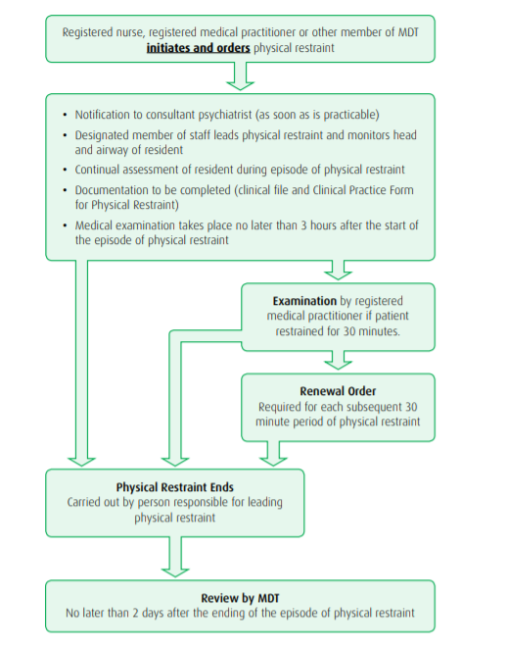
Steps in Physical Restraint Process

Slide 77
Team Intervention
Why?
Safety in numbers
Professionalism
Witnesses
How?
One leader: Assess, Plan, Direct other team leaders (agree call)
Communication with Team & individual

Slide 78
Restraint
Risk Assess: Assess immediate risk to you and others
Respond: Retreat and Raise alarm. Always consider your own safety first
3 P’s
Position: Exits, obstacles & others
Posture: Broad stable base, side on, Hands open & looking forward
Proximity: Outside personal space/ARC (accounts for 70% or injuries).
Restraint: In close, broad Stable Base, Firm Palm Grip, Looking Forward

Slide 79
Recap
What is Restraint?
What are the principles of restraint?
What are the MHC Rules on restraint?
Risk factors associated with PI
Harm associated with PI
Precautions and controls required to reduce the risk.
Signs and symptoms of distress.

