Slide 1

VDU/DSE Assessor Workbook
Presented by
Sean Kelleher 086 2660596 info@qualtec.ie
From
Qualtec
Notes:
Joining Instructions
Advise people of the duration of the course and the need to wear appropriate clothing.
If necessary you may need to advise them of the need to wear PPE.
Room Set Up
The room should be large enough to seat delegates comfortably and space to carry out the manual handling moves comfortably.
U shaped is preferred as it allows you to engage better with the delegates.
Ensure that the room is adequately ventilated, comfortable temperature and there is enough light. Avoid a noisy venue.
It is a good idea to provide water and to put name tags up.
Set up your flipchart, screen and projector in such a way that you can move around safely and comfortably.
Leave yourself enough time to set up before your delegates arrive! As delegates come in ask their name and shake their hand.
Get them to complete the attendance sheet so you have a record of the names.
Ensure that you have your props and sample loads available to you.

Slide 2
Welcome & Introductions
Introductions, me & you!
Housekeeping: Fone, Food, Fire, Finish!
Notes
Action Learning
Great expectations!
Assessment: Written test, Skills demonstration
Notes:
Introduce yourself and the topic. You might give a brief background on yourself and your experience in training manual handling and in the specific industry that you are training them in.
As an ice breaker you could ask them to introduce themselves and explain what manual handling activities they carry out in their departments.
Cover all housekeeping requirements. They will want to know when the session is finishing. The usual duration for a course would be 3 hours.
Action learning & Assessment: Explain to your class that the assessment is continuous and that if they contribute in the class there will be less emphasis on the final assessment. If anyone has any difficulties with the written or skills assessment they might point this out to you on the break.

Slide 3
Course Aim
The aim of this course is to provide you with the Knowledge, skills and attitude to be able to carry out VDU/DSE Assessments
Notes:
Course aim:
It is important that you state clearly the aim of the course.
The aim of your course is to provide the learners with the knowledge, skills and attitude to be able to:

Slide 4
Road map
What, Why?
Legislative requirements
Minimum Requirements
Anatomy & backcare
Ergonomic principles and Risk Assessment
Skills demonstration
Notes:
Road map/ Contents
Quickly go through the contents or road map for the session.
Explain quickly why each topic is covered.

Slide 5
Unit 1 Legislation
The aim of this module is to provide you with an understanding of your rights & responsibilities
At the end of this module you will be able to:
Explain what VDU/DSE means
Explain why VDU/DSE Assessments are important
List the duties of the employer and employees,
State and explain the requirements of the DSE regulations,
Explain the implications of not complying with these requirements.

Slide 6
What is?

Slide 7
Why?

Slide 8
Includes:
) a work chair and work desk or work surface, (b) any optional accessories and peripherals, and
(c) the immediate work environment of the display screen equipment

Slide 9
Statistics
Musculoskeletal disorders arise from the following work related tasks:
Manual Handling- 33%
Materials manipulation- 31%
Keyboard work- 19%

Slide 10
Who does it apply to?
If the employee has no choice but to the use the VDU to carry out his or her work
If the employee normally uses the VDU for continuous periods of more than one hour
If the VDU is generally used by the employee on a daily basis

Slide 11
Regulation 70: Non applicable equipment
drivers’ cabs/control cabs for vehicles/ machinery,
computer systems on board means of transport,
computer systems mainly for public use,
portable display screen equipment not in prolonged use at a workstation,
calculators, cash registers etc, and
typewriters of traditional design

Slide 12
Laptops
A laptop is not covered by these regulations
Keyboard is not separate and tiltable
Should not be used for extended periods
Carry out Risk Assessment
Set up temporary workstation

Slide 13
When?

Slide 14

Safety Health & Welfare at Work
Duty of the employer
Duties of the employee
Safe Place of Work
Safe Access & Egress
Safe Systems of Work
Safe Plant and machinery (examples?)
Provide PPE (Examples?)
Training (What type?)
Risk Assessment
Supervision
Notes:
Safety, Health & Welfare at Work 2005
Explain that this is the main piece of legislation governing Health & Safety in the workplace. It sets out in broad terms the responsibilities of different groups towards health & Safety.
Duty of the employer
First go through each duty of the employer and ask/ explain what they mean and their relevance to manual handling
Duties of employees
Ask them to tell which corresponding duties do employees have (you can prompt them.. So the employer must provide you with PPE, what must you do etc?:
Keep workplace tidy and exits clear
Follow procedures
Use machinery correctly/ Report defects
Wear PPE
Attend training/ stay awake!
Don’t endanger yourself or others

Slide 15
Display Screen Equipment Regulations 2007
Are entitled to workstation assessment
Must be trained in the use of workstation
Must be given information about H&S factors
Must be given periodic breaks away from VDUs
Are entitled to eye and eyesight test
Must be informed of this

Slide 16
Regulation 72: Duties of employer
An employer shall:
Ensure equipment does not pose risk
Perform an analysis of the work station
Take appropriate measures
Ensure workstation meets minimum requirements
Provide adequate breaks
Provide information & training
Review if change in workstation or equipment

Slide 17
Minimum requirements
Display screen:

Slide 18
Keyboard

Slide 19
Work desk or work surface

Slide 20
Work chair

Slide 21
Environment

Slide 22
Employee/ computer interface
Software shall be suitable for the task
Software shall be easy to use
Appropriate levels of skills & experience
No monitoring without knowledge of employees
System should provide feedback performance
Should display information in a suitable format
Software ergonomics should be applied

Slide 23
Case Law
Fifield V Denton Hall Legal services
Legal secretary
Developed considerable wrist pain
Notes:
CCCCThe following are actual case law examples
Don’t go through them all. Familiarise yourself with the detail of the cases. There are more cases on the website.
Pick a few relevant ones and give them some of the information and ask them to ask relevant questions in order to establish whether the plaintiff got compensation or not.
Gorry V British Midland 1999
The plaintiff was lifting bags off a baggage carrousel
He wrenched his shoulder and arm
The bag was heavy but not marked “heavy”
There were labels available but not used.
He had been shown a 15 minute video
The training should have included theory, demonstration and practise
They should remind people of bad habits
£ 6,000 damages
McKelvey V Avonmore Foods Plc
Factory Worker removing frozen food boxes from conveyor belt & placing onto pallets.
25-35 kgs. 10 boxes on each stack
Placing 1oth box. 5ft 2 inches high
Box fell onto floor. Bent down to pick it up
Severe pain in his lower back
6 days in hospital
Negligence- Stacking
Judge found the system of work was unsafe
Dangerous to lift 25-35 kg continuously
Should not have been more than 7 boxes high
Employer was negligent
Contributory Negligence: Instruction & Training
Employer had provided a handbook
Handbook had clear instructions on lifting
Statement on noticeboard about lifting safely
No practical or oral instruction given
Should have been forseen that employee may not read handbook
Contributory negligence
Worker was negligent not to read the book
Total disregard for his own safety
The handbook and notice provided clear instructions
The worker did not bend his knees and used back muscles instead
50% contributory negligence
Total damages of £ 143,500
£30,000 for general pain
£20,000 for future general damages
£28,400 for special damages
£ 65,000 for future loss of earnings
Reduced the award to £ 71,750
Harrison V Sligo County Council
Harrison unloading pipes from a lorry
Harrison & collegue unloaded 7 pipes
Each pipe was 12 inches wide, 3ft long, 180lbs
Lifting pipes and handing them to person on the ground
Harrison got a twinge in his back and complained of back pain
A Ramp to the lorry would have allowed safe unloading
Unsafe system of work
Employee had not received training in safe lifting
Harrison should have known that it was unsafe
£ 138,568 damages reduced by 50 %
Delaney v United Frames Ltd (Circuit Court ’96)
Plaintiff assembling picture frames
Lifted five panes and hurt her back
Had been trained in manual handling
System of work was standard in the industry
Weight of panes was within maximum weight guidelines
Case was dismissed
Hurley V Imokelly Co-Op (Supreme Court 1972)
Lifting milk churn
Damaged back
Other companies have mechanised the process
£40,000
Dunleavy V Glen Abbey Ltd
Dunleavy worked in warehouse
Forklift kept breaking down
Delivery of metal fastners arrived
Battery was flat
Dunleavy lifted cartons with the driver
Driver let go and dunleavy suffered a back injury
Dunleavy had not received manual handling training
£ 15,000 compensation
Bowdren V Southern Health Board
Plaintiff Working in the Archives Office in Cork Regional Hospital
Placing medical records onto shelves.
With the steps provided the height of the top shelf wa at eye level.
There was a clearance of 17 inches between top shelf and the ceiling.
Plaintiff was lifting a 13kg box of x rays onto top shelve.
He was trying to shove or squeeze them into place
Felt a pulling sensation in his lower back.
Defendant found not liable.
Did not involve stretching upwards.
Weight was not particularly heavy.
Firth V South Eastern Health Board
Plaintiff was ward attendant.
Joined in 1970 and was trained
Lifting a patient on 70 kgs using the cradle technique with another nurse
Sustained back injury.
Cradle technique was banned in 1985.
High Court determined that the defendant was negligent as it failed to update training.

Slide 24
Recap- Questions & Answers!
What is DSE/VDU?
What is included?
What is not applicable?
Duties of employers?
Duties of employees?
DSE Regulation requirements?
Minimum requirements?
Notes:
Question and Answer session
It is a good idea to go through a Q & A session with your learners to test their understanding of what you have gone through.

Slide 25
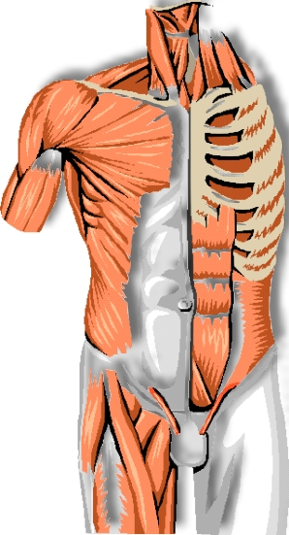
Unit 2 Anatomy & Backcare
The aim of this module is to provide you with and understanding of how the back works and how it can get injured
At the end of this module learners should be able to:
State the function , composition and characteristics of the main parts of the spine
Explain the relevance of these characteristics to DSE
Notes:
Anatomy
Explain that you are going to go through anatomy and the aim of this session is to give them an understanding of how the body works, particularly the spine, how it can get injured and how it can protect itself. It is not to turn them into doctors or physiotherapists!
Explain that you are going to focus on the musclo- skeletal system not the respiratory, nervous, reproductive sysrtems!
Musclo-Skeletal System
Made up from:
Musclo which is the fibres such as Muscles, Ligaments, Tendons, Nerves, Discs
And Skeletal which is the Skeleton, Bones and Joints

Slide 26
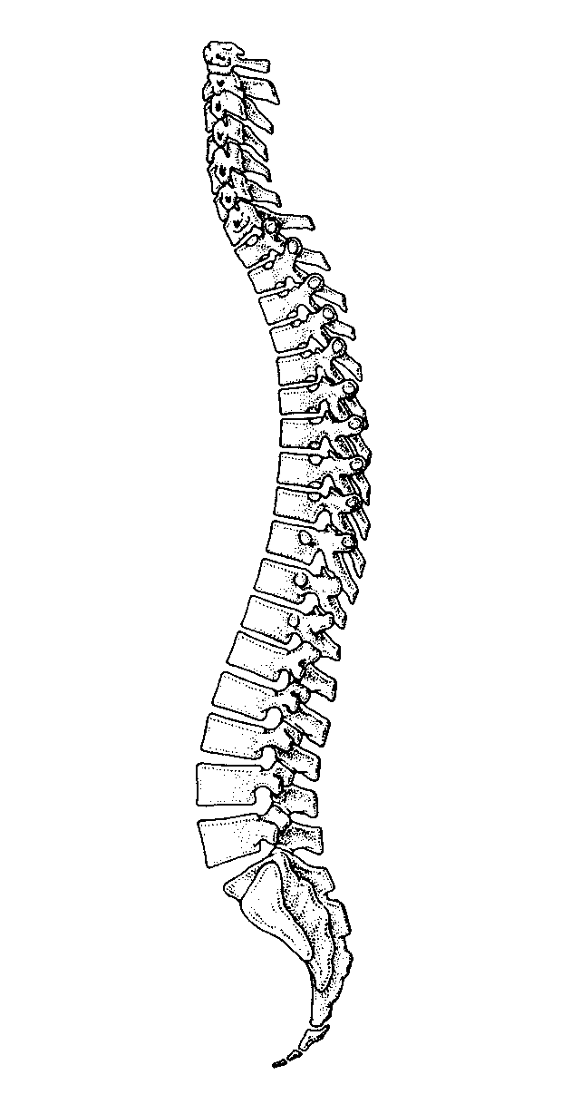
Spine
What is it for?
What is it made up of?
What is notable about it?
Notes:
Spine
Function:
To protect the spinal cord
To allow movement.
To support the upper body
Provides attachment for our ribs, muscles and ligaments
Composition:
Column of bones rising from the pelvis. Ask them what are the bones called (vertabrae).
There are 33 in total. You can show them the curves of the spine and name them if you wish:
Cervical (or neck!)
Thoracic
Ask them do they know what the lower curve is called (lumbar).
Sacral
Coccyx (tail bone)
Indicate the Facet joints, the nobbly bits at the back using the spine prop. Who how lower down there is very little rotation in the spine. The protect the lumbar spine from excessive twisting.
Characteristics
Strong and Flexible
Gentle ‘S’ bend
Move or lift in wrong way balance can be disturbed
Demonstrate using the prop that the spine can take significant downward pressure (up to 1 ton weight) but once it is put out of its correct alignment, it has no strength

Slide 27
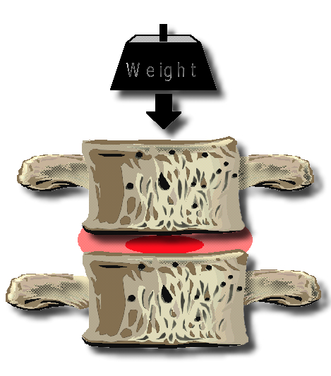
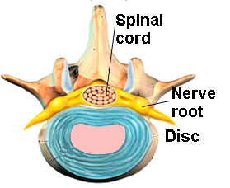
Discs
What do they do?:
What are they made up of?
Outer rings- annulus
Inner core- nucleus
What is notable about them?
Poor Blood supply
Poor nerve supply
Notes:
Discs
Function
Kidney shaped, discs separate the vertebrae and act as shock absorbers. Discs are made of cartilage and allow movement of the spine. Ask them what it would be like t drive your car if you were missing a shock absorber!
Composition:
The outer part of the disc is made up of layers of a fibrous gristly material (annulus) which is very firmly attached to the vertebral bodies above and below.
In the centre is a fluid with a similar consistency to toothpaste (nucleus).
Characteristics:
Poor blood supply
Poor nerve supply
Flexible
Ask them why this might be a problem.
If they have very little nerve supply you can’t feel when they are being damaged.
Demonstrate by putting your finger between the vertabrae. It feels like the jaws of a vice grip!
Injury:
Repeated stresses can cause minute tears and bulging of the disk. These little tears are visible on the disc in the picture.
Presses on adjacent nerves and ligaments – pins & needles, pain, numbness
Commonly called a slipped disc.
“slipped disc” is a misleading term giving rise to the belief that the disc is like an unstable packing piece and can be pushed back into place.
A slipped disc is a bulge of the disc usually caused by the weakening of the annulus or outer wall by uneven pressure (bending/ stooping while lifting) and pinching of the disc .
The annulus can even a split of the allowing the nucleus to protrude through.
The nucleus can then push on the nerve. This is called sciatica. Depending on the level of the disc affected and the severity of the damage; pain/numbness/pins and needles/weakness can be experienced in the back, buttock, groin, leg or foot.
Ageing causes fluid loss from the nucleus in late middle age and the disc will slowly become almost uniformly gristly and slightly thinner.
A disc can collapse (Prolapse) suddenly if to much pressure is put on it especially if combined with twisting (Tomatoe effect).

Slide 28
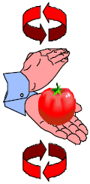
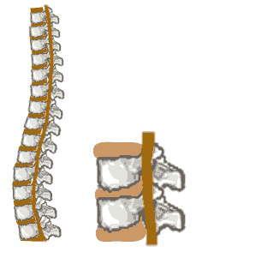
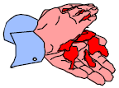
Dangerous movements
Notes:
Stooping
This slide demonstrates very well very simply the effect of stooping on the discs.
You can also demonstrate this very simply using a balloon.
You can also show the disc protusion video. This video demonstrates very well the impact of incorrect lifting (stooping , twisting and bending) on the back.
I would be best to put the video on silent and talk over it yourself. You will need external speakers if you are just going to play the video.

Slide 29
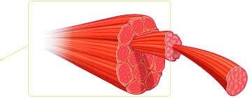
Muscles
What they are made up of:
Muscles are bundles of fibre
What is notable about them:
Good nerve supply
Good blood supply
How they can be injured:
Pulled muscle- strain
Aches, pain from tension
Thrombousis
Notes:
Μυσχλεσ
Ψου χαν σταρτ βψ εξπλαινινγ τηατ μυσχλεσ αρε βυνδλεσ οφ φιβρε. Τηεψ αλλοω μοϖεμεντ. Ψου χαν ρεμινδ τηεμ τηατ α λυμπ οφ στεακ ισ μυσχλε.
Χηαραχτεριστιχσ:
Γοοδ βλοοδ συππλψ.
Γοοδ νερϖε συππλψ.
Ασκ ωηψ τηισ ισ γοοδ. Ηεαλσ φαστ. Αλσο βεχαυσε οφ α γοοδ νερϖε συππλψ ψου αωαρε οφ δοινγ δαμαγε.
Ασκ τηεμ το χλενχη τηειρ φιστσ φορ α μινυτε. Ωηατ ωιλλ ηαππεν αφτερ α φεω μινυτεσ? Ιτ ωιλλ τιρε βεχαυσε νο βλοοδ ανδ τηερεφορε οξψγεν χαν γετ ιντο ιτ. Ιτ ισ λικε α σπονγε. Ιτ νεεδσ το βε σθυεεζεδ ανδ τηεν ρελαξεδ το αλλοω βλοοδ τηρουγη ιτ.
Μυσχλεσ δο νοτ λικε το βε χοντινυουσλψ χοντραχτεδ.
Μυσχλε Τψπεσ:
Explain that you are going to contrast the differences between the 2 different types of muscles: Postural and Action.

Slide 30
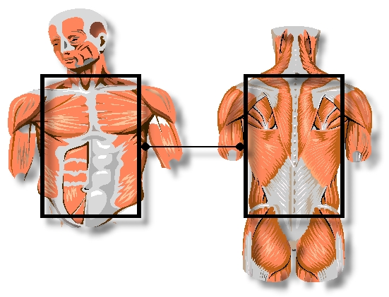
Postural Muscles
What are they for?:
Posture, protection
Examples:
Abs, neck
Notes:
Action/ Voluntary muscles
Function:
The function of action muscles are to move the limbs and carry out work!
Composition:
The action muscles are long muscles such as the limbs.
Characteristics:
Generally longer and they tire more easily.
Demonstrate that action muscles like to move by demonstrating keeping one hand static whilst moving the other one.
Injuries:
Muscle strains in action muscles will come from again overstretching them during activities.
Postural muscles/ involuntary
Function:
The function of postural muscles is to support and protect the back. If a postural muscles are weak and the back is less stable and the discs are under more pressure.
Composition:
These are the small short muscles which extend from vertebrae to vertebrae, they use ready oxygen and tire less easily.
Characteristics:
Postural muscles are generally shorter and have greater endurance. Hence they can keep up upright for a long time.
Injuries:
Αχηεσ & παινσ ιν τηε ποστυραλ μυσχλεσ ωιλλ χομε φρομ ποορ ποστυρε βεχαυσε τηεψ αρε βεινγ οϖερστρετχηεδ ανδ ηαϖε το ωορκ ηαρδερ τρψινγ το συππορτ τηε βοδψ.

Slide 31
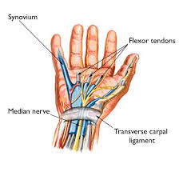
Tendons
What are they for:?
Muscle to bone
Examples?
Wrist flexor tendons
How they can be injured
Carpel Tunnel Syndrome
Notes:
Ligaments
Ask them are they familiar with any ligaments. They will probabily be familiar with the cruciate ligament.
Function:
They attach bone to bone
Show the ligament cavity between the vertabrae on the model
Explain that ligaments have a small degree of elasticity. However if they are over stretched they will be weakened and thus the back will be less stable.
Injuries:
Strained ligaments cause localised aches & pains- Like when you have been stooping.
Overstretching weaken the joint and put more pressure on the disc. They can snap altogether if they are overstretched or put inder sudden pressure.
Tendons
Function:
They attach muscle to bone. E.g achilles tendon.
Injuries:
Again overstretched tendons can give localised pain. Also it can snap!

Slide 32
Posture
What is posture?
Correct alignment of the body
Why?
Prevent pain, MSDs
How?
Head: Neck:
Shoulders:
Back:
Elbows:
Wrists:
Fingers:
Legs:

Slide 33
Other effects
DSE use does not cause disease or eye damage
Long spells can result in discomfort or tired eyes
Use of poor workstations can cause stress
VDUs do not emit ionising radiation
DSE can cause headaches from poor image etc.
DSE does not affect the unborn
DSE does not cause skin dosorders
DSE does not affect persons with epilepsy

Slide 34
Recap- Questions & answers
Purpose of the spine?
Purpose of discs?
Different types of muscles?
Purpose of these?
Purpose of tendons?
Posture?
Correct alignment?

Slide 35
Recap- Questions & answers
Purpose of the spine?
Purpose of discs?
Different types of muscles?
Purpose of these?
Purpose of ligaments?
Purpose of tendons?

Slide 36
Other effects
DSE use does not cause disease or eye damage
Long spells can result in discomfort or tired eyes
Use of poor workstations can cause stress
VDUs do not emit ionising radiation
DSE can cause headaches from poor image etc.
DSE does not affect the unborn
DSE does not cause skin dosorders
DSE does not affect persons with epilepsy

Slide 37
Unit 4 Ergonomics & DSE Assessment
Objectives
The aim of this module is to you the skills to be able to identify hazards associated with DSE use
At the end of this module You will be able to:
Explain risk assessment & ergonomics
Identify risk factors with DSE workstations
Notes:
The aim of this module is to provide the learners with the skills to be able to identify risks associated with manual handling tasks

Slide 38
Explanations
Risk Assessment
Ergonomics
Notes:
Ask what is risk assessment?
You can ask them what risk assessments do they carry out on a daily basis. Examples could include crossing the road!
Risk assessment is the identification of hazards (risk factors) and the reduction of risk
Ergonomics is organising workplaces and work to reduce the strain on people.

Slide 39
How?
Stage 1: Initial consultation with employee
Stage 2: Observation of the employee working at the computer workstation
Stage 3: Identifying the issues that need to be addressed
Stage 4: Review the implementation of the action plan

Slide 40

Case Study

Slide 41
Recap
Ergonomics?
Risk Assessment?

Slide 42
Unit 5 Fitness & Flexibility
At the end of this module learners will be able to:
Perform basic stretching exercises.

Slide 43
Stretches
Shoulder shrugs
Neck stretches
Arms
Back
Ankle flexes

