Slide 1
People Moving Course
Presented by
Conor Kelleher

Slide 2

Introductions
Introductions
Housekeeping
Expectations
Assessments

Slide 3

Course Aim
The aim of this course is to provide you with the
Knowledge, skills and attitude to be able to move people correctly
Notes:
Course aim:
It is important that you state clearly the aim of the course.
The aim of your course is to provide the learners with the knowledge, skills and attitude to be able to:
Carry out manual handling tasks safely

Slide 4
Unit 1 Introduction
The aim of this module is to provide you with an understanding of what People Handling is and why is a major issue
At the end of this module, you will be able to:
Explain what People Handling is
List common People Handling injuries
List the consequences of People Handling injuries
Explain why People Handling is important
State the % of injuries due to People Handling

Slide 5

People Handling
The manual handling / moving and handling of people
Examples?
Pushing/ Pulling beds, hoists
Turning in bed, moving up the bed,
Lying to sitting
Transferring from bed to chair, sitting to standing
Walking,
bed to bed transfers
Lifting!
Notes:
Definition of manual handling
What is meant by “unfavourable ergonomic conditions”
Unfavourable ergonomics means and conditions that puts your body in a compromised position
You can give the example of trying to put a child into a car seat as an example of this.

Slide 6
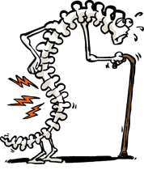
Anyone Hurt?
Notes:
Anyone hurt?
Ask the class has anyone here suffered from a bad back?
You can include any relevant anecdotes from your own experiences of manual handling injuries

Slide 7
Other People Handling injuries?
Infections
Twisted knees
Shoulder and neck strain

Slide 8

What are the implications of back injury?
Pain!
Quality of life
Employability
Notes:
Managing Manual Handling
Normally I start a discussion on why the course needs to be completed.
Responses can be written onto the flipchart
You might get the answer that it is because the company has to do it by law.
You may point out that that is correct, but the most important reason for carrying out the course is to prevent injury and if a person gets injured they are the ones that will suffer the most as result of injury. It can affect quality of life and employability.
Quality of life
Employability
Pain!

Slide 9
Adverse Incidents
All accidents, incidents, near misses must be reported, and managed in accordance with the HSE
Incident Management Framework, 2018.
Use National Incident Report Form (NIRF)

Slide 10
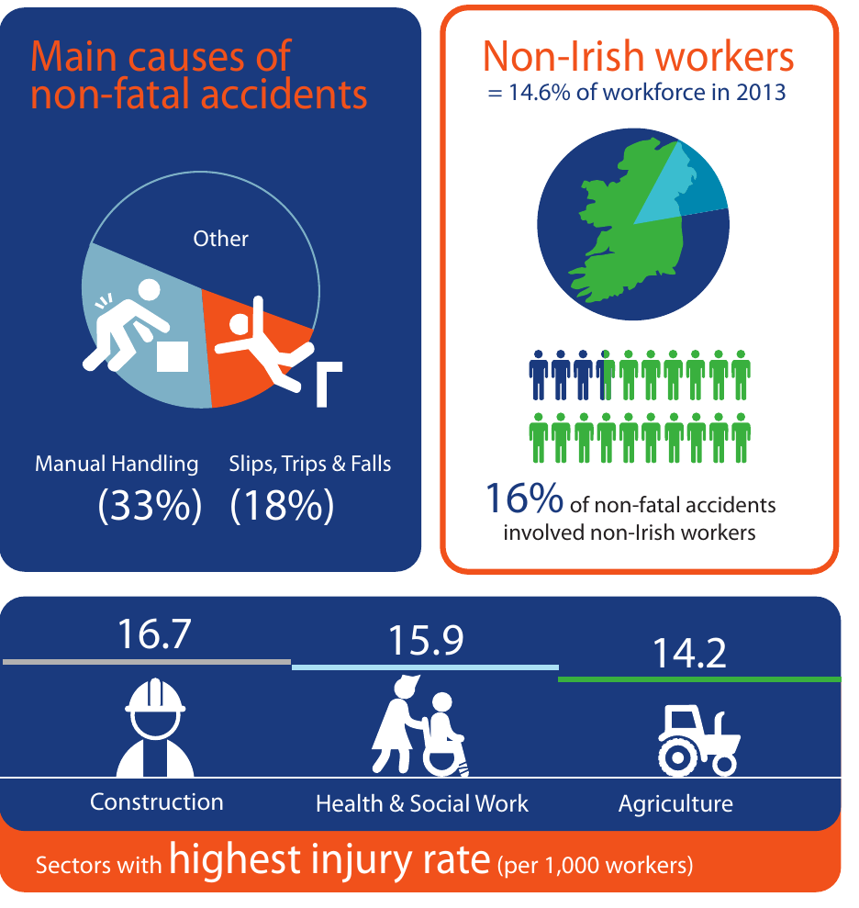
Health & Safety Authority
Notes:
15.9 per 1,000
i.e. multiply 15.9 by 1,000

Slide 11
Managing Manual Handling
Manual Handling Policy
Consultation
Risk Assessment
Implement controls/training/Supervision
Notes:
Managing Manual Handling
Normally I start a discussion on why the course needs to be completed.
Responses can be written onto the flipchart
You might get the answer that it is because the company has to do it by law.
You may point out that that is correct, but the most important reason for carrying out the course is to prevent injury and if a person gets injured they are the ones that will suffer the most as result of injury. It can affect quality of life and employability.
Legal requirement
Prevent injury
Quality of life
Employability
Productivity?

Slide 12
Recap
How can you move people by hand?
What are common manual handling injuries?
What are the consequences of manual handling injuries?
Why is People Handling training important?
State the % of injuries due to manual handling?

Slide 13
Unit 2 Legislation
The aim of this module is to give an understanding of your rights & responsibilities under the law.
At the end of this module you will be able to:
List the duties of the employer and employees,
State and explain the requirements of the manual handling regulations,
Explain the implications of not complying with these requirements.
Notes:
Module objectives
Again at the start of each module it is important to set out clear objectives for each module. State them in terms of what they will be able to do. These objectives will make good recap questions at the end of the module.

Slide 14
Safety Health & Welfare at Work
Duty of the employer
Duties of the employee
Safe Place of Work
Safe Access & Egress
Safe Systems of Work
Safe Plant and machinery
Provide PPE (Examples?)
Training (Task specific MH)
Risk Assessment (MH)
Supervision
Keep workplace tidy and exits clear
Follow procedures
Use machinery correctly/ Report defects
Wear PPE
Attend training/ stay awake!
Don’t endanger yourself or others
Co-operate
Notes:
Safety, Health & Welfare at Work 2005
Explain that this is the main piece of legislation governing Health & Safety in the workplace. It sets out in broad terms the responsibilities of different groups towards health & Safety.
Duty of the employer
First go through each duty of the employer and ask/ explain what they mean and their relevance to manual handling
Duties of employees
Ask them to tell which corresponding duties do employees have (you can prompt them.. So the employer must provide you with PPE, what must you do etc?:

Slide 15
Principles of Prevention
Avoidance of risks
Evaluation of unavoidable risks
Combating of risks at source
Adaptation of work to the individual
Adapt to technical progress
Replacement of dangerous articles, systems of work
Develop prevention policy
Training and instruction
PPE
Notes:
Nine principles of Prevention
This is unnecessary to go through these principles of prevention with your staff

Slide 16

Manual Handling Regulations 2007
Assess the risk
Avoid need for manual handling
    Eliminate
    Automate
    Mechanise
Reduce Risk
Notes:
This comes from the general principlces of principles of prevention
Ask them how manual handling can be avoided i.e. Mechanical equipment, get the supplier to deliver it to where it is needed.
Ask them how it can be reduced.
i.e. Substitute with smaller loads, engineering solutions such as trolleys, administrative controls such as information on contents. training

Slide 17
Other Related Legislation
General Application) Regulations, 2007:
Use of Work Equipment
Sensitive Risk Groups
Protection of Pregnant, Post Natal Employees.
Notes:
Young workers, pregnant, post natal and breastfeeding employees;
People with reduced mobility
New or inexperienced workers, person’s with particular serious
problems, night workers and shift workers, children and young
persons.
(Ref: The Safety Health and Welfare at Work (General Application) Regulations, 2007 Part 6, Chapters 1‐3)

Slide 18
Case Study
Healthcare Assistant walking past a patients room
Hears a cry for assistance
Resident asks to be assisted to the bathroom
Halfway across the floor she collapses
Healthcare assistant fell as well injuring her shoulder
What would you like to know in deciding on compensation?
Was she familiar with the patient and MH plan?
No. Care Plan states history of falling, walk with two people
Was assistance available?
Yes. Other care assistants were at the nurses desk 30 m away
Compensation
No. Should have consulted care plan and sought assistance

Slide 19
Case Study Bowdren V HSE
(Bowdren) worked in Medical Records
Bowdren was taking down a box of high shelf
Hurt her back
What would you like to know to decide if she gets compensation?
Box was 10 kgs, over shoulder height
Trained in manual handling,
Steps provided/did not use
Did she get compensation?
No! She was negligent…did not use steps provided
Notes:
The following are actual case law examples

Slide 20
White V Mid Western HB High Court
Absence of training or mechanical aids
Hospital attendant was lifting 14 stone patient
Patient slipped and plaintiff used her full weight to prevent him falling on the floor
The plaintiff suffered an injury to her shoulder
Plaintiff had not been trained or instructed in proper lifting procedures
Judge noted that, in the absence of a hoist
He awarded € 79,882.80

Slide 21
O’Connor v North Eastern HB (High Court)
Patient has fallen out of bed
Plaintiff had to reach over to get the patient
Injured his back
Had not been trained in manual handling
Total general damages were €112,000

Slide 22
Firth v. South Eastern HB (High Court)
Training not updated
Firth was a ward attendant
In 1970, she had been shown how to lift patients
In 1990 she sustained a back injury while lifting a patient using cradle technique
1987 publication The Handling of Patients
Recommended a ban on this method
Judge concluded the training was outdated
Total damages awarded in the case was €135,658

Slide 23
Recap- Questions & Answers!
Duties of employers?
Duties of employees?
Manual Handling Regulation requirements?
Implications for non compliance?
Notes:
Question and Answer session
It is a good idea to go through a Q & A session with your learners to test their understanding of what you have gone through.

Slide 24
People Handling Risk Assessment
On completion of this module you will be able to:
Explain what Risk Assessment and ergonomics are
Explain the people handling risk assessment process
Identify issues which may impact on the process,
Describe a range of controls to avoid and reduce the risk of injury
Notes:
to include an understanding of the concept of balanced decision making, infection control, challenging behaviour, critical medical emergencies, complex clinical issues, human rights and the fluctuating mobility level of the person

Slide 25
Explanations
What is Risk Assessment?
Identifying hazards/ Risk Factors
Hazard/ Risk Factors
Issues that will cause harm/ increase risk
Controls
Solutions put in place to reduce the risk
What Ergonomics is
Changing work to reduce the strain on workers
Notes:
Ask what is risk assessment?
You can ask them what risk assessments do they carry out on a daily basis. Examples could include crossing the road!
Risk assessment is the identification of hazards (risk factors) and the reduction of risk
Ergonomics is organising workplaces and work to reduce the strain on people.

Slide 26
Types of PH Risk assessments
Generic ward/department risk assessment;
Task specific risk assessment;
Individual patient handling risk assessment
Completed on each service user on admission/ referral
Reviewed every four months or
When initial assessment is no longer valid
Dynamic Risk Assessment
Carried out on the spot by employees prior to task
Notes:
Health Act, 2007 (Care and Welfare of Residents in Designated Centres for Older People) Regulations, 2013.
Generic ward/department risk assessment
This is an assessment of the general situation usually found in the ward or department. It takes account of the work environment and how the work is organised with regard to manual handling. This generic risk assessment will identify the range and complexity of manual handling activities occurring. It will highlight problem areas such as space constraint and lack of manual handling equipment, and identify training needs and the controls in place or required. Risk assessments must be reviewed and revised as necessary (e.g., if the review shows that the controls are not effective or there are changes in the workplace which affect the assessment). A checklist of some of the key controls that should be in place at department level is included in Appendix III.
Task specific risk assessment
Where the ward/department level risk assessment identifies that a manual handling activity presents a risk of injury, the activity must be assessed in greater detail to determine what controls are required.
The stages in the risk assessment are as follows:
• Collect information on how the task is performed and identify the key stages of the task – describe how the task is carried out;
• Collect technical information, which may include the load weight, its size, the number of lifts required, the physical dimensions of the work area and general information about the work environment;
• Identify the problems or risk factors. Consider the risk factors listed in Appendix II and decide what risk factors are present in the particular manual handling activity;
• Identify the improvements that are required to avoid or reduce the risk from this activity. Where reasonably practicable, take measures to avoid the need for a manual handling task that has been identified as posing a risk. Where the task cannot be avoided the employer must introduce organisational measures or use mechanical means to reduce the risk. The risk assessment should be documented and should include the controls required. This information should be communicated and made available to all staff undertaking the activity;
• Review the effectiveness of the control measures or solution – the effectiveness is the degree to which the control measures have avoided or reduced the risk of injury

Slide 27
Risk Assessment Process
Step 1 Observe and describe the process
Step 2 Collect data
Step 3 Identify risk factors
Step 4 Develop solutions
Step 5 Review
Notes:
Appendix III– Task Specific Risk Assessment
Where the ward/department level risk assessment identifies that a manual handling activity presents a risk of injury, the activity must be assessed in greater detail to determine what controls are required.
The stages in the risk assessment are as follows:
• Collect information on how the task is performed and identify the key stages of the task – describe how the task is carried out;
• Collect technical information, which may include the load weight, its size, the number of lifts required, the physical dimensions of the work area and general information about the work environment;
• Identify the problems or risk factors. Consider the risk factors listed in Appendix I and decide what risk factors are present in the particular manual handling activity;
• Identify the improvements that are required to avoid or reduce the risk from this activity. Where reasonably practicable, take measures to avoid the need for a manual handling task that has been identified as posing a risk. Where the task cannot be avoided the employer must introduce organisational measures or use mechanical means to reduce the risk. The risk assessment should be documented and should include the controls required. This information should be communicated and made available to all staff undertaking the activity;
• Review the effectiveness of the control measures or solution – the effectiveness is the degree to which the control measures have avoided or reduced the risk of injury. (Reference: HSA (2011) Guidance on the Management of Manual Handling in Healthcare)

Slide 28
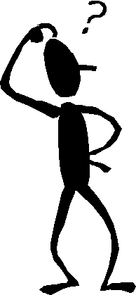
Risk Factors
Task (What movements and body postures put pressure on the back?)
Individual (what characteristics of a person make them more at risk?
Load (What characteristics of the load increase the risk?
Environment (What aspects of the environment will increase the risk?)
Notes:
Ask what types of tasks or body postures pose a risk of injury to the back
Ask them to thing back to anatomy
Possible answers include:
Awkward postures
Holding loads away from body
Twisting
Bending/ Stooping
Reaching upwards
Long travel distances
Forceful pushing or pulling
Repetitive handling
Ask them what conditions or characteristics could people have that could increase the likelihood or injury?
Possible answers include:
Physical condition
Illness
Pregnancy
Requires unusual strength, height, etc.?
Any reservations lifting ability?
Trained?
Ask them what characteristics could a load have that could increase the likelihood of injury?
Heavy
Bulky or unwieldy
Difficult to grasp
Unstable
Harmful i.e. sharp/hot
You need to use either a case study (picture) or role play to ensure that they have the skills to use TILE

Slide 29
Task
Over frequent/ prolonged
Involves the spine
Insufficient rest/recovery
Excessive lifting or lowering
Excessive carrying distances
Too strenuous
Only achieved by twisting movement of trunk
Likely to result in sudden movement of load
Made with body in unstable posture
Notes:
Ask them what characteristics could a load have that could increase the likelihood of injury?
Heavy
Bulky or unwieldy
Difficult to grasp
Unstable
Harmful i.e. sharp/hot

Slide 30
Individual (You!)
Physically unsuited to task in question
Unsuitable clothing/footwear/other personal effects
Inadequate training or knowledge
Young, old or inexperienced employee
Pregnant or breastfeeding employee
Employee physically unfit
Notes:
Ask them what conditions or characteristics could people have that could increase the likelihood or injury?
Possible answers include:

Slide 31
Load (Service users)
History of falls
Pain
Drips/drains/catheter
Infection
Communication/Sensory
Skin condition/tissue viability
Recent surgery
Amputation
Muscle spasm
Weight bearing
Joint replacement
Walking aids
Physical disabilities
Psychological/mental health
Culture/religious considerations
Day/night variation
Other considerations
Notes:
The National Institute of Clinical Excellence (NICE) recommends the use of Body Mass Index (BMI) in conjunction with waist circumference as the means for measuring overweight and obesity and determining health risks i.e. • Body Mass Index (BMI) greater than 35 kg/m2 plus co‐ morbidities or over 40kg/m2 (NICE 2006) National Obesity Observatory 2010) and • Waist circumference greater than 88cm for women and 102cm for men (NICE, 2014) (Ref: NICE (2014) Obesity: identification, assessment and management, Clinical Guidance (CG189)

Slide 32
Protocols and Procedures that impact on PH Risk Assessment
Balanced decision making,
Infection control,
Challenging behaviour,
Critical medical emergencies,
Complex clinical issues,
Human rights,
Fluctuating mobility level of the person
Notes:
Consultation with Service Users In all moving and handling activities a balanced approach will be followed which considers the wishes and safety of the service user as well as the need to protect the employee from injury. Each service user who needs assistance will be individually assessed, taking into account their particular needs, capabilities and circumstances including their understanding of the movement and their ability to communicate and help themselves. Particular attention should be paid where English is not the primary language of the service user. The service user and, where appropriate, those acting on their behalf will be actively involved throughout the assessment and decision making process. The independence of the service user will be encouraged at all times. However, the wishes of the service user should not be to the detriment of the health and safety of the employees involved. Where issues arise, a comprehensive multi disciplinary risk assessment process including consultation with the service user and their family should take place. All complex risk assessments should demonstrate balanced decision making, clinical reasoning and where possible should be evidence based. Where a resolution cannot be reasonably achieved at local level, this should be escalated to senior management.
All complex risk assessments should demonstrate balanced decision making,
balanced decision-making between patients' needs and comfort and staff safety needs clinical reasoning and where possible should be evidence based
Emergency Situations
Lifting all or most of a person’s weight should be avoided except in exceptional or emergency situations where service users or employees are at risk of serious injury if immediate action is not taken. However, written local procedures should be developed and incorporated in the local Emergency Response Plan.

Slide 33
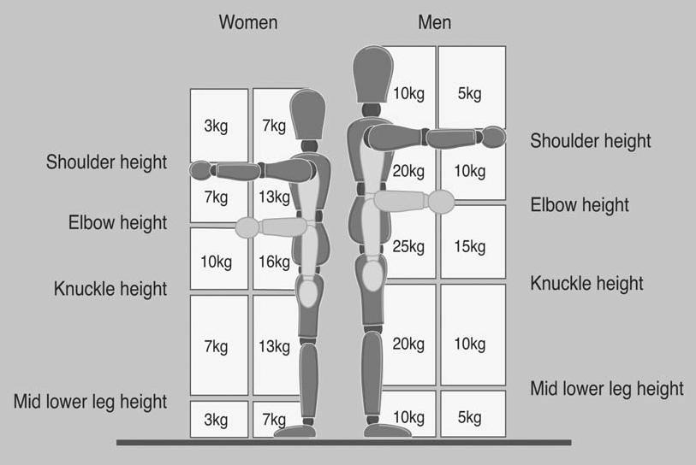
Lifting Guidelines
Notes:
The above chart are only guidelines on the weights for men and women.

Slide 34
Environment
Is the floor slippy?
Are there space constraints?
Are there steps?
Is it windy?
Is it too hot/ cold?
Is there poor lighting?

Slide 35
Completing the PH RA Form
Independent: If the service user is independent in all tasks
Weight: Record the service users weight in kgs, BMI
Medication: Note any medication which affects mobility
Comprehension / Communication / Behaviour Is the service user able to understand simple verbal instructions from carers
Falls Risk Identification : Note any history of falling
Environmental Constraints : Is there enough space etc?
Carer’s ability / experience: Is specialised care required?
Current mobility: Can service user mobilise independently?
Physical limitations? Note Any paralyses, eyesight impairment
Notes:
1) Independent If the service user is independent in all tasks please date and sign the form here. No further information is required. Please bear in mind that the need to complete the assessment may change during the admission as independent service users may become dependent due to surgery, deterioration etc. If the service user is not independent please proceed with the assessment. 2) Weight Record the service users weight in kgs, body mass index (BMI) if known. Where the service users weight exceeds the safe working load (SWL) of equipment or furniture, it may be necessary to organise equipment/furniture with increased weight capacity prior to admission on to the ward. 3) Medication Is the service user is on any medication which affects their ability to move e.g. Parkinson’s drugs, sedatives, anti‐spasmodic drugs. Does movement of the service user need to coincide with their medication? If yes refer to the service user Drug Kardex. 4)? Is there a language difficulty? Will the carer understand the service user? Is the service user intermittently confused? Will the service users behaviour affect their ability to co‐operate with moving and handling? 5) Falls Risk Identification Please note if the service user has a recognised history of falls or seizures as a falls risk assessment may be required. 6) Environmental Constraints Note any environmental issues that may interfere with the ability to move and handle safely e.g. Is there enough room to move a hoist? Is furniture easy to move? Is equipment adjustable in height? Are floor surfaces likely to be uneven or slippery? Are the service user’s attachments likely to constrain movement? 7) Carer’s ability / experience Does handling this service user require any additional specialized training or experience beyond standard moving and handling training? E.g. spinal rolls, abnormal muscle tone / movement patterns. Does handling this service user present a risk to carers with underlying health issues, restricted mobility or pregnant carers? If so report to the line manager. 8) Current Mobility Is the service user able to mobilise independently, do they require assistance and if so how many carers? Please detail mobility aids used if any. Please detail any handling equipment used prior to admission. 9) Physical limitations Please list the main physical limitations to the service users mobility e.g. impaired sight or hearing, surgery, pain, loss of use of limbs, pain, etc. 10) Further assistance If following your assessment, you feel you are unable to complete the people handling assessment and handling plan, or

Slide 36
Avoid/ Reduce?
Let them move themselves!
Use of a handling aid, such as a trolleys, sliding sheets
Training in the use of a patient hoist or sliding sheet;
Training in patient handling techniques;
Widening of door openings to allow hoists to fit through
Installation of low gradient ramps and slopes
Notes:
Avoid/ Reduce
Ask people which is avoid and which is reduce

Slide 37
Completing the Handling Plan
People Handling Risk Level: Tick H,M.L for service user
Special Considerations : Note any i.e. poor eyesight, deaf etc
Activities : Note most common i.e. Lying to sitting etc.
If not independent, indicate how many carers are required
Equipment: Note type of equipment required e.g. hoist etc
Service User Action: Can the service user complete the task with equipment? E.g. walk with a walking frame, hoist etc
Transport : Note appropriate method of transport off ward

Slide 38
Recap
What is risk assessment?
What is ergonomics?
What does T.I.L.E stand for?
What are the issues that may impact on the process?

Slide 39
Unit 6 Mechanical Equipment
The aim of this module is to provide you with an awareness of the mechanical equipment available in the organisation.
At the end of this module learners will be able to:
List the mechanical equipment available
State the rules of using mechanical equipment
Notes:
You can explain that mechanical equipment is one way that manual handling can be reduced or removed completely. You might ask them what mechanical equipment they use in their own workplace and discuss whether they would reduce or avoid manual handling completely. You could discuss the pros and cons of these pieces of equipment.
The type of manual handling equipment required within an organisation may vary widely and will be informed by the risk assessment process. The risk assessments will identify: • Where equipment is required and the type of equipment required; • Implications for training in use of equipment; • Requirements for the safe use of equipment.
It is important when procuring new equipment to consult with relevant stakeholders. Equipment purchased must be fit for purpose taking account of the tasks, the work environment, the patient and employee needs. The provision of appropriate equipment has numerous benefits for the patient and the staff (e.g., the use of electric profiling beds to reduce high risk manual handling activities). Effective equipment management will involve a number of functions and personnel. This may include clinical engineering, health and safety and procurement, and manual handling expertise such as the manual handling advisor and senior clinical management. Equipment management will include: • Identifying gaps in equipment needs; • Being aware of the latest developments in equipment design; • Ensuring the care and maintenance of equipment; • Evaluation of equipment prior to procurement to ensure compatibility with existing furniture and equipment; • Consultation with health professionals in the assessment, selection and use of equipment.

Slide 40
Patient Handling Equipment
What is Patient Handlig equipment is
Equipment used to avoid or reduce patient handling?
Examples?
Trolleys, Hoists, profile beds, transfer boards
Why (benefits)?
Safer, more efficient
How?
Based on Risk Assessment by competent persons
Ensure that it is the correct one fore the job
Inspected & maintained
Notes:
patient trolleys, stretcher attachments to hoists, sliding sheets, transfer boards, overhead hoists, mobile hoists and hoist slings.

Slide 41
Trolleys
Hazards/ Risk Factors
Controls/ Solutions
Wonky wheels
Sharp edges
Overloaded
Don’t overload
Check condition
Report defects
Use correctly

Slide 42
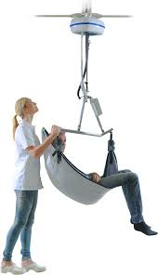
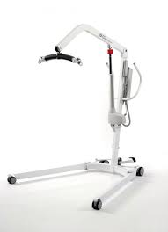
Hoists
Hazards/Risk factors
Controls/ Solutions
Faulty equipment
Slings not attached correctly
Wrong sized sling
Only use if trained
Check hoist & slings
Two persons
Consult care plan

Slide 43
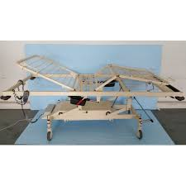
Profile beds
Hazards/ Risk Factors
Controls/ Solutions
Brakes not on
Bed too low
Adjust to the right height
Ensure that brakes are on

Slide 44
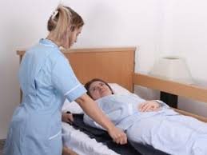
Sliding Sheets
Hazards/ Risk Factors
Controls/ Solutions
Slippy!
Infection
Put away safely afterwards
One set per patient
Keep off ground
Train staff

Slide 45
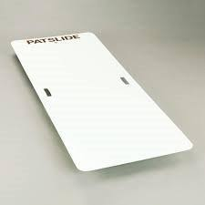
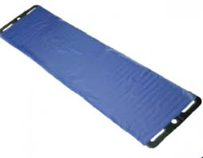
PAT Slide
Hazards/ Risk Factors
Controls/ Solutions
Brakes not on
Height of beds
Hard surfaces
Train staff
Minimise bed height difference
Cover hard surfaces i.e. headboard

Slide 46
Recap
What equipment do we have available?
What are the benefits of mechanical equipment (ME)?
What are employees responsibilities in relation to ME?

Slide 47
Infection Prevention & Control
What is Infection prevention and control?
Infection prevention and control (IPC) is a scientific approach and practical solution designed to prevent harm caused by infection
Why?
To protect patients & ourselves from infection and cross contamination

Slide 48
Principles of infection control
Wash your hands before touching a wound, blood/body fluids.
Avoid direct contact with wounds and fluids
Cover your mouth/nose during any treatment of patient with an infection
If splashed with fluids wash thoroughly & seek medical advice.
Wash any contaminated clothes thoroughly with bleach.
Dispose of gloves, bandages, dressing safely.
Wash used instruments, such as scissors with warm water.

Slide 49

Standard Precautions:
What are Standard Precautions?
These precautions apply to the care of all patients regardless of their diagnosis or presumed infection status.
Why?
1 in 10 patients have some sort of infection.
Transmission based precautions
TBPs are extra precautions and are categorised according to the route of transmission of the infectious agent such as contact, airborne and droplet.
https://www.hpsc.ie/a-z/microbiologyantimicrobialresistance/infectioncontrolandhai/standardprecautions/File,3600,en.pdf
Notes:
What are Standard Precautions? Standard Precautions are evidence based clinical work practices published by the Centre of Disease Control (CDC) in 1996 and updated in 2007 that prevent transmission of infectious agents in healthcare settings. (Siegal JD, Rhinehart E, Jackson M, Chiarello L, and the Healthcare Infection Control Practices Advisory Committee, Guideline for Isolation Precautions: Preventing Transmission of Infectious Agents in Healthcare Settings, 2007)
Standard Precautions are designed to reduce the risk of transmission of micro-organisms from known and unknown sources of infection. These precautions apply to the care of all patients regardless of their diagnosis or presumed infection status (ERHA, 2002)

Slide 50

Effectiveness of Hand Hygiene
Hand hygiene is the simplest, most effective measure for preventing infections
Hand Hygiene Products
Soap with water can physically remove a certain level of microbes
However, antiseptic agents are necessary to kill microorganisms
Alcohol-based preparations have more rapid action than products containing other antiseptics
Must used approved products
https://wwwnc.cdc.gov/eid/article/7/2/70-0234_article

Slide 51
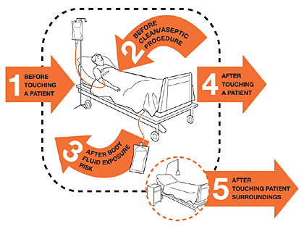
When is hand hygiene is required?
1 Before touching a patient,
2. Before clean/aseptic procedures,
3. After body fluid exposure/risk,
4. After touching a patient, and.
5. After touching patient surroundings.
https://www.who.int/gpsc/5may/background/5moments/en/

Slide 52
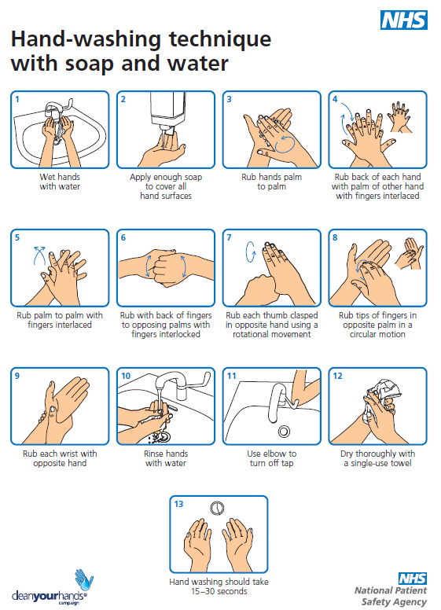
https://www.hey.nhs.uk/patient-leaflet/hand-hygiene-information/

Slide 53
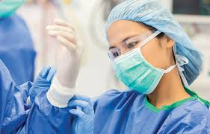
Personal Protective Protection (PPE)
Types?
Gloves (Latex, Nitryl)
Clothing (gowns/ Aprons)
Face/ Eye protection: (visor/goggles/face shield)
Risk of splashes to eyes of blood/body fluids, respiratory secretions
PPE used is based on risk assessment on type of activity
PPE is generally single use only.
https://fastlifehacks.com/n95-vs-ffp/#N95_vs_FFP3_FFP2

Slide 54
How to put on and take off PPE
Donning
1. Decontaminate hands
2. Put on disposable apron/gown
3. Put on mask (Fit check)
4. Put on goggles if required
5. Put on gloves
Doffing
Remove Gloves
Decontaminate Hands
Remove goggles
Remove apron/ gown (Avoid touching front)
Remove mask
Discard all mask etc as healthcare risk waste
Decontaminate Hands

Slide 55
Covid 19
What is Covid 19?
COVID-19 is a new illness that can affect your lungs and airways. It's caused by a virus called coronavirus.
Signs & symptoms
a fever (high temperature - 38 degrees Celsius or above)
a cough - this can be any kind of cough, not just dry
shortness of breath or breathing difficulties
loss or change to your sense of smell or taste

Slide 56
PHECC Guidelines for Covid 19 PPE
PPE should match the route of transmission | When to use in a patient being treated as COVID | Recommended PPE
Contact precautions | > 2m away from patient | Hand hygiene Gloves Apron
Droplet precautions | Within 2m of patient | Hand hygiene Gloves Apron Surgical facemask +/- Eye protection* (risk assess)
*Eye protection may be goggles or a visor. Personal spectacles are insufficient.

Slide 57
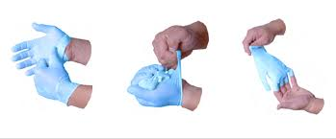
Removing contaminated gloves

Slide 58
Surgical masks during Covid-19
Wearing masks reduce the risk of droplet transmission of infection for workers and others
Surgical masks should be worn by healthcare workers when providing care to patients within 2m of a patient, regardless of the COVID-19 status of the patient
Surgical masks should be worn by all healthcare workers for all encounters of with colleagues in the workplace closer that 2m and >15 mins
Notes:
A recent recommendation (22nd April) has been introduced on the routine use of surgical masks by healthcare workers in the context of pandemic COVID-19
Wearing masks may serve two purposes • reduce the risk of droplet transmission of infection to the wearer • To reduce the risk of droplet transmission of infection to others
Surgical masks should be worn by healthcare workers when providing care to patients within 2m of a patient, regardless of the COVID-19 status of the patient
Surgical masks should be worn by all healthcare workers for all encounters of 15 minutes or more, with other healthcare workers in the workplace where a distance of 2m cannot be maintained
[Note there is need for institutional risk assessment in some circumstances] Hand Hygiene, respiratory etiquette and social distancing remain key to prevent COVID-19 transmission
Extended use of surgical masks for all healthcare settings
In relation to other healthcare workers 15 minutes refers to a single interaction that you anticipate is going to last for 15 minutes or more

Slide 59

Recap
What is Infection Control?
Why is hand hygiene important?
What are the different types of PPE.
What are the steps to Donning and Duffing PPE.
What is the rationale for preventing self-contamination when removing PPE?
Why is hand hygiene required after removing PPE?
Why so gloves do not replace the need for hand hygiene.

Slide 60
Unit 10 Safe People Moving
The aim of this module is to provide you with a set of principles for safe moving of people
On completion of this module you will be able to:
Push and pull a load correctly.
Sit up
Turn
Stand up
Walk & Sit down
Roll & Slide a patient correctly
Notes:
The aim of this module is to provide learners with the skills to be able to carry out common manual handling tasks.
Demonstrate each task first and then get then to have a go. Get them to verbalise the steps as they do it.
You can then break them up into smaller groups to practise. Ensure that there is a person with good technique in each group. Get them to give each other feedback. You need to monitor this and give constructive feedback.

Slide 61
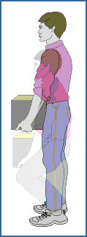
Principles of Manual Handling
Assess- TILE
Stand close to load
Broad Stable Base, feet in direction of travel
Look forward to align spine
Bend Knees
Firm Palm grip/ Arms in line with trunk
Move smoothly using the power the legs
Notes:
1. Assess
Assess the environment for trip hazards, space, room to set down the load
Assess the task. Is it dangerous? Can it be avoided?
Assess the Load
Determine the weight
Look for sharp edges
See if weight is evenly distributed
Keep heaviest side to body
Decide how to hold the load
2. Load Close
3. Broad Stable Base
Comfortably apart
Feet in the direction you are going
4. Bend Knees
Lower the body by relaxing the knees
5.Arms in line with trunk
6. Firm Palm grip
Take a firm grip by using the palms of the hands and roots of fingers
Taking weight on finger tips will create pressure at the end of fingers and could strain muscles and tendons in the arms
7. Look forward
Lift your head up, then straighten the back and look ahead before lifting
8. Use legs
maximum use of legs
Don’t jerk

Slide 62
People Moving
Team work
Agree commands
Seek consent
Risk Assess

Slide 63
Demonstration of ski sheets
https://www.facebook.com/Qualtec/videos/1418974851556704

Slide 64
Planning and design of People Handling Training
The aim of this module is to provide you with the skills to plan and develop an effective training session
At the end of this module you will be able to:
Set clear aims and learning outcomes
Develop a lesson plan for People moving

Slide 65
Aim
What?
Statement of the overall activity the learners will be able to perform.
How?
The aim of this session is to provide you with the knowledge, skills and attitude to……….
Why?
Give an overall direction and focus for the course

Slide 66
Time | Topic | Respnsibility of trainers | Responsibility of Hospital
7.30-8.00 | Trainer arrives | Room set up, projector, laptop,leads | Provide access
8.00 | Arrival of students | Supervise social distancing Check pre screening | Provide room with Training room with enough space, flipchart, pens Set up room as required with chairs for 4 persons 2 m apart
8.00-10.30 | Learners complete Manual Handling theory | Deliver course and assess students | Provide disinfected, bed, hoist sliding sheets, sling (*2) PPE (gloves, face mask, aprons) Set up Donning/duffing station
10.45-11.00 | Arrival of students and PPE/ Donning | Supervise Donning of PPE | Provide adequate PPE
11.00-13.30 | Delivery of Patient Handling practise | Supervise social distancing | Adhere to standard precautions
13.30-13.45 | Doffing of PPE | Supervise Duffing of PPE | Provide clinical waste bags and dispose of PPE

Slide 67
10-15 mins | Introduction to PM | Explain the basic principles of how the principles apply to PM | Whiteboard
10-15 mins | Weight transfer | Get students into a circle and get them to practise weight transfer
15- 20 mins | Pushing/pulling | Demonstrate how to apply the principles of MH to push/pull Get students to practice. Observe and assess | Bed
15- 20 mins | Sitting up a Client | Demonstrate how to apply the principles of MH to sitting up Get students to practice. Observe and assess | Bed
15- 20 mins | Turning a Client | Demonstrate how to apply the principles of MH to standing Get students to practice. Observe and assess | Bed
15- 20 mins | Standing & Sitting | Demonstrate how to apply the principles of MH to standing & sitting Get students to practice. Observe and assess | Bed
15- 20 mins | Walking | Demonstrate how to apply the principles of MH to walking Get students to practice. Observe and assess | Bed
15- 20 mins | Fallen patient | Demonstrate how to apply the principles of MH to dealing with a fallen patient. Get students to practice. Observe and assess | Bed
15- 20 mins | Rolling | Demonstrate how to apply the principles of MH to Sitting up Get students to practice. Observe and assess | Bed
15- 20 mins | Sliding | Demonstrate how to apply the principles of MH to sliding Get students to practice. Observe and assess | Sliding sheets
15- 20 mins | Hoist | Demonstrate how to apply the principles of MH to using a hoist Get students to practice. Observe and assess | Hoist, sling
15- 20 mins | Turntable/ Bananna Board | Demonstrate how to apply the principles of MH to using turntables/ Bananna Boards. Get students to practice. Observe and assess | Turntable/ Banana Board
15- 20 mins | PAT Slide | Demonstrate how to apply the principles of MH to using a PAT Slide Get students to practice. Observe and assess | PAT Slide

Slide 68
Bibliography and Further Reading
HOP 6 (2011) Guide to the Handling of People, 6th Edition, Backcare
HSA (2005) Guidance on the Management of Manual Handling in the Workplace
HSA (2007) Guide to the Safety, Health and Welfare at Work (General Application) Regulations 2007
Guidance on the Management of Manual Handling in Healthcare
Health and Safety Executive (2007) Risk assessment and process planning for bariatric patient handling pathways, Loughborough University
Health and Safety Executive (2003), the Principles of Good Manual Handling: Achieving a Consensus (2016)
Policy on Statutory Occupational Safety and Health Training, 2016
Safety, Health and Welfare at Work Act, 2005 (S.I. No. 10 of 2005)
Safety, Health and Welfare at Work Act (General Application) Regulations, 2007 (S.I. No. 299 of 2007)
Safety, Health and Welfare at Work (General Application) (Amendment) (No. 3) Regulations 2016 (S.I. No. 370 of 2016).

