Slide 1

Manual Handling Course
Presented by

Slide 2



Basic Housekeeping Rules
Phones: Please keeping on silent and leaving meeting if necessary
Health & Safety: Fire exits and assembly point
Schedule and breaks: 3 hours duration. Break after 1.5 hours
Participation: Participation is expected, and questions used to check progress
Assessment: Simple true of false test and assessment of manual handling skills

Slide 3

Course Aim
The aim of this course is to provide you with the knowledge, skills and attitude to be able to perform manual handling tasks safely & efficiently.
Notes:
Course aim:
It is important that you state clearly the aim of the course.
The aim of this course is to provide you with the Knowledge, skills and attitude to be able to train others how to perform manual handling tasks safely & efficiently.

Slide 4

Road map
Unit 1 – Legislation
Unit 2 – Anatomy & Backcare
Unit 3 – Ergonomics & Risk Assessment
Unit 4 – Manual Handling Principles & Techniques
Notes:
Road map
Quickly go through the contents or road map for the session.
Explain quickly why each topic is covered.

Slide 5
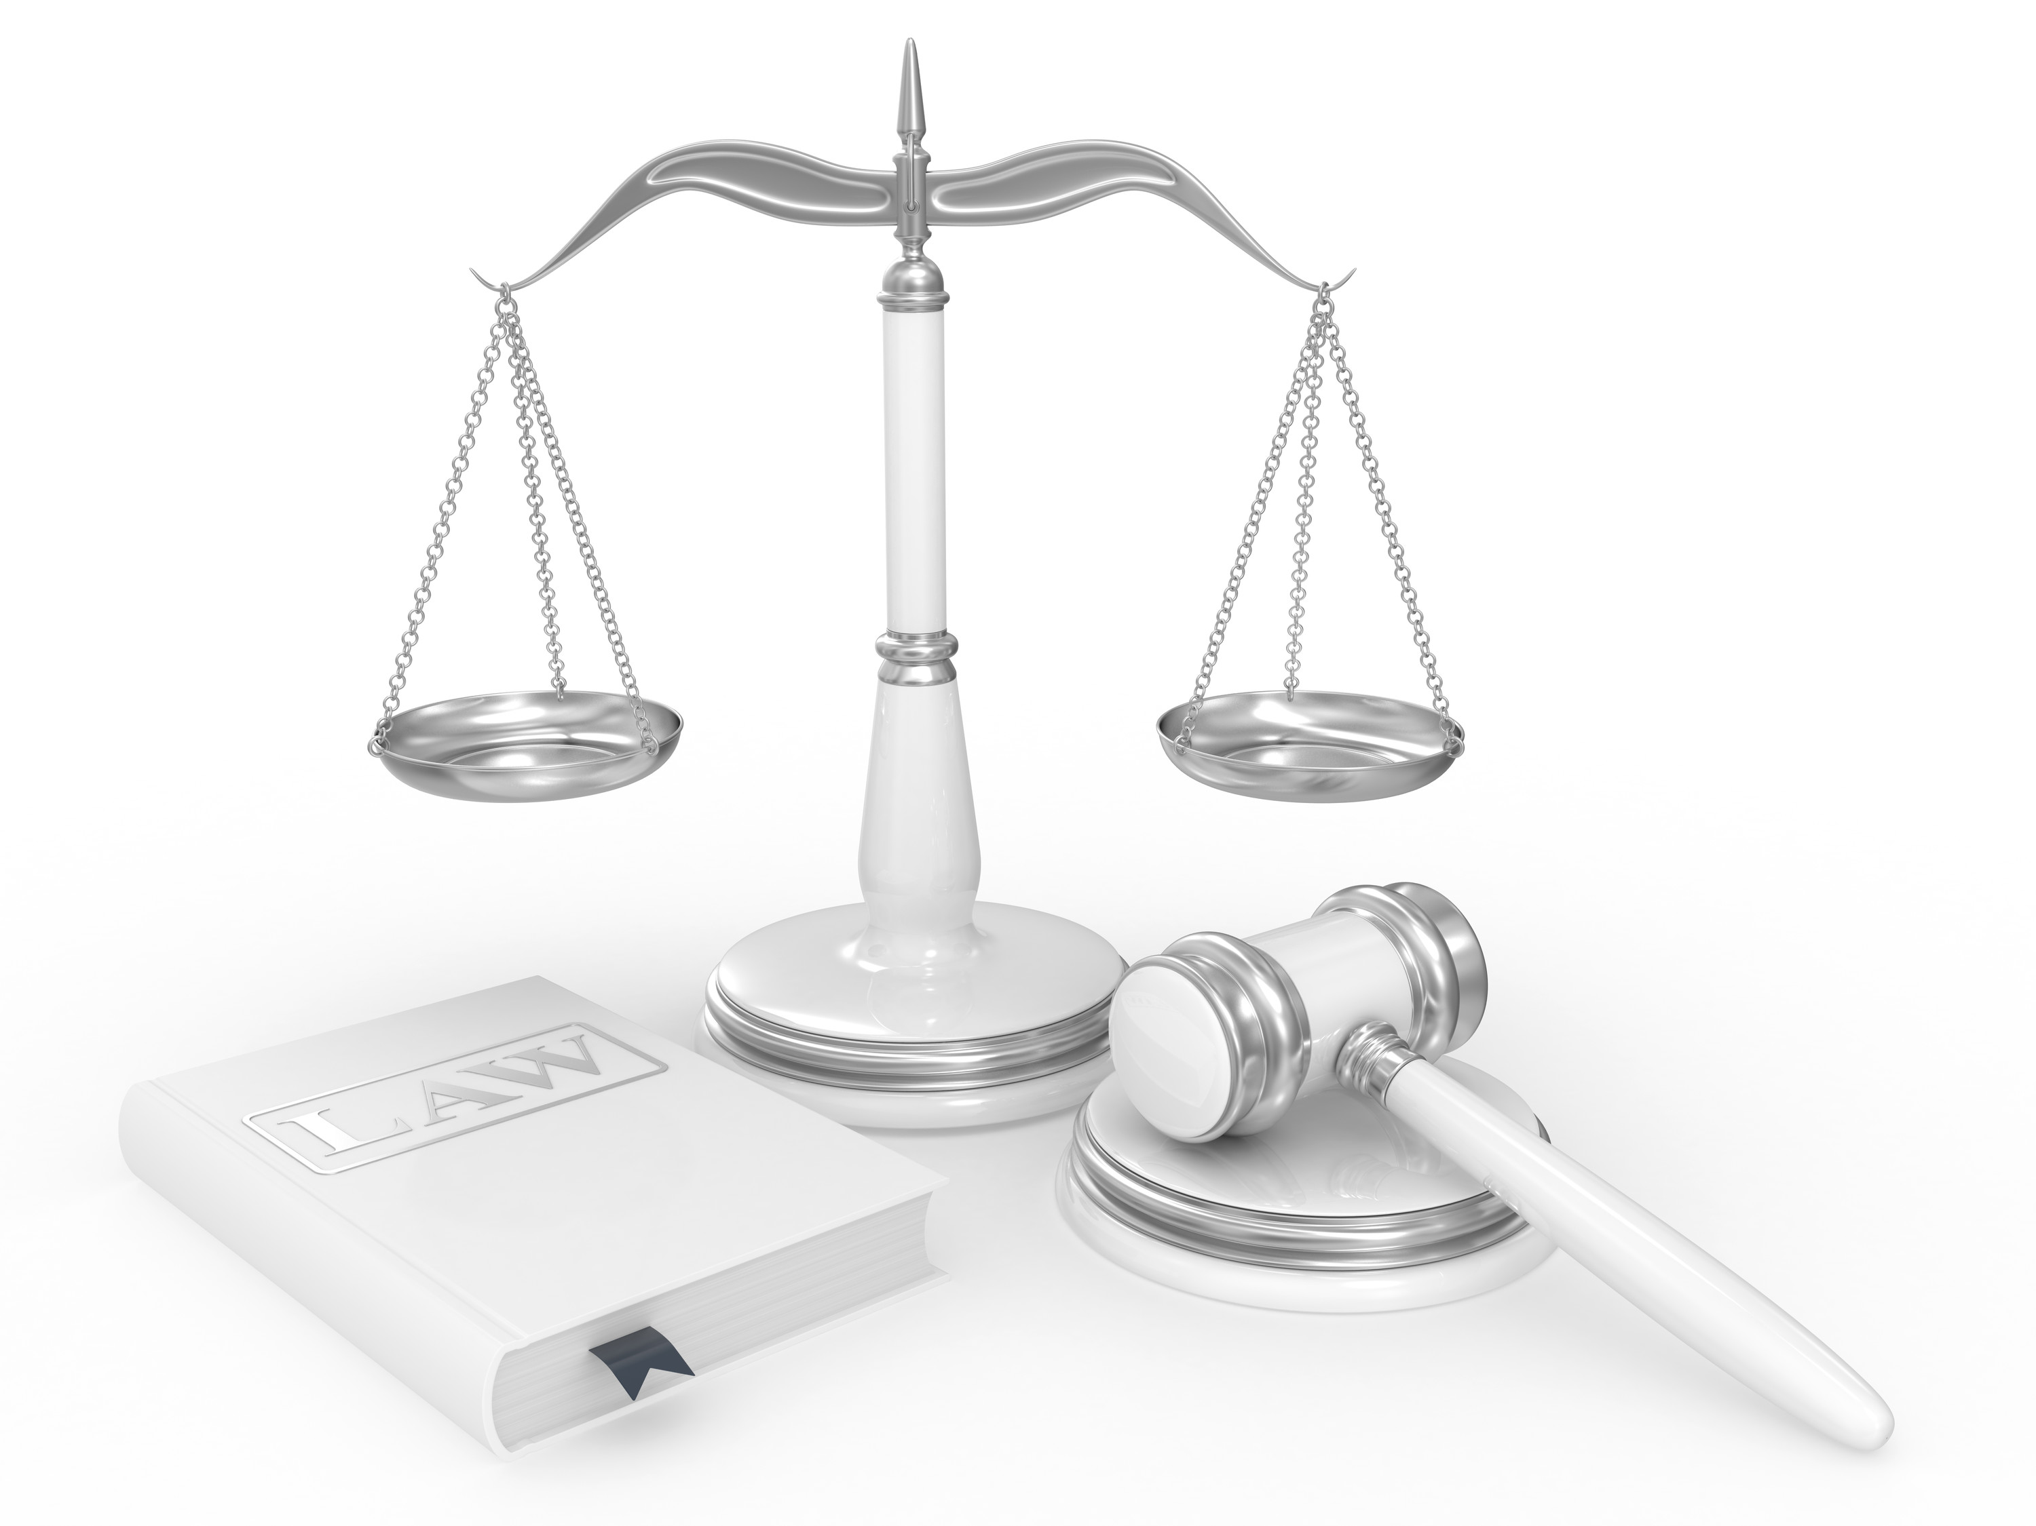
Unit 1 Legislation

Slide 6

Learning Outcomes
At the end of this module, you will be able to:
Explain what manual handling is.
List the duties of the employer and employees.
List common manual handling injuries.
List the benefits of correct manual handling.
Notes:
Module objectives
Again at the start of each module it is important to set out clear objectives for each module. State them in terms of what they will be able to do. These objectives will make good recap questions at the end of the module.

Slide 7
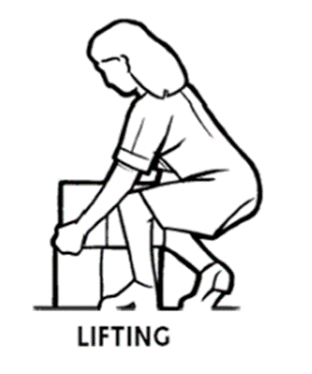
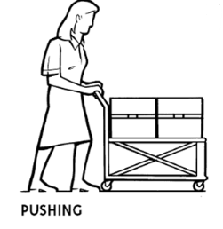
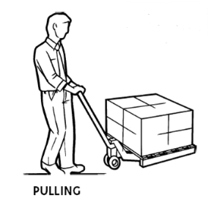
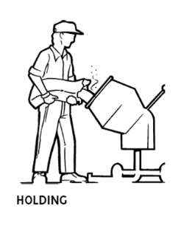
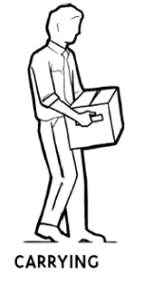
Definition of Manual Handling
Transporting or supporting of a load by one or more employees
This includes:
Notes:
Definition of manual handling
Ask them how can you move a load and write their responses on the flipchart before bringing the answers up on the screen
Possible options are:
Lifting, putting down, carrying, pushing, pulling
Normally I explore this definition by discussing :
How loads can be moved
What manual handling activities are carried out in their company
Ask what characteristics does a load have? Possible answers can be heavy, slippy, bulky, hot, cold.
What is meant by “unfavourable ergonomic conditions”
Unfavourable ergonomics means and conditions that puts your body in a compromised position
You can give the example of trying to put a child into a car seat as an example of this.
You can explain that the back is the part of the body that is most at risk when carrying out manual handling tasks and the most serious when they happen.
Source: https://www.hsa.ie/eng/publications_and_forms/publications/occupational_health/guidance_manual_handling.pdf

Slide 8

Do you agree?
“Lifting correctly is natural”
“Manual Handling is a life skill”
“Manual Handling should be taught in schools”
“Lifting correctly is efficient”
Notes:
The walking debate
I use this as an ice breaker.
You can use this as an opportunity to generate debate. You can either get them to stand up and go to one side of the room or the other or put up their hand to indicate whether they agree or disagree
Get a discussion going in the class. Ask both sides:
“Why do think lifting correctly is natural?” Or “Why do you think it feels unnatural?”
“Is manual handling a life skill?” “Why?”
“Why should manual handling be taught in schools?” or “Why not?”
“Why is lifting correctly efficient?” or “Why not?”
Get them to cross their hands one way and then the other. Does it feel right?
Our muscles have memory. Programmed.
Explain muscle memory can be built through repetition of a task (correct manual handling included)
Talk about:
Unconscious ineffeciency
Consious ineffeciency
Consious effeciency
Unconsious effeciency

Slide 9
Benefits of correct Manual Handling
Reduced likelihood of injury
Reduced severity of injuries
Less sick leave
Maintain Quality of life
Notes:
This should be asked to class. Get class members to write down the benefits of managing manual handling down on their notebook. Ask them to consider the benefits from perspectives of both the individual (themselves) and the organisation.
https://www.hsa.ie/eng/Workplace_Health/Manual_Handling/Manual_Handling_Research_Reports/Manual_Handling_Analysis_Report.pdf

Slide 10
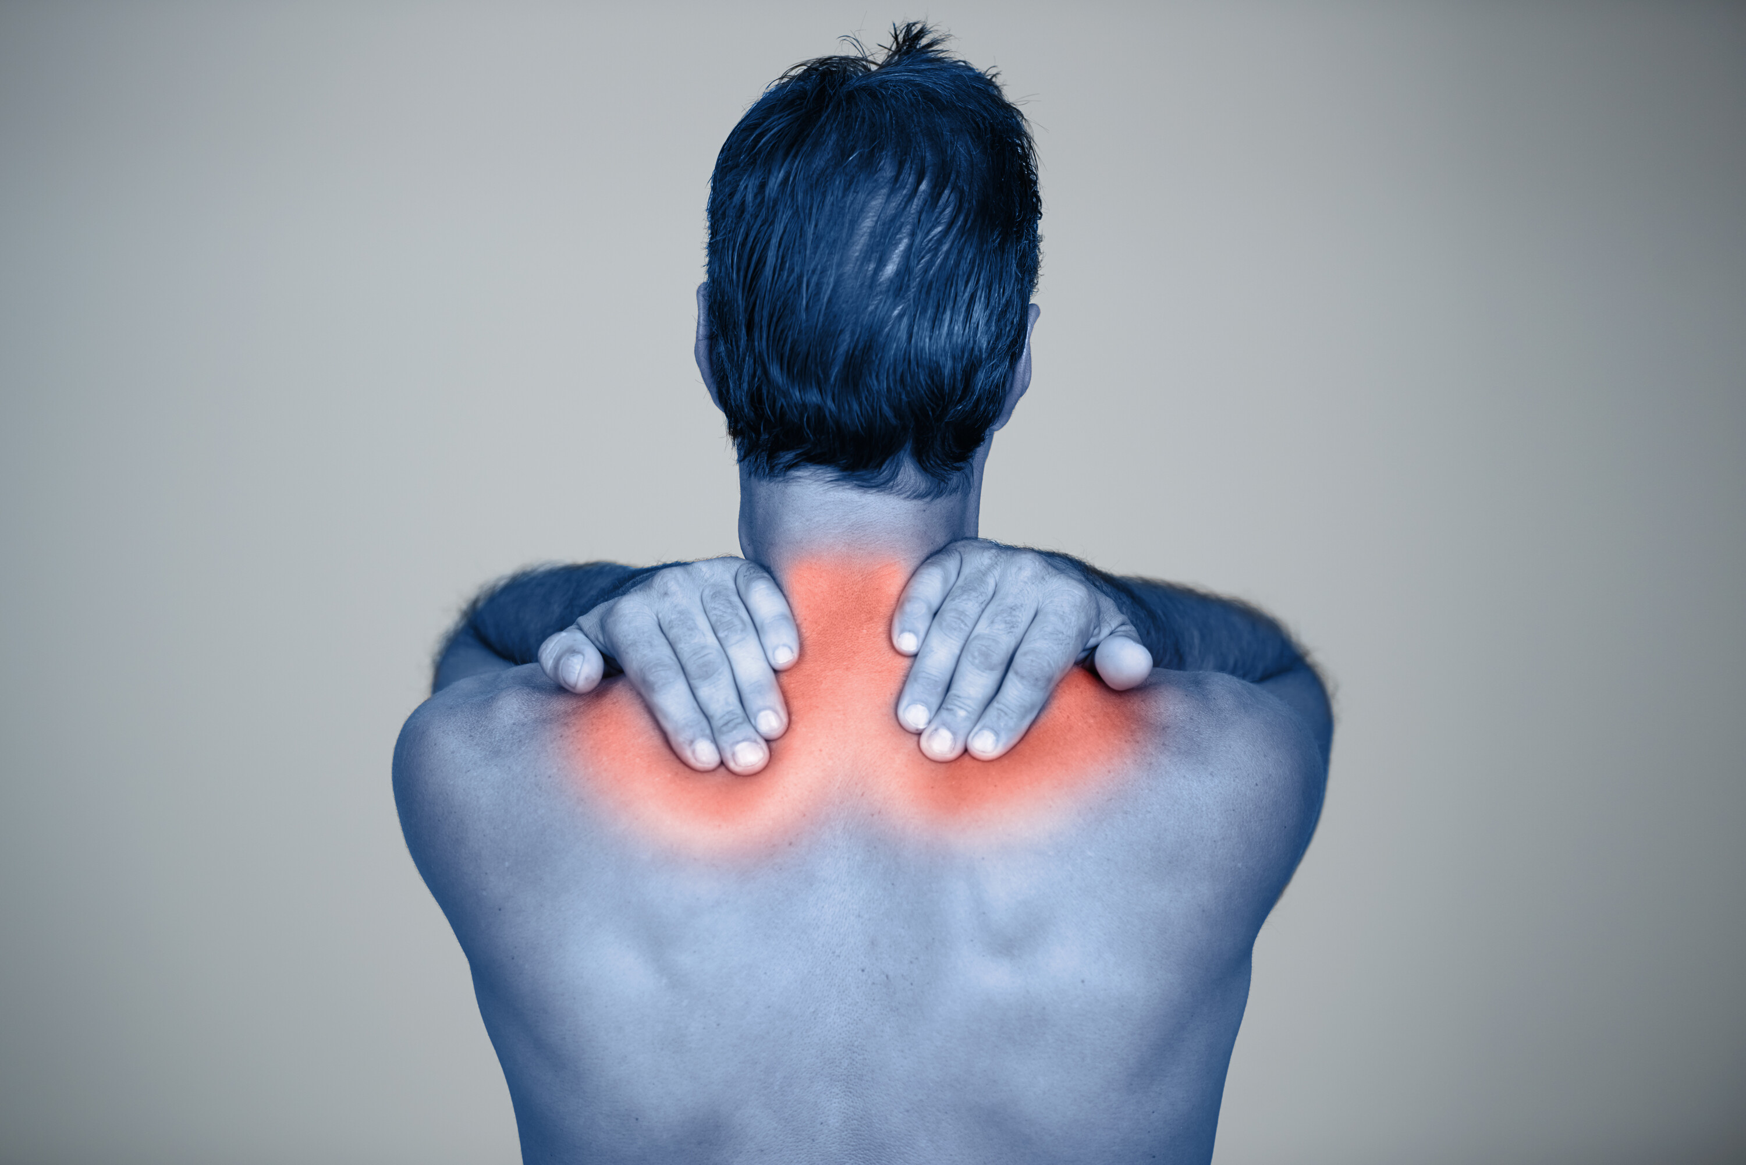
Other manual handling injuries?
Cuts to hands
Broken toes
Twisted knees
Shoulder and neck strain
Repetitive strain injuries
Notes:
Ask they class to list some manual handling injuries other than the back.
Answers include:
Cuts to hands
Broken toes
Twisted knees
Shoulder and neck strain
Repetitive strain injuries

Slide 11
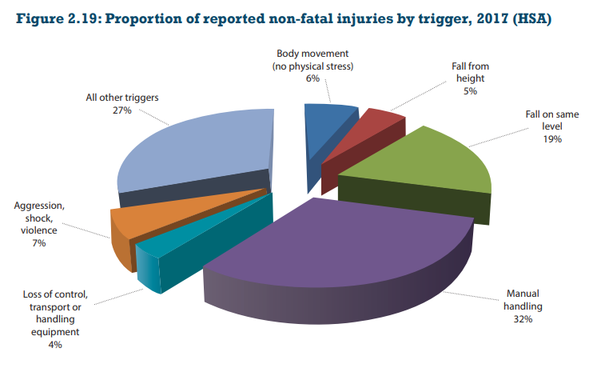

Accident Statistics
Notes:
Statistics
Here we discuss the fact that manual handling is the biggest cause of injury in the work. It is the biggest cause of people being absent from work for extended periods. Manual handling injuries account for approximately 1/3 of workplace injuries. This is why there is so much focus on manual handling by the HSA.
Not much has changed over the years, in the 2011 manual handling accounted for 33% of all non-fatal injuries and in the 2017 that number was 32% a 1% drop. Although the body movement (no physical stress) increased 1%.
Between 2015 & 2019 we had over 2,500 injuries a year on average here in Ireland.
Source: https://www.hsa.ie/eng/Publications_and_Forms/Publications/Corporate/Statistics_Report_2015.html

Slide 12
Safety Health & Welfare at Work Act 2005
Duty of the employer
Duties of the employees
Safe Place of Work
Safe Access & Egress
Safe Systems of Work
Safe Plant and machinery
Provide PPE
Training
Risk Assessment
Health surveillance
Medical fitness to work
Consultation & Supervision
Not engage in dangerous behaviour
Attend training
Proper use of PPE
Report defects in equipment, systems of work etc
Notify employer of any health issues
Notes:
Safety, Health & Welfare at Work 2005
Explain that this is the main piece of legislation governing Health & Safety in the workplace. It sets out in broad terms the responsibilities of different groups towards health & Safety.
Duty of the employer
First go through each duty of the employer and ask/ explain what they mean and their relevance to manual handling
Duties of employees
Ask them to tell which corresponding duties do employees have (you can prompt them.. So the employer must provide you with PPE, what must you do etc?:

Slide 13
Case Law: Dunnes
Customer arrived up at checkout
Bag of potatoes was torn
Checkout person went to get replacement bag
Injured her shoulder
What questions would you like to ask in deciding on whether she got compensation?
Trained in manual handling? Yes
Looked for assistance? No
Compensation?
No!
Notes:
Basic Level Case Study
Explain the initial details of the case to the class:
Customer arrived up at checkout
Bag of potatoes was torn
Checkout person went to get replacement bag
Injured her shoulder
Ask class what questions they like to ask in deciding on whether she got compensation? Answers include:
Trained in manual handling? Yes
Looked for assistance? No
At this point ask the class to make a judgement on if they believe the plaintiff was awarded compensation?
Answer: No! She had been trained and appropriate systems were in place.

Slide 14
Recap
What is manual handling?
Duties of the employer?
Duties of employees?
Benefits of correct manual handling?
Notes:
Ask students the following recap questions to ensure the learning outcomes have been achieved.

Slide 15
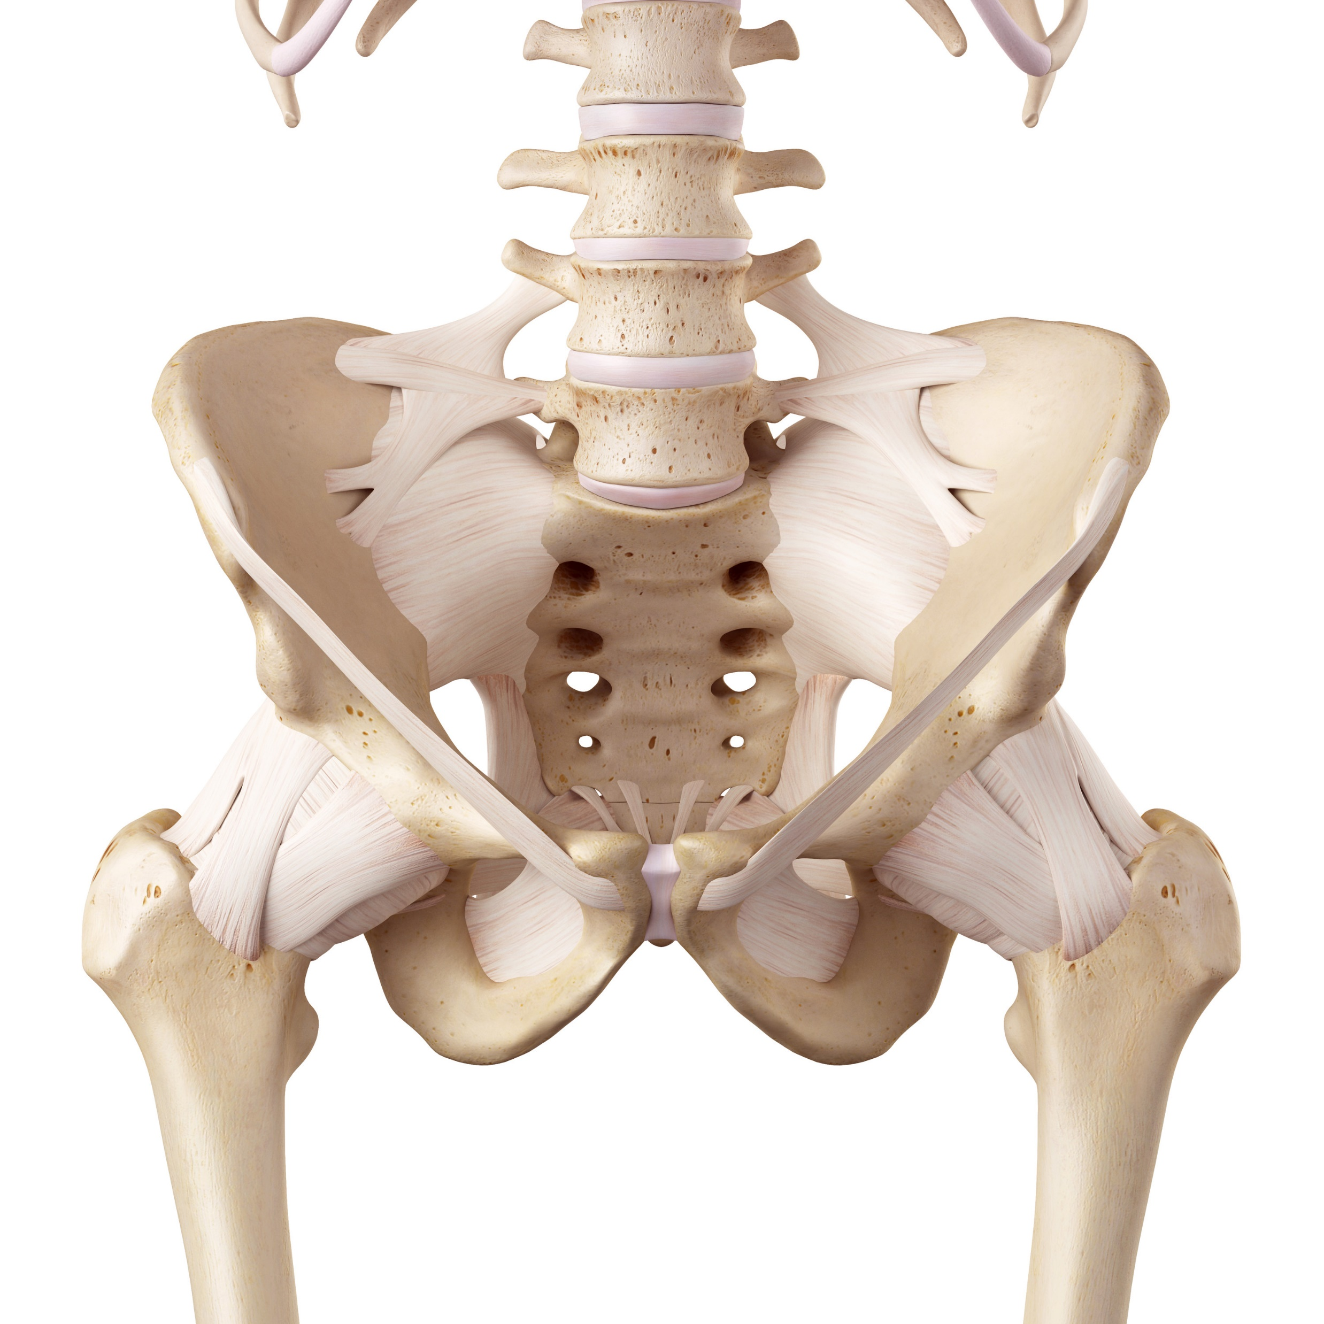
Unit 2 Anatomy and Back Care

Slide 16
Learning outcomes
On completion of this module, learners will be able to:
Identify the main parts of the spinal column.
State the purpose of these.
Explain how they can get injured.
Explain how to look after your back at home and work.

Slide 17
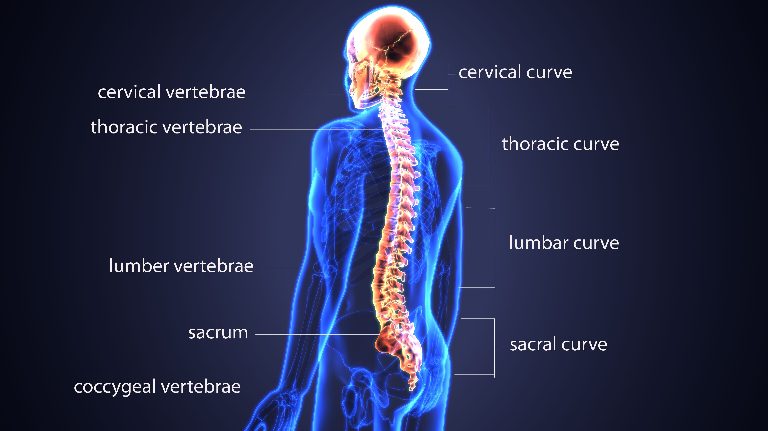
Spine
What is it for?
To protect the spinal cord,
To allow movement,
To support the upper body.
What is it made up of?
Vertebrae, discs.
What is notable about it?
S Shaped- very strong.
Notes:
Spine
Function:
To protect the spinal cord
To allow movement.
To support the upper body
Provides attachment for our ribs, muscles and ligaments
Composition:
Column of bones rising from the pelvis. Ask them what are the bones called (vertabrae).
There are 33 in total. You can show them the curves of the spine and name them if you wish:
Cervical (or neck!)
Thoracic
Ask them do they know what the lower curve is called (lumbar).
Sacral
Coccyx (tail bone)
Indicate the Facet joints, the nobbly bits at the back using the spine prop.
show how lower down there is very little rotation in the spine. The protect the lumbar spine from excessive twisting.
Characteristics
Strong and Flexible
Gentle ‘S’ bend
Move or lift in wrong way balance can be disturbed
Demonstrate using the prop that the spine can take significant downward pressure (up to 1 ton weight) but once it is put out of its correct alignment, it has no strength

Slide 18
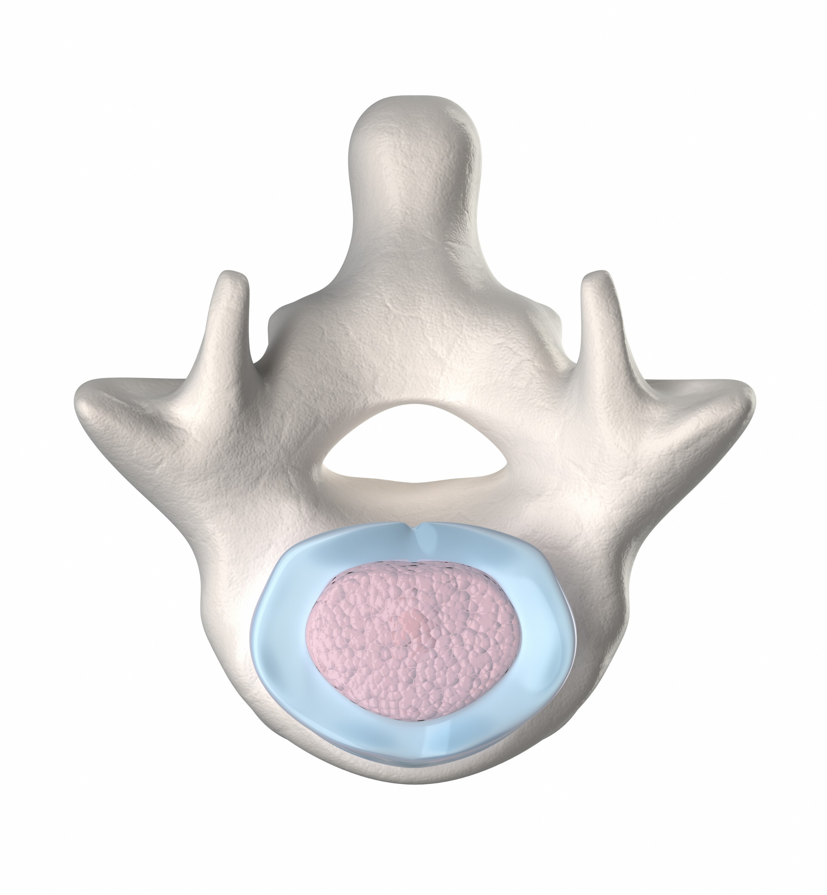
Vertebrae
What are they?
The bones in the back.
What are they for?
Allow support and movement,
Attaches to muscles and ligaments,
Create gaps for nerves.
How they can get damaged
Impact or disease (Osteoporosis).

Slide 19
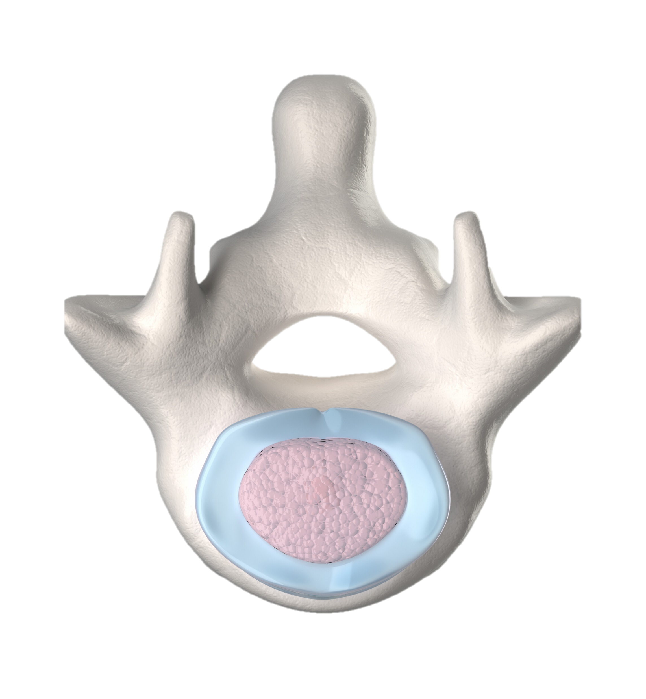
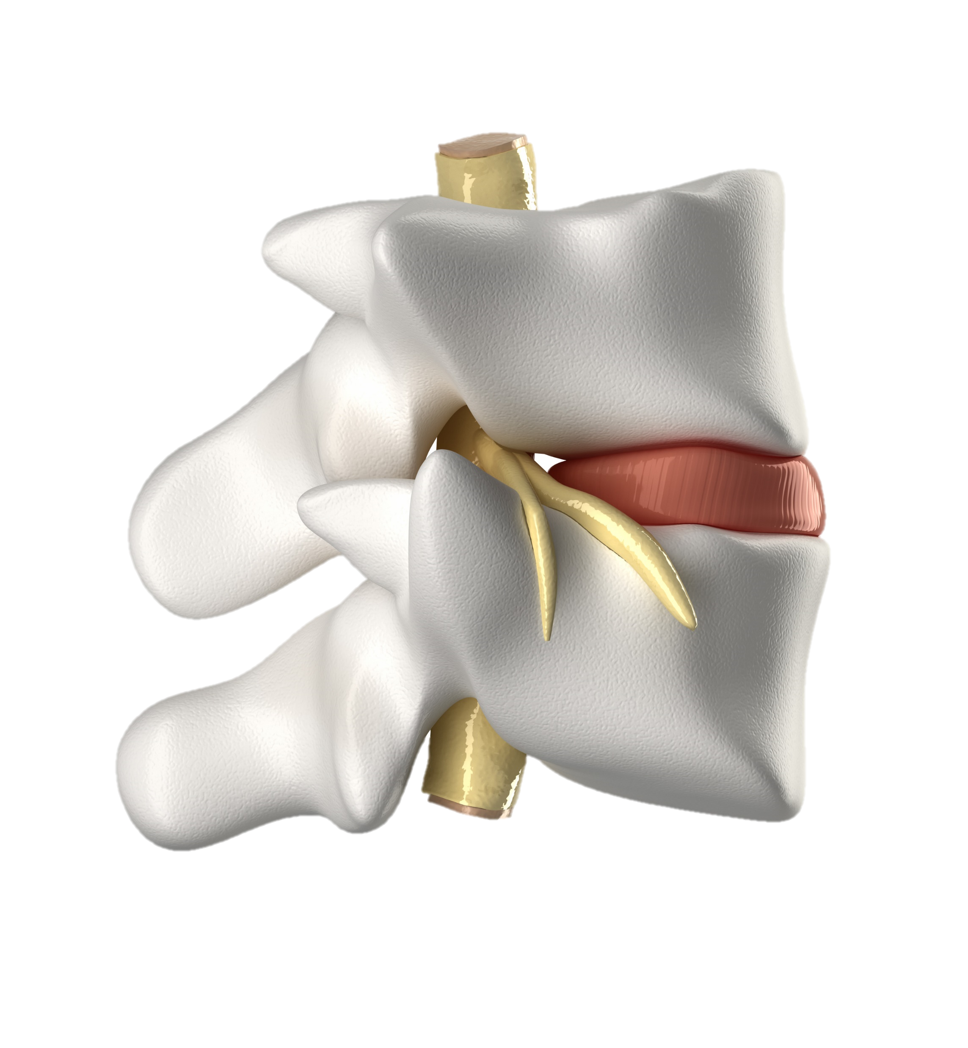

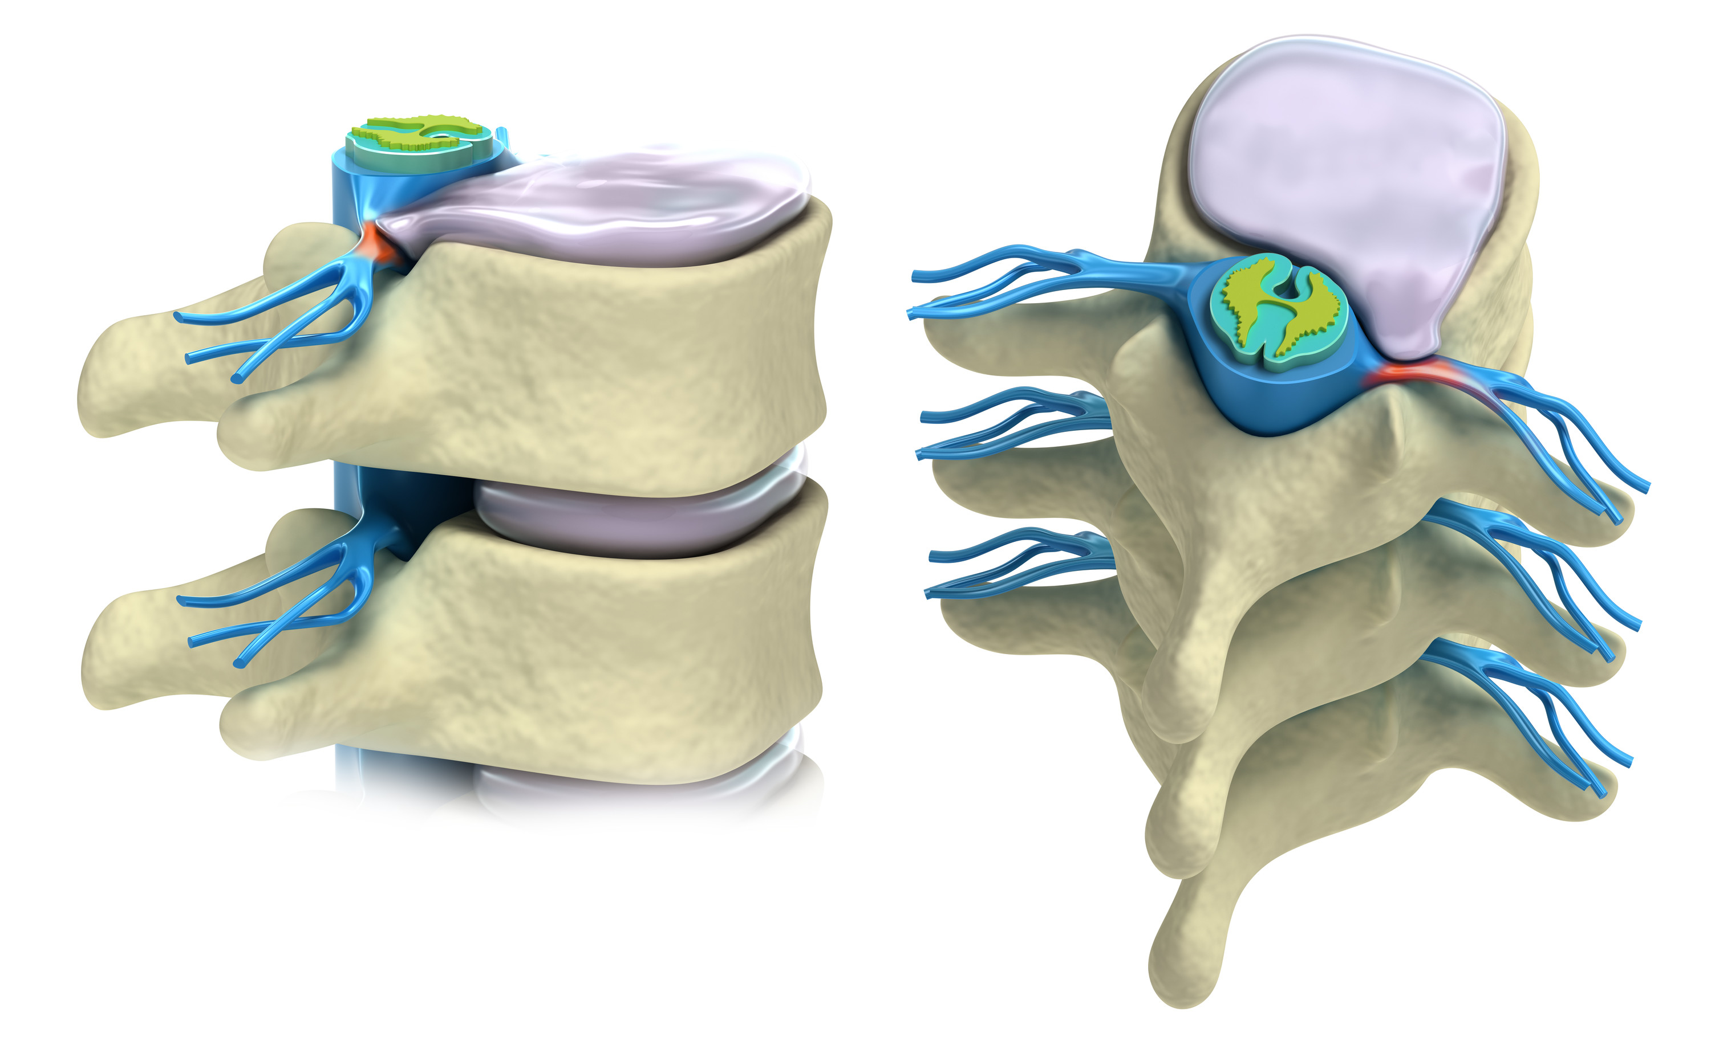
Intervertebral Discs
What are they for?
Act as shock absorbers, allow movement
What they are made up of:
Outer ring- rubbery
Centre- like toothpaste
What is notable about them
Poor Blood supply
Poor nerve supply
How they can get injured
Disc bulge or herniation caused by incorrect manual handling
Annulus Fibrosis
Nucleus Pulposus
Notes:
Explain the different views and the 2 main components (nucleus and annulus).
Explain the 3 main functions for the discs.
How they can get injured
Bending and twisting the back when loaded
Disc can bulge or herniate causing pressure on nerves

Slide 20
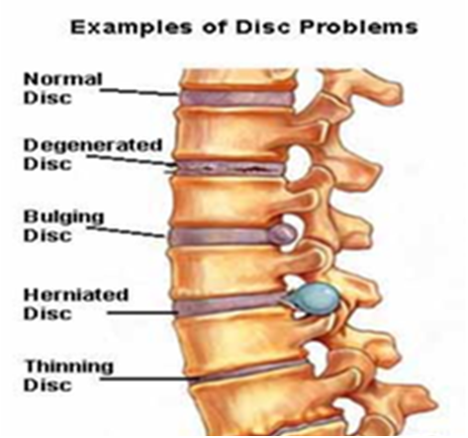
Disc problems
Notes:
Need to get a better graphic here
Go down through the various conditions describing them as you go

Slide 21
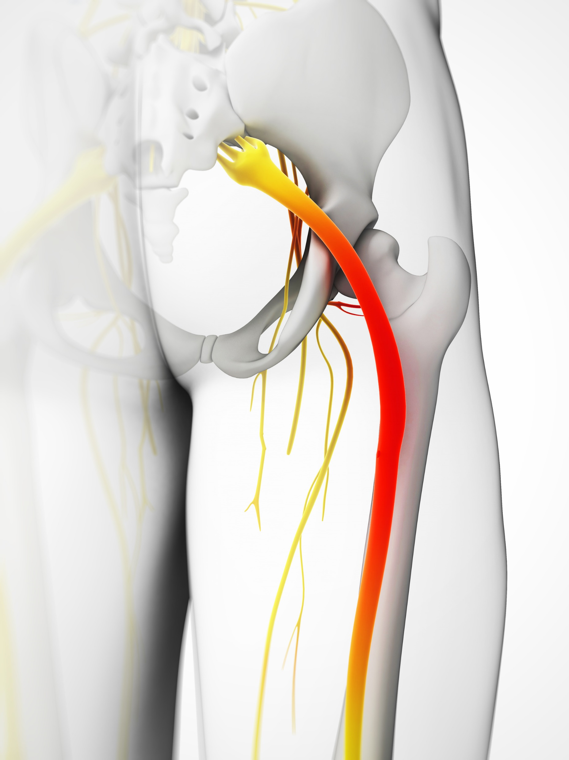
Nerves
What are they for?
Transmitting messages
What they are made of
Millions of fibres
What is notable about them
Not very strong
How they can be injured
Sciatica
Pinched nerves
Notes:
Nerves control all our movement and communicate to our muscles to fire and engage. Issues with nerves can result in pain or uncoordinated movements that feel awkward.
Point out the 2 sciatic nerves in the graphic
Nerves:
Function:
They transmit info to and from the brain.
Composition:
Explain that nerves are light delicate fibres. The main nerves branch off from the spinal cord.
Injury:
Sciatica. If a nerve is touched by a bulging disc the pain is “referred” or transmitted down the nerve. These nerves travel from the spinal cord to the legs and feet. This is extremely painful. We are all familiar with the term “touched a nerve”.

Slide 22
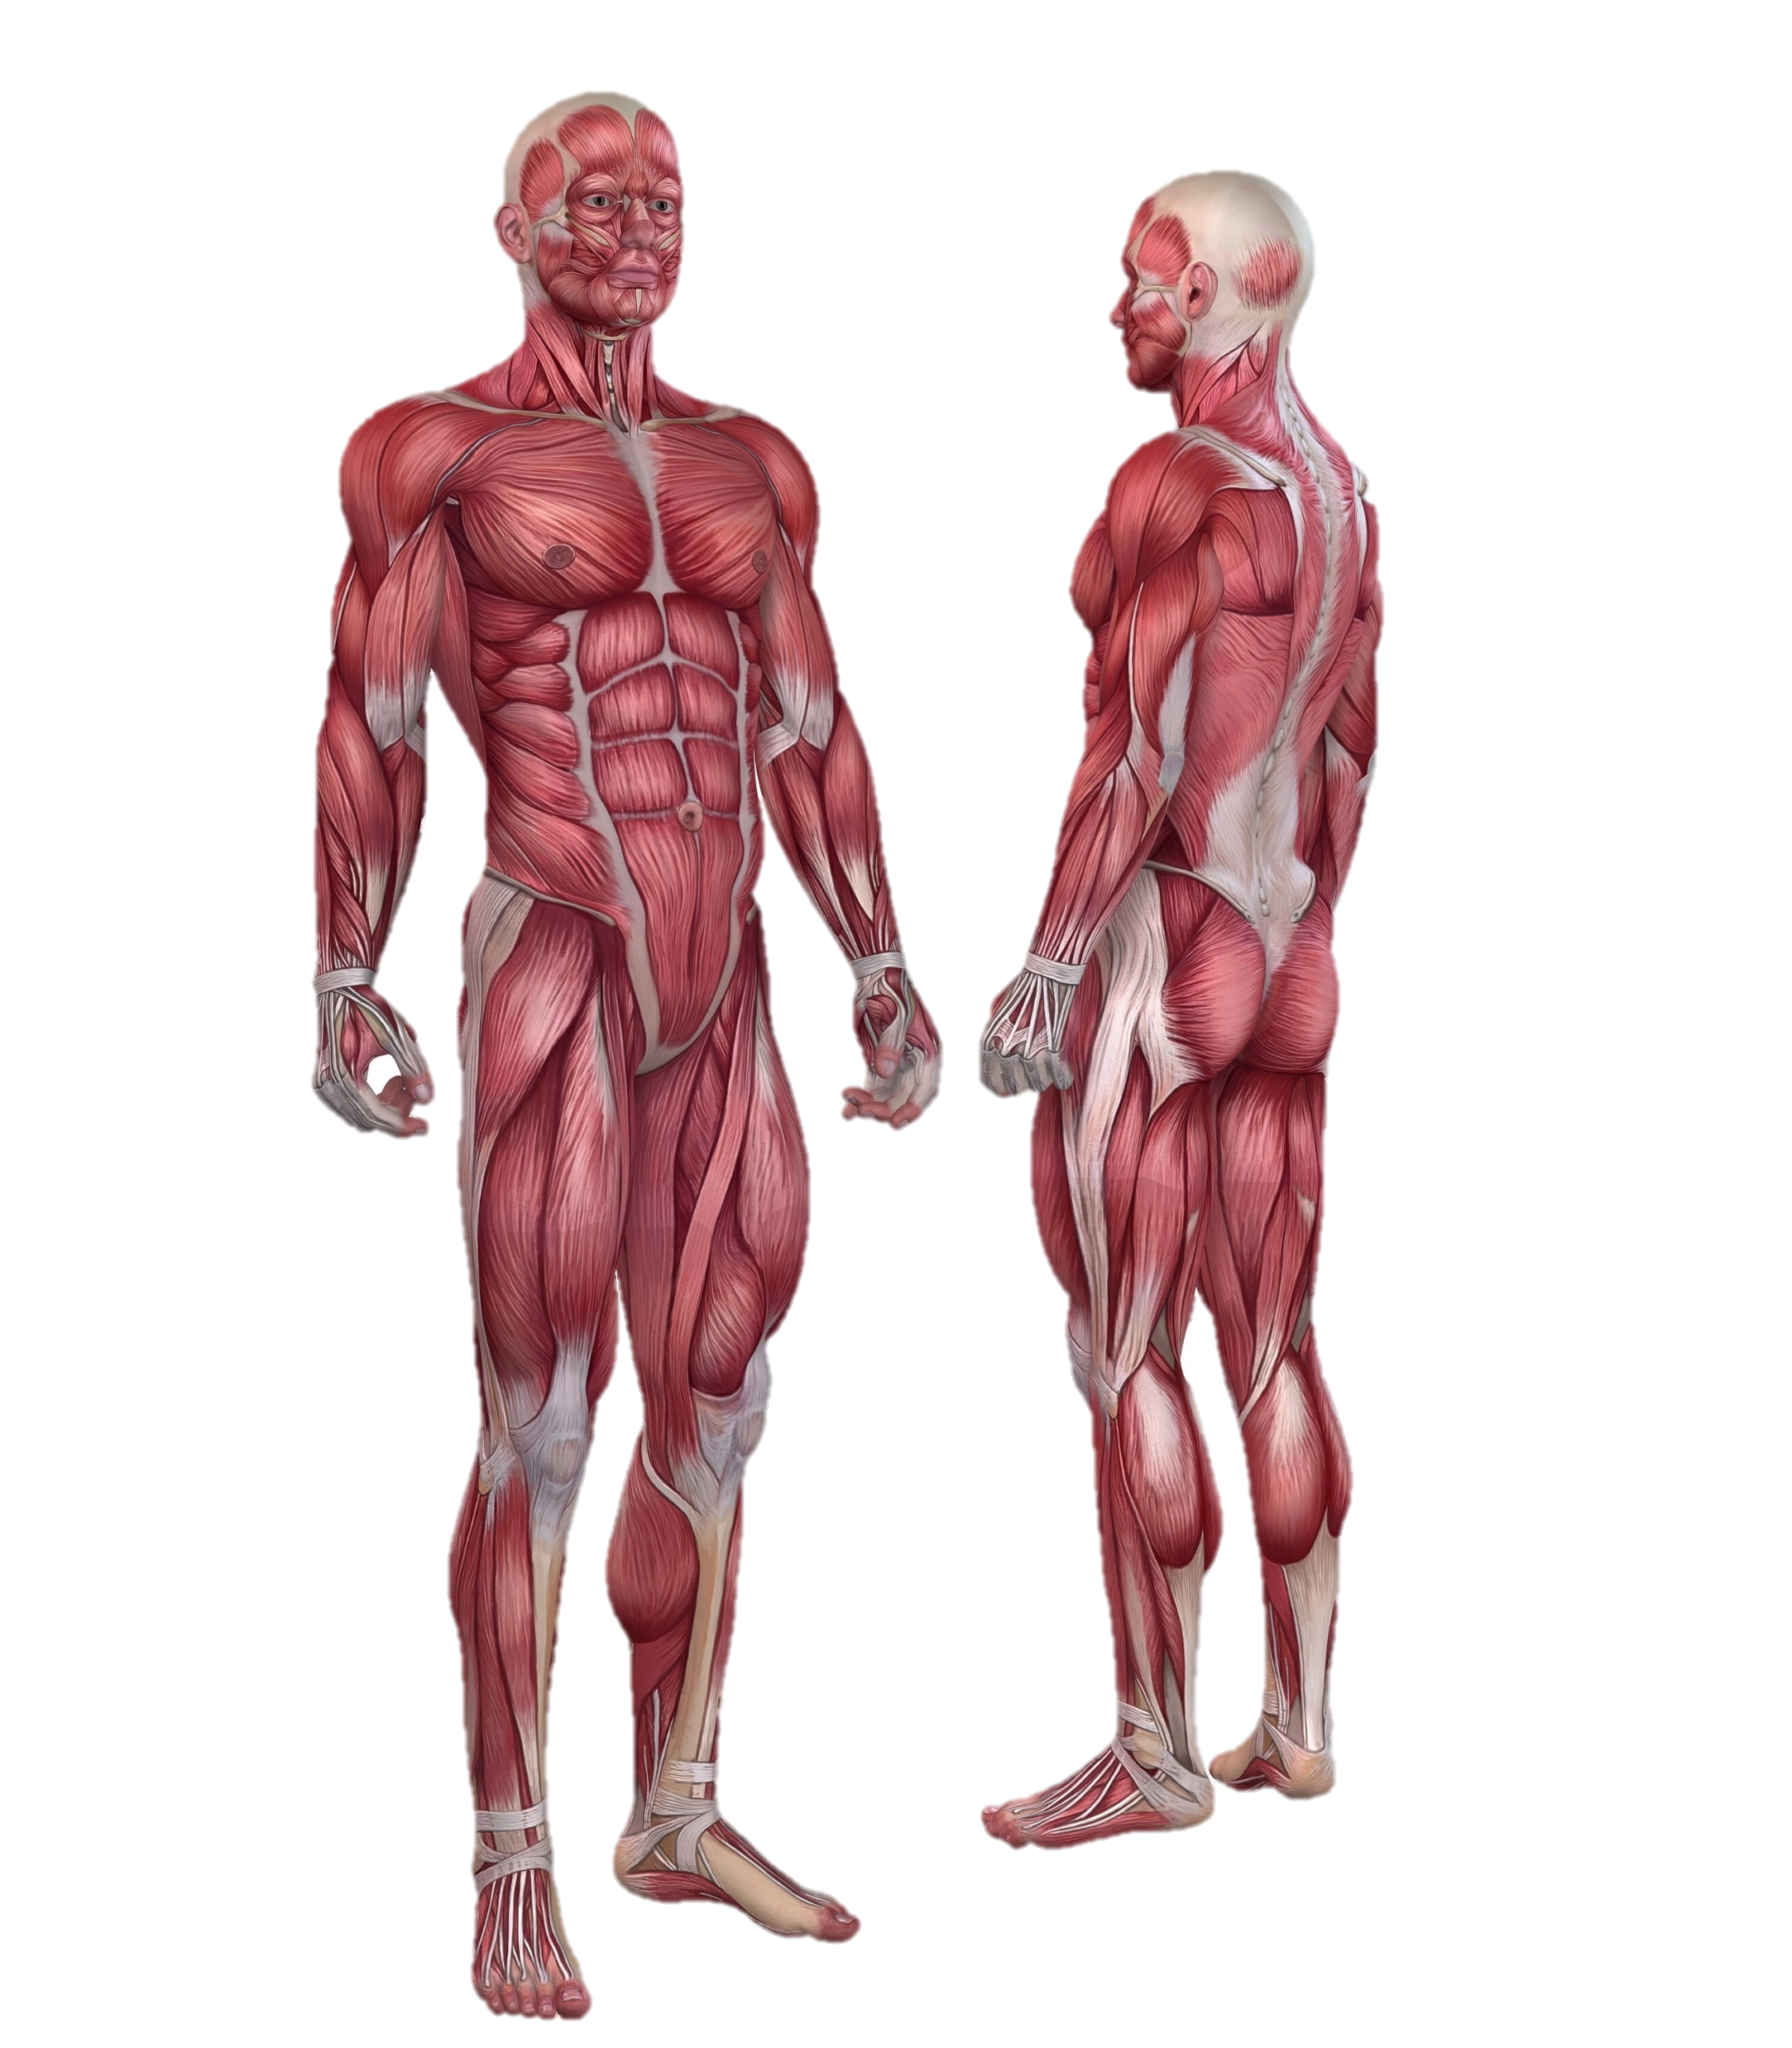
Muscles
What they are made up of:
Muscles are bundles of fibre
What is notable about them:
Good nerve supply
Good blood supply
How they can be injured:
Pulled muscle- strain
Aches, pain from tension
Notes:
Μυσχλεσ
Ψου χαν σταρτ βψ εξπλαινινγ τηατ μυσχλεσ αρε βυνδλεσ οφ φιβρε. Τηεψ αλλοω μοϖεμεντ. Ψου χαν ρεμινδ τηεμ τηατ α λυμπ οφ στεακ ισ μυσχλε.
Χηαραχτεριστιχσ:
Γοοδ βλοοδ συππλψ.
Γοοδ νερϖε συππλψ.
Ασκ ωηψ τηισ ισ γοοδ. Ηεαλσ φαστ. Αλσο βεχαυσε οφ α γοοδ νερϖε συππλψ ψου αωαρε οφ δοινγ δαμαγε.
Ασκ τηεμ το χλενχη τηειρ φιστσ φορ α μινυτε. Ωηατ ωιλλ ηαππεν αφτερ α φεω μινυτεσ? Ιτ ωιλλ τιρε βεχαυσε νο βλοοδ ανδ τηερεφορε οξψγεν χαν γετ ιντο ιτ. Ιτ ισ λικε α σπονγε. Ιτ νεεδσ το βε σθυεεζεδ ανδ τηεν ρελαξεδ το αλλοω βλοοδ τηρουγη ιτ.
Μυσχλεσ δο νοτ λικε το βε χοντινυουσλψ χοντραχτεδ.
Μυσχλε Τψπεσ:
Explain that you are going to contrast the differences between the 2 different types of muscles: Postural and Action.

Slide 23
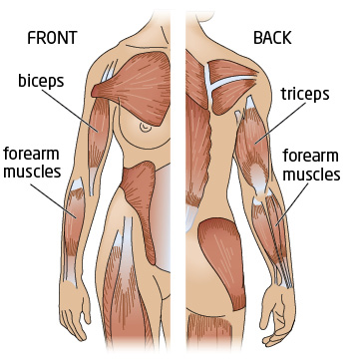
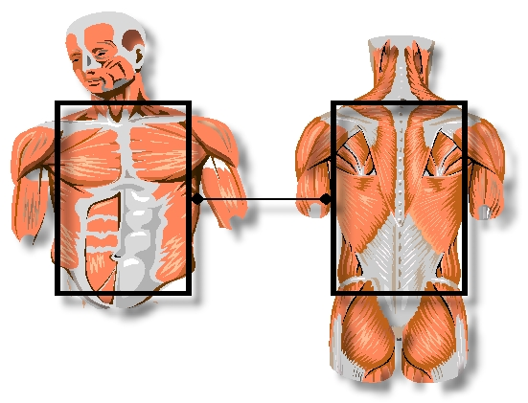
Muscle Types
Action
Postural
What are they for?
Movement, action (manual handling)
What is notable about them?
Voluntary, Tire faster
Examples?
Quads
What are they for?:
Posture, protection
What is notable about them?
Involuntary, good endurance
Examples:
Abs
Notes:
Action/ Voluntary muscles
Function:
The function of action muscles are to move the limbs and carry out work!
Composition:
The action muscles are long muscles such as the limbs.
Characteristics:
Generally longer and they tire more easily.
Demonstrate that action muscles like to move by demonstrating keeping one hand static whilst moving the other one.
Injuries:
Muscle strains in action muscles will come from again overstretching them during activities.
Postural muscles/ involuntary
Function:
The function of postural muscles is to support and protect the back. If a postural muscles are weak and the back is less stable and the discs are under more pressure.
Composition:
These are the small short muscles which extend from vertebrae to vertebrae, they use ready oxygen and tire less easily.
Characteristics:
Postural muscles are generally shorter and have greater endurance. Hence they can keep up upright for a long time.
Injuries:
Αχηεσ & παινσ ιν τηε ποστυραλ μυσχλεσ ωιλλ χομε φρομ ποορ ποστυρε βεχαυσε τηεψ αρε βεινγ οϖερστρετχηεδ ανδ ηαϖε το ωορκ ηαρδερ τρψινγ το συππορτ τηε βοδψ.

Slide 24
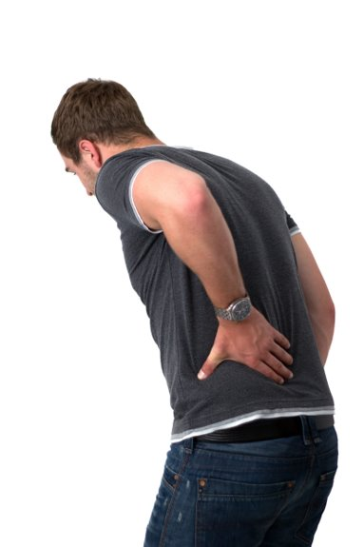
How do back injuries occur?
Lifting weights that are too heavy,
Poor static posture,
Twisting, stooping, over-reaching,
Sitting or standing for too long,
Sudden movement,
Vibration during handling,
Stress.

Slide 25
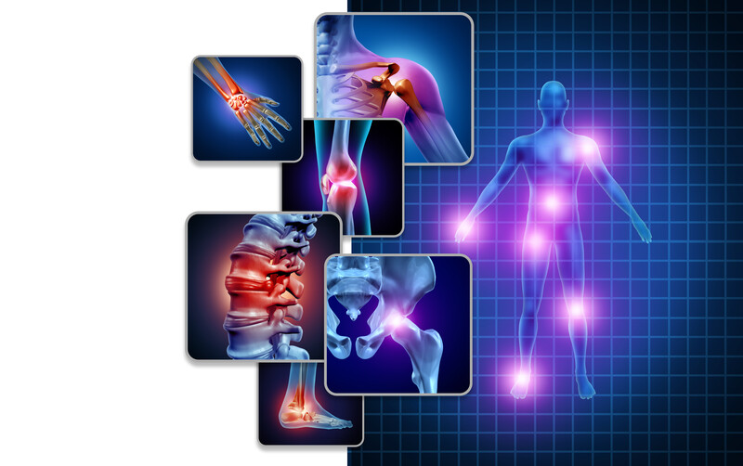
Musculoskeletal Disorders (MSDs)
Injuries or pain to the following:
Joints,
Muscles,
Nerves,
Tendons, or
Ligaments.
Notes:
Ask the group what they think MSDs are.
Tell them what they are and where they can occur.

Slide 26
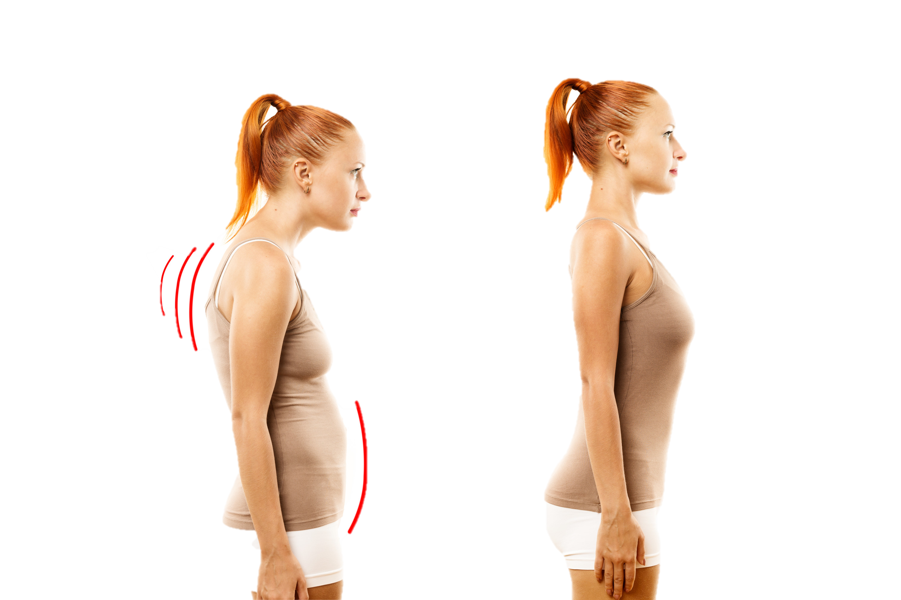
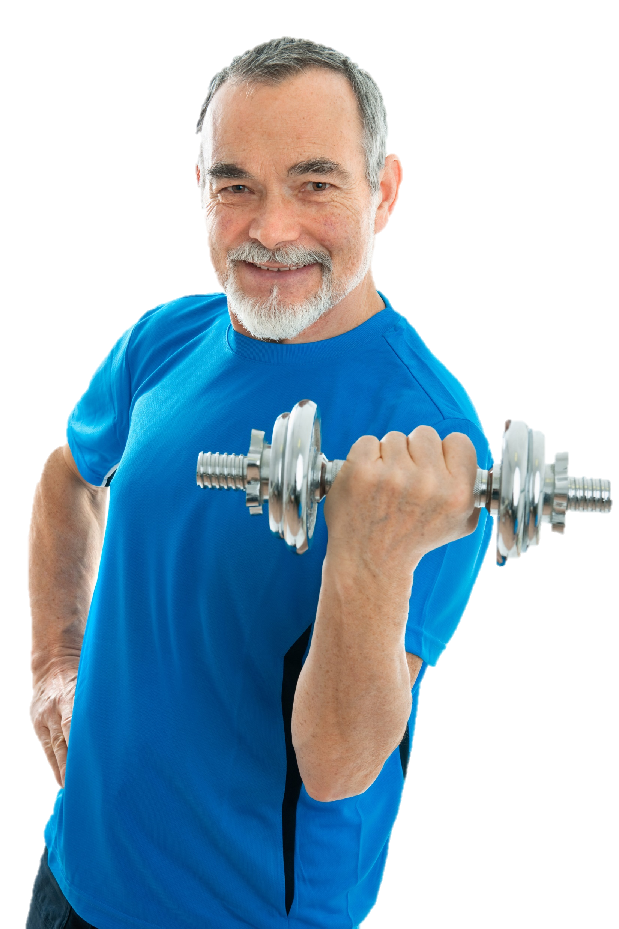
Caring for your back
Posture Exercise
Notes:
Ask the group can they identify the two key ways we can look after our backs.

Slide 27
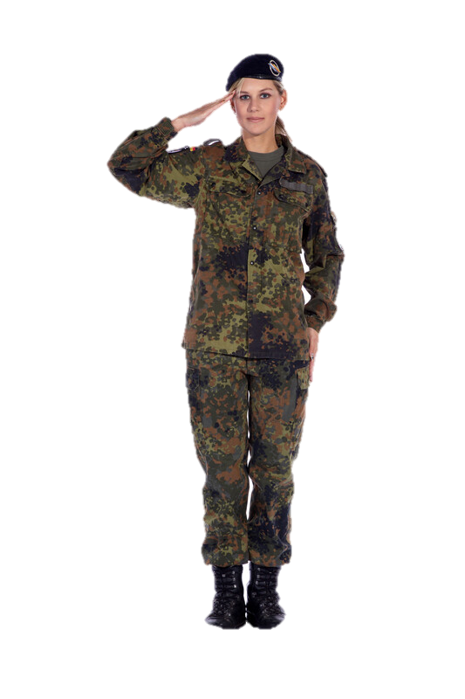
Posture
What is posture?
The correct alignment of the body.
“The way you carry yourself”.
Why?
Less strain on your back.
How?
Ears over shoulders, over hips, over knees, over ankles.
Notes:
In this slide you can explore posture. You can discuss posture when sitting on a chair, bed, getting in and out of a car.
WE ARE NOT ALL THE SAME, SO CANNOT HAVE THE SAME POSTURE.
*EXERCISE
Ask the group to stand and march without looking at their feet- different people march in different ways. Ask them to stop and settle without looking at their feet – you will see the patterns above
Everyone has imbalances but we need a tool to allow all to succeed as best they can.
We need different positions for different capacities such as these foot positions here. You will see people with different foot positions for example.
For some people, posture is about standing up tall and straight like the military.
For others it is about movement and exercise.
However for all of us it is a massive balancing act.
Cars:
Getting in and out.
Muscles switch off when using pedals.
Getting children in and out of a car seat
Sitting room: Chairs/ Seats
The seat should be high enough for you to get out of with your arms folded
Ensure you can sit back against the lumbar support and still put your feet flat on the floor
When you sit with your feet on the floor the postural muscles remain engaged and you back is supported.
If you sit cross legged the signals to the muscles go haywire ant it ends up switching off the postural muscles to one side and you end up sagging. You invariably end up propping yourself up in some way!
Getting in and out of a chair. Lean forward to let your weight forward.
Bedroom: Bed
To find the right degree of firmness, lie on your back and slide your hand under the curve in your lower back.
If you can’t, the bed is too soft, if its very easy the bed is too hard Ensure the bed is high enough to get on and off easily and comfortably and to make the bed without bending
A firm bed should support you in a comfortable position, test this by lying on your back you should be able to slide your hand under your lower back fairly easily without a gap.
Using an old bed base may cause a new mattress to have the same faults as the old base. It is also important to buy a bed which is easy to use and make.
Getting up out of bed. How do you do it? You should roll onto one side and then push youreslf up while dropping your feet to the ground.

Slide 28
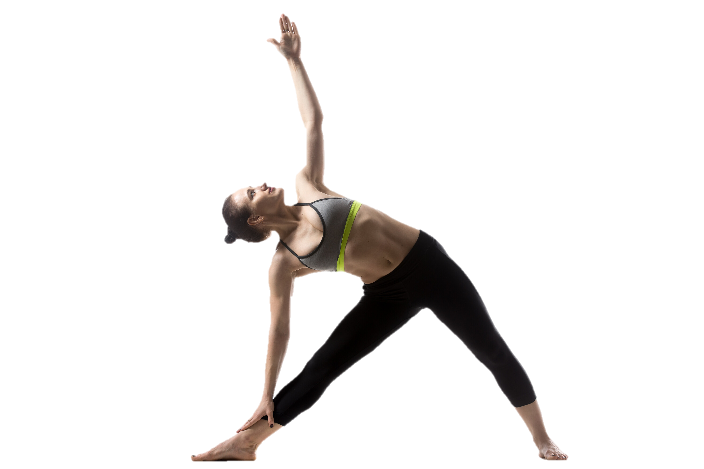
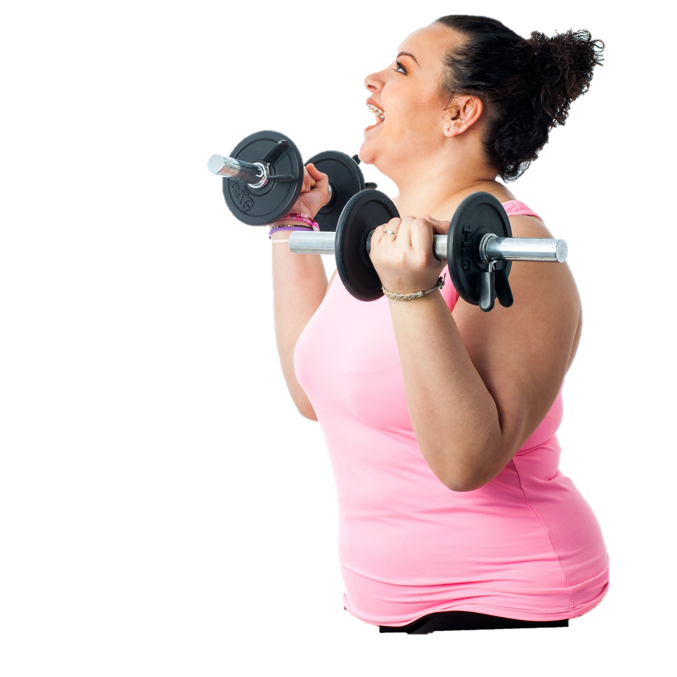
Fitness
What is fitness
The ability to perform tasks without being under pressure
What exercise is?
Physical activity performed to improve fitness
Elements of fitness
Strength, Aerobic, Flexibility & Endurance
Why?
Efficient, less likely to get injured

Slide 29

Recap Questions
What does your spine do?
What are the roles of the discs?
What are the different types of muscles and their purpose?
How can we look after our backs?
What is posture?

Slide 30

Unit 3
Ergonomics & Risk Assessment

Slide 31

Learning Outcomes
On completion of this module, learners will be able to:
Explain what ergonomics is.
List the principles of good ergonomics.
Explain what risk assessment is.
Identify risk factors using TILE.
Explain how to avoid/reduce risk of injury.
List mechanical equipment available.

Slide 32
Ergonomics
What?
"Fitting the task to the person"
Why?
To reduce strain on workers
How?
Redesigning work following risk assessment
Notes:
Could we use a simpler definition of ergonomics? Ive added the 2015 one from the H.S.A.
this first slide you will explain the concept of ergonomics to the students. Begin by using the following definition that is currently being used by the HSA:
“Ergonomics applies information about human behaviour, abilities and limitations and other characteristics to the design of tools, machines, tasks, jobs and environments for productive, safe, comfortable and effective human use” (McCormick and Saunders 1993).
Then explain to the students another simple way to describe ergonomics is the organising or reorganising the workplace and/or work to reduce the strain on people. Matching the task to the worker.
Examples include:
Moving stuff closer to where its needed
Adjustable chairs/workstations
Tailoring systems/layouts to suit the individuals carrying out the tasks

Slide 33
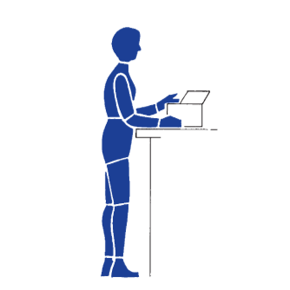
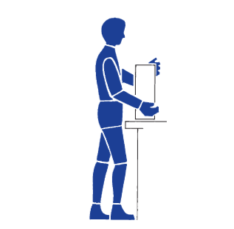
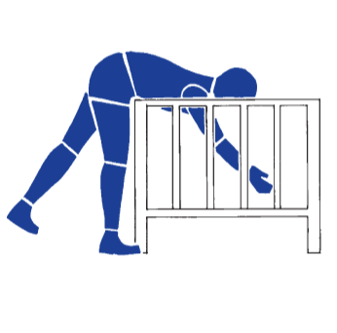
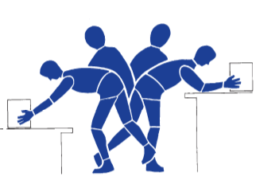
Ergonomic Principles
Keeps joints in a neutral position
Keeps work close to the body
Avoids excessive bending
Avoids twisting
Notes:
Describe the different ergonomic principles to the students:
Image 1: Explain that the joints must be in a neutral position. In the neutral position the muscles and ligaments, which span the joints, are stretched to the least possible extent
Image 2: Keep the work close to the body. If the work is too far from the body, the arms will be outstretched and the trunk bent over forwards. Keep the work as close to the body as possible.
Image 3: Avoid bending forward. The upper part of the body of an adult weighs about 40kg on average. The further the trunk is bent forwards, the harder it is for the muscles and ligaments of the back to maintain the upper body in balance
Image 4: Twisted postures of the trunk cause undesirable stress to the spine, avoid twisting as much as possible (particularly when carrying a heavy load)

Slide 34
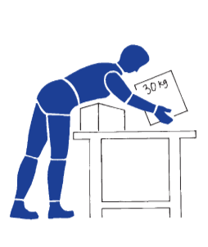
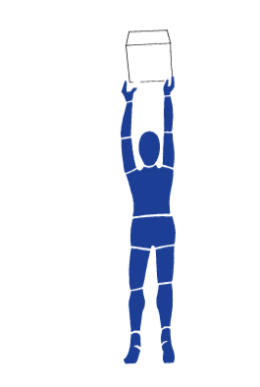
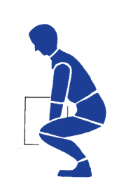
Ergonomic Principles
Avoids excessive reaches
Avoids tasks above shoulder level
Limits the weight of the load
Notes:
Image 1: Avoid excessive reaches. It is necessary to limit the extent of forward and sideways reaches to avoid having to bend over or twist the trunk
Image 2: Avoid carrying out tasks above shoulder level. The hands and elbows should be well below shoulder level when carrying out a task
Image 3: Limit the weight of the load. There are guidance weight limits for both males and females detailed in Environment slides later in the module.

Slide 35
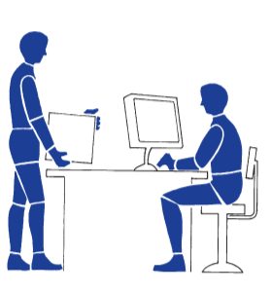
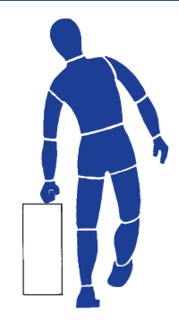
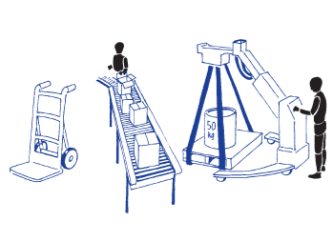
Ergonomic Principles
Allows use of mechanical aids
Avoids carrying loads with one hand
Alternates posture as well as movement
Notes:
Image 1: Many lifting accessories are available to help lift and move loads. There are a large number of accessories such as roller conveyors, conveyor belts, trolleys and mobile raising platforms that can be applied eliminate or reduce manual handling. We’ll look at mechanical aids we can use later in the module also.
Image 2: When only one hand is used to carry a load, the body is subject to mechanical stress (avoid carrying with one hand where possible)
Image 3: Alternate postures as well as movements. No posture or movement should be maintained for a long period of time. Prolonged postures and repetitive movements are tiring.

Slide 36

Risk Assessment
What is a Risk Assessment?
Identifying hazards, assessing and controlling risk.
Types
Task Risk Assessment: Formal written assessment carried out on a task
Dynamic Risk Assessment: Performed on the spot by workers
Notes:
Ask what is risk assessment? (This is an easy question that most people should have an answer to)
Risk assessment is the identification of hazards (risk factors).
You can then ask them what risk assessments do they carry out on a daily basis?
Examples could include:
Crossing the road.
Checking the weather before swimming/cycling.
Testing how hot food is.
Explain that a hazard is an issue that has the potential to cause you harm (i.e. a car is a potential hazard when crossing a road)
A risk factor then is an issue that increases the risk of said harm being suffered (i.e. crossing the road at blind turn, as you cannot see what is coming thus increasing the risk of being struck by a car)
A control measure on the other hand is simply a solution we can implement to either remove or reduce the risk associated with the hazard.

Slide 37
Risk Assessment
What is a hazard?
Anything that will cause harm
Risk Factors
Issues that can increase risk
Controls
Solutions put in place to avoid or reduce the risk
Notes:
Ask what is risk assessment? (This is an easy question that most people should have an answer to)
Risk assessment is the identification of hazards (risk factors).
You can then ask them what risk assessments do they carry out on a daily basis?
Examples could include:
Crossing the road.
Checking the weather before swimming/cycling.
Testing how hot food is.
Explain that a hazard is an issue that has the potential to cause you harm (i.e. a car is a potential hazard when crossing a road)
A risk factor then is an issue that increases the risk of said harm being suffered (i.e. crossing the road at blind turn, as you cannot see what is coming thus increasing the risk of being struck by a car)
A control measure on the other hand is simply a solution we can implement to either remove or reduce the risk associated with the hazard.

Slide 38
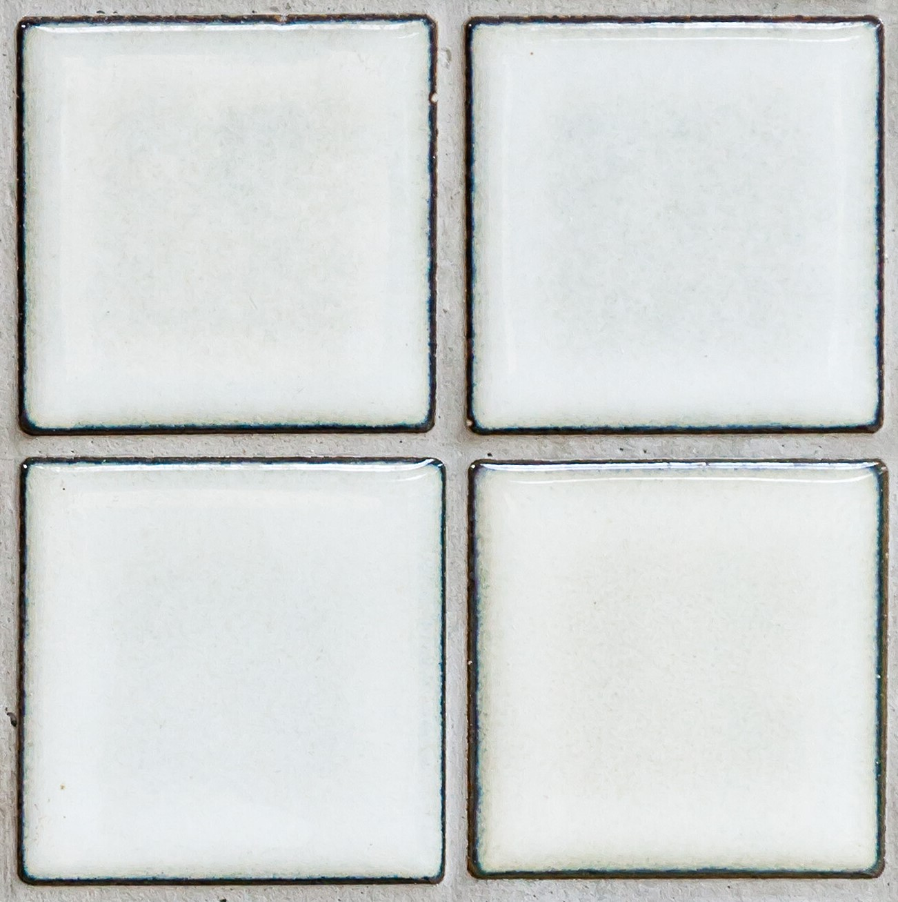
Risk Factors
Task
What movements and body postures put pressure on the back?
Individual
What characteristics of a person make them more at risk?
T
I
Load
What characteristics of the load increase the risk?
L
E
Environment
What aspects of the environment will increase the risk?
Notes:
Ask what types of tasks or body postures pose a risk of injury to the back (Ask them to think back to the anatomy module)
Possible answers include:
Awkward postures
Holding loads away from body
Twisting
Bending/ Stooping
Reaching upwards
Long travel distances
Forceful pushing or pulling
Repetitive handling
Ask them what conditions or characteristics could people have that could increase the likelihood or injury?
Possible answers include:
Physical condition
Illness
Pregnancy
Requires unusual strength, height, etc.?
Any reservations lifting ability?
Trained?
Ask them what characteristics could a load have that could increase the likelihood of injury?
Heavy
Bulky or unwieldy
Difficult to grasp
Unstable
Harmful i.e. sharp/hot
What aspects of the environment will increase the risk?
Is the floor slippy
Stairs
Lighting
Windy

Slide 39
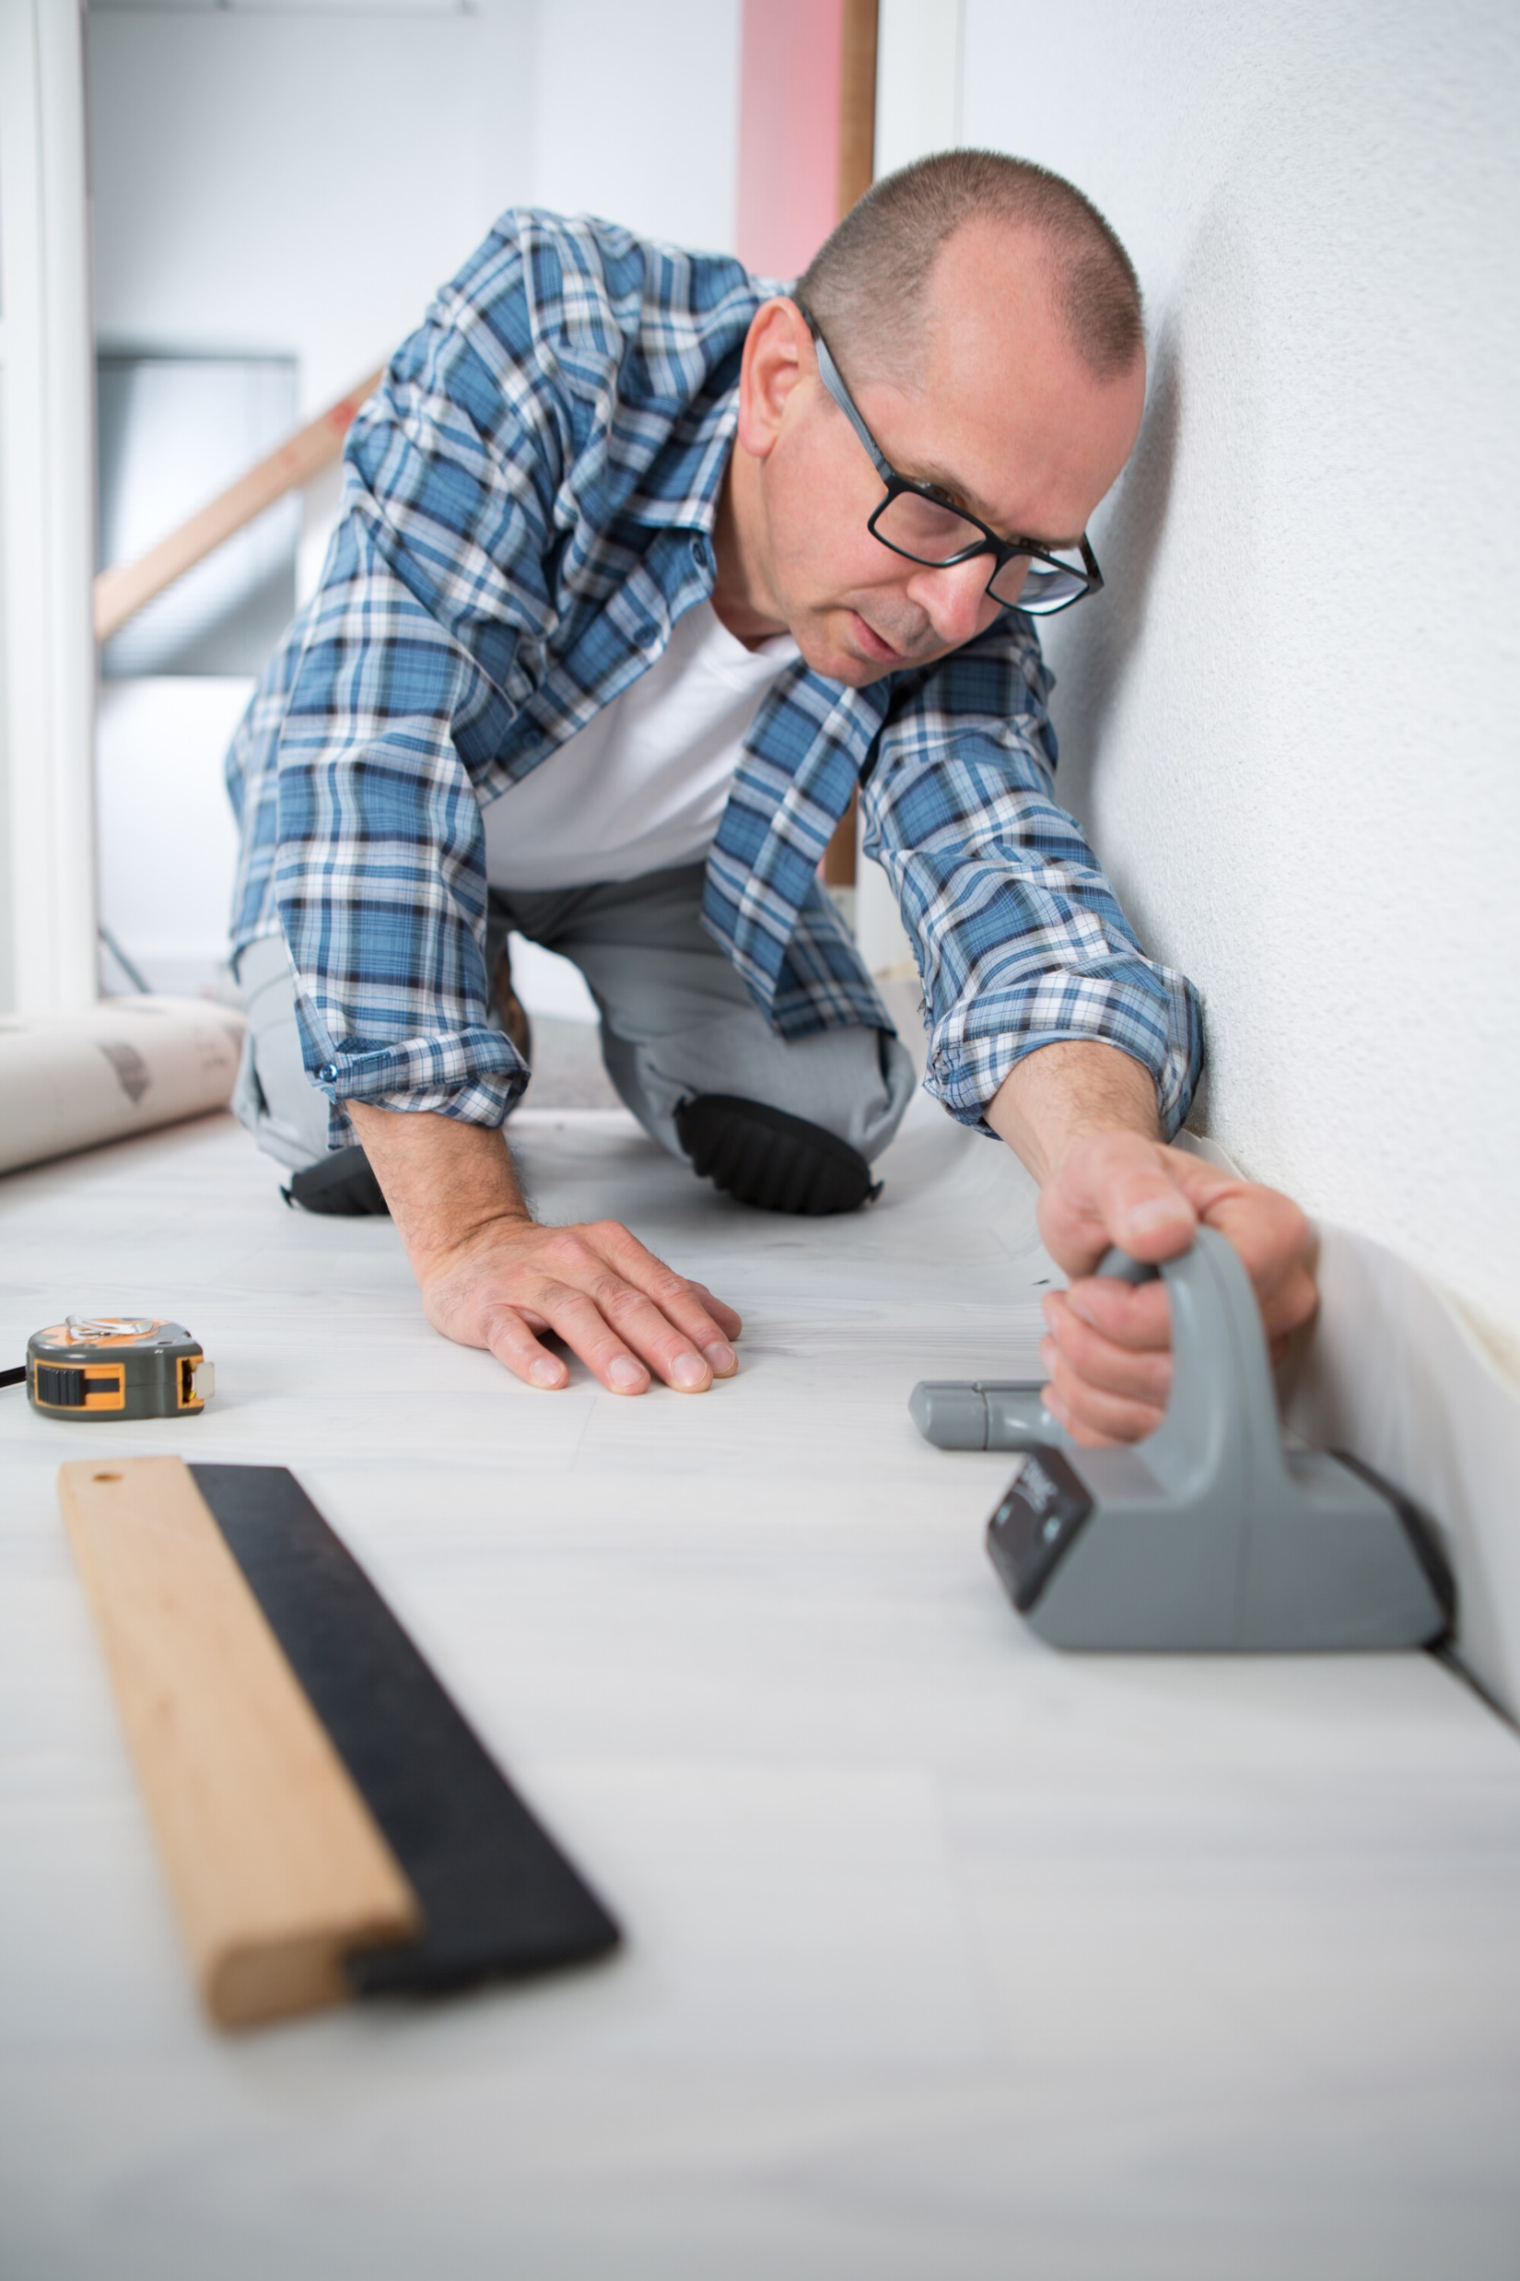
Task
Does the job involve:
Awkward postures
Holding loads away from body
Twisting
Bending/ Stooping
Reaching upwards
Long travel distances
Forceful pushing or pulling
Repetitive handling
Notes:
Lecture students on all the characteristics of the task listed on the slide, particularly examples not mentioned by students on the T.I.L.E slide.

Slide 40

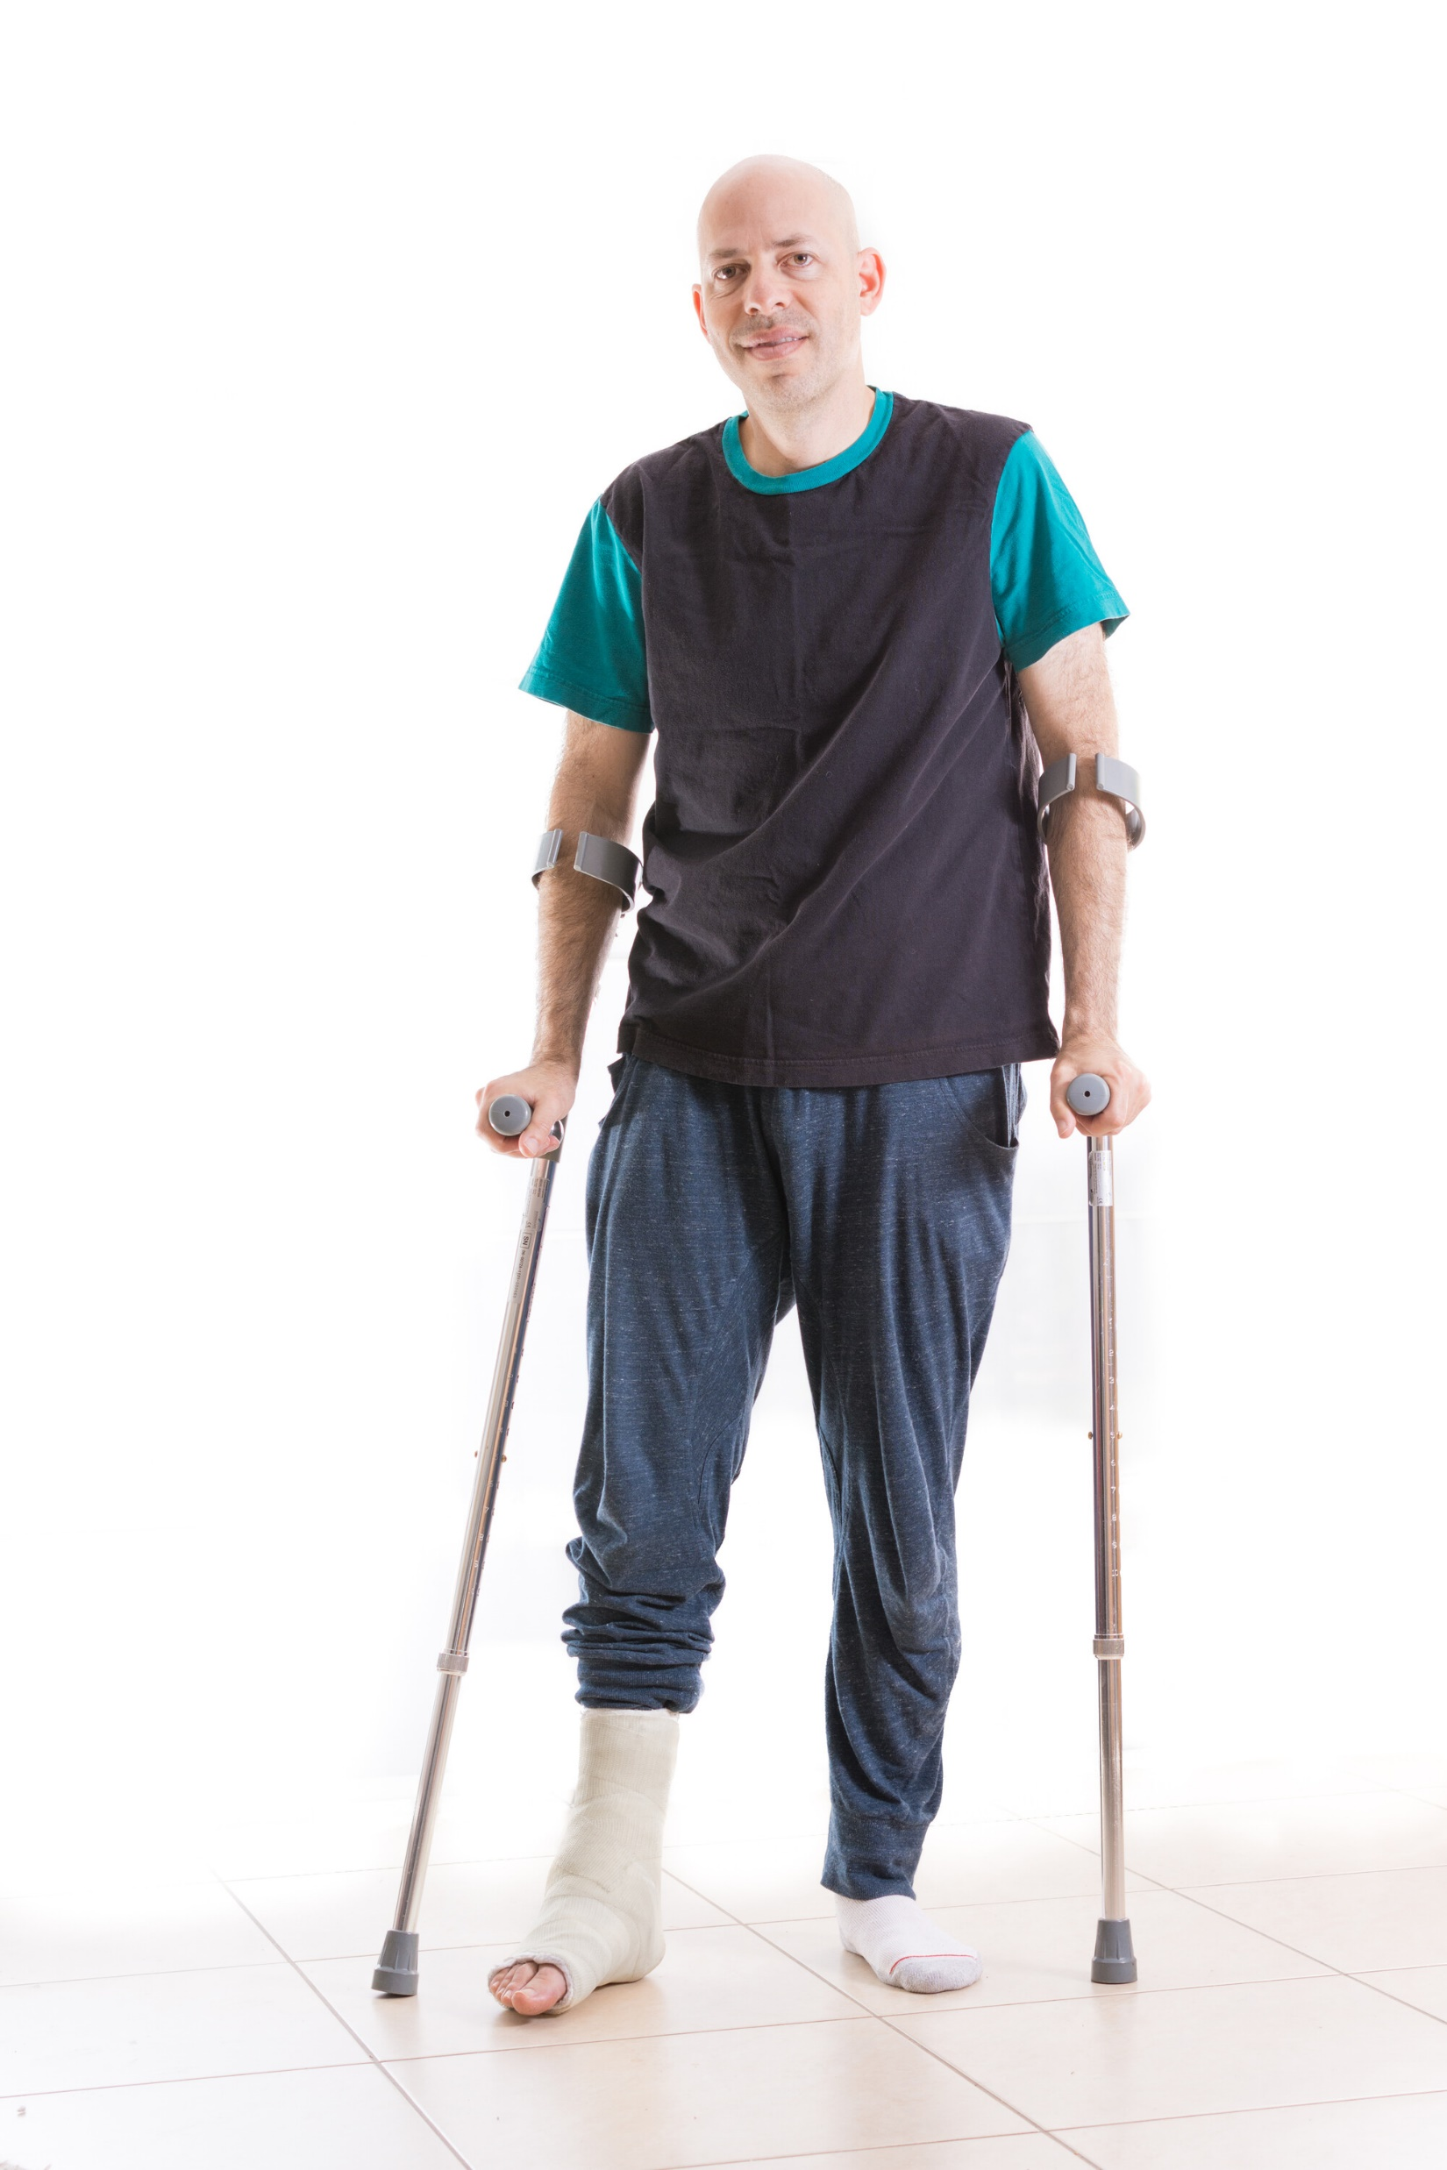
Individual (You!)
Are you:
Physically unfit?
Ill?
Injured?
Pregnant?
Requires unusual strength, height, etc.?
Untrained?
Unsuitably attired?
Notes:
Lecture students on all the characteristics of the individual listed on the slide, particularly examples not mentioned by students on the T.I.L.E slide.

Slide 41
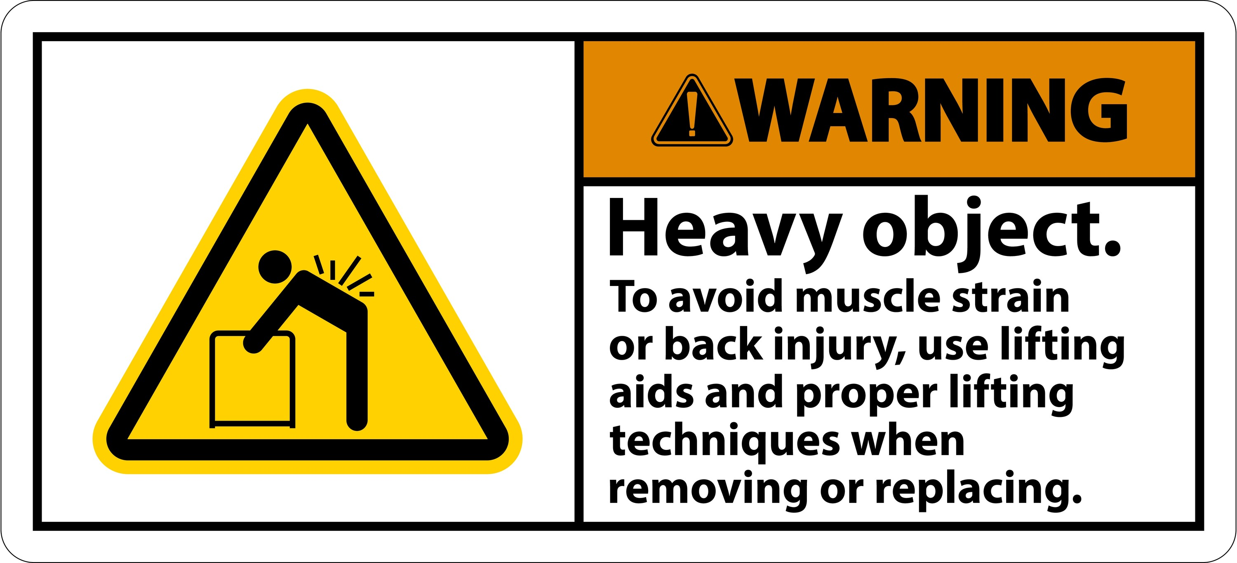
Load
Is the load:
Heavy?
Bulky or unwieldy?
Difficult to grasp?
Unstable?
Harmful i.e. sharp/hot?
Notes:
Lecture students on all the characteristics of the load listed on the slide, particularly examples not mentioned by students on the T.I.L.E slide.

Slide 42

Environment
Is the floor slippy?
Are there space constraints?
Are there steps?
Is it windy?
Is it too hot/ cold?
Is there poor lighting?
Notes:
Lecture students on all the characteristics of the environment listed on the slide, particularly examples not mentioned by students on the T.I.L.E slide.

Slide 43
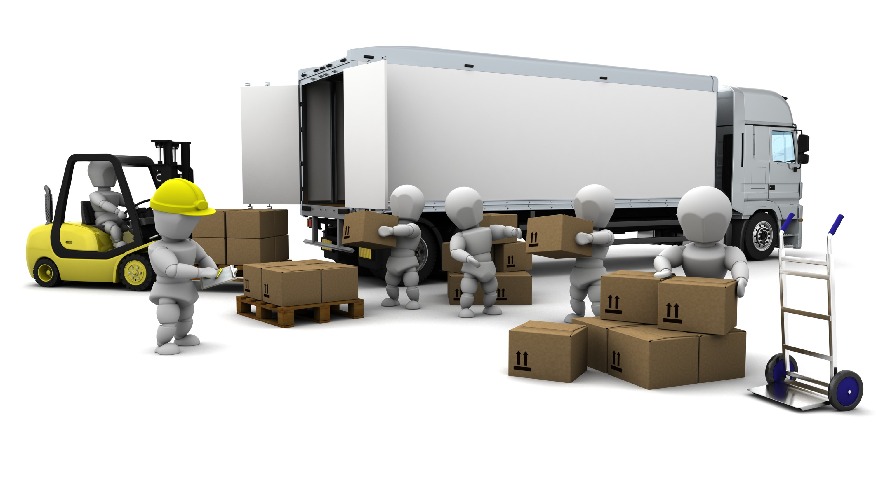
Mechanical Aids
What is a mechanical aid?
Any equipment used to avoid or reduce manual handling
Examples?
Trolleys, Pallet trucks, Forklifts, Hoists, Profile beds
Why (benefits)?
Safer, more efficient
Notes:
In the context of manual handling, mechanical aids comprises of equipment that can be used to either avoid or reduce the need for manual handling at home or at work.
Ask the class to give examples of mechanical aids they themselves have used in the past?
Examples include:
Trolleys
Pallet trucks,
Forklifts,
Hoists,
profile beds
Explain the benefits of using mechanical aids to the class. Highlight that not only is it safer but it can be more efficient too.

Slide 44


Slide 45
Recap questions
What is ergonomics?
What are the principles of ergonomics?
What is a risk assessment?
What does T.I.L.E stand for?
What are the benefits of mechanical aids?

Slide 46
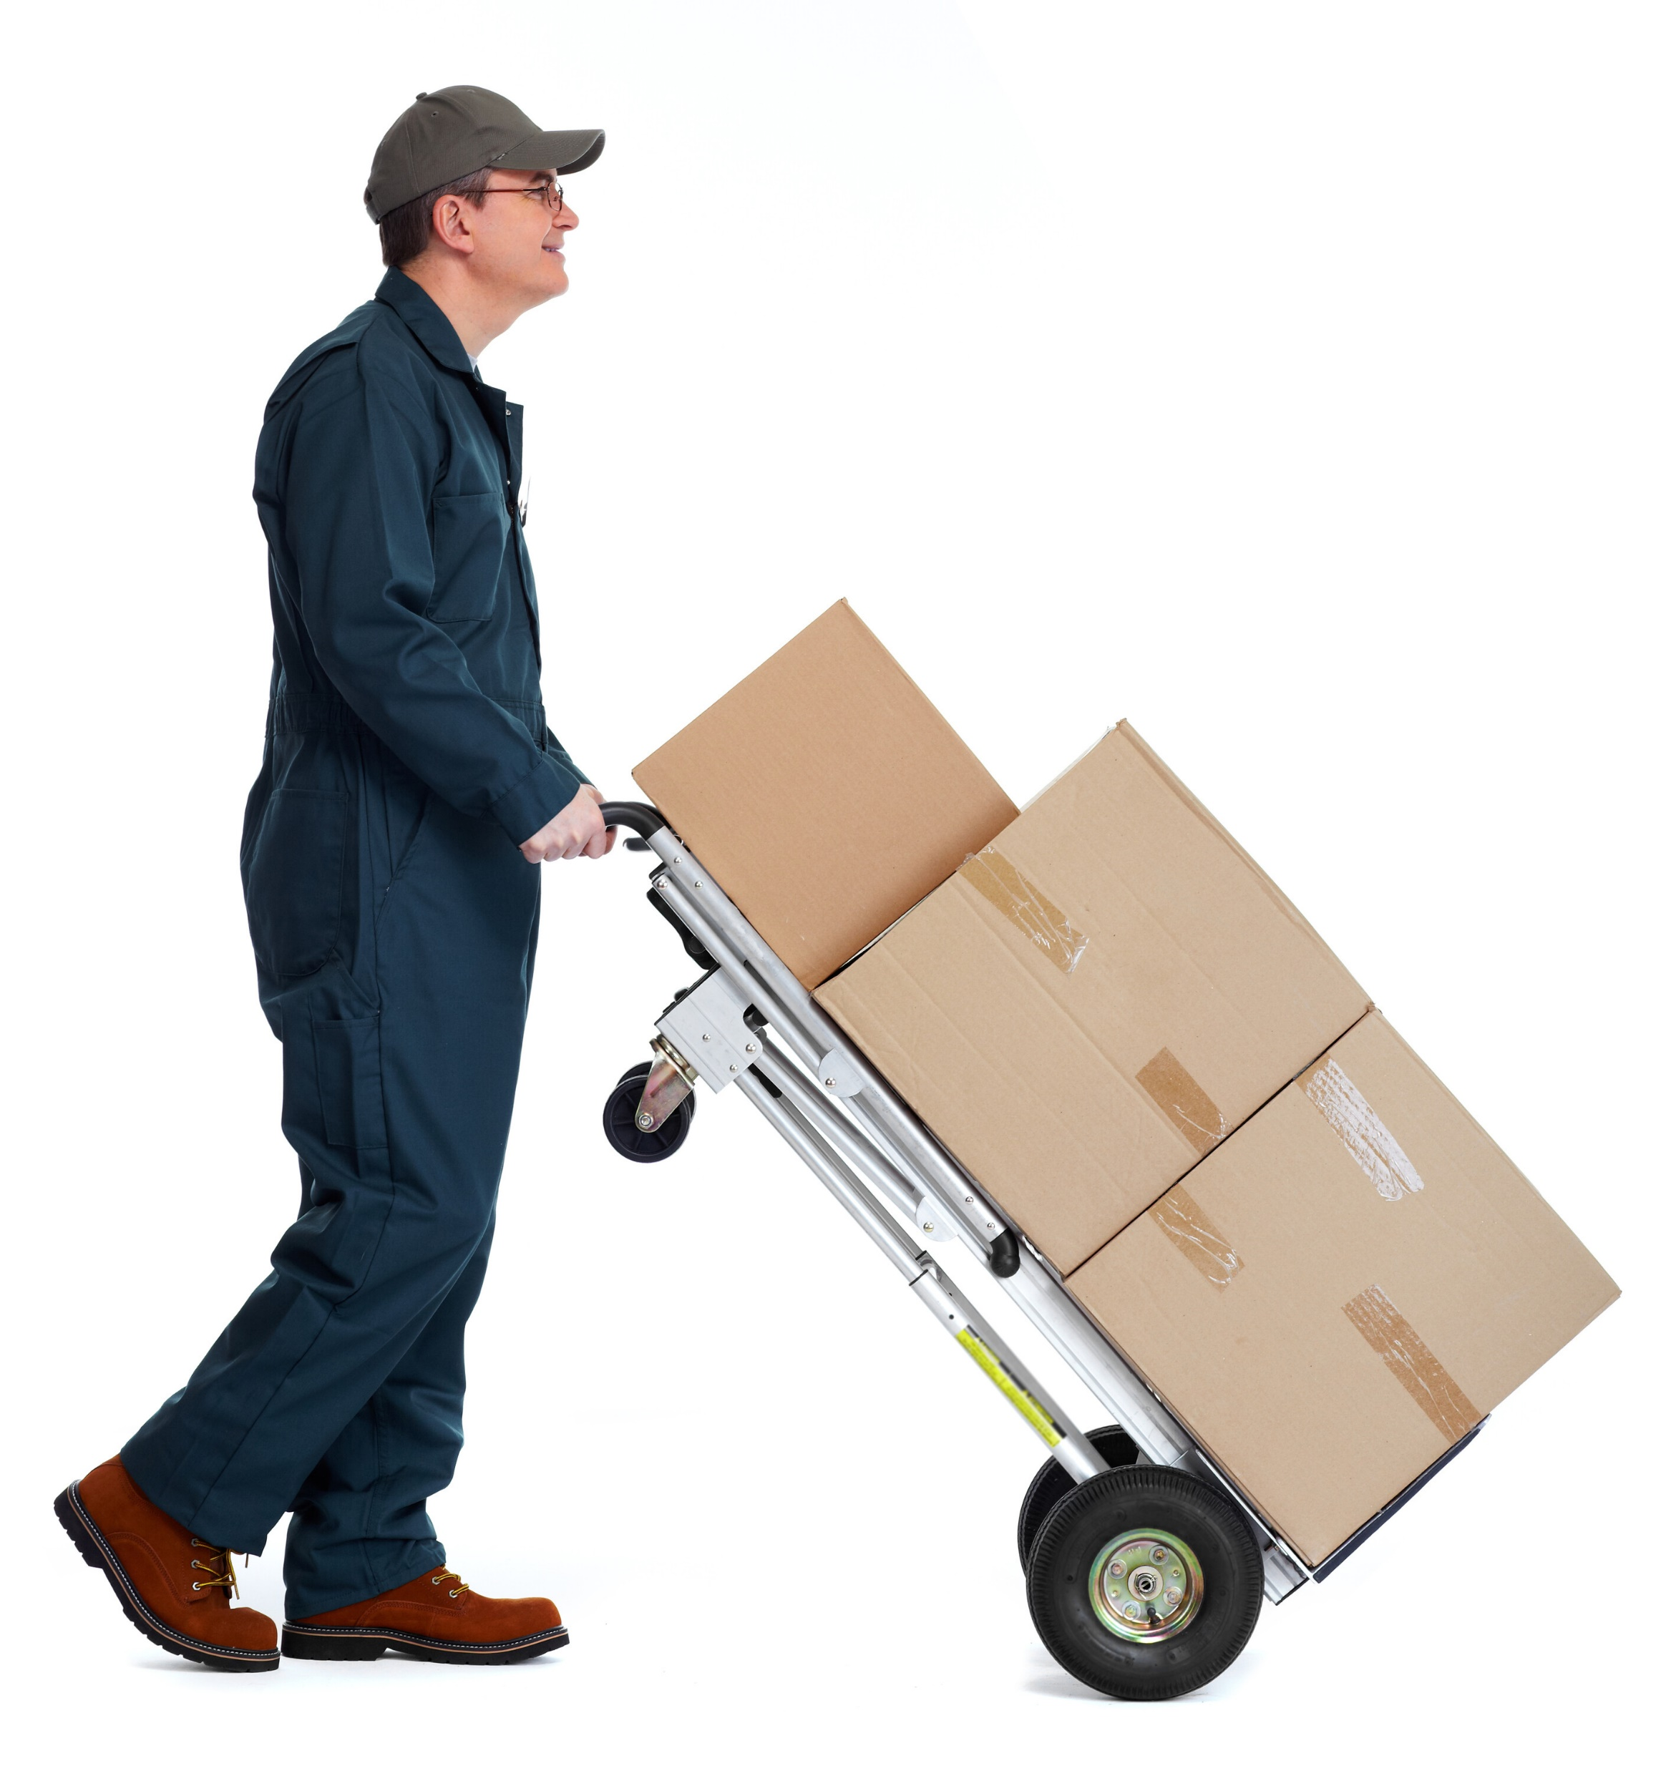
Unit 4
Manual Handling Principles and Techniques

Slide 47
Learning Outcomes
By the end of this session learners will be able to:
List the principles of manual handling.
Apply the main principles of manual handling.
Lift, Carry, Push, pull and put down a load correctly.
Perform a team manual handling task.

Slide 48
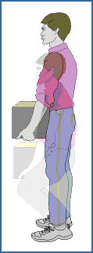
Principles of Manual Handling
Assess - TILE
Stand close to load
Broad Stable Base, feet in direction of travel
Look forward to align spine
Bend Knee(s)
Firm Palmar grip/ Arms in line with trunk
Move smoothly using the power the legs
Notes:
1. Assess
Assess the environment for trip hazards, space, room to set down the load
Assess the task. Is it dangerous? Can it be avoided?
Assess the Load
Determine the weight
Look for sharp edges
See if weight is evenly distributed
Keep heaviest side to body
Decide how to hold the load
2. Load Close
3. Broad Stable Base
Comfortably apart
Feet in the direction you are going
4. Bend Knees
Lower the body by relaxing the knees
5.Arms in line with trunk
6. Firm Palm grip
Take a firm grip by using the palms of the hands and roots of fingers
Taking weight on finger tips will create pressure at the end of fingers and could strain muscles and tendons in the arms
7. Look forward
Lift your head up, then straighten the back and look ahead before lifting
8. Use legs
maximum use of legs
Don’t jerk

Slide 49




Practice!

